Slide 1


Big Data FIFA Analyzer
Presented By
Abdelrahman Mohamed Ezzat 1190158
Ali Mohamed Ali Hashish 1190223
Farah Mohamed Abdelfattah 1190176
Ziad Ahmed Hamed 4200002

Slide 2
Table of contents
01
02
03
Problem Description
EDA & Visualizations
Technicalities

Slide 3
01
Problem Description

Slide 4
Problem Description
Showing how different factors affect the player­ price and overall score.
Game developers gain insights on how each player is used by the community.
Insight for the community to know each team better and which performs the best.

Slide 5
EDA & Visualizations
02

Slide 6
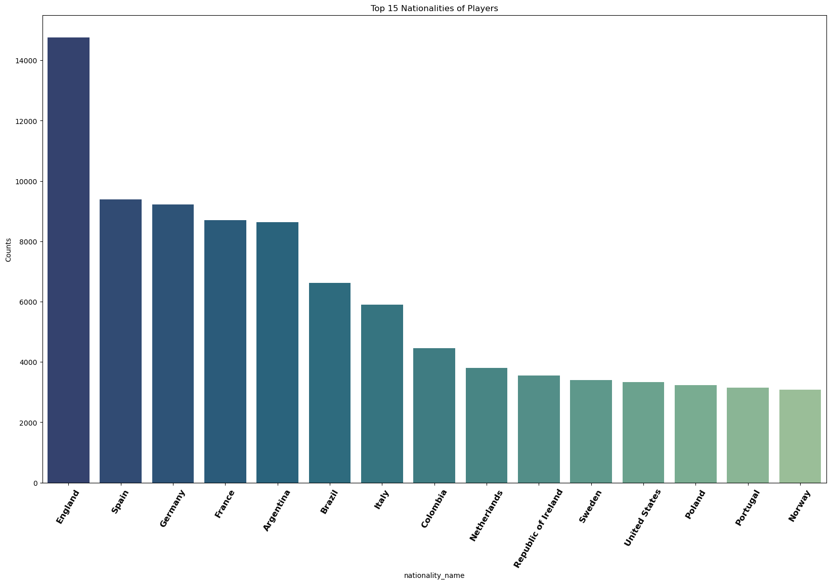
EDA & Visualizations
Number of players in different countries

Slide 7
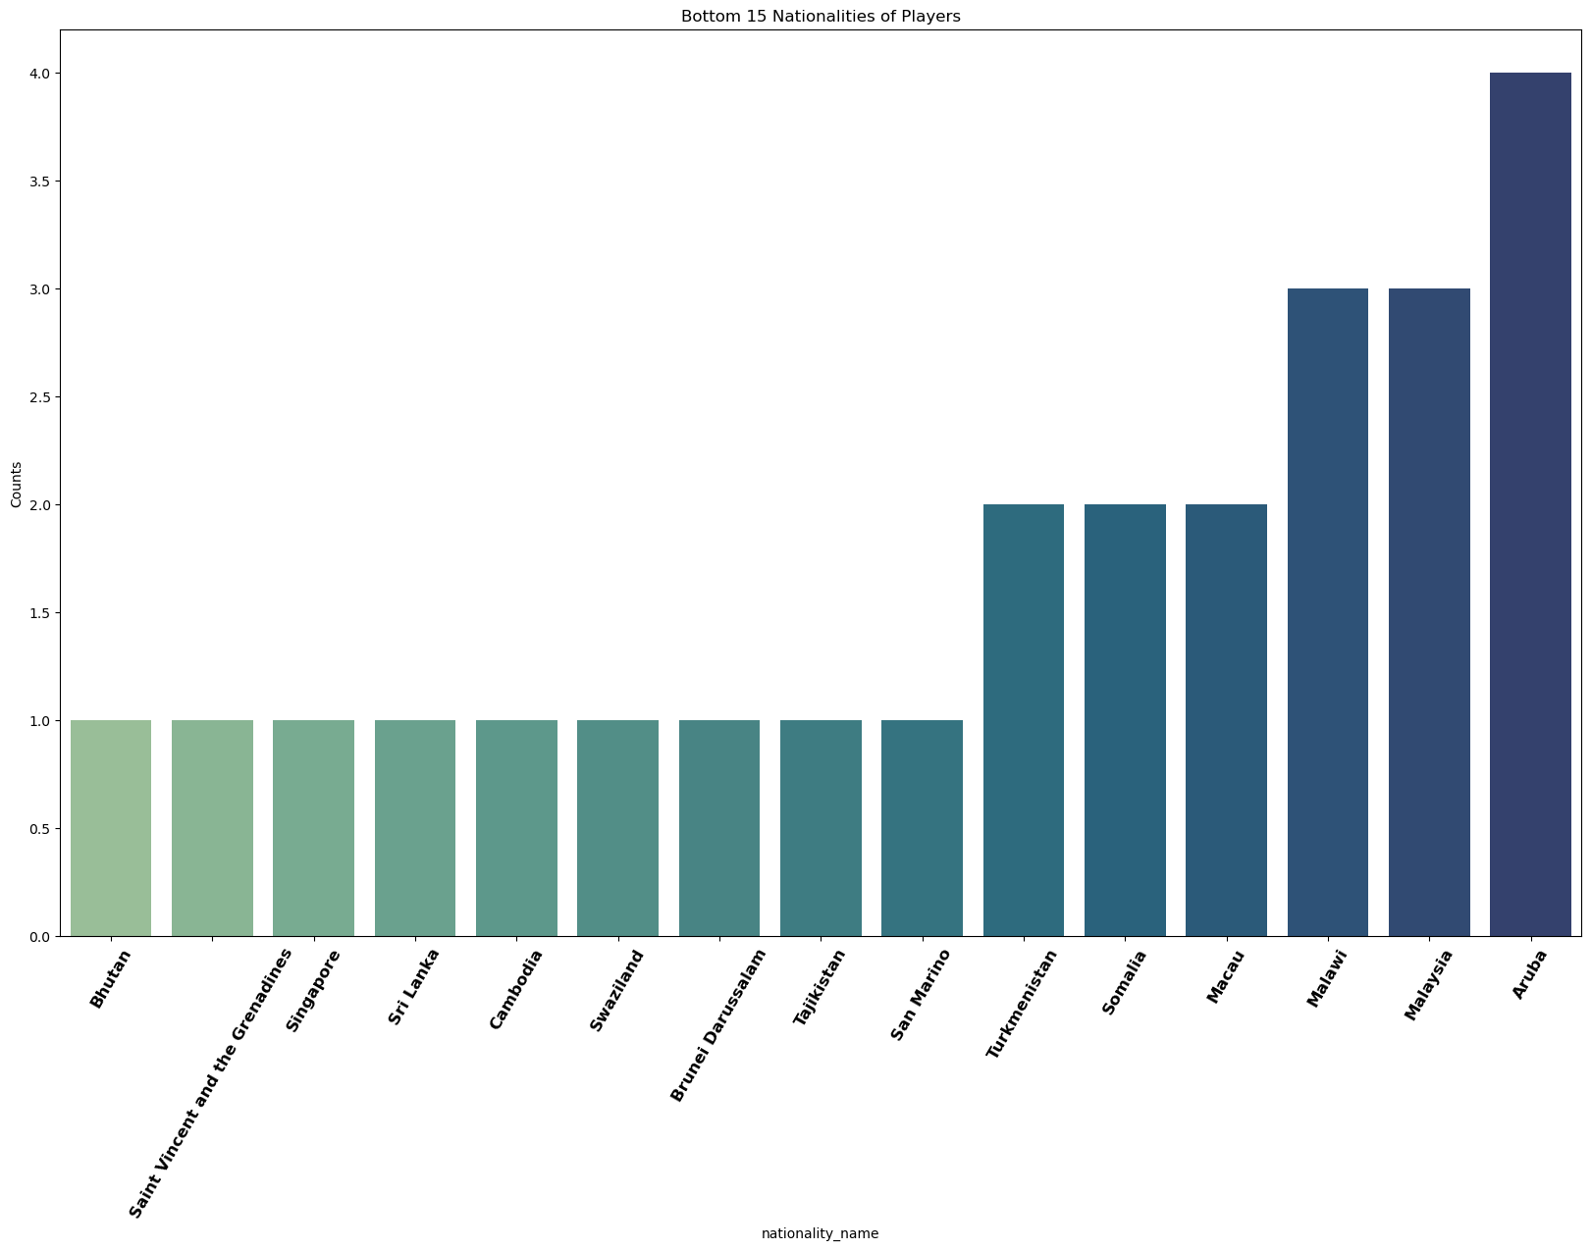
EDA & Visualizations
Number of players in different countries

Slide 8
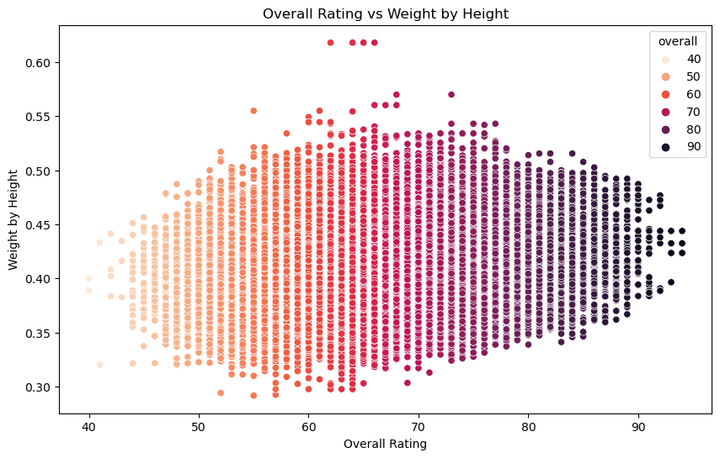
EDA & Visualizations
People with overall rating greater than 90 have a ratio between 0.35 and 0.5

Slide 9
EDA & Visualizations
HEXACO visualizer
Visualizing stats per club for detailed information about each position.
Providing recommendations for future improvements.
Comparing between different clubs.

Slide 10
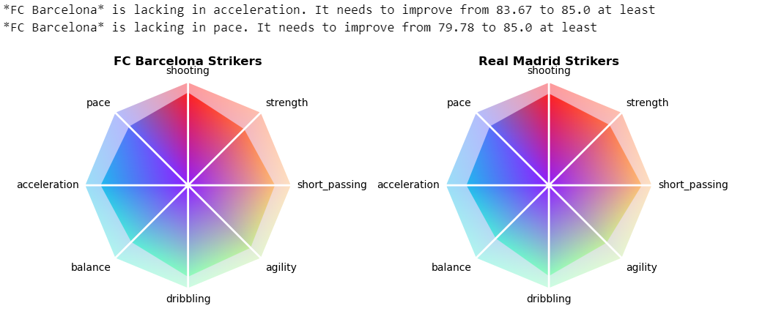
EDA & Visualizations
HEXACO visualizer

Slide 11
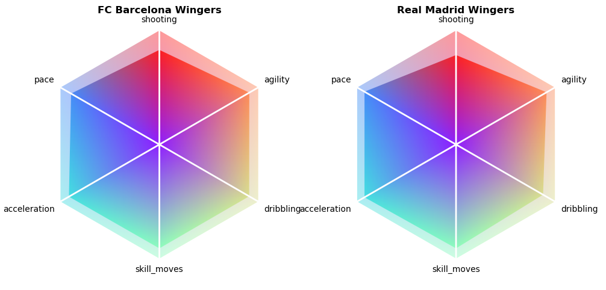
EDA & Visualizations
HEXACO visualizer

Slide 12
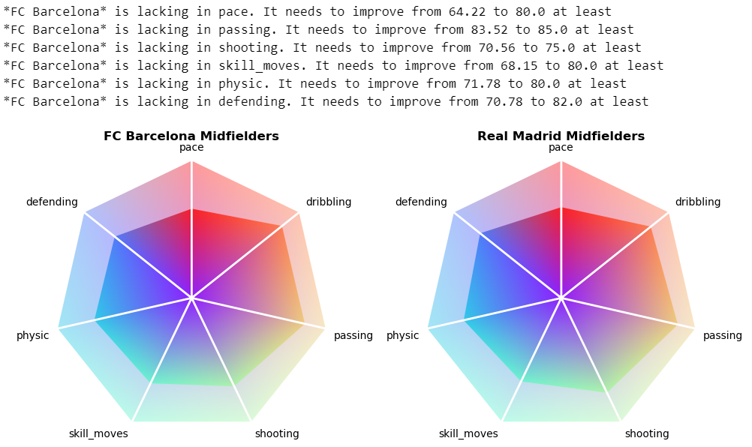
EDA & Visualizations
HEXACO visualizer

Slide 13
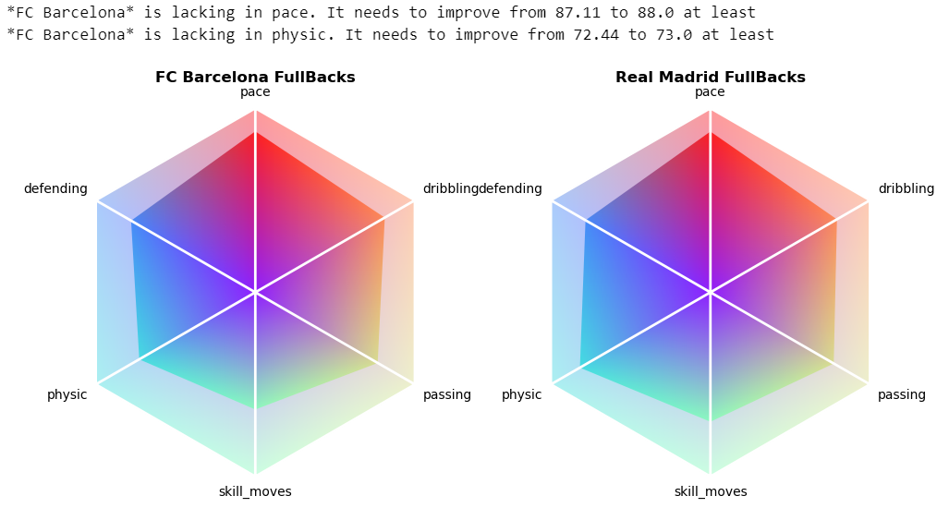
EDA & Visualizations
HEXACO visualizer

Slide 14
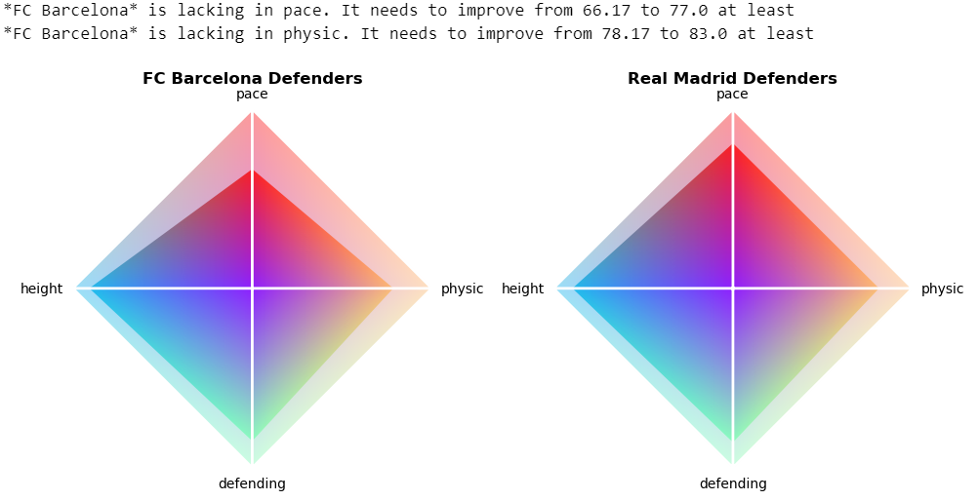
EDA & Visualizations
HEXACO visualizer

Slide 15
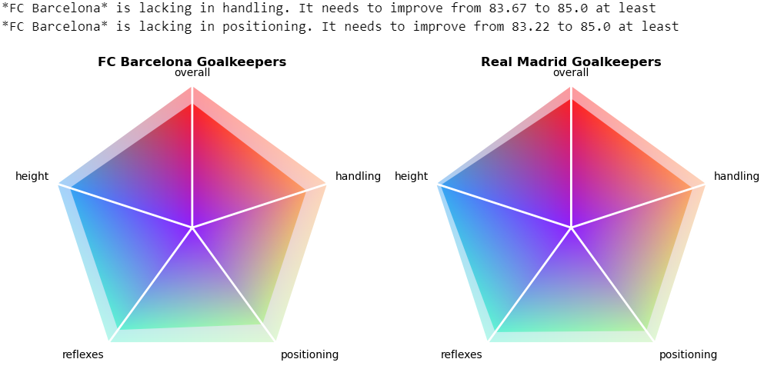
EDA & Visualizations
HEXACO visualizer

Slide 16
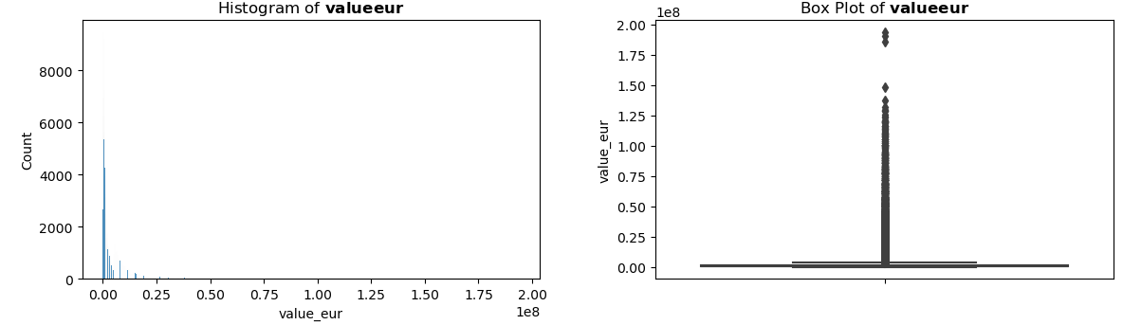
EDA & Visualizations
Outliers handling

Slide 17
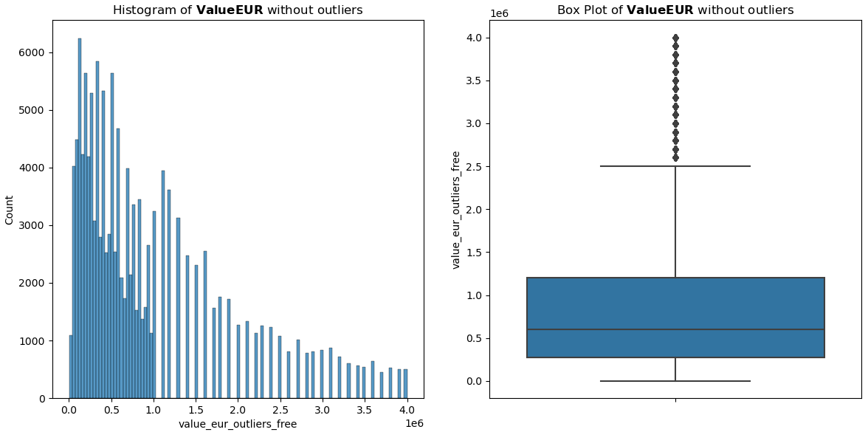
EDA & Visualizations
Outliers handling

Slide 18
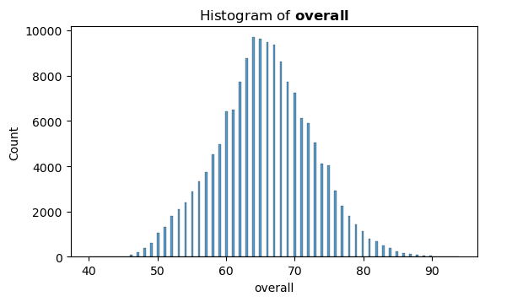
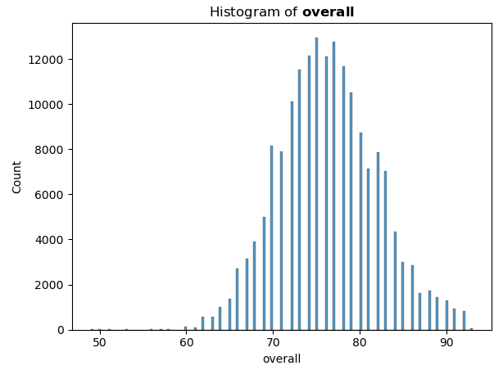
EDA & Visualizations
Male and Female datasets comparison
Males Females

Slide 19
03
Technicalities

Slide 20
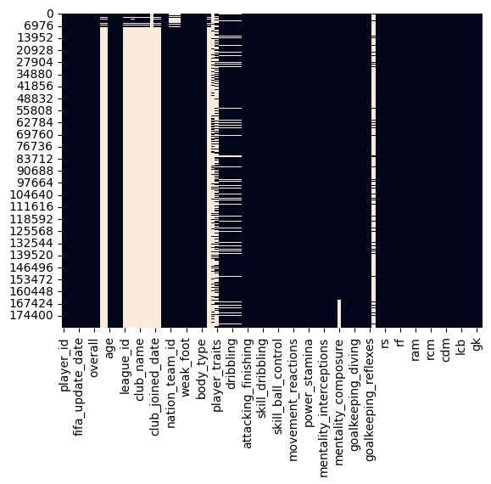
Technicalities
Data cleaning
Nulls
Duplicates
Changing categorical values to numerical ones

Slide 21
Technicalities
Models Comparison
Predicting Player Value in EUR
Model | R2 Score | MAE | MSE
XGBoostRegressor | 94.9% | 0.0023 | 4.68e-05
XGBRegressor using KFold cross validation | 94.5% | - | -
Support Vector Regression (SVR) | 14.31% | 0.021 | 0.0007
KNNRegressor | 89% | 0.0027 | 0.0001
KNN with our handmade MapReduce | 89% | 0.001 | 1.15e-05

Slide 22
Technicalities
Models Comparison
Predicting Overall Player Rating
Model | R2 Score | MAE | MSE
XGBoostRegressor | 96.2% | 0.018 | 0.0006
XGBRegressor using KFold cross validation | 97% | - | -
XGBRegressor using KFold and PCA | 96.9% | - | -
LinearRegression | 92.6% | 0.027 | 0.0012
LinearRegression with 2 PCA features | 28.2% | 0.08 | 0.012
LinearRegression with 8 PCA features | 87.3% | 0.03 | 0.002
KNN with our handmade MapReduce | 90.36% | 0.027 | 0.0014

Slide 23
Any Questions?

