Slide 1
AccordPay
BroGrammers
Vendor invoice review with fictional demo funds
Notes:
Ali, 35 seconds. Explain the bill/deal mismatch problem. Team: Ali Hasan, Asad, Adil, Moeez. This is a prototype, with no customer research or real banking integration.

Slide 2
Three checks before owner review
1. Is the cost already included?
2. Was this extra actually approved?
3. Did a later message change it?
Notes:
Moeez, 35 seconds. Exactly three checks. AI interprets supplied words and returns original quotes. Code checks exact quotes, invoice arithmetic and the approved destination. Source: BUILD_HANDOFF/PRODUCT_SPEC.md and prototype/prompt.txt.

Slide 3
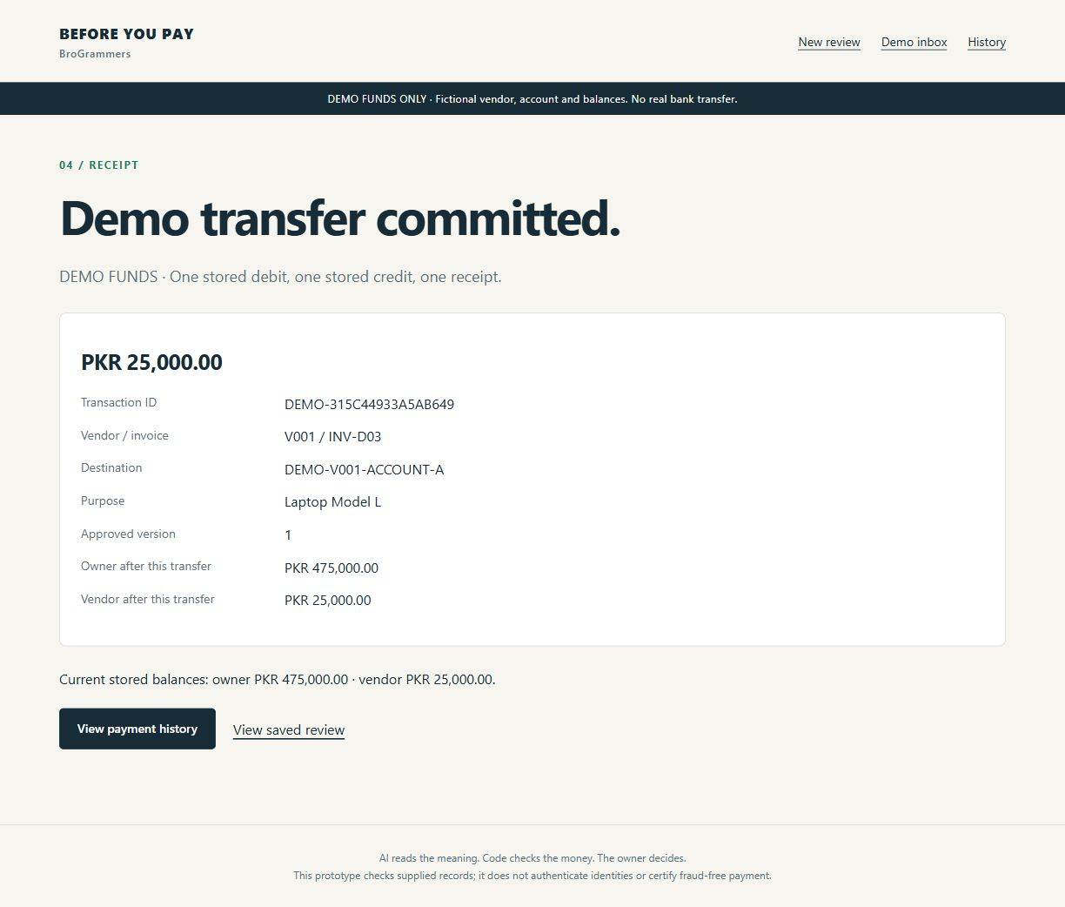
Verified demo transfer
After the transfer:
Owner: PKR 475,000
Vendor: PKR 25,000
PKR 25,000 moved once
Fictional DEMO FUNDS
Notes:
Actual live Gemini D03 browser flow succeeded with the replacement key. One receipt DEMO-315C44933A5AB649 and balances survived a real app restart. Screenshot records that verification, not a new call. Afterwards we archived the state and reset to500,000/0 for rehearsal. Source: BUILD_STATUS.md and runtime/screenshots/receipt-live.jpg. Asad,75 seconds: also show D07 HOLD, with exact correction from5,000 to3,000. The screenshot predates the AccordPay rename and documents the earlier verified transfer.

Slide 4
Owner decision and stored demo money
Saved vendor, amount, account and evidence
Passcode and unchanged approval required
One atomic transfer and one receipt
Notes:
Adil,90 seconds. Run fresh D03 after reset, approve with private passcode, show receipt. Real browser flow, exact stored transfer and restart persistence verified. Returning to completed owner review links the same receipt without another payable form. Controlled tests verify sequential/concurrent repeated POST and rollback. D04 REVIEW and D07 HOLD had no owner payment link. Source: tests/test_payment.py and BUILD_STATUS.md.

Slide 5
Actual verification and remaining limits
66 local tests passed
Current PDF checks: ready, review and hold
Historical repeat: 8 of 9 matched
Previous model/prompt; 1 safe failure
Hosted link and team rehearsal pending
Notes:
Latest revision uses gemini-3.5-flash-lite with prompt b306d6ae5ed5793b. Pair02 AWAITING_OWNER and Pair06 HOLD completed in 5 seconds; Pair04 REVIEW in 6.1 seconds plus successful browser recheck. These three PDF pairs were development cases. Historical repeat evaluation: 8/9 matched, one safe API failure, zero unsafe readiness; original run 2/9 matched, seven failures. Historical frozen configuration 9063daea71c2844e used a different model/prompt and does not validate current revision. Remaining nine PDF pairs, fresh independent evaluation and teammate meaning review pending. Two earlier videos are edited saved-result walkthroughs with the previous product name, not current live calls. Render Free deployment prepared; its database is ephemeral. No hosted URL yet. Source: BUILD_STATUS.md.

