Slide 1



IBM WatSon
Orchestrate

Slide 2

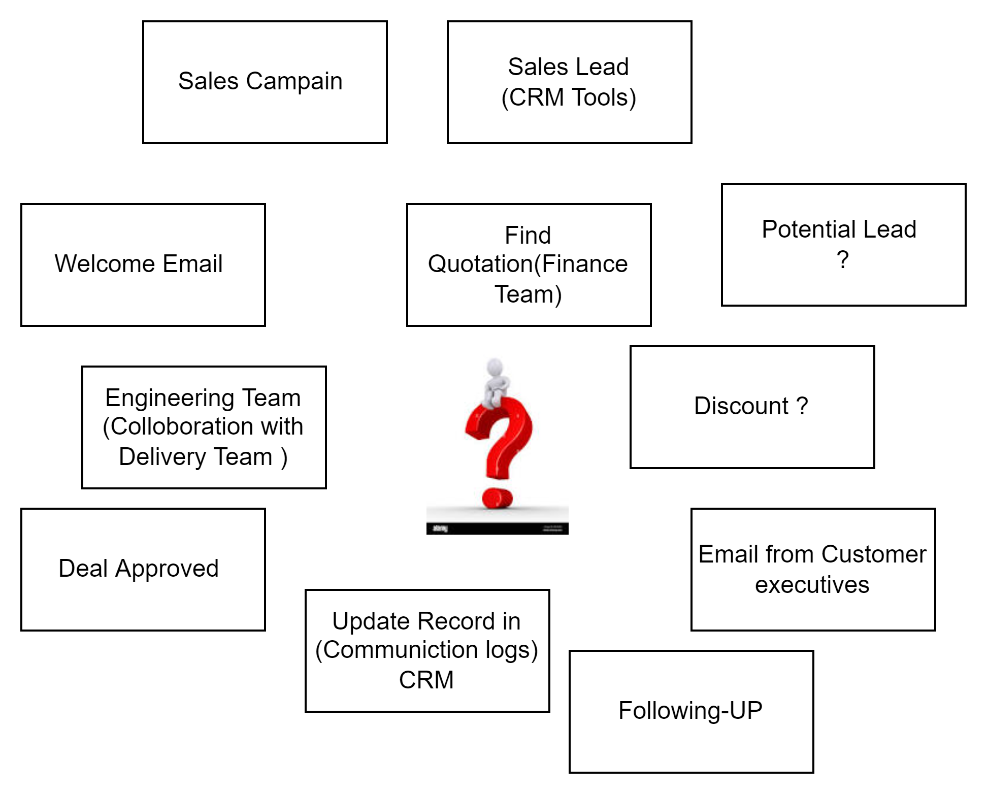
I am Salesperson Can you Help Here ?
Skills
CRM- Sales Lead
Finance – Project Quotation
Cost Analysis and Discount
Email Interaction/Outlook
Sales Campaign
Sales Campaign &
Mundane tasks

Slide 3

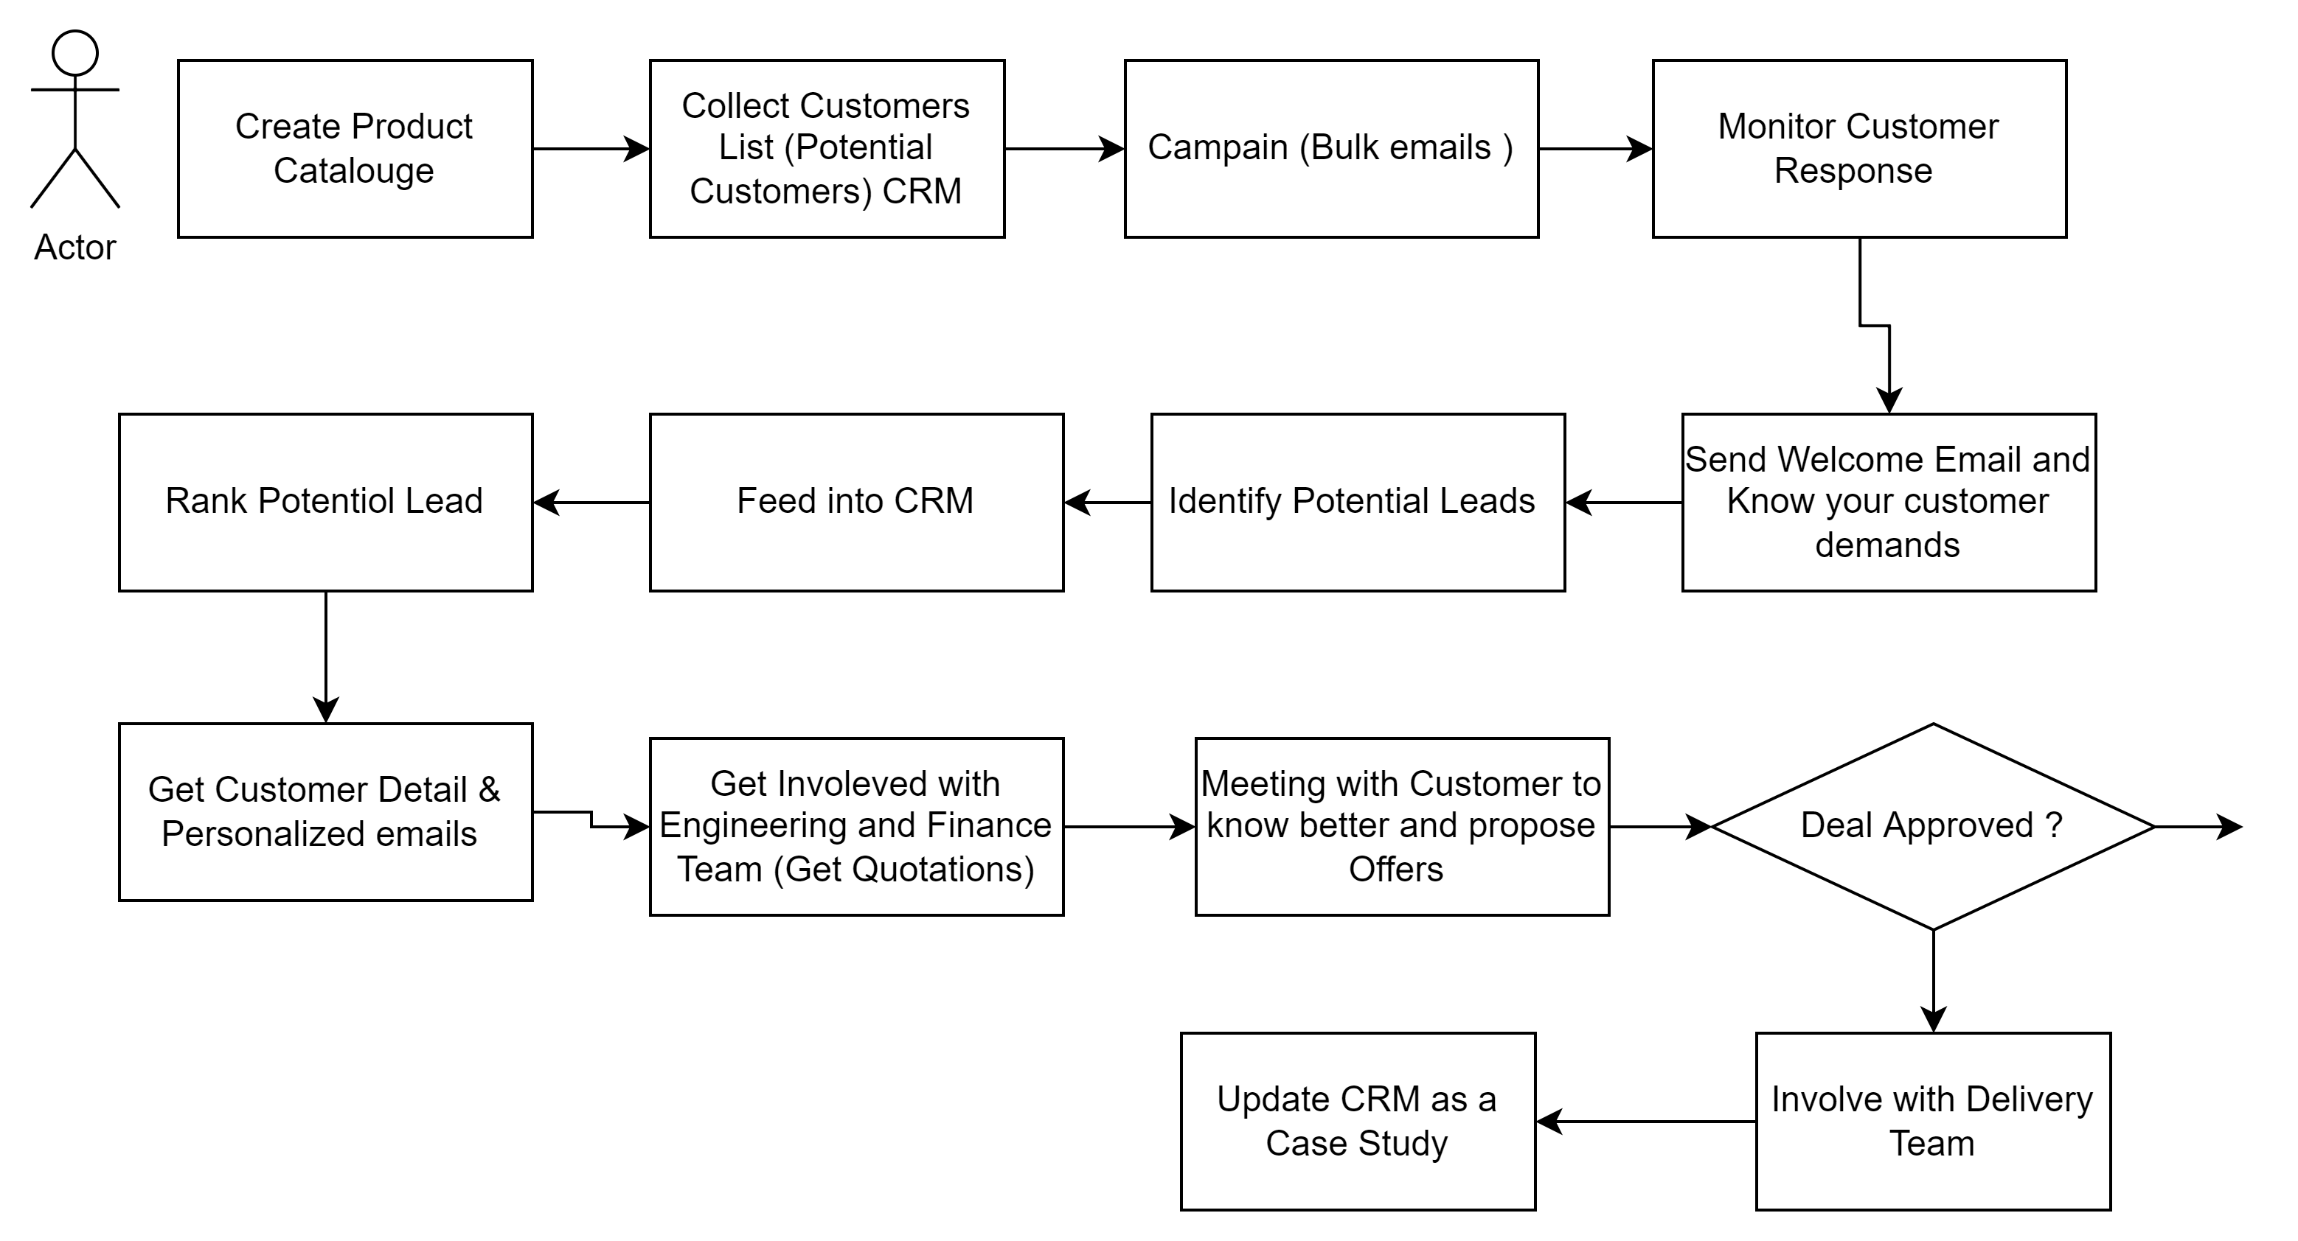
Watson Orchestrate
Building automations

Slide 4


Watson Skills
Product CataloUGE
MS Outlook
SLACK
Monday.COM
Salesforce

Slide 5


Thanks
Jabar.ali1@IBM.com
JABAR.ALI@CapGEMINI.com
wahaj.sayyed@capgemini.com

