Slide 1
Zonotope-Based Control
Ali Jnadi

Slide 2
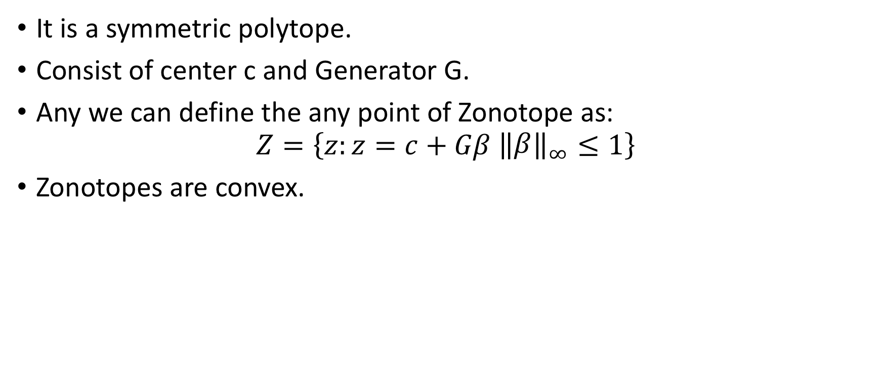
What is Zonotope!
It is a symmetric polytope.
Consist of center c and Generator G.
Any we can define the any point of Zonotope as:
$$Z=\left\{z:z=c+Gβ {\left\|\begin{matrix}β\end{matrix}\right\|}_{∞}≤1\right\}$$
Zonotopes are convex.

Slide 3
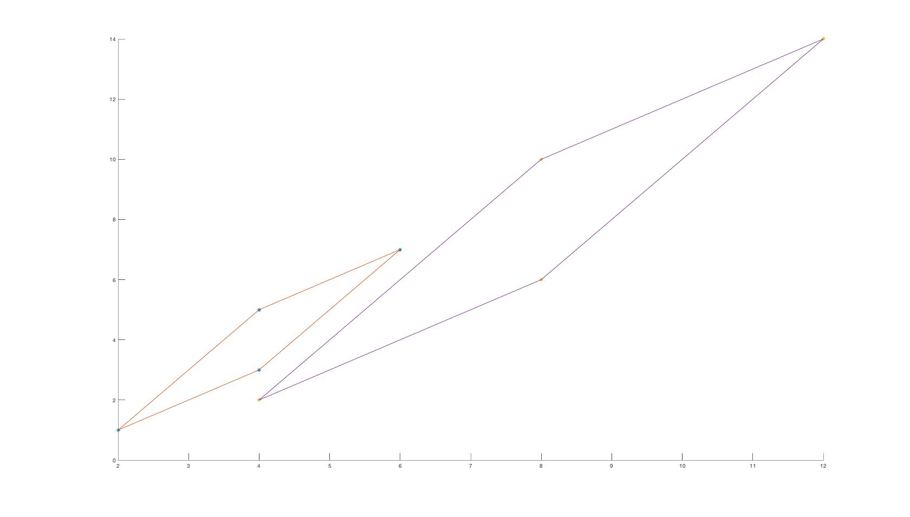

Zonotope properties
$$A\left\langle c, G\right\rangle = \left\langle Ac, AG\right\rangle$$

Slide 4
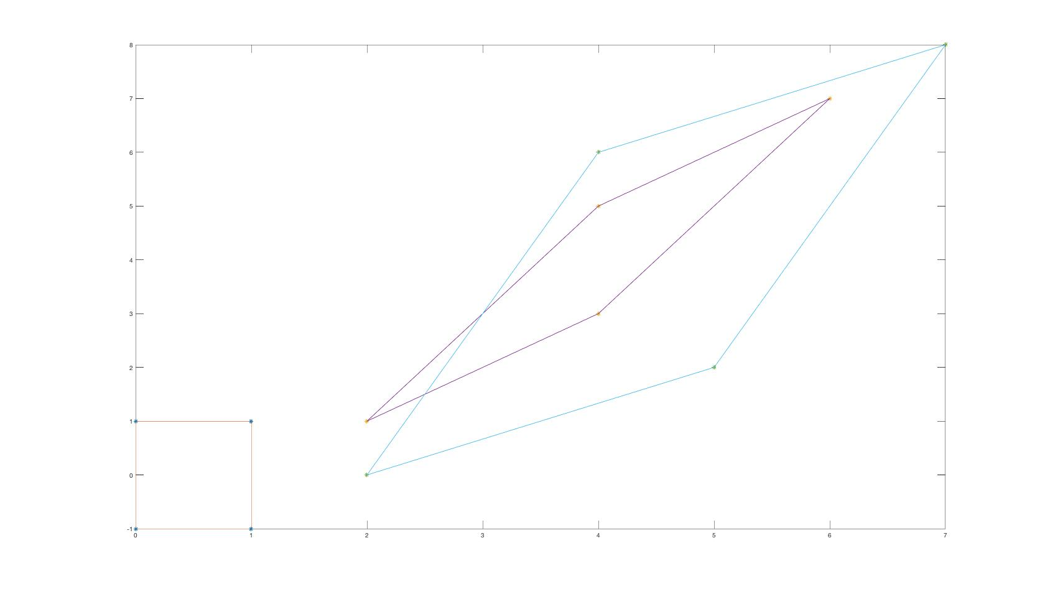

Zonotope properties
$$\left\langle x, X\right\rangle +\left\langle y, Y\right\rangle =\left\langle x+y, X+Y\right\rangle$$

Slide 5
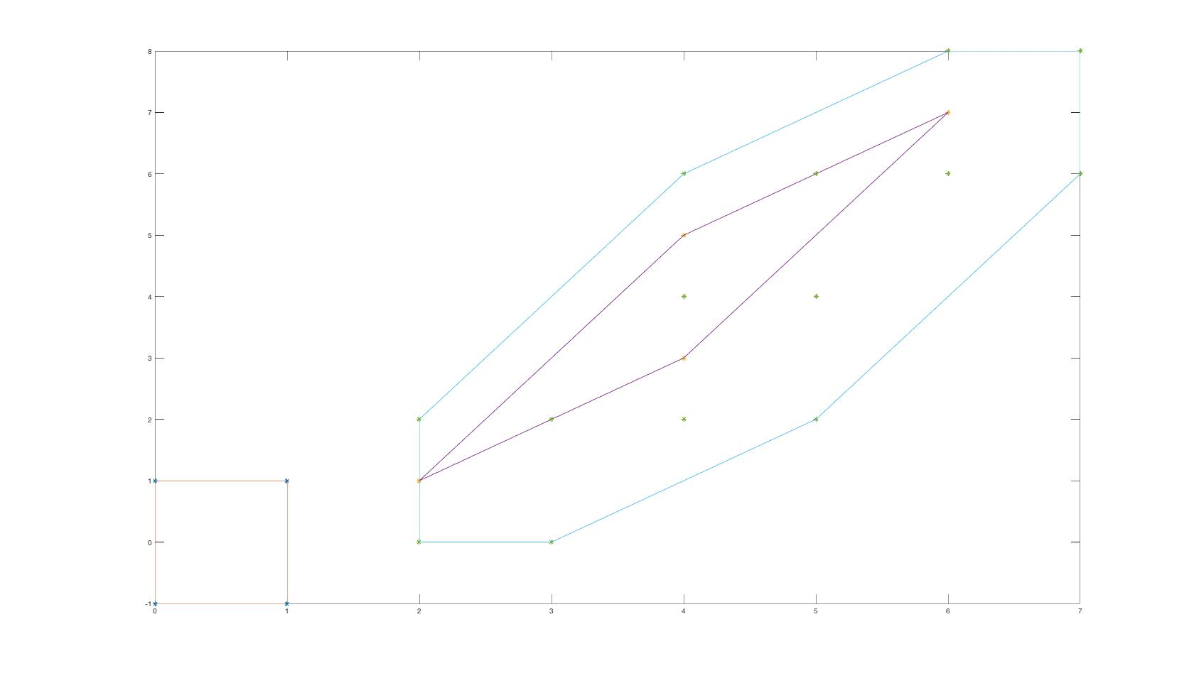

Zonotope properties
$$\left\langle x, X\right\rangle ⨁\left\langle y, Y\right\rangle \left\langle x+y, (X, Y)\right\rangle$$

Slide 6

Zonotope containment
If we have two Zonotopes $𝕏= \left\langle x, X\right\rangle , 𝕐=\left\langle y, Y\right\rangle$, we said that $𝕏$ is contained in $𝕐$ if we could find $β,γ$ where:
$$X=Yγ , y −x=Yβ , {\left\|γ, β\right\|}_{∞}≤1$$

Slide 7
Problem formulation
If we have a spring-mass-damper system, we are certain about system, but we don’t know from which initial state it will start, we just know that all initial states are bounded in some region, we want to find a zonotope based control that make the system wherever it starts from, reaches a specific region.

