Slide 1
CATV(CABLE TELEVISION)
CS 410
Spring 2018
Ali Kalkandelen

Slide 2
Cable television is a system of delivering television programming to paying subscribers via radio frequency (RF) signals transmitted through coaxial cables or light pulses through fiber-optic cables. Cable television, introduced in the 1970s, offers a greater number of channels, while solving antenna reception problems. Even though it started in the 70s, Satellite Television with an antenna was though about even back in the 1940s. Using a direct feed to the television or decoder box, cable TV is the most widely used television reception medium. Understanding how cable television really works allows insight into how one cable leading into your home can carry so much information. About 70 Percent of households have cable TV

Slide 3
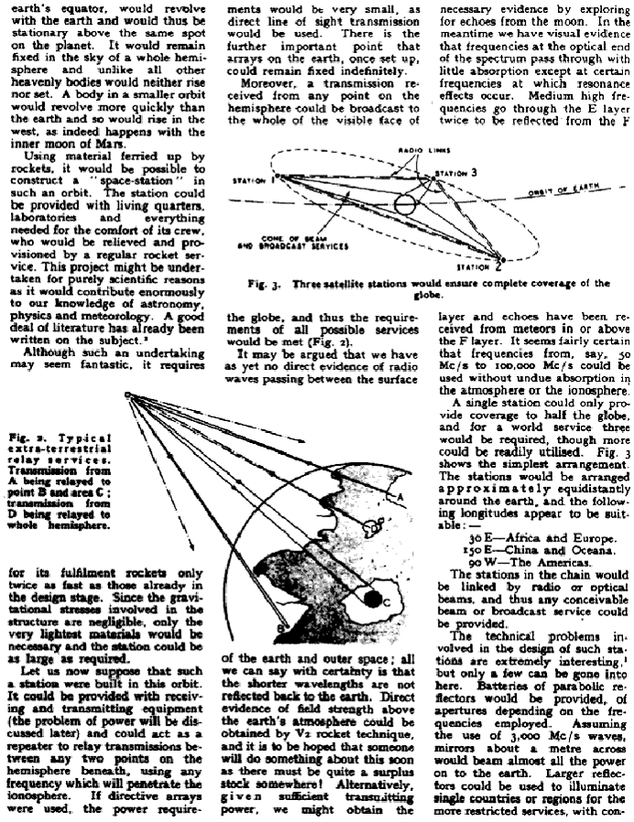
Even though the cable television didn’t
come into play until the 1070s,
television broadcasting through using satellites
were imagined back in 1940s, when a science
fiction author Artur C. Clarke imagined 3 satellites
(which he calls extra-terrestrial relay
services in geosynchronous orbit).
In this orbit, satellites maintain the same footprint

Slide 4
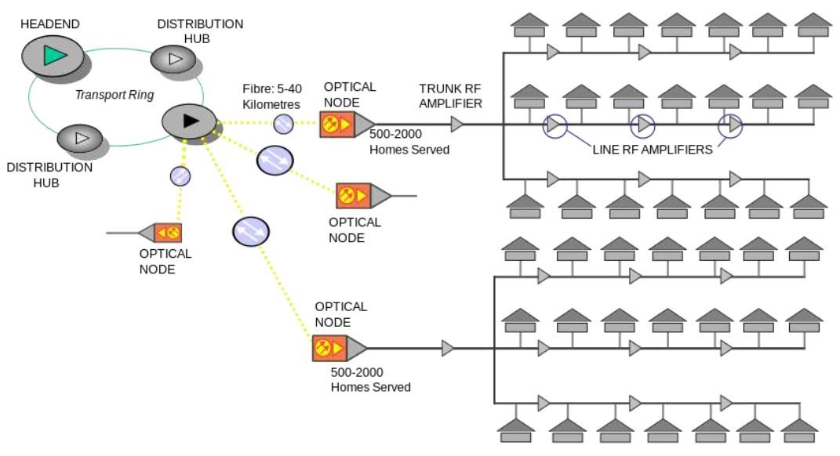
THE PRINCIPLE

Slide 5
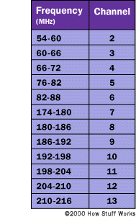
By giving each channel a different frequency "slot" on the cable, the separate television signals do not interfere. At the subscriber's residence, either the subscriber's television or a set-top box provided by the cable company translates the desired channel back to its original frequency (baseband), and it is displayed on-screen.

Slide 6
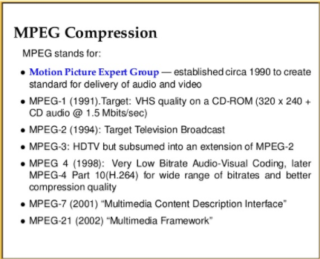
HD is enabled via cable, thanks to MPEG compression schemes.

Slide 7

Video

Slide 8

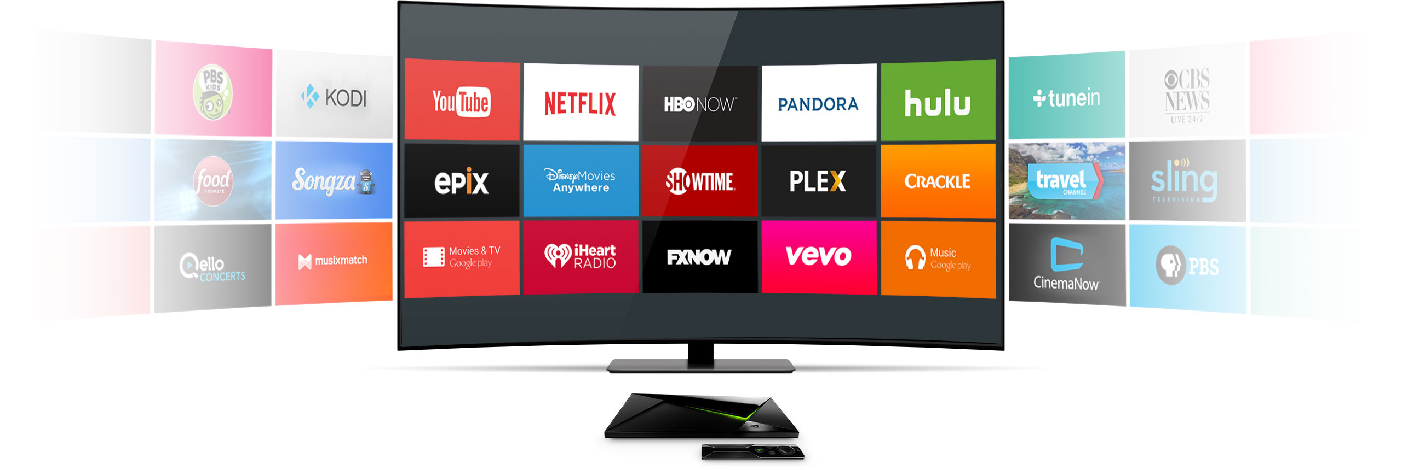

The Diffusion Group (TDG) estimates that by 2030, the “traditional” pay TV market — think cable and satellite TV — will have shrunk by 26%, leaving only 60% of households subscribing to traditional pay TV.

Slide 9
Url: AliKalkandelen.github.io/CS410
References:
https://en.wikipedia.org/wiki/Cable_television
https://electronics.howstuffworks.com/cable-tv.htm
https://itstillworks.com/cable-television-works-tutorial-17251.html
https://avc.com/2012/02/clearqam-what-it-is-and-why-it-matters/
http://jhr.uwpress.org/content/early/2017/10/02/jhr.54.2.0316.7819R1.abstract

