Slide 1
“Fire Detection and Localization”
Ali Istanbullu (100095755)
William Dolan (100587997)
Andre Dallaire (100337151)

Slide 2
Project Overview
Our goal is to create a web application that can take live footage from security and firewatch cameras to identify and locate where the fire happens. With this information, we would like to alert our users when a fire is detected and where it is, so that it can be dealt with swiftly and efficiently.
The purpose of our program is to help minimize the potential damage caused by fires by warning our users as soon as possible.

Slide 3
Functionality Overview
Our software will:
Analyse picture or video input and decide whether there is a fire or not.
If the software detects a fire, it will use provided map coordinates as well as the camera’s height and angle to estimate where the fire is happening in real time.
Alert the user when it detects a fire, returning to them a picture and the estimated location.
With further development, it may also:
Provide suggestions for how to deal with the fire based on the location.
By analysing weather data from an API, offer warnings if a location is in an area that is at higher risk.
Become compatible with moving cameras, such as those on drones.

Slide 4
Project Functionalities and stages
Minimum Viable Product | A simple web page that can accept an image or video file and tell the user if there is a fire and, if so, where in the image or video the fire is.
Minimum Marketable Product | A web page that accepts multiple video files or feeds and runs actively checks them for fires. If a fire is detected, the user will be alerted with a popup. The popup will describe which video the fire was detected in, and where it was relative to the camera.
Final Product | A web page that accepts multiple video files or feeds along with associated coordinates, and actively checks them for fires. If a fire is detected, the user is alerted with a notification and potentially an email or text message containing the name of the video it was detected in, an image of the fire (in an email at least), and estimated coordinates of the fire.

Slide 5
Application
Frontend
Backend
Html, CSS, Javascript
Python
Python
Roboflow / YOLOv5
MongoDB

Slide 6
Frontend Functionality and Technology.
The frontend of the final project will include an interface to upload and manage videos and feeds. It will include a notification settings page which will give the user the option to choose whether to receive notifications via text or email as well as inputs for both addresses.

Slide 7
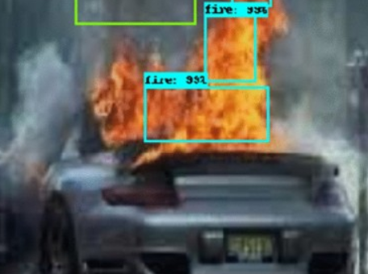
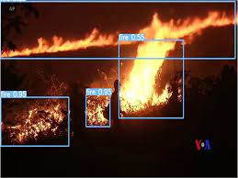
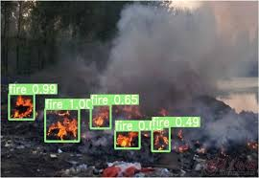
AI Feature
We will use Roboflow and YOLOv5 to train an AI algorithm that can recognize fires through machine learning.

Slide 8
Backend and Database Functionality.
The backend of our product will review provided video feed to attempt to find fires using computer vision. If a fire is detected, it will take a picture from the video. With that picture, it will attempt to determine the exact location of the fire.
The program will send an alert to the user either via text or email and will include the title of the video as well as the estimated location of the fire.
Account information (username, a hashed password and notification settings) and associated stream and file data will be stored in a mongoDB database to make sure the alerts get sent to the right users.

Slide 9
Thank you!

