Slide 1

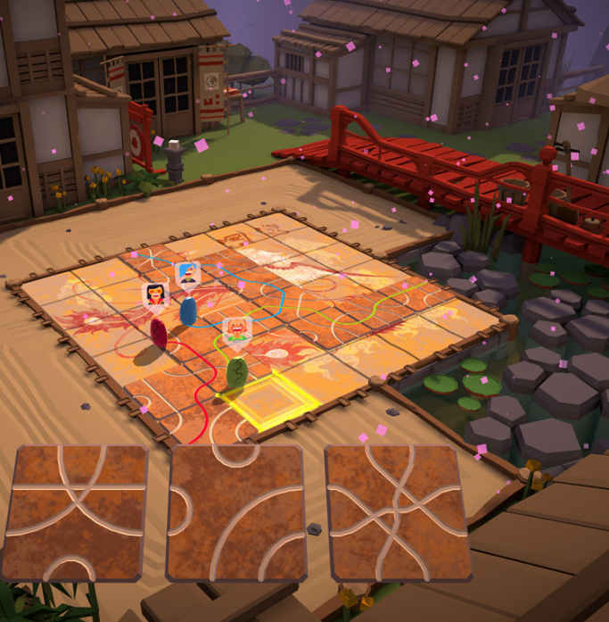
Tsuro – Final Milestone
Alyssa Vandale
Mihajlo Chonev
Sophia Brown
Aliyah Davis

Slide 2
Technology stack and tool chain
Language: C++, JS, HTML
Visual Studio Code
Git, Github
Command Terminal (Powershell, Ubuntu)
Testing Tools(Catch2, Deleaker, Cppcheck)
Inkscape, gimp

Slide 3

Individual Contributions
Mihajlo – Researcher, Developer
Alyssa – Researcher, Developer, Maintainer
Sophia – Researcher, Developer
Aliyah – Researcher, Developer

Slide 4
Definition of Final Milestone
Have all of the 35 tiles ready for use to play and set them up on map
Ability to move both players with different keys, one player is moved with (wasd) and the other (ijkl).
Much more smoother gameplay with the placing of tiles and the movement of the characters (dragons)
Have an 6x6 board playable with about 2 players at least ​
Note: We were not able to fully implement the win function in time.

Slide 5
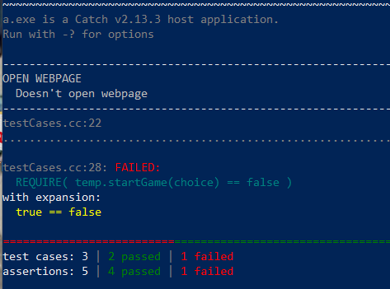
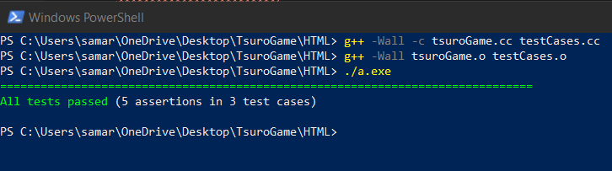
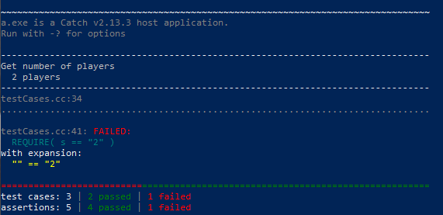
Unit Testing Results [from different times of testing]

Slide 6
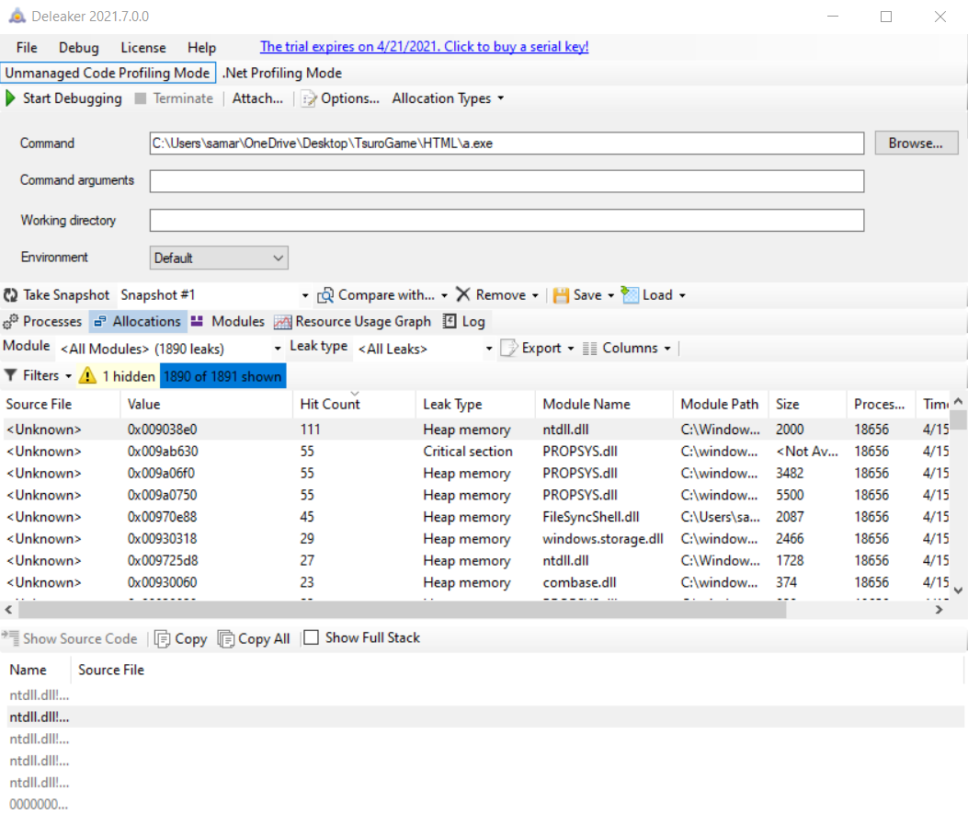
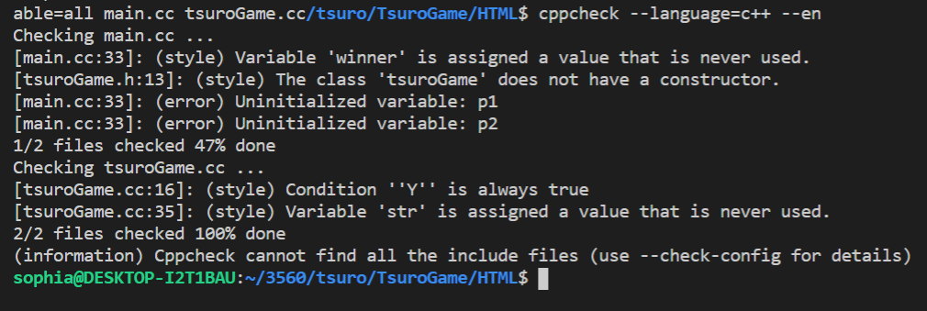
Static and Dynamic Test Results: This slide shows all the static and dynamic analysis test results.

Slide 7
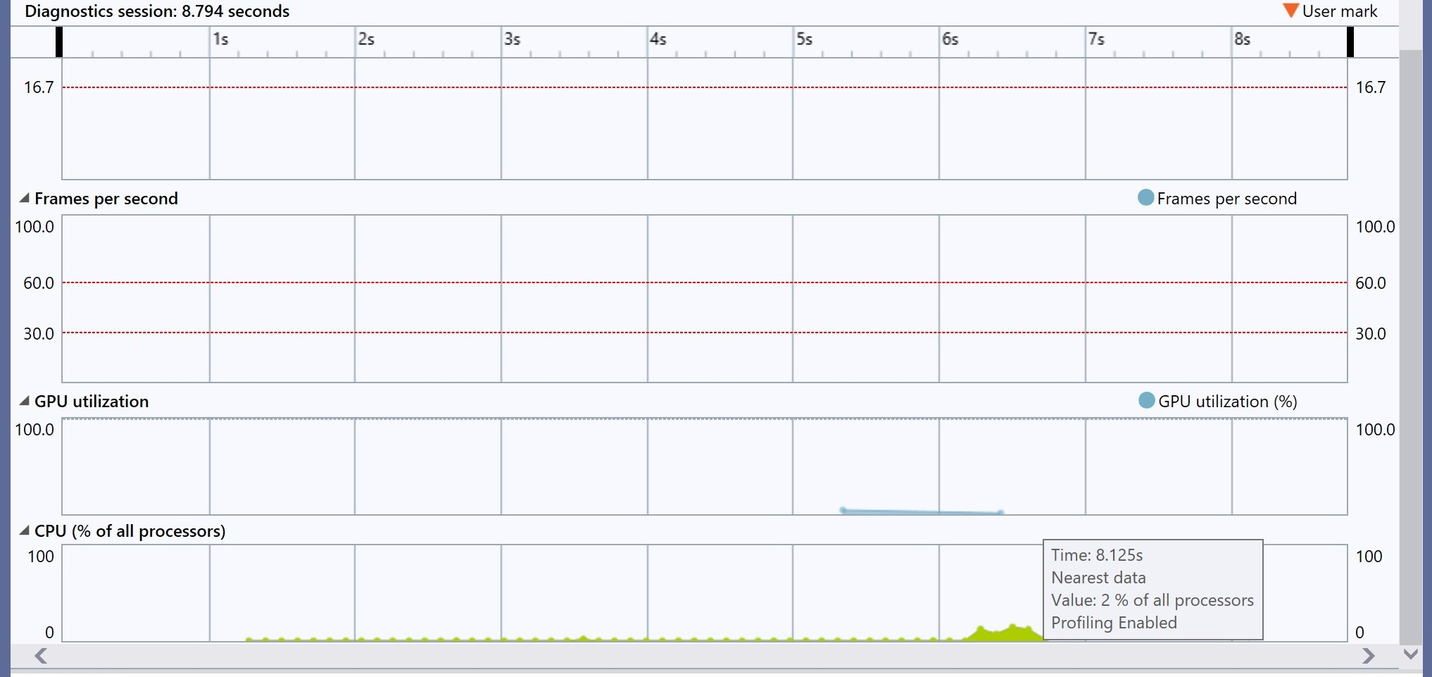
Profiling Tool Results: This is the results of the profiling tools that measure the performance of the program.

Slide 8
Reflection on tools
Gimp
Great for manipulation of images like resizing
Inkscape
Great for simple designs
Not easy to use for resizing images
Deleaker
Good memory leak detection tool
Had to use instead of Valgrind
Catch2
Easy to use and write test cases for
Cppcheck
Warnings are easy to read and gives lines for where potential error occurs

