Slide 1
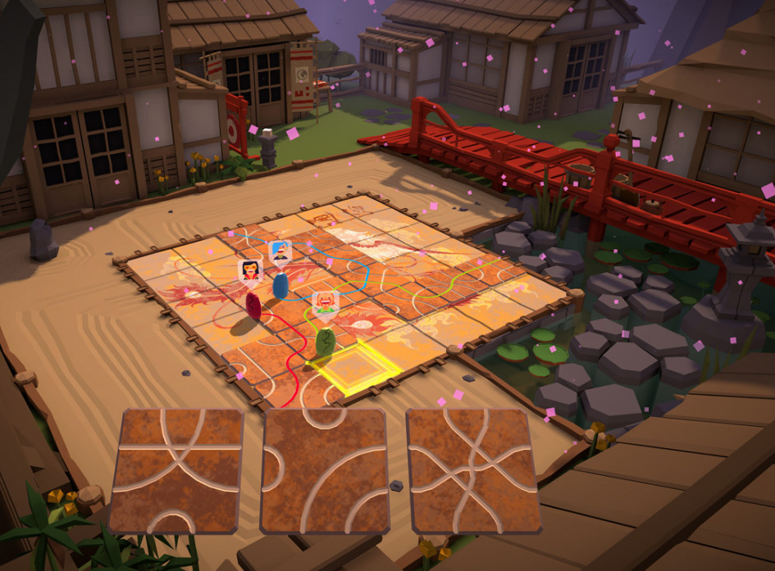
Tsuro – Milestone 3
Alyssa Vandale
Mihajlo Chonev
Sophia Brown
Aliyah Davis

Slide 2
Technology stack and tool chain
Language: C++, JS, HTML
Visual Studio Code
Git, Github
Command Terminal (Powershell)

Slide 3

Individual Contributions
Alyssa – Researcher, Developer, Maintainer
Mihajlo – Researcher and tester about Apache, Developer
Sophia – Researcher, Developer
Aliyah – Researcher, Developer

Slide 4
Definition of Final Milestone
Have all of the 35 tiles ready for use to play and set them up on map
Achieve proper player death and control of second character (i.e win condition and control)
Much more smoother gameplay with the placing of tiles and the movement of the characters (dragons)
Have an 8x8 board playable with about 2 players at least ​

