Slide 1
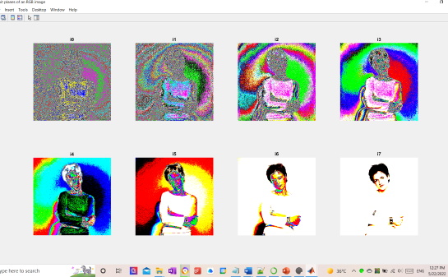
© Ali Masaoodi

Slide 2
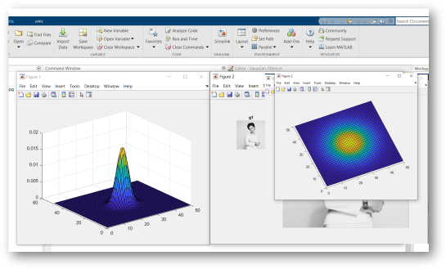
© Ali Masaoodi

Slide 3
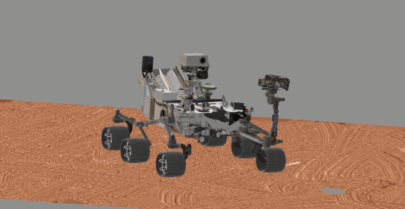
© Ali Masaoodi
© Ali Masaoodi

Slide 4
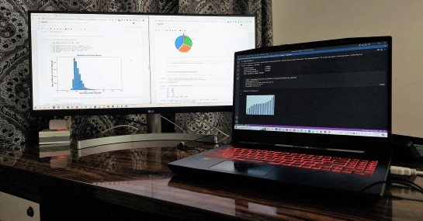
© Ali Masaoodi

Slide 5
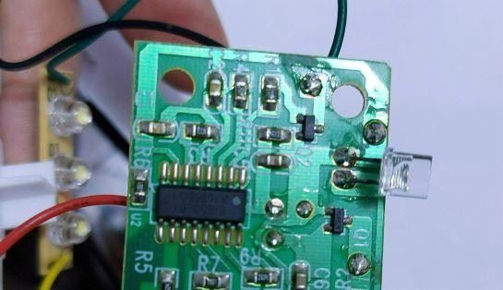
© Ali Masaoodi

Slide 6
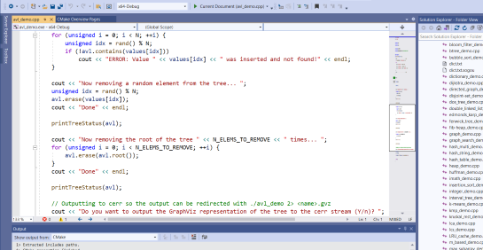
© Ali Masaoodi

Slide 7
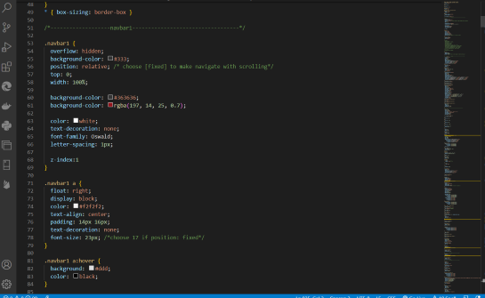
© Ali Masaoodi

