Slide 1

Reconnaissance
ACM CYS – Red Team
Muhammad Iqbal | 19K
Taha Qaiser | 21K

Slide 2
Table of Contents
1 Red Team
Intro and Phases of Red Team Assessment
2 Reconnaissance
Active and Passive Reconnaissance
3 Active Recon
Intro, Tools, Usage
4 Passive Recon
Intro, Tools, Usage
5 Essentials
Shells, Privilege Escalation

Slide 3
1
Red Team
Intro

Slide 4
What is Red Teaming?
Trusted group of individuals who emulate adversary
Red Team VS. Penetration Testing
1
Importance
Red Team VS. Blue Team

Slide 5
Phases of Red Team Assessment
Reconnaissance
Scanning
Gain Access
Maintain Access
Reporting*

Slide 6
Reconnaissance
Active Recon
Direct Connection to the Target System, Website, Service
2
Passive Recon
Information Gathering without raising any red flags

Slide 7
3
Active Recon
Tools

Slide 8
Active Recon - Tools
Nmap
ffuf/gobuster
Network Discovery, port scanning, services
Directory busting – Locating directories on a webapp
Wappalyzer/whatweb
Traceroute
Identify web technologies used in websites
Trace route of packet from source to destination

Slide 9
Active Recon - Tools
Netcat
Ping
Read/Write data over a network through CLI
Check reachability of a remote system

Slide 10
Nmap – Network Mapper
Flag | Description
-p [n] OR –p- | Scan all ports in the range of [n]
-A | OS Detection (Requires sudo privileges)
-v | Verbosity
-sV | Version of the services running target system
-Pn | Port scanning ONLY
-sC | Default scan
Example
$ nmap [target address] -A -T4

Slide 11
Netcat - nc
Flag | Description
-l | Listen on specific port
-p | Port number
-v | Verbosity
Example
$ nc -lvnp 4000

Slide 12
Whatweb
Flag | Description
-a | Sets the aggression level
-v | Verbosity
Example
$ whatweb -a 3 -v 192.168.1.100
Wappalyzer (In browser)

Slide 13
fuff – Fuzz Faster U Fool
Flag | Description
-u | Target URL
-t | Number of threads
-w | Wordlist
-o | Output file path
Example
$ ffuf -w [wordlist] -u “http://10.10.186.191:3000/FUZZ

Slide 14

4
Passive Recon
Tools

Slide 15
Passive Recon - Tools
whois
nslookup
Email Discovery
Information about the domain
Returns various results about the domain based on query type
Hunter.io
Phonebook.cz
Sublist3r/crt.sh
Subdomain discovery of a given domain

Slide 16
Passive Recon - Tools
Commands | Usage
Whois | whois [domain]
nslookup | nslookup –type=[type] [domain]
Email Discovery | Hunter.io, phonebook.cz
sublist3r | Sublist3r –d [domain] –t [threads] –e [seng]

Slide 17
Essentials - SSH
SSH or (Secure Shell) provides a secure channel for users to exchange information/data or access remote systems, also called remote login. The SSH port is 22.
Example
$ ssh [username]@[ip addr]

Slide 18
Essentials - Shell
Shell, a remote session for running commands on the victim machine. Access to a machine.
Types:
Reverse Shell: Shell session initiated by the victim machine to the host Or our target connecting to us.
Bind Shell: The session initiated by the host/us. We send a payload which opens a port and we connect to that specific machine on that port.

Slide 19
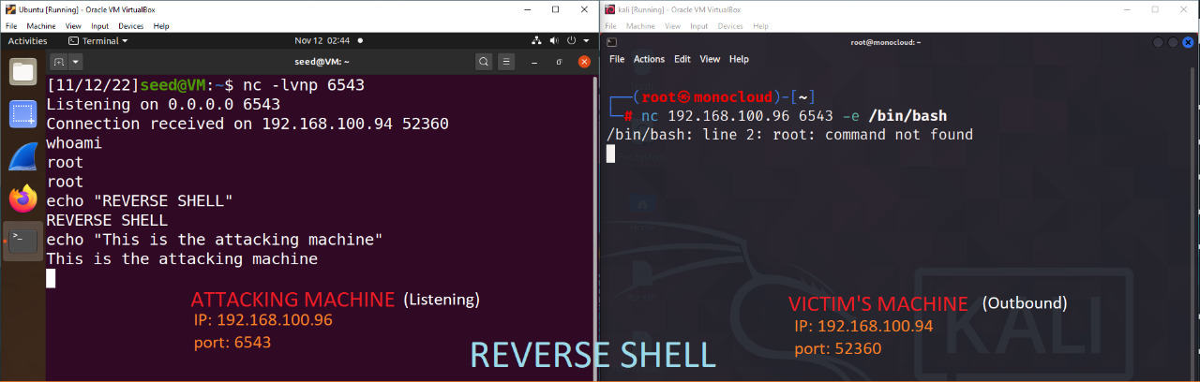
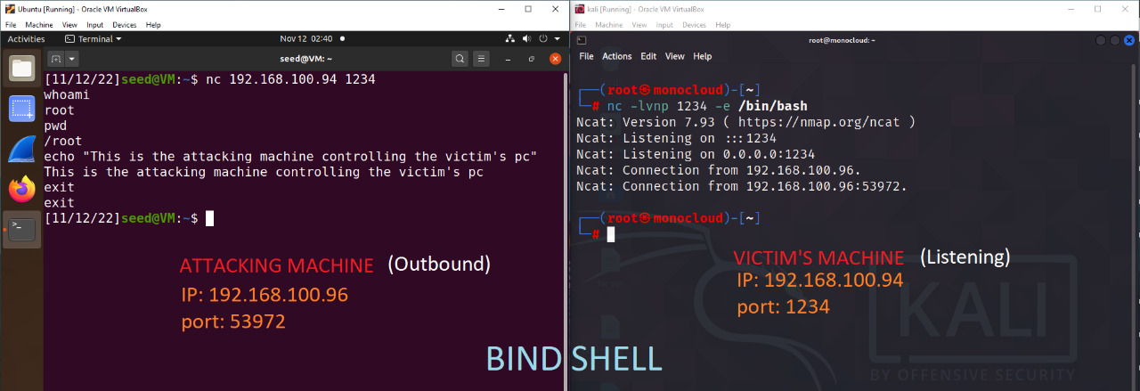
Essentials - Shell

Slide 20
Privilege Escalation
Horizontal Privilege Escalation
Gaining access to a user account on the with the same level of privileges
Vertical Privilege Escalation
Gaining access to a user account on the with a higher level of privileges.

Slide 21
Privilege escalation vectors
sudo
You can use the command
sudo –l
to see what binaries you can run with sudo
Use:
https://gtfobins.github.io/
to look up commands related to those binaries
Use those commands to escalate your privileges!

Slide 22

Activity
Time

