Slide 1

Vahag Gragoosian

Slide 2
Video8
HA

Slide 3
High Availability
Server Level
MinIO Level

Slide 4
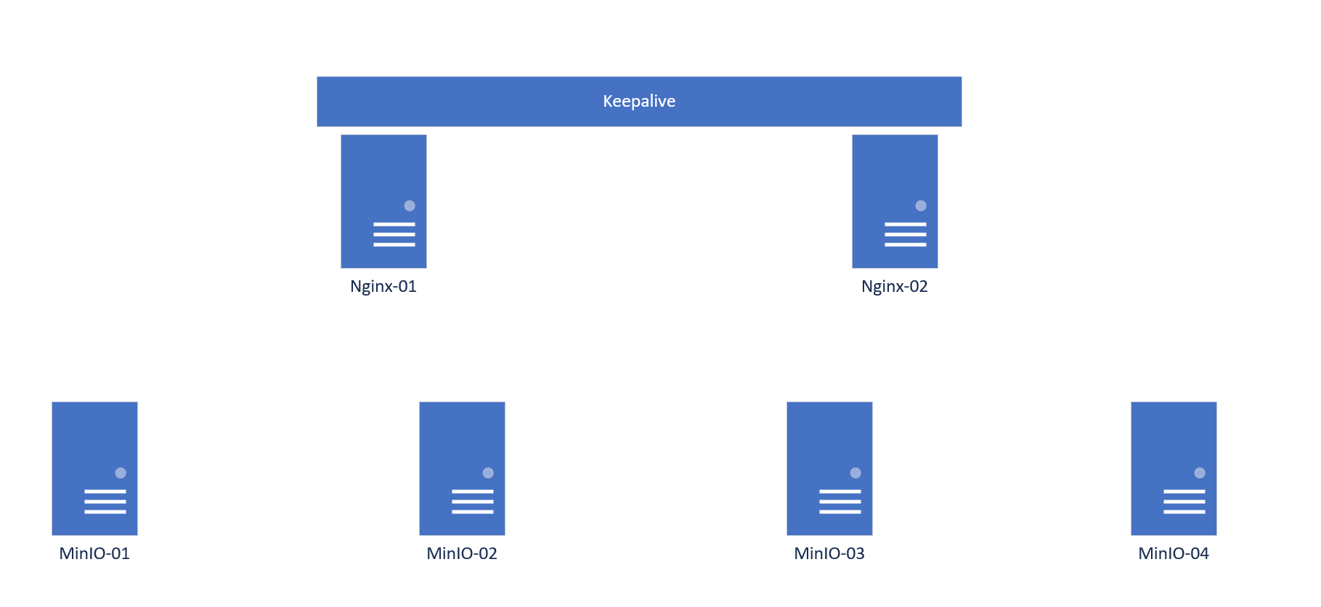
Install MinIO

Slide 5

Install HA

