Slide 1

Vahag Gragoosian

Slide 2
Video 2
What is S3?

Slide 3
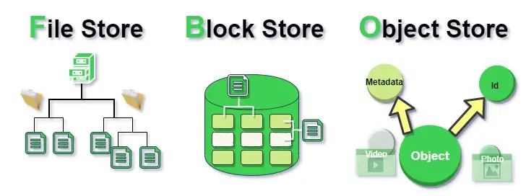
Different Kind of Storage
File Storage vs. Block Storage vs. Object Storage

Slide 4
File Storage
Hierarchical structure or file hierarchy
How we can access it
Driver\\Folder-X\\Folder-Y\\File. Ext
Hardware ➔ NAS (Network Attached Storage)
Data Replication – (RAID)
Centralized
Cost
LAN
Performance
Scalable

Slide 5
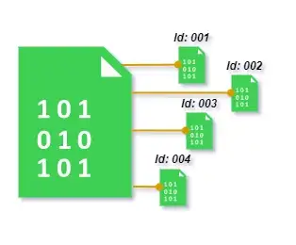
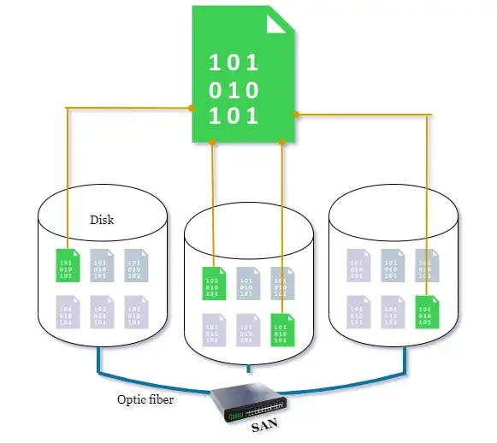
Block Storage
File is decomposed into smaller units or sectors
Hardware ➔ SAN (Storage Area Network)

Slide 6
Block Storage
Fiber
Good Read/Write
Expensive
Complex
Scalable

Slide 7
Object Storage
Not Like NAS ➔ Saved to a folder
Not Like SAN ➔ Separate to different parts
Data ➔ Object
Object :
1- ID
2- Metadata ➔ Size, Name and …
3- Data

Slide 8
Object Storage
Static content applications
Scalable
Unstructured data
Performance
Expensive
Update whole object

Slide 9
Object Storage
AWS: Amazon S3 = Amazon Simple Storage Service
Microsoft Azure: Azure Blob Storage
Google: Cloud Storage
Digital Ocean: Spaces

Slide 10

The Best One!!

