Slide 1

Vahag Gragoosian

Slide 2
Video 4
Architecture of MinIO

Slide 3
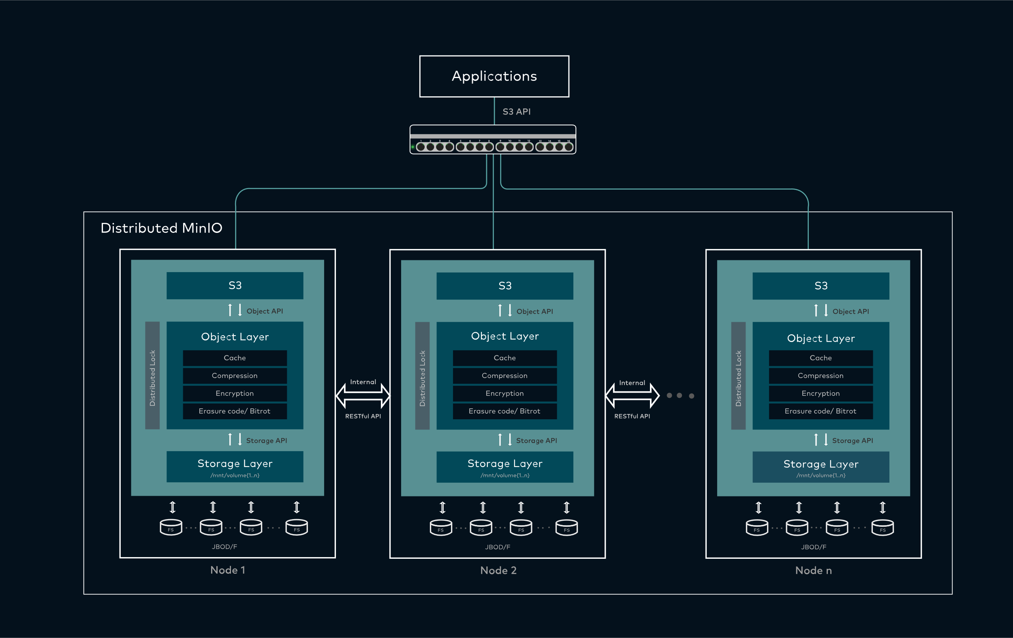

Slide 4
General
Drive
Disk
Format
Disk Type
Node
MinIO Node
Load Balancer

Slide 5
General
MinIO Server
MinIO Client
=================
MinIO Operator
MinIO Tenants

Slide 6
Disk
Direct-Attached Storage or Network Storage
(For deployments that require using network-attached storage, use NFSv4 for best results.)
No RAID
Deployments using non-XFS filesystems ➔
Lower performance
Exhibiting unexpected or undesired behavior.
High Speed Disk
Disk Capacity limitation

Slide 7
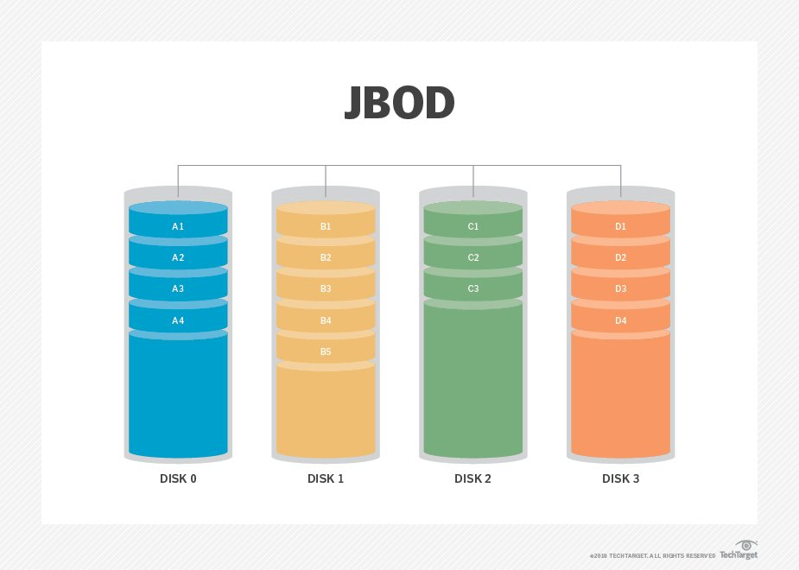
Disk
“MinIO strongly recommends direct-attached JBOD arrays with XFS-formatted disks for best performance”
JBOD (just a bunch of disks)

Slide 8
Node
Same Hardware
Same Disk
Same OS (Better to use same version)
Firewall and connection

Slide 9
Different Cluster
Single-Node Single-Drive
Single-Node Multi-Drive
Multi-Node Multi-Drive
==========================
Cluster Up and Running➔ https://min.io/product/erasure-code-calculator

