Slide 1

Vahag Gragoosian

Slide 2
Video 5
Features Of MinIO

Slide 3
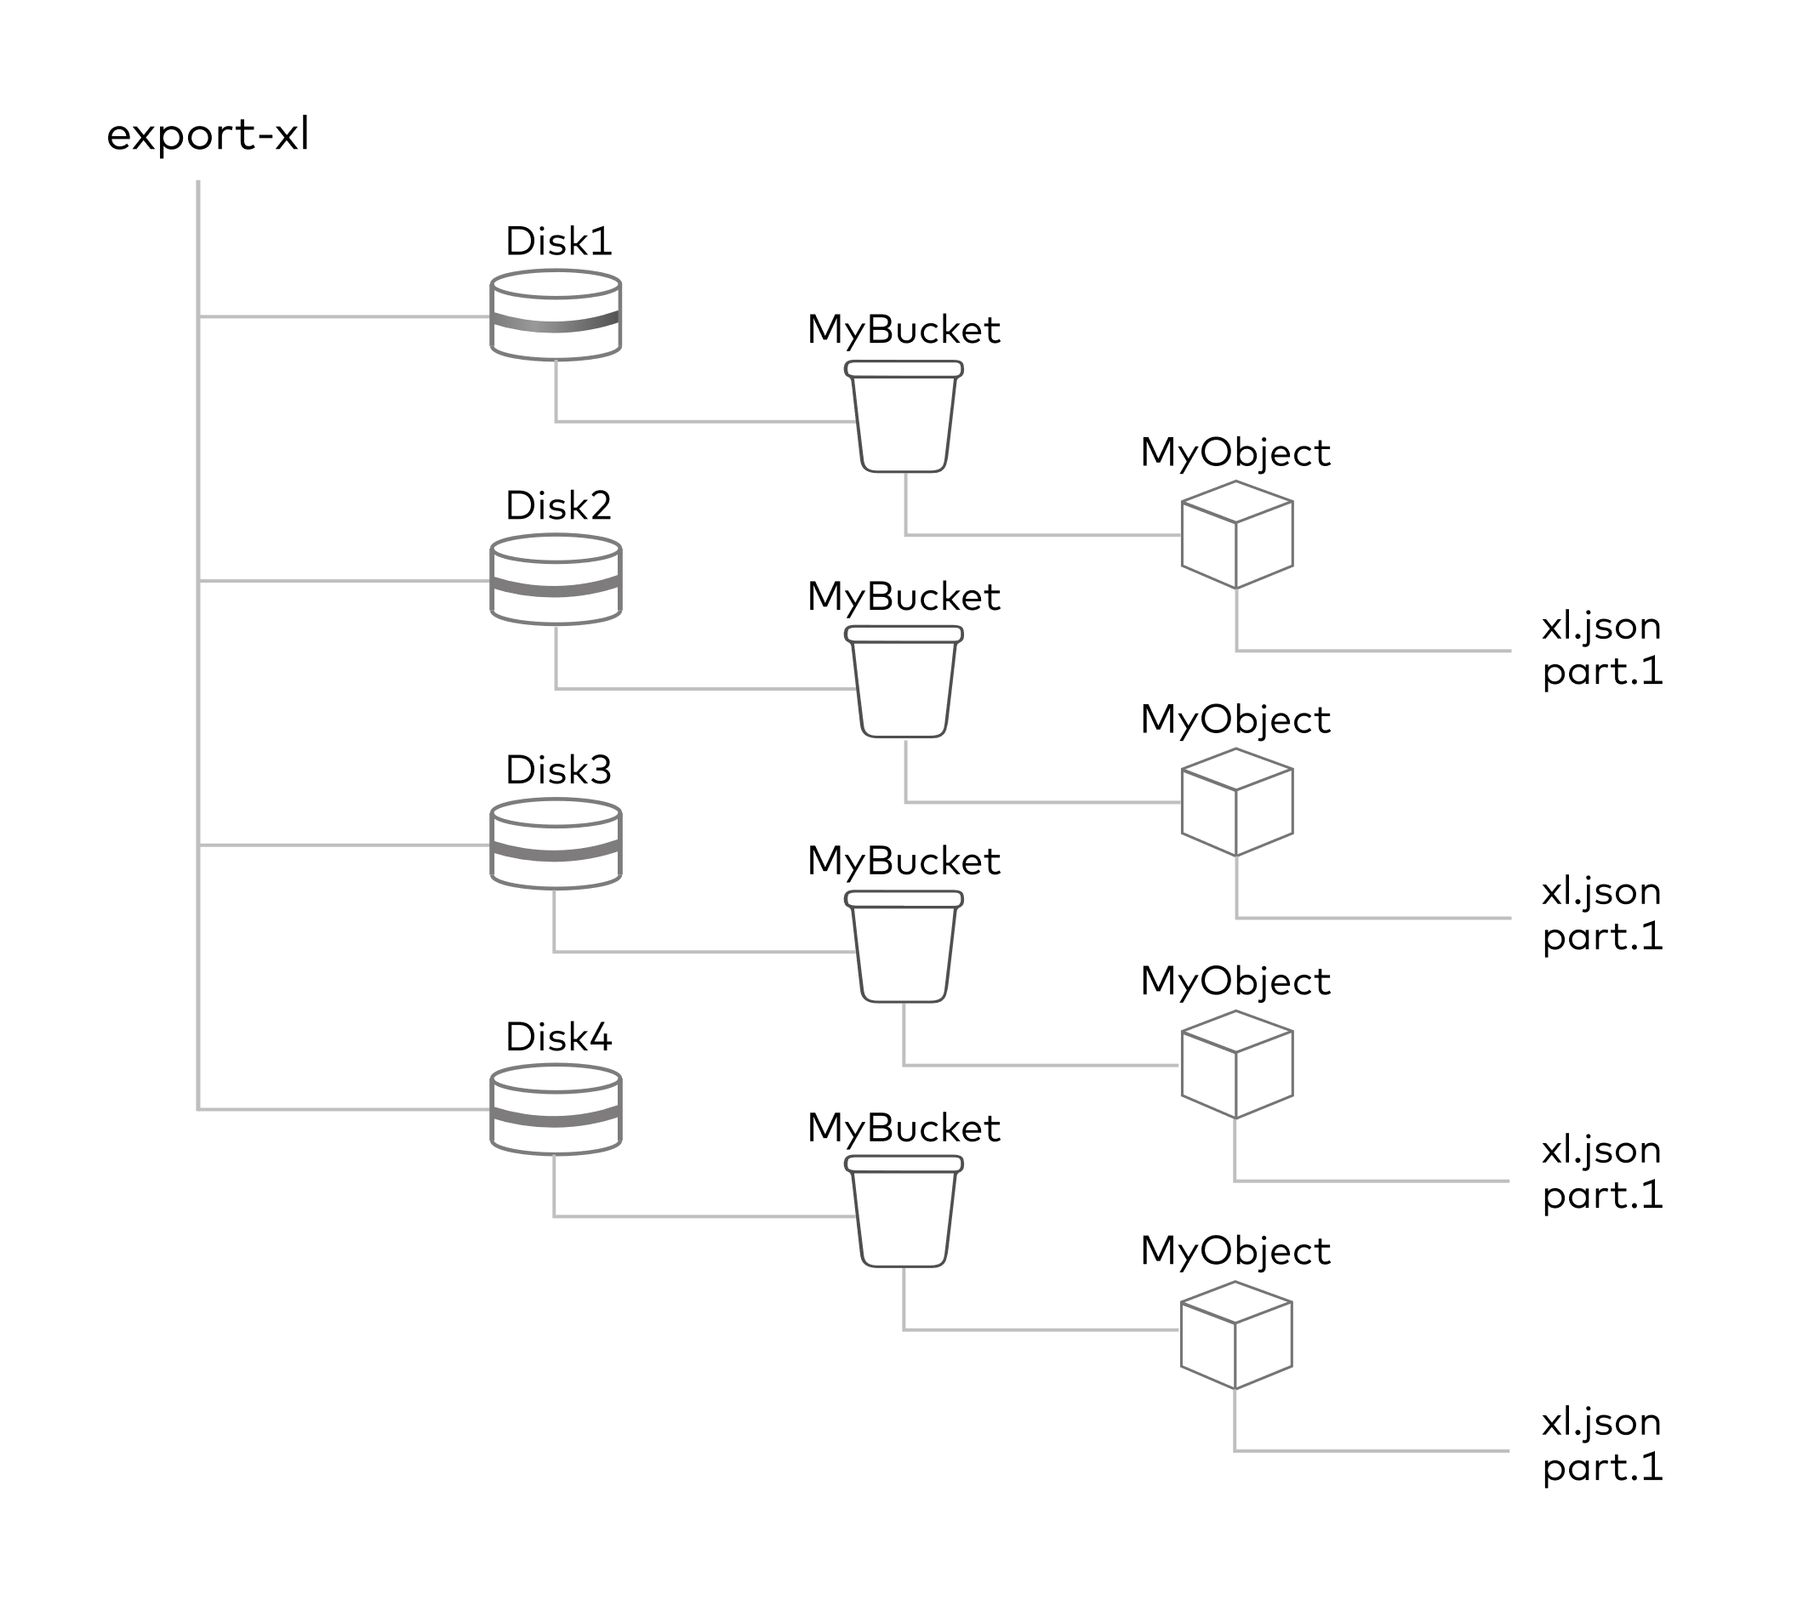
Erasure Coding
Object Data Value=25
X= 2 Y= 5
x+y=7➔A y-x=3➔B 2x+y=9➔C x*y=10➔D
Erasure Coding VS RAID

Slide 4
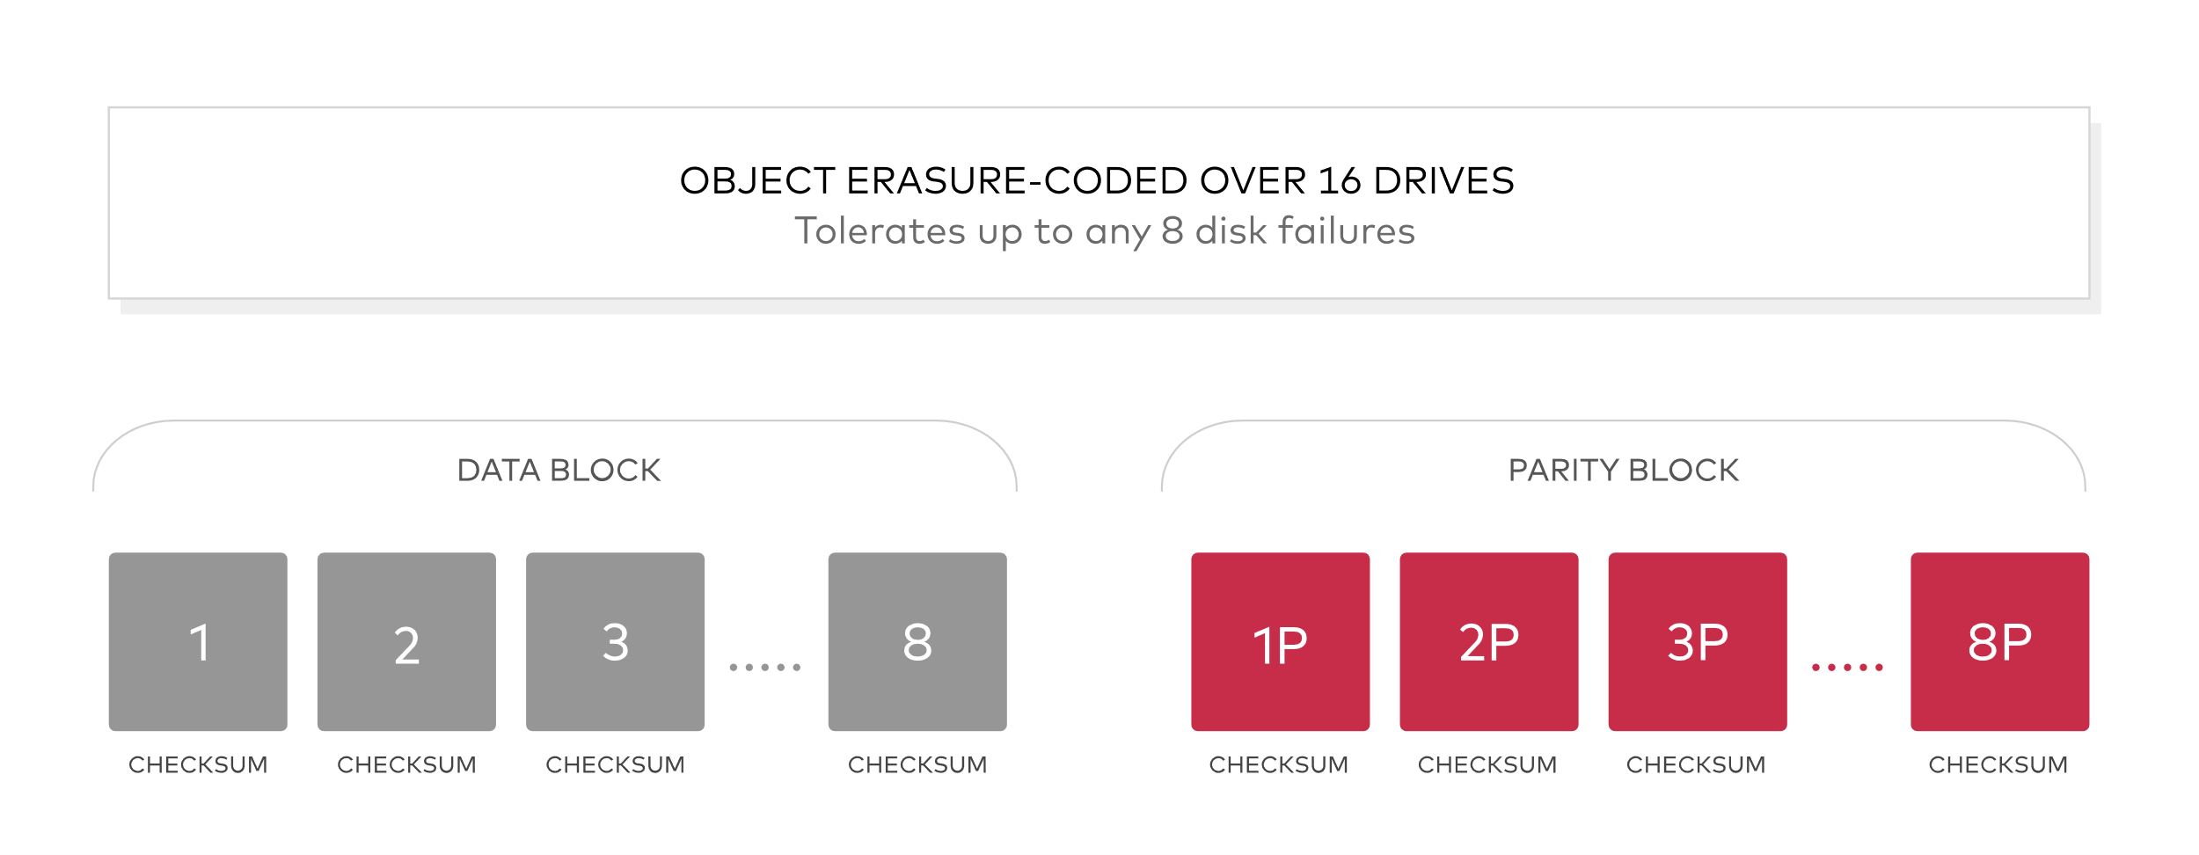
BitRot Protection
Aging drives, current spikes, bugs in disk firmware, phantom writes, misdirected reads/writes, driver errors, accidental overwrites
“Achieve hashing speeds over 10 GB/sec on a single core on Intel CPUs”

Slide 5
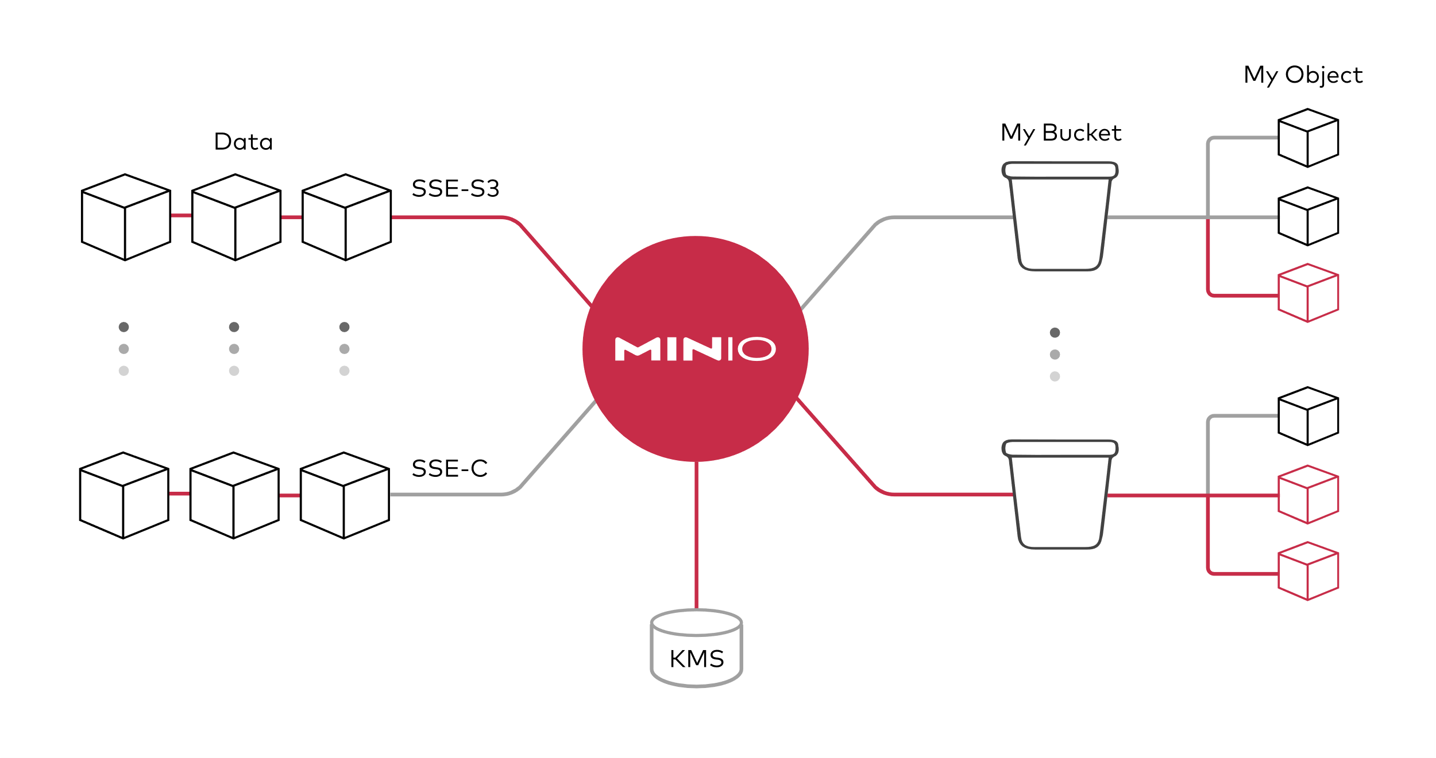
Encryption
Data
SSE-KMS Recommended
SSE-S3
SSE-C
Connect to Vault
Network
TLS /SSL
WORM ➔ Write-Once Read-Many (MinIO Object Locking)

Slide 6
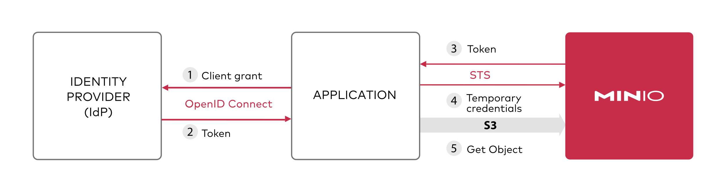
Identity Management
IDentity Provider
Internal
OpenID
Active Directory - LDAP
STS = Security Token Service

Slide 7
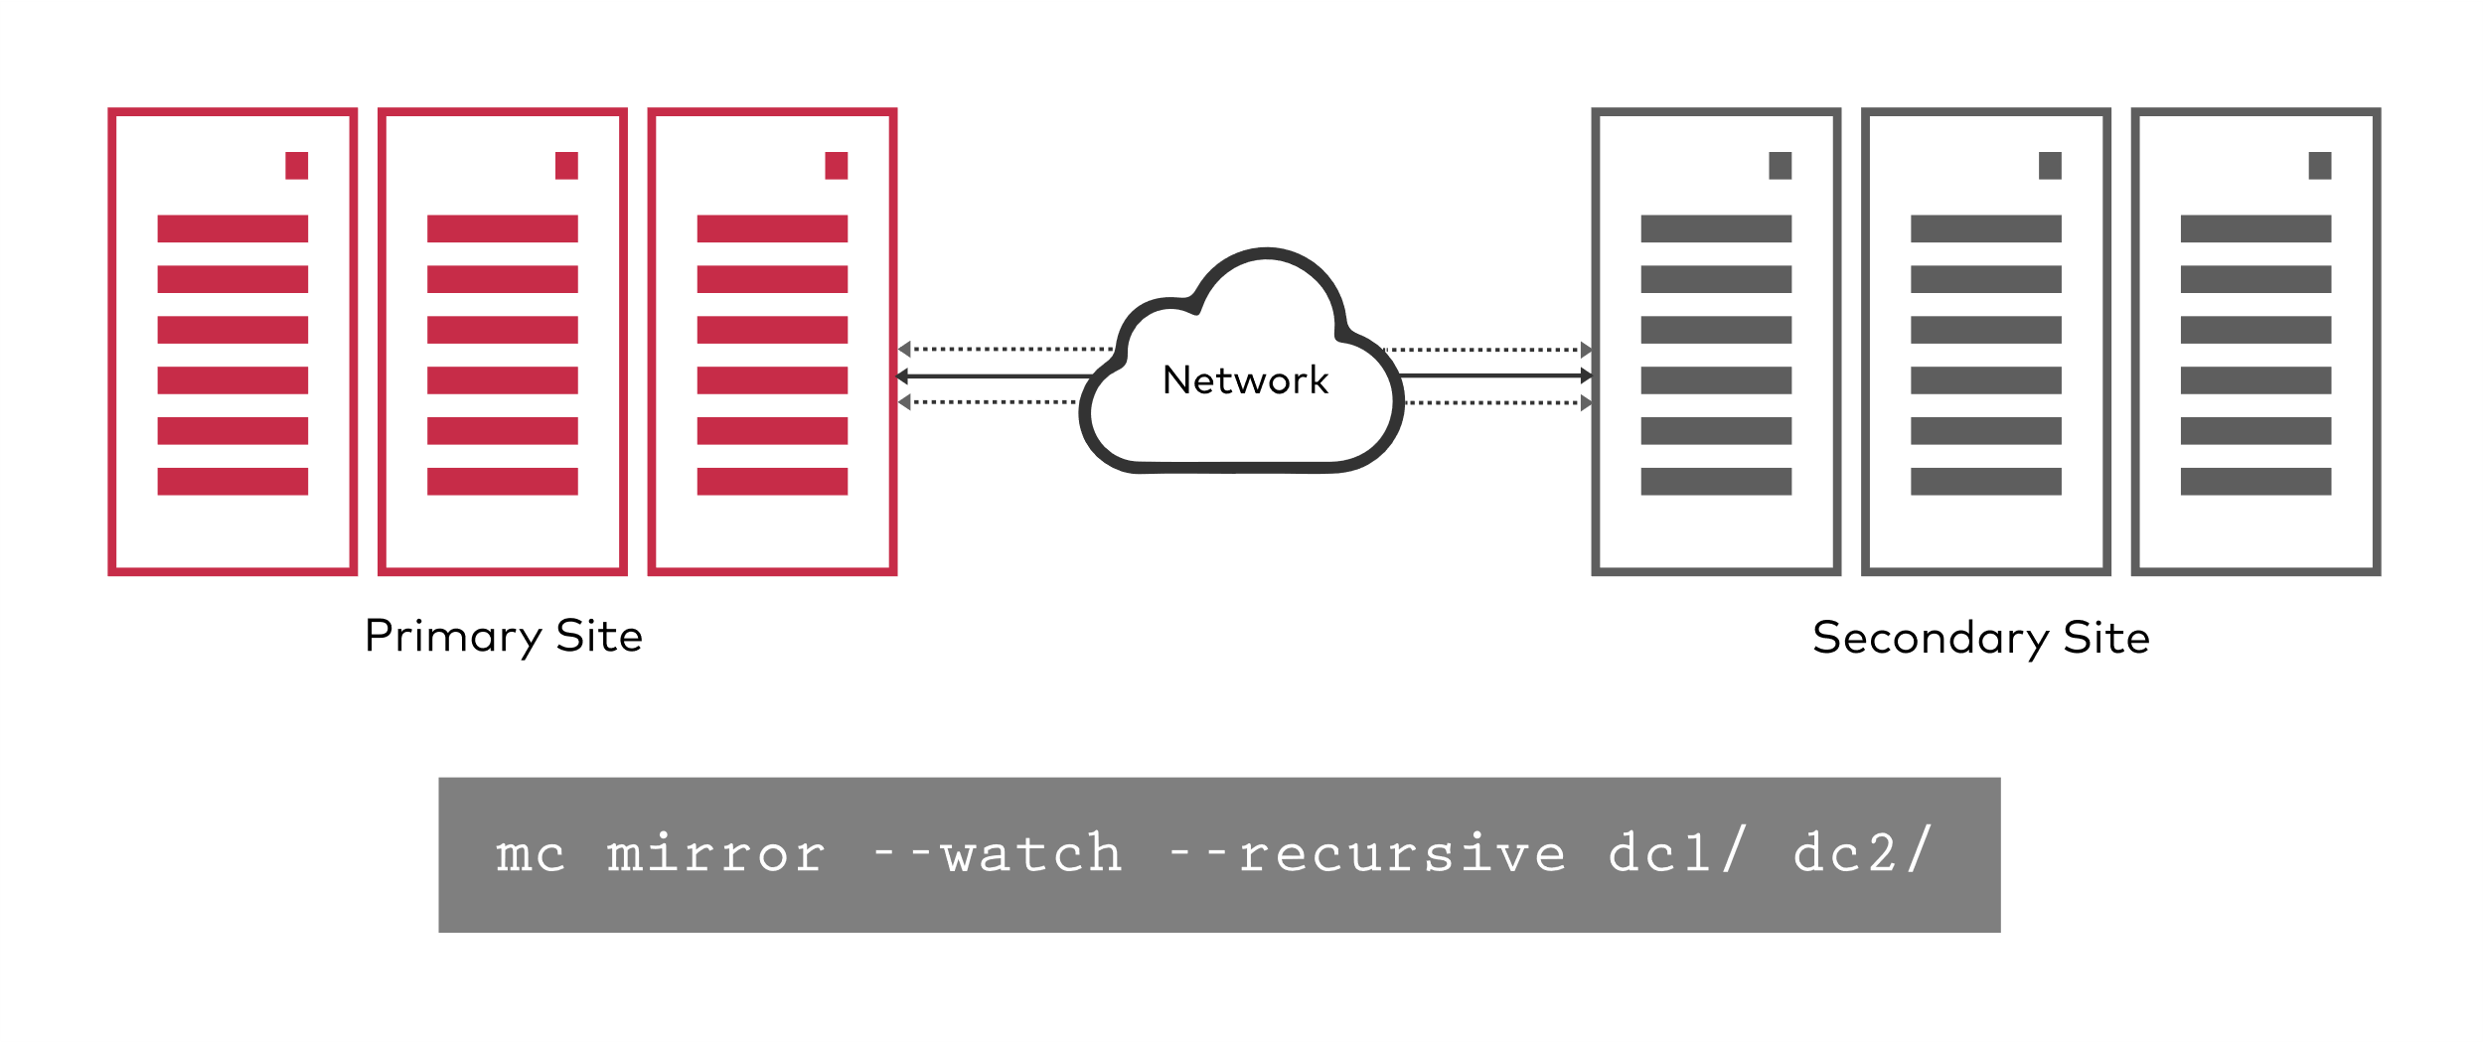
Continuous Replication
One way
Two way
Site
Bucket
Active
Passive

Slide 8
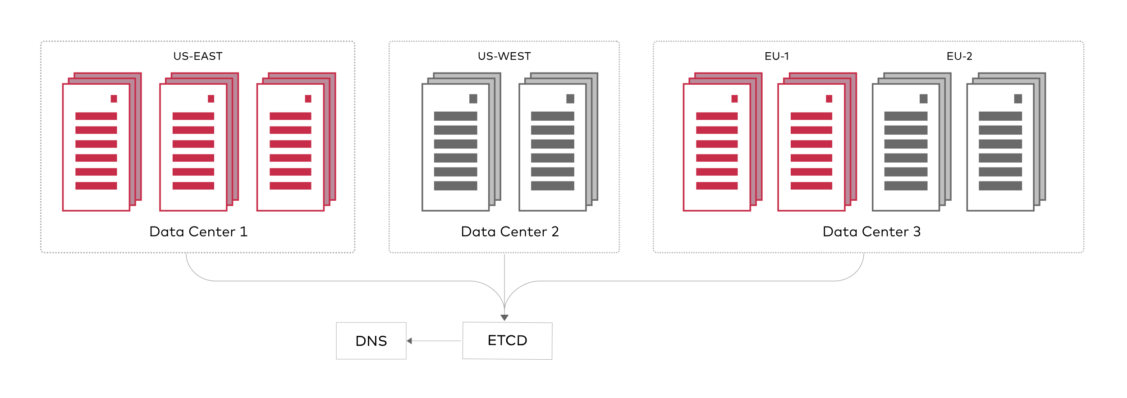
Global Federation

Slide 9
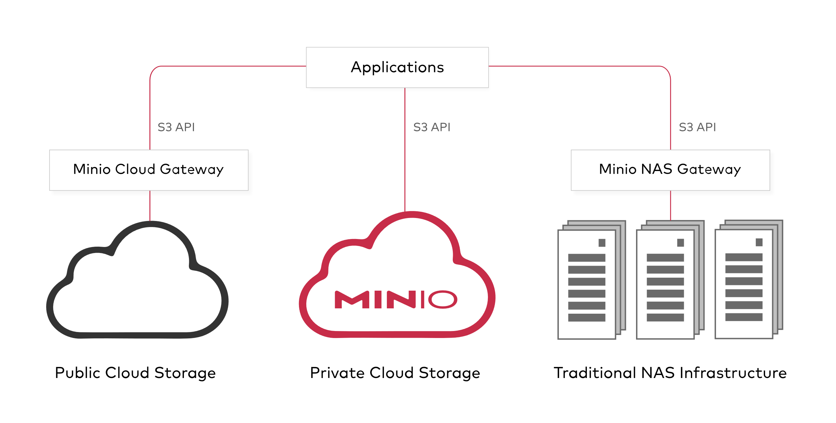
Multi-Cloud Gateway

Slide 10
Other
Versioning
Object Lifecycle
Monitoring Bucket and Object Events

