Slide 1

Vahag Gragoosian

Slide 2
Video6
Part 1 ➔ Deployment Checklist & Install MinIO
Part 2 ➔ Demo

Slide 3
Deployment Checklist
Resources
Server
Disk
Certificates
DNS
Limitations

Slide 4
Deployment Checklist
MinIO Hardware: https://min.io/docs/minio/linux/operations/checklists/hardware.html https://min.io/product/reference-hardware Security: https://min.io/docs/minio/linux/operations/checklists/security.html Software: https://min.io/docs/minio/linux/operations/checklists/software.html Thresholds: https://min.io/docs/minio/linux/operations/checklists/thresholds.html

Slide 5
Deployment Checklist
Resources (Test Env.)
CPU (t2.micro)
RAM (t2.micro)
Network (t2.micro)
OS Disk (8GB-gp2-EBS)
Data Disk (1GB-gp2-EBS)
DNS (Host File)

Slide 6
Deployment Checklist
Server
OS ➔ Ubuntu 22.04 TLS
Software ➔ GitHub
Disk
OS ➔ Hardware (Type, Size and …)
Data ➔ Hardware(Type, Size and …)

Slide 7
Deployment Checklist
Certificate
DNS
Limitations
Rate Limit
Connection Limit
DDoS Protection
Caching
Load Balance
Sync

Slide 8
Install MinIO
Install https://min.io/docs/minio/kubernetes/upstream/index.html
https://min.io/download#/kubernetes
Linux ➔ https://min.io/download#/linux
Docker ➔ https://min.io/download#/docker

Slide 9
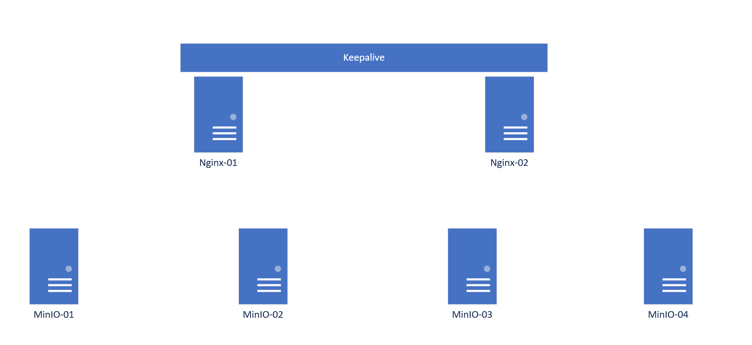
Install MinIO

Slide 10
Install MinIO
Prerequisites
Install OS
Update && Upgrade
Hostname
NTP
DNS
Data Disk

Slide 11

Install MinIO

