Slide 1
Neural Network Architecture
hidden Layers with different sizes
input layer
output layer
Inter Fully Connected
Inter Fully Connected
Inter Fully Connected

Slide 2
Connecting all the neuron inside the box to the related neuron
1,1
1,1 corresponding neuron
Local receptive fields
Starting from top-left corner
4,5 corresponding neuron
Local receptive fields
4 steps to right and
5 steps to down

Slide 3
first hidden layer with 3 Kernel (Filters) neurons
input neurons

Slide 4
Output from feature map
max-pooling unit

Slide 5
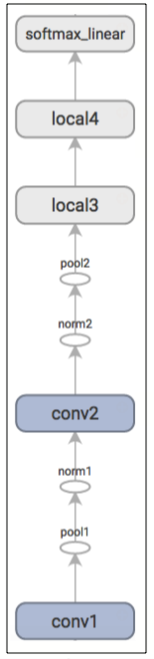
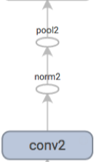
Add new layer and
make three CNN layers

Slide 6
TensorBoard steps:
tf.scalar_summary
Serializing the Data
Summary Operation
tf.image_summary
…
tf.merge_all_summaries
write to disk
tf.train.summaryWriter
(graph & shape information)
tensorboard –logdir=to/the/path

