Slide 1




Vision and Mission
Presented by: Insight.

Slide 2

  Overview
  About the Company
Agenda
  Most Significant Achievement
  Vision
  Mission
  Vision Vs Mission
  Team

Slide 3

Back to Agenda Page
Vision
Mission
Goals
  What is the impact of the company you want to leave behind?
  What is the culture that you want to play out in your employees' lives?
  What is your company doing today?
  Why are you doing it and who are you doing it for?
  How does it contribute to the greater good?
  What does your company want to achieve?
  What are the company's long-term and short-term goals?

Slide 4
Oracle Cloud Infrastructure (OCI)
  Provides global cloud services (computing power, storage, networking) designed for high-performance computing, serving as the scalable and secure backbone for modern workloads.
About the Company
Cloud Applications (SaaS)
  A broad portfolio of cloud-based business applications, including Fusion ERP, Fusion HCM (Human Capital Management), and NetSuite, managing critical functions (finance, HR, supply chain).
Back to Agenda Page

Slide 5
Database Technology
  The flagship Oracle Database, which remains the gold standard for mission-critical data management, renowned for its reliability and performance.
About the Company
Hardware and Systems
  Includes engineered systems and servers, primarily for customers seeking integrated hardware/software solutions.
Back to Agenda Page

Slide 6
While not the inventor of the theory
  Oracle's most profound achievement was successfully commercializing the Relational Model and SQL, making it the robust, global standard for enterprise data management.
Most Significant Achievement
Oracle Autonomous Database
  It uses Machine Learning to automatically handle routine, manual, and error-prone tasks like patching, tuning, and security. This self-driving capability makes the database more secure, cost-effective, and virtually eliminates downtime caused by human error.
Back to Agenda Page

Slide 7

Vision
  To be the leading global provider of comprehensive cloud solutions.
  To lead the technological transformation and empower businesses with data and innovation.
Back to Agenda Page

Slide 8
To be the leading global provider of comprehensive cloud solutions
  This expresses Oracle's goal to be the number one company globally in providing integrated Cloudsolutions.
Vision
To lead the technological transformation and empower businesses with data and innovation
  This clarifies Oracle's ambition to lead the technological transformation and help businesses utilizedata and innovation to achieve success
Back to Agenda Page

Slide 9


Mission
"To help people see data in new ways, discover insights, and unlock endless possibilities."
  What is your company doing today?
  How does it contribute to the greater good?
Back to Agenda Page

Slide 10
Explanation
Helping People See Data in New Ways
  The first step is transformation. For too long, data has been locked away in complex tables, accessible only to IT experts. Oracle’s goal is to make data visual, intuitive, and accessible to everyone
And the example of it is
  This is the purpose of tools like the Oracle Analytics Cloud, which provides easy-to-use, interactive dashboards andreal-time reports. It turns confusing, complex data into clear, engaging visualizations. Think of a sales managerinstantly seeing performance trends on a dashboard instead of sifting through spreadsheets—that’s how Oracle ishelping customers shift their focus from data collection to data understanding.
Back to Agenda Page

Slide 11
Explanation
  Seeing the data clearly leads to the next crucial step: discovering valuable insights to enable smarter business decisions. This is where Oracle injects the power of Machine Learning and automation.
Discover Insights
And the example of it is
  The ultimate example of this is the Oracle Autonomous Database. It's a self-managing database powered by AI that automates everything—tuning, patching, and backups. It frees up customers' time so they can focus entirely on the analysis
Back to Agenda Page

Slide 12
Explanation
  The final and most ambitious pillar is Unlocking Endless Possibilities. This is the vision for innovation—providingthe technological runway for customers to reimagine what is possible
Unlock Endless Possibilities
And the example of it is
  This ambition is realized through Oracle Cloud Infrastructure, or OCI. OCI provides a high-performance, securecloud platform supporting everything from small startups to the world’s largest companies. A perfect illustration isZoom, which uses OCI to power millions of meetings globally. Oracle fuels this possibility through massivecommitment, investing over $7 billion yearly in research and development for future technologies like AI,Blockchain, and IoT integration.
Back to Agenda Page

Slide 13
Feature | Vision | Mission
Focus | Future oriented (what we want to become) | Present-oriented (Why we exist and what we do).
Answers the Question | What will we achieve?" or "Where are we going?" | What do we do?" or "Why do we exist?"
Time Horizon | Long-term (aspirational, 5-10 years or more). | Short- to mid-term (operational, day-to-day activities).
Nature | Inspirational, idealistic, and often short. | Practical, descriptive, and more detailed.
Nature | Provides the ultimate destination and inspiration. | Provides the path and guiding principles to reach the vision.
Example | (vision ultimate goal) To be the world’s leading provider of intelligent and secure cloud infrastructure and software. | (mission…current purpose) To help people see data in new ways, discover insights, and unlock endless possibilities

Slide 14






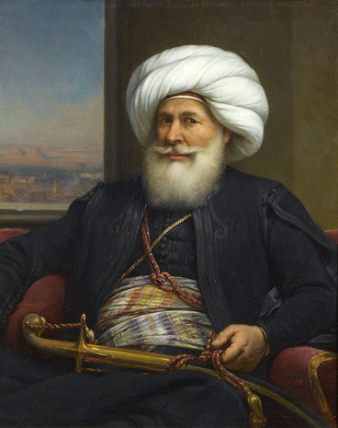
INSIGHT
Mohamed
Abd-Elrahman
Mohamed Sharaf
Mohmed Hussein
Team leader
Mahmoud
Waleed
Mahmoud
Soliman
Ali
Mohamed

