Slide 1
Survey of consumer finance a customer segmentation project

Slide 2
agenda
Overview
EDA
Building KMeans Model
Evaluating Model ( Inertia & Silhouette score )
PCA
Dash App

Slide 3

Overview
the dataset is the public extract of 2019 Survey of Consumer Finances from the official federal reserve website
consist of 28885 rows and over 350 columns that track all sorts of behaviors relating to the ways households earn, save, and spend money in the United States.
For this project, we're going to focus on households that have "been turned down for credit or feared being denied credit in the past 5 years.

Slide 4
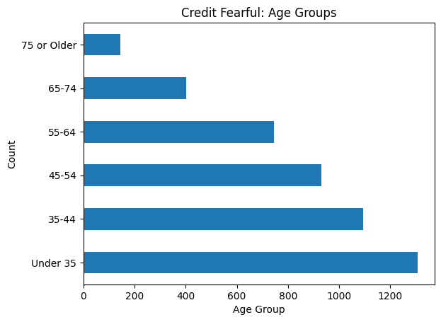
EDA
Age
many of the people who fear being denied credit are younger. But the first two age groups cover a wider range than the other four. So it might be useful to look inside those values to get a more granular understanding of the data.

Slide 5
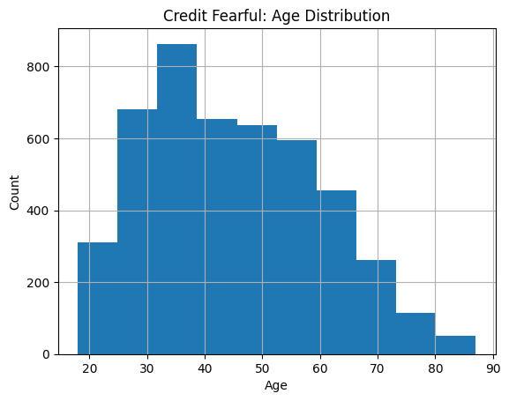
EDA
Age
Make younger people are still more concerned about being able to secure a loan than older people, but the people who are most concerned seem to be between 30 and 40.

Slide 6
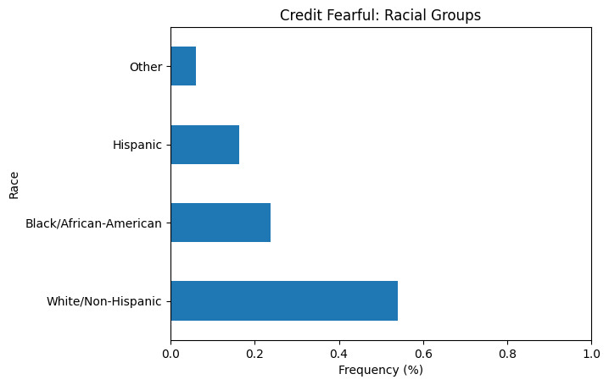
EDA
race
This suggests that White/Non-Hispanic people worry more about being denied credit, but that might be because there are more White/Non-Hispanic in the population of the United States than there are other racial groups, and the sample for this survey was specifically drawn to be representative of the population as a whole.

Slide 7
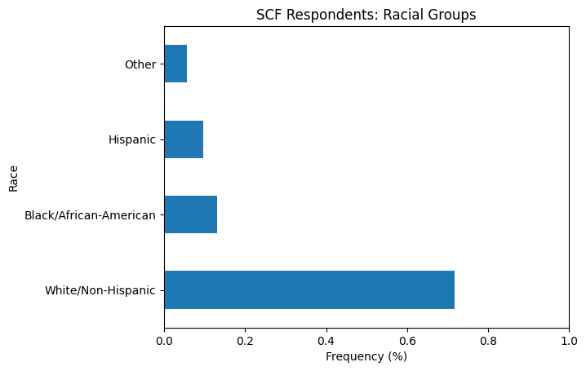
EDA
race
we can see that White Non-Hispanics account for around 70% of whole dataset, but only 54% of credit fearful respondents. On the other hand, Black and Hispanic respondents represent 23% of the whole dataset but 40% of credit fearful respondents. In other words, Black and Hispanic households are actually more likely to be in the credit fearful group.

Slide 8
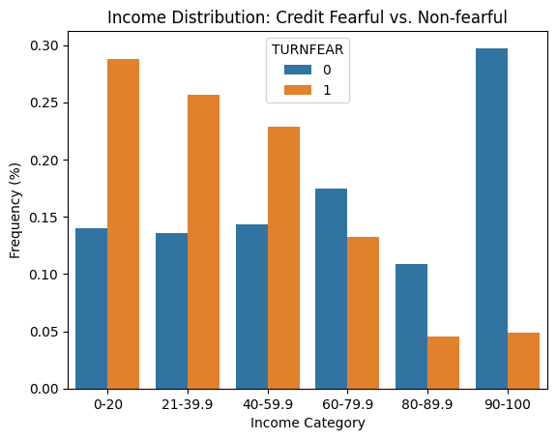
EDA
income
we can see that credit fearful households are much more common in the lower income categories. In other words, the credit fearful have lower incomes.
Among the people who responded that they were indeed worried about being approved for credit after having been denied in the past five years, a plurality of the young and low-income had the highest number of respondents.

Slide 9
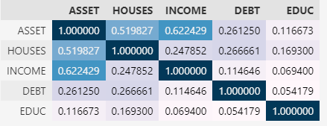
EDA
assets
Correlation heatmap using whole dataset
There's a moderate positive correlation between Asset and Houses , For many Americans, the value of their primary residence makes up most of the value of their total assets.
The relationship between "DEBT" and "HOUSES" is positive but weak

Slide 10
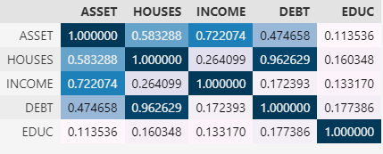
EDA
assets
Correlation heatmap using Turnfear dataset
the coefficient for "DEBT" and "HOUSES" correlation is .96 which is very high, This suggests that the main source of debt being carried by the "TURNFEAR" people is their primary residence

Slide 11
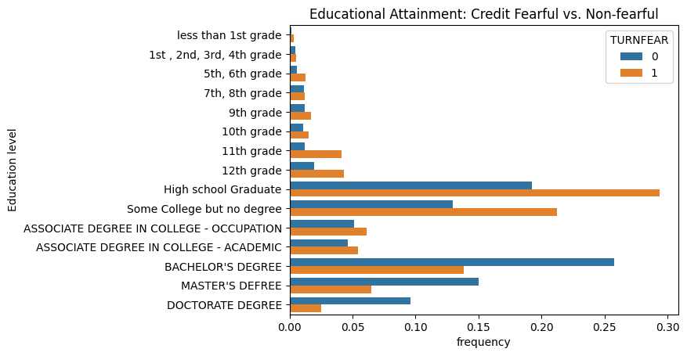
EDA
assets
we can see that a much higher proportion of credit-fearful respondents have only a high school diploma, while university degrees are more common among the non-credit fearful.

Slide 12
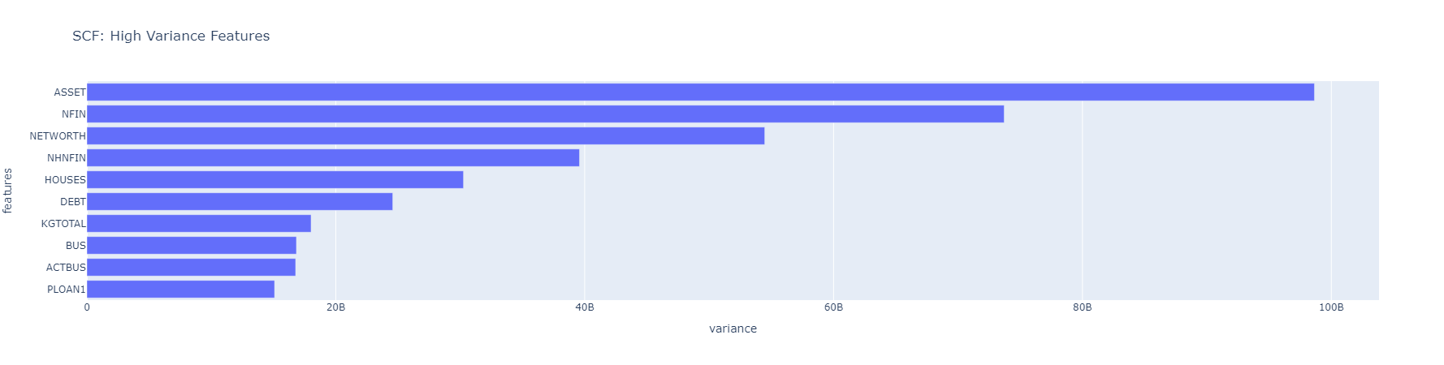
clustering
Exploring features
We will build our clustering model based on high variance features, sense we have more than 300 features
many of the wealth indicators are highly skewed, with a few outlier households having enormous wealth. Those outliers can affect our measure of variance.
Let's see if that's the case with one of the features from our top 5 variance features

Slide 13
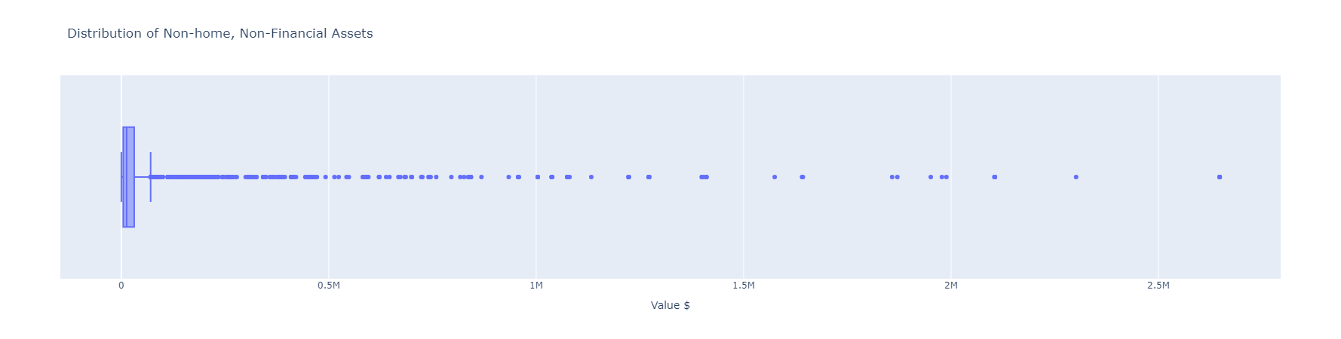
clustering
Exploring features
The dataset is massively right-skewed because of the huge outliers on the right side of the distribution. Even though we already excluded households with a high net worth , the variance is still being distorted by some extreme outliers.

Slide 14
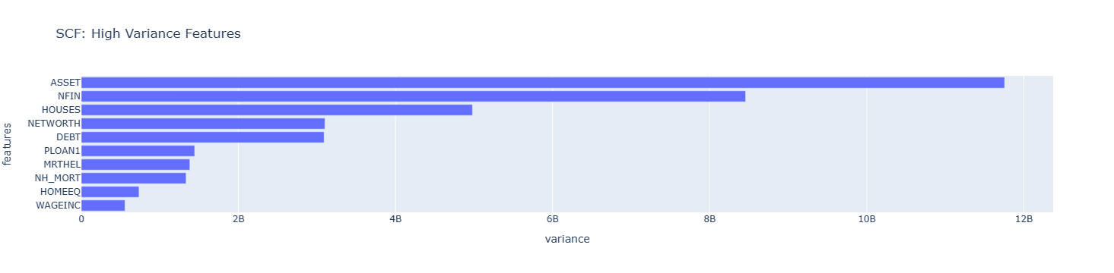
clustering
Exploring features
High variance features after trimming
The variances have decreased a lot. In our previous chart, the x-axis went up to $80 billion; this one goes up to $12 billion.
we can see that there are big differences in variance from feature to feature. For example, the variance for "WAGEINC" is around than $500 million, while the variance for "ASSET" is nearly $12 billion
In other words, these features have completely different scales. This is something that we'll need to address before we can make good clusters.

Slide 15
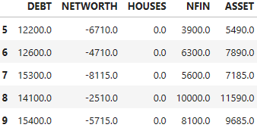
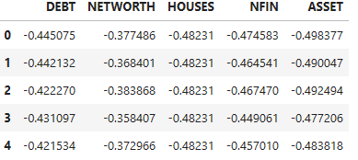
clustering
Exploring features
we saw that we had a scale issue among our features. That issue can make it harder to cluster the data, so we'll need to fix that.
One strategy we can use is standardization, a statistical method for putting all the variables in a dataset on the same scale.
We will use StandardScaler to help us standardizing the data.
Feature matrix before scaling
Feature matrix after scaling

Slide 16
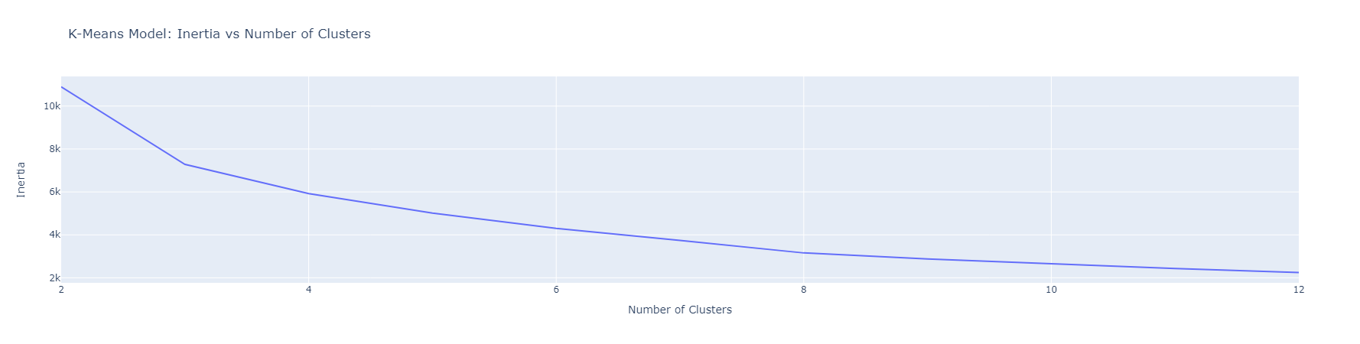
clustering
evaluating
We will use for loop to iterate of range of numbers of clusters from 2 to 12, and make a pipeline for every iteration contaning a Standardscaler and a KMeans model, and then record the Inertia and Silhouette score in order to visualize them and be able to decide the perfect number of clusters.
Inertia
we can see that the line starts to flatten out around 4 or 5 clusters.

Slide 17
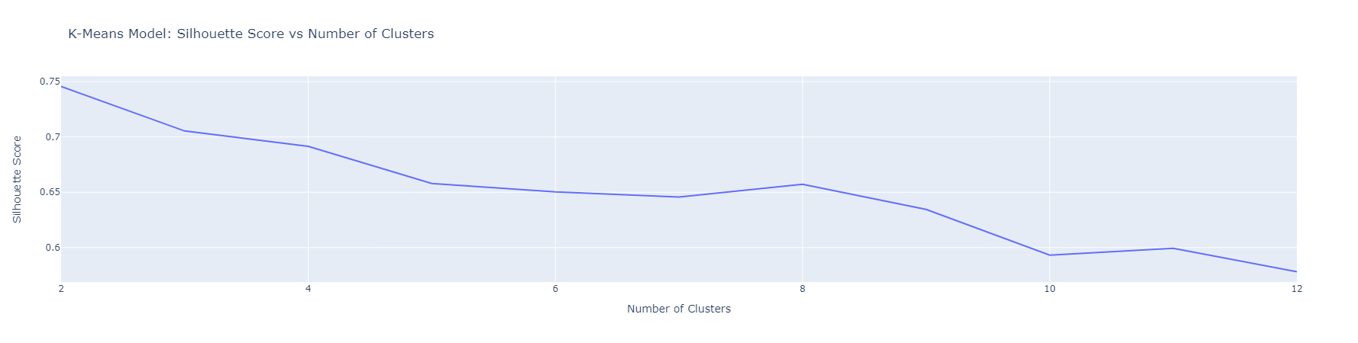
clustering
evaluating
Silhouette score
we can see that the best silhouette scores occur when there are 3 or 4 clusters.
So our final model will be based on 4 clusters.

Slide 18
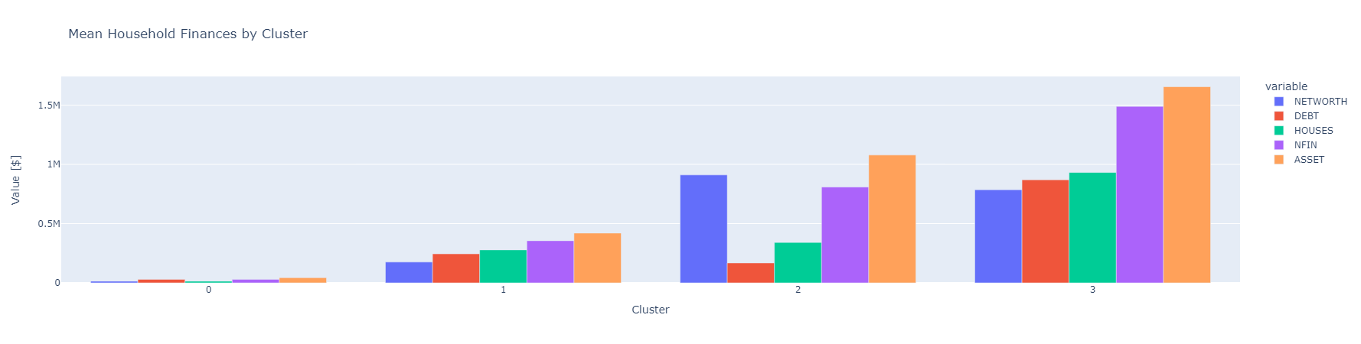
clustering
Communicating results
Figure shows the average the mean values of the features for each of the clusters in our final model.
our clusters are based partially on NETWORTH, which means that the households in the 0 cluster have the smallest net worth, and the households in the 2 cluster have the highest
Cluster 0 : has the lowest NETWORTH and the value of their debt is higher than the value of their houses which suggests it comes from their house mortgage
Cluster 1 : has a higher NETWORTH, but their debt is higher and roughly the same value as their houses.
Cluster 2: has the highest NETWORTH, and much low debt value,
Cluster3: has the highest debt value, but their asset and NETWORTH are much higher and allow them carry that huge amount of debt

Slide 19
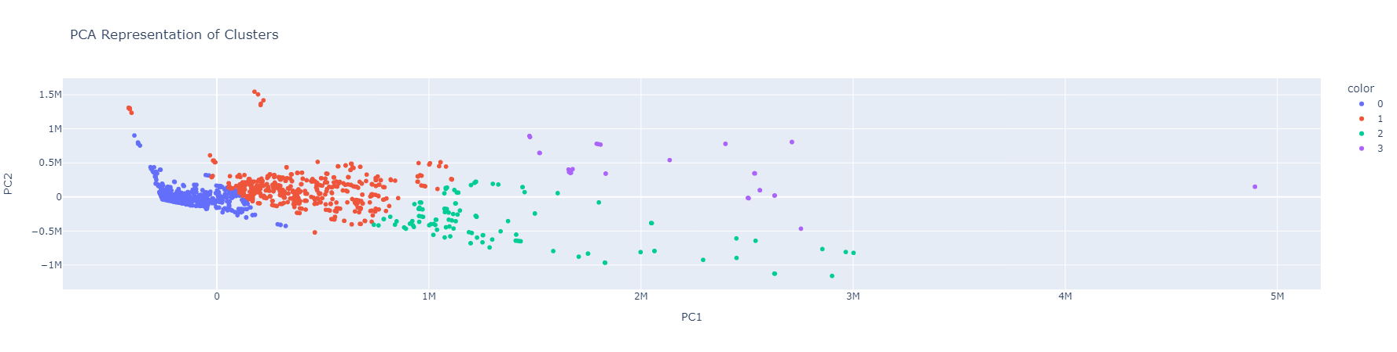
clustering
Communicating results
2D representation of clusters

Slide 20
Thank you

