Slide 1
CS/PHYS-314/300: Quantum Computing Unit 00: Introduction and Motivation
Habib University – Shaping Futures
Faisal Alvi
(For any suggested modifications please email: faisal.alvi@sse.habib.edu.pk)

Slide 2
Unit Outline
Introduction
Syllabus
Content
Session Plans
Motivation

Slide 3
Introduction
Course: CS Elective + General Elective
Instructor: Faisal Alvi
Students: A brief Intro
Expectations from the Course

Slide 4
Syllabus
http://syllabus.habib.edu.pk

Slide 5
Contents and Assessments
Textbooks
Assessments
Assignments
Quizzes
Exams
Class Participation
Various Activities

Slide 6
Session Plans
Review of Previous Class
Content Coverage including Q/A
Class Activity and/or Demo

Slide 7
Motivation
A common statement I got from some students when offering this course?
What is the scope of quantum computing?
Can you define scope as used here?
Do you have any ideas about the scope of quantum computing?

Slide 8
Quantum Computing
Quantum Computing is a fundamentally different type of computing as compared to the current computing paradigms.
To differentiate with QC, we use the term ‘classical computing’ for computers that are in use today.
The basic unit of computation in Quantum Computing [subsequently referred to as QC] is the qubit.
This contrasts with the bit as the unit of digital devices in use today.
More on that later…

Slide 9
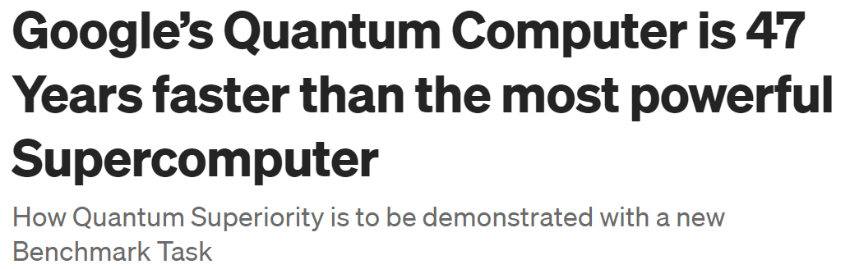
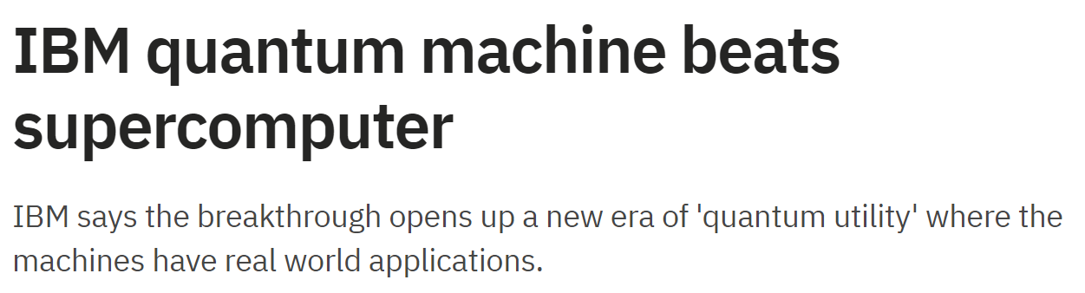
Quantum Computing – Current Progress
July 2023
June 2023
https://www.sciencealert.com/google-quantum-computer-is-47-years-faster-than-1-supercomputer
https://techmonitor.ai/hardware/quantum/ibm-quantum-machine-beats-supercomputer

Slide 10
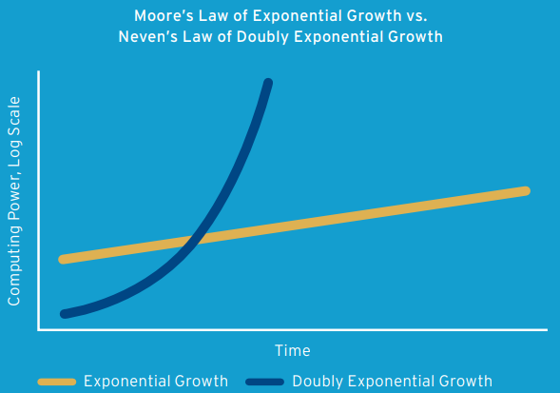
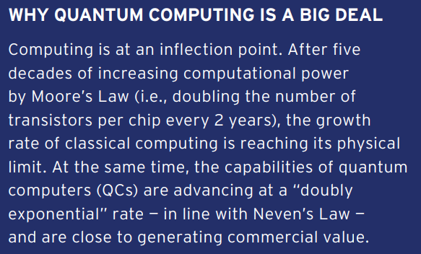
Quantum Computing – Neven’s Law

Slide 11
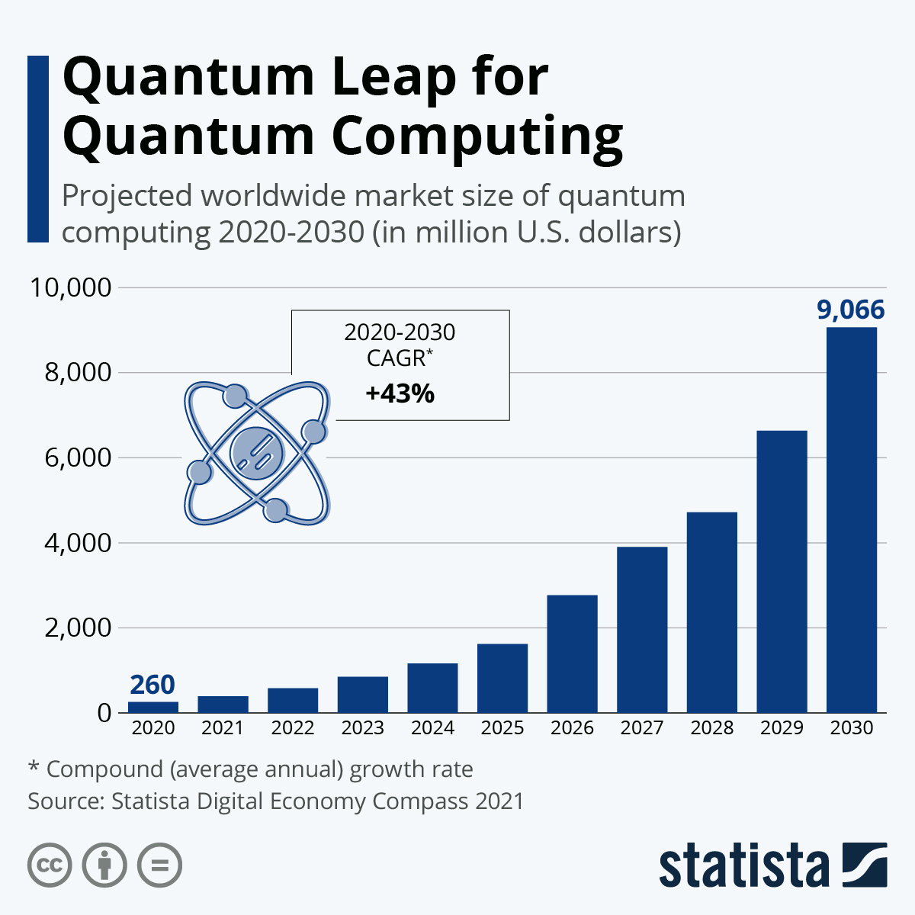
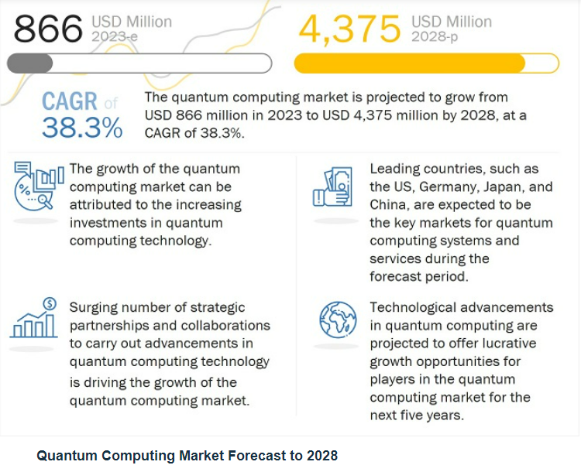
Quantum Computing: Market Share Projections

Slide 12
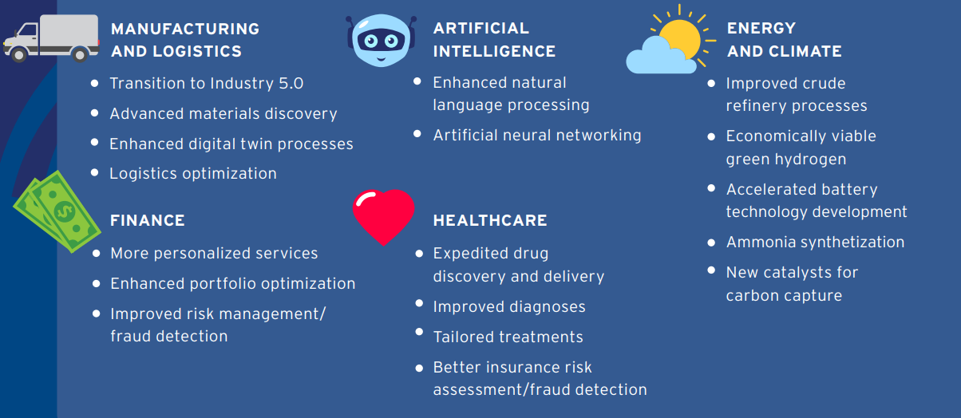
Quantum Computing Application Areas

Slide 13
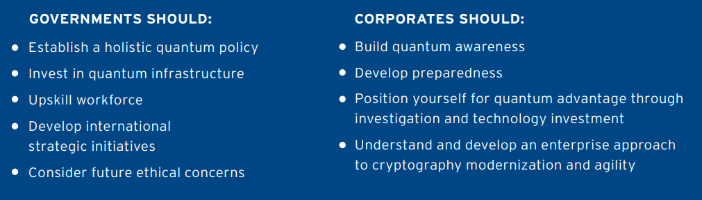
Preparing for the Quantum Era

Slide 14
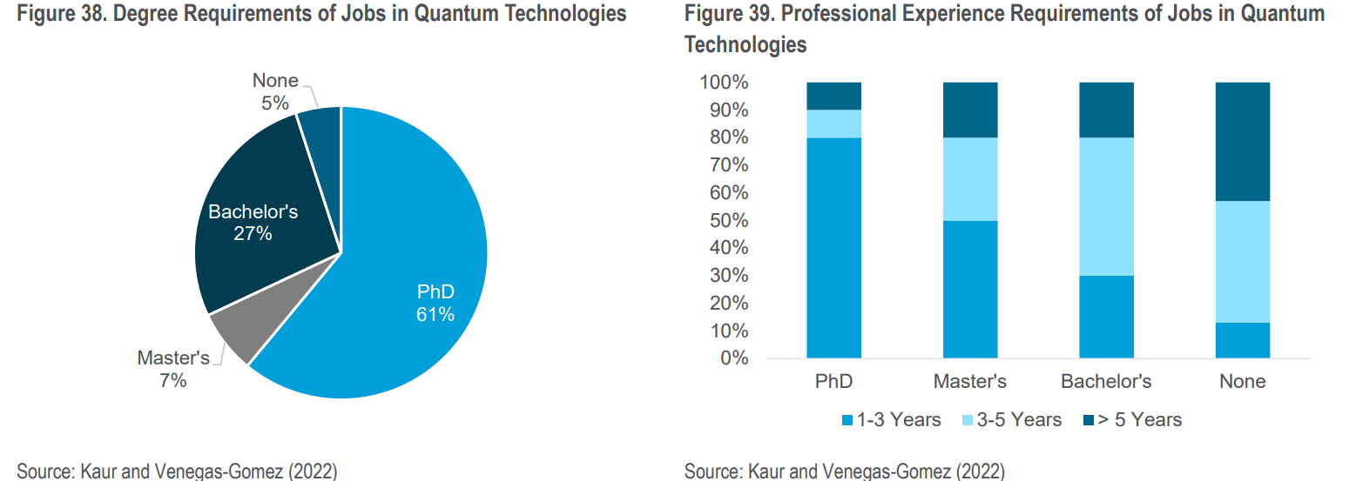
Degree Requirements for Jobs in QC

Slide 15
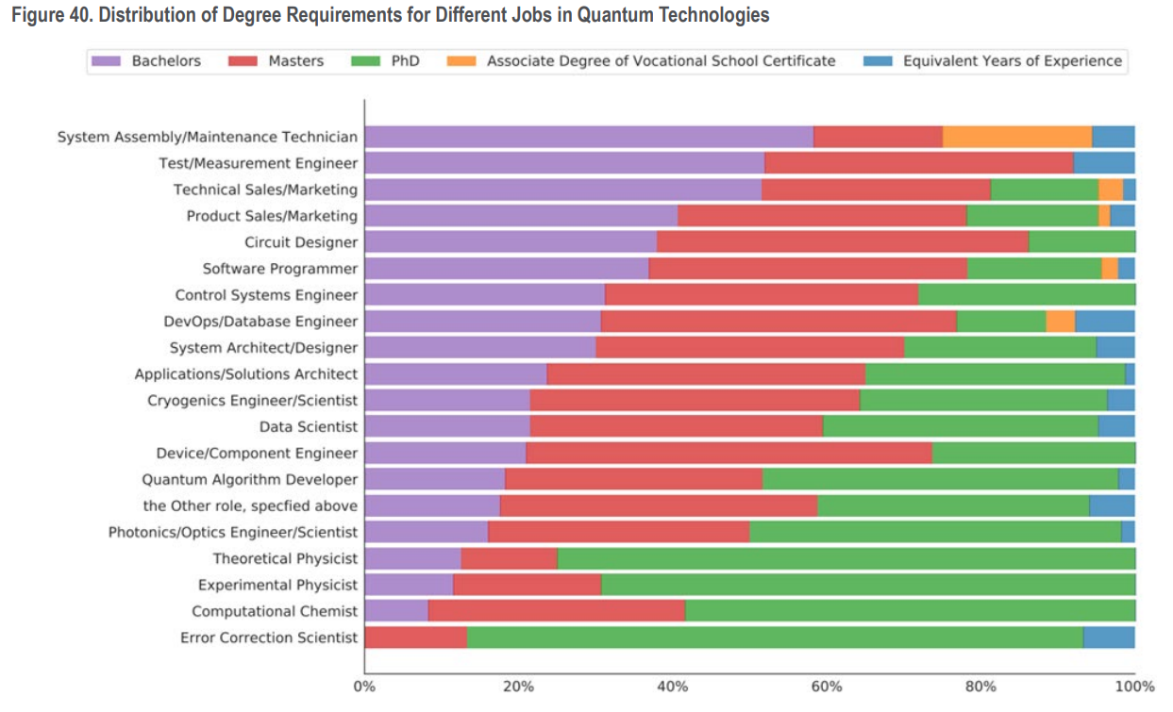

Slide 16
Conclusion
Quantum Computing will be widespread in the very near future.
Investments (financial) have already started.
It is up to you to invest in education in QC to reap the benefits.
Best of Luck!

