Slide 1
CS/PHYS-314/300: Quantum Computing Unit 01: Single Qubit Systems
Habib University – Shaping Futures
Faisal Alvi
(For any suggested modifications please email: faisal.alvi@sse.habib.edu.pk)

Slide 2
Unit Outline
Introduction to Classical Information
Classical Information States
Probabilistic States
Dirac Notation
Operations on Probabilistic States
[Reference] IBM Qiskit Textbook: Single Qubit Systems https://learn.qiskit.org/course/basics/single-systems

Slide 3
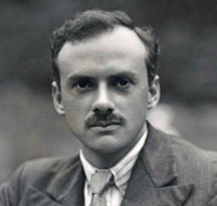
A Model of Classical Information
To comprehend quantum information, we will begin with a model of classical information.
Classical information is a familiar point of reference when studying quantum information.
Analogous to Quantum Information.
We also introduce the Dirac notation here.
Paul Dirac

Slide 4

Classical Information Systems
Consider the following classical information systems:
A bit that has states ‘0’ and ‘1’.
A six sided die that has digits ‘1’, ‘2’, ‘3’, ‘4’, ‘5’, ‘6’ on its faces.
A DNA strand with nucleotides: A, C, G and T.
A fan switch with states high, medium, low and off.

Slide 5
Classical Information Systems
Let X be the system under consideration and Σ be its set of states.
If X is a bit then Σ = {0, 1}.
If X is a six-sided die, then Σ = {1, 2, 3, 4, 5, 6}.
If X is a DNA strand, then Σ = {A, C, G, T}.
If X is a fan switch then Σ = {high, medium, low, off}.

Slide 6
State of a Classical Information System
Given a classical information system X, we may know the state of X with certainty.
For example in case of fan switch, we may know that the state is high.
However, often times, the state of X is unknown.
In such a scenario, we might assign probabilities to various states of X.
In case of a fan switch if it is known with certainty that the state is high, we assign a probability of 1 to high and 0 to all other states.

Slide 7


State of a Classical Information System
So for example, if X is a bit, then based on past information, we might assign the probability 3/4 to ‘0’ and 1/4 to ‘1’. That is:
Another way to represent this set of probabilities is using a column vector, i.e.,

Slide 8
Probabilistic States
A probabilistic state of a system can be represented as a vector of probabilities.
The probabilities can be ordered in any arbitrary way.
A column vector representing a probabilistic state must satisfy two properties:
All entries of the vector are nonnegative real numbers.
The sum of the entries is equal to 1.
Conversely, any column vector that satisfies these two properties can be taken as a representation of a probabilistic state.

Slide 9
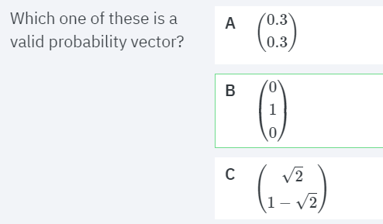
Quick Quiz

Slide 10
Measuring Probabilistic States
What happens if we measure a system when it is in a probabilistic state?
By measuring a system, we mean that we look at the system and unambiguously recognize whatever classical state it is in*
Measurement changes our knowledge of the system, and therefore changes the probabilistic state that we associate with that system.
* [Intuitively, we can never "see" a system in a probabilistic state; a measurement will yield exactly one of the allowed classical states]

Slide 11
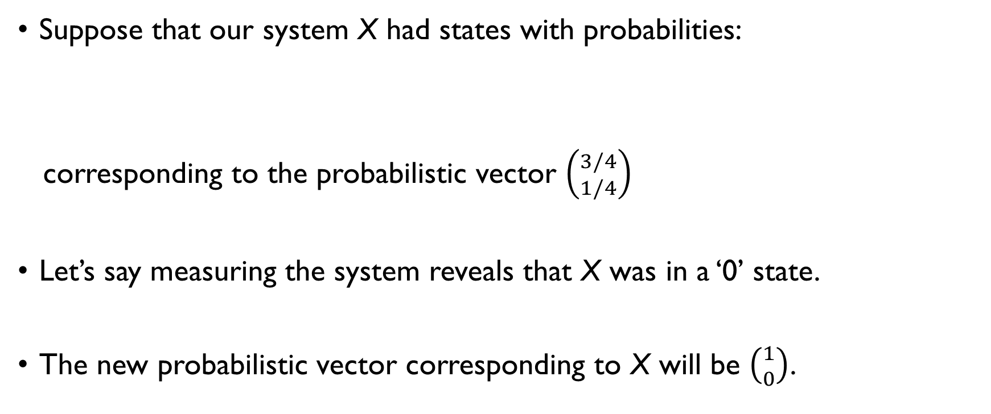
Measuring Probabilistic States.
Suppose that our system X had states with probabilities:
corresponding to the probabilistic vector $\left({3/4 \atop 1/4}\right)$
Let’s say measuring the system reveals that X was in a ‘0’ state.
The new probabilistic vector corresponding to X will be $\left({1 \atop 0}\right)$.

Slide 12
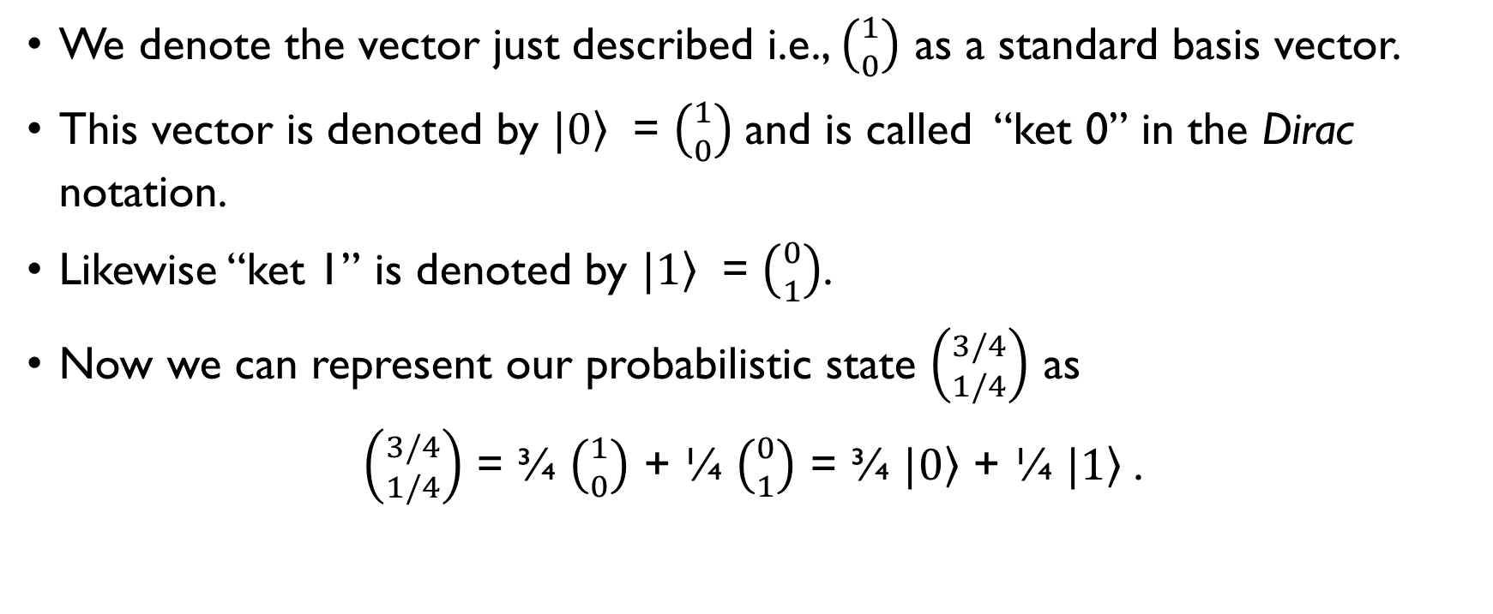
A Gentle Introduction to Dirac Notation
We denote the vector just described i.e., $\left({1 \atop 0}\right)$ as a standard basis vector.
This vector is denoted by $|\left.0\right\rangle$ = $\left({1 \atop 0}\right)$and is called “ket 0” in the Dirac notation.
Likewise “ket 1” is denoted by $|\left.1\right\rangle$ = $\left({0 \atop 1}\right)$.
Now we can represent our probabilistic state $\left({3/4 \atop 1/4}\right)$ as
$\left({3/4 \atop 1/4}\right)$ = ¾ $\left({1 \atop 0}\right)$ + ¼ $\left({0 \atop 1}\right)$ = ¾ $|\left.0\right\rangle$ + ¼ $|\left.1\right\rangle$.

Slide 13
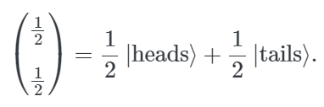
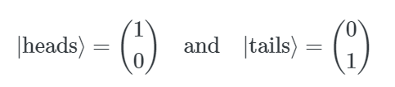
Another Example…
Suppose we flip a fair coin, but cover up the coin before looking at it. We would then say that its probabilistic state is:
where

Slide 14
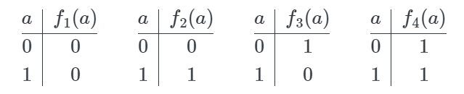
(Deterministic) Operations on States
Consider operations on classical information that transform one probabilistic state into another.
For example, if Σ = {0, 1}, we have the following functions f₁, f₂, f₃ and f₄ on a classical state a.
Note that f₁, and f₄ are constant; f₂, and f₃ are balanced.
Furthermore f₂ is the identity function and f₃ is the NOT function.

Slide 15
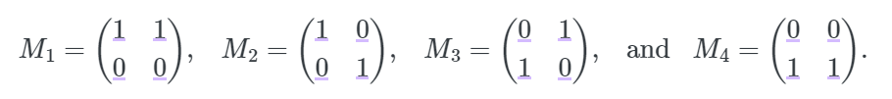
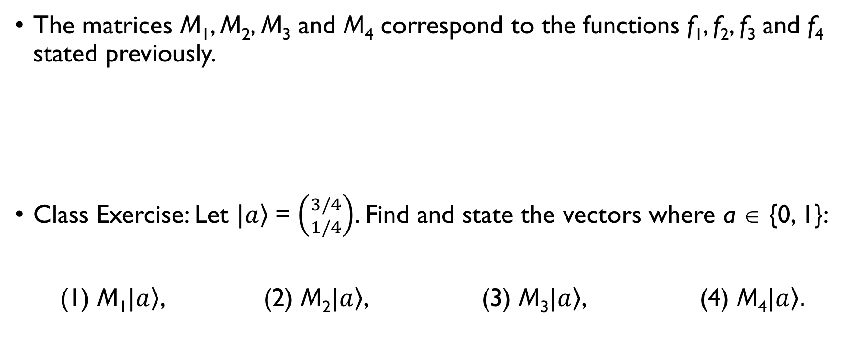
Operations on Classical Information
The matrices M₁, M₂, M₃ and M₄ correspond to the functions f₁, f₂, f₃ and f₄ stated previously.
Class Exercise: Let $|\left.a\right\rangle$= $\left({3/4 \atop 1/4}\right)$. Find and state the vectors where a ∈ {0, 1}:
(1) M₁$|\left.a\right\rangle$, (2) M₂$|\left.a\right\rangle$, (3) M₃$|\left.a\right\rangle$, (4) M₄$|\left.a\right\rangle .$

Slide 16
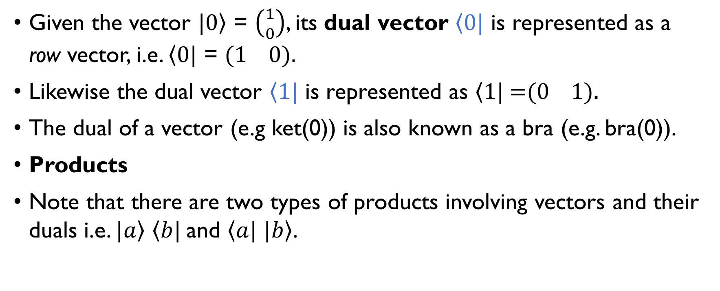
Dual of a Vector
Given the vector $|\left.0\right\rangle$ = $\left({1 \atop 0}\right)$, its dual vector $\left\langle 0\right.|$ is represented as a row vector, i.e. $\left\langle 0\right.|$ = (1 0).
Likewise the dual vector $\left\langle 1\right.|$ is represented as $\left\langle 1\right.|$ =(0 1).
The dual of a vector (e.g ket(0)) is also known as a bra (e.g. bra(0)).
Products
Note that there are two types of products involving vectors and their duals i.e. $|\left.a\right\rangle$ $\left\langle b\right.|$ and $\left\langle a\right.|$ $|\left.b\right\rangle$.

Slide 17

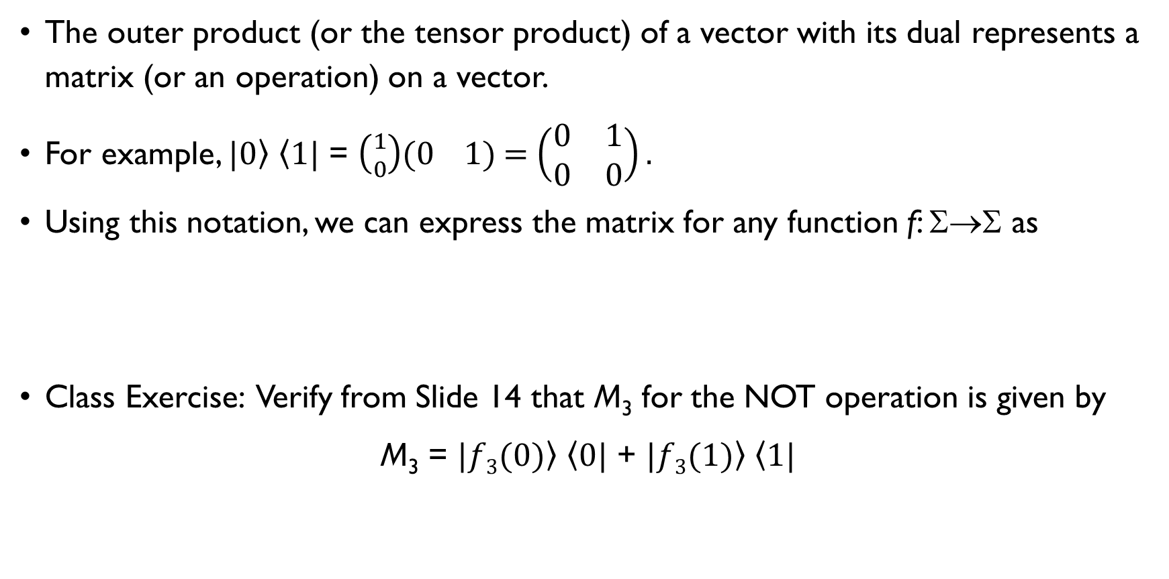
Vector Products: The Outer Product
The outer product (or the tensor product) of a vector with its dual represents a matrix (or an operation) on a vector.
For example, $|\left.0\right\rangle$ $\left\langle 1\right.|$ = $\left({1 \atop 0}\right)$(0 1) = $\left(\begin{matrix}0 & 1 \\ 0 & 0\end{matrix}\right).$
Using this notation, we can express the matrix for any function f: Σ→Σ as
Class Exercise: Verify from Slide 14 that M₃ for the NOT operation is given by
M₃ = $|\left.f3(0)\right\rangle$ $\left\langle 0\right.|$ + $|\left.f3(1)\right\rangle$ $\left\langle 1\right.|$

Slide 18
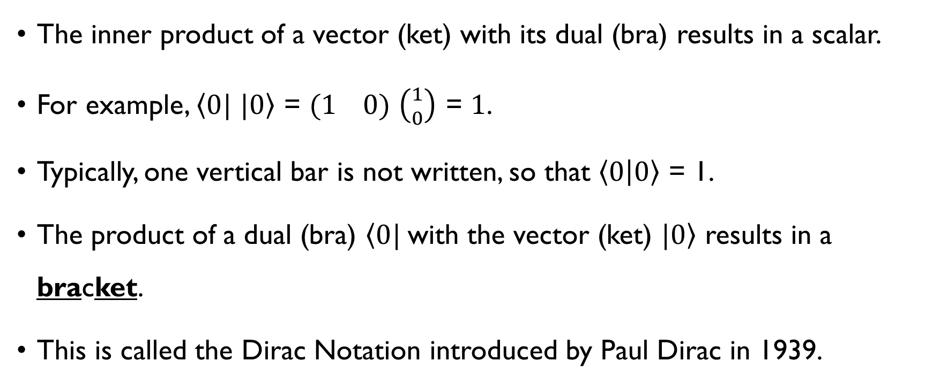
Vector Products: The Inner Product
The inner product of a vector (ket) with its dual (bra) results in a scalar.
For example, $\left\langle 0\right.|$ $|\left.0\right\rangle$ = (1 0) $\left({1 \atop 0}\right)$ = 1.
Typically, one vertical bar is not written, so that $\left\langle 0 | 0\right\rangle$ = 1.
The product of a dual (bra) $\left\langle 0\right.|$with the vector (ket) $|\left.0\right\rangle$ results in a bracket.
This is called the Dirac Notation introduced by Paul Dirac in 1939.

Slide 19

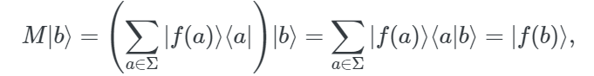
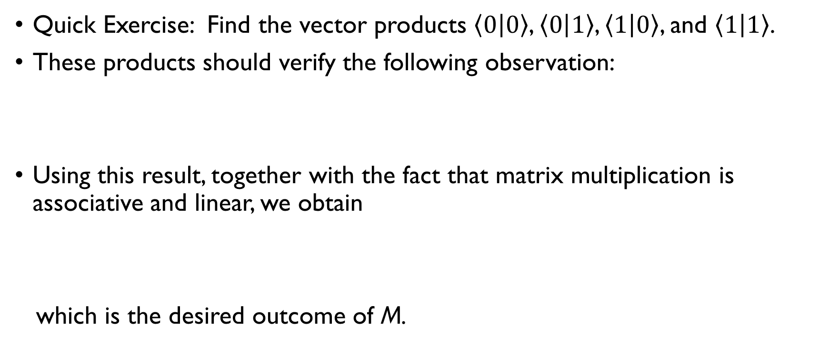
Vector Products: Some Results
Quick Exercise: Find the vector products $\left\langle 0 | 0\right\rangle$, $\left\langle 0 | 1\right\rangle$, $\left\langle 1 | 0\right\rangle$, and $\left\langle 1 | 1\right\rangle$.
These products should verify the following observation:
Using this result, together with the fact that matrix multiplication is associative and linear, we obtain
which is the desired outcome of M.

Slide 20
Summary
Classical Information can serve as a useful analogy for quantum information.
A classical information state can be represented by a probability vector.
Probability Vectors can be operated upon by operations which may be constant or balanced.
The Dirac Notation can be used to represent vectors and their duals.
Useful Results can be obtained by considering outer and inner products in the Dirac Notation.

Slide 21
Activities
Reading Assignment in Class.

