Slide 1
CS/PHYS-314/300: Quantum Computing Unit 02: Single Qubit Systems
Habib University – Shaping Futures
Faisal Alvi
(For any suggested modifications please email: faisal.alvi@sse.habib.edu.pk)

Slide 2
Unit Outline
Introduction to Quantum Information
Qubit
Measuring a Qubit
Unitary Operations
Summary
[Reference] IBM Qiskit Textbook: Single Qubit Systems https://learn.qiskit.org/course/basics/single-systems

Slide 3
A Model of Quantum Information
The previous unit on Classical Information lay the groundwork for quantum information.
Much of the notation utilized previously will be used with subtle differences.

Slide 4
A Model of Quantum Information
A quantum state of a system is represented by a column vector, similar to probabilistic states.
As before, the indices of the vector label the classical states of the system.
Vectors representing quantum states are characterized by these two properties:
The entries of a quantum state vector are complex numbers.
The sum of the absolute values squared of the entries of a quantum state vector must equal to 1.

Slide 5
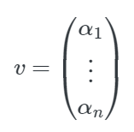
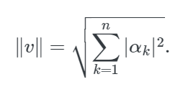
Euclidean Norm
The Euclidean norm of a vector
is given by:

Slide 6

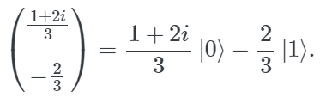
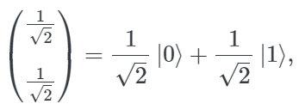
Qubit
The term qubit [quantum bit] refers to a quantum system whose classical state set is {0, 1}.
In simpler words, a qubit (a quantum bit) is a bit in a quantum state.
Some examples of qubit states are:

Slide 7




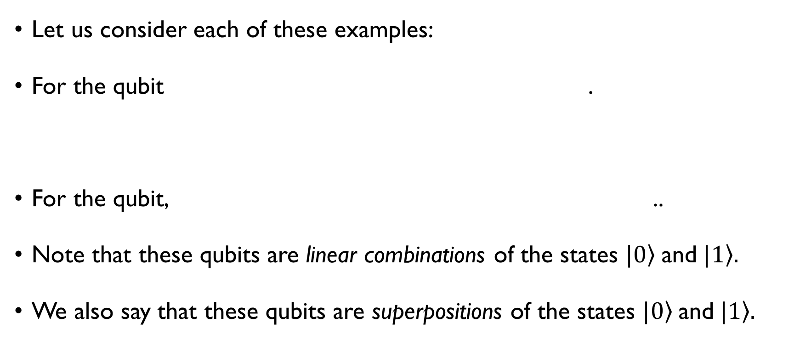
Qubit - Examples
Let us consider each of these examples:
For the qubit .
For the qubit, ..
Note that these qubits are linear combinations of the states $|\left.0\right\rangle$and $|\left.1\right\rangle .$
We also say that these qubits are superpositions of the states $|\left.0\right\rangle$and $|\left.1\right\rangle .$

Slide 8
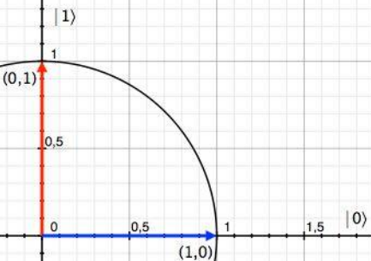
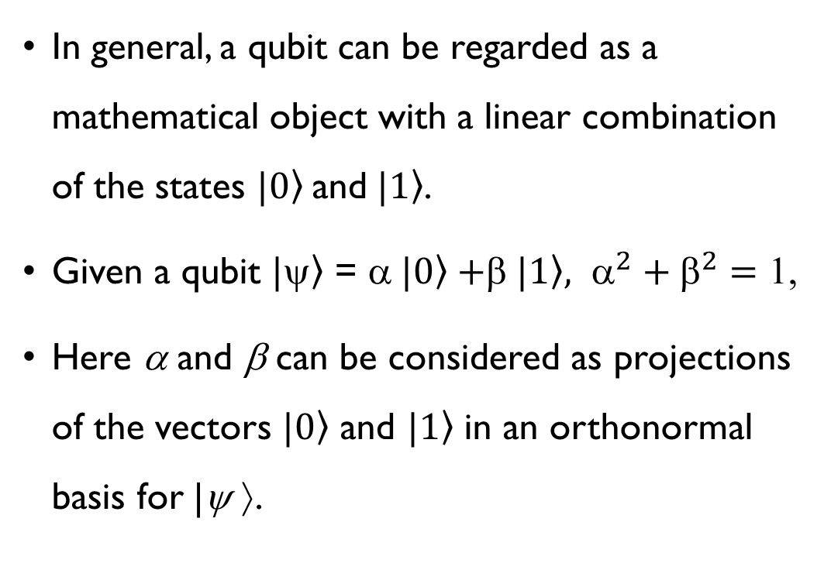
Qubit
In general, a qubit can be regarded as a mathematical object with a linear combination of the states $|\left.0\right\rangle$and $|\left.1\right\rangle$.
Given a qubit $|\left.\right\rangle$ = α$|\left.0\right\rangle +$β$|\left.1\right\rangle , α^{2}+β^{2}=$ 1,
Here α and β can be considered as projections of the vectors $|\left.0\right\rangle$ and $|\left.1\right\rangle$ in an orthonormal basis for |ψ ⟩.

Slide 9
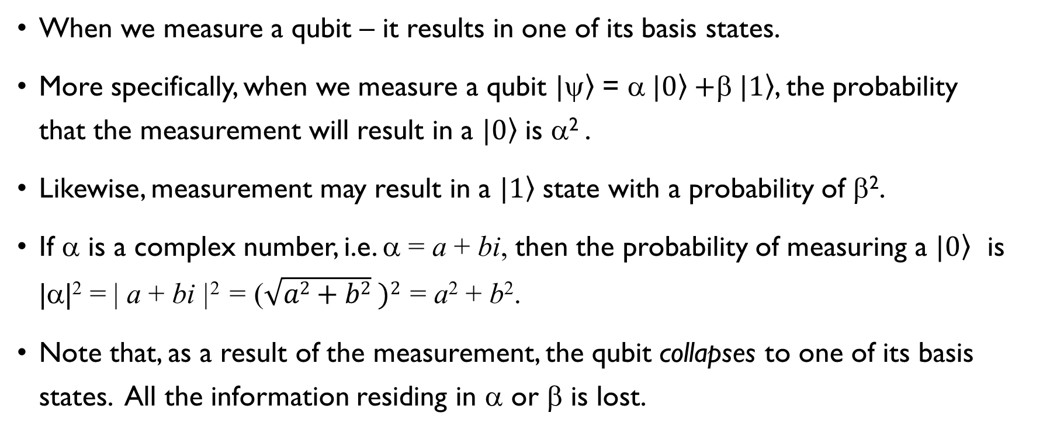
Measuring a qubit
When we measure a qubit – it results in one of its basis states.
More specifically, when we measure a qubit $|\left.\right\rangle$ = α$|\left.0\right\rangle +$β$|\left.1\right\rangle$, the probability that the measurement will result in a $|\left.0\right\rangle$ is α² .
Likewise, measurement may result in a $|\left.1\right\rangle$ state with a probability of β².
If α is a complex number, i.e. α = a + bi, then the probability of measuring a $|\left.0\right\rangle$ is |α|² = | a + bi |² = ($\sqrt{a2+b2} )2$ = a² + b².
Note that, as a result of the measurement, the qubit collapses to one of its basis states. All the information residing in α or β is lost.

Slide 10
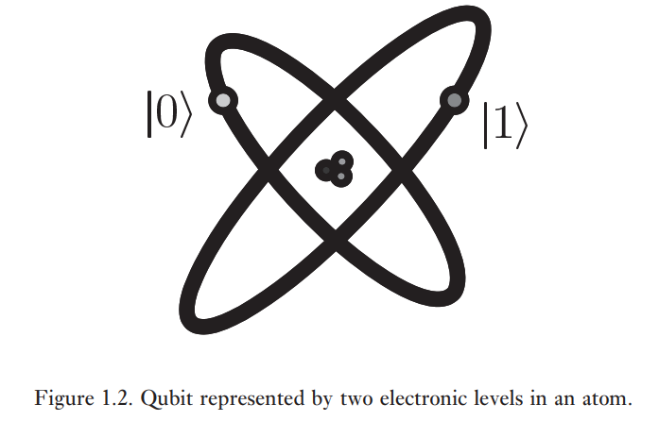
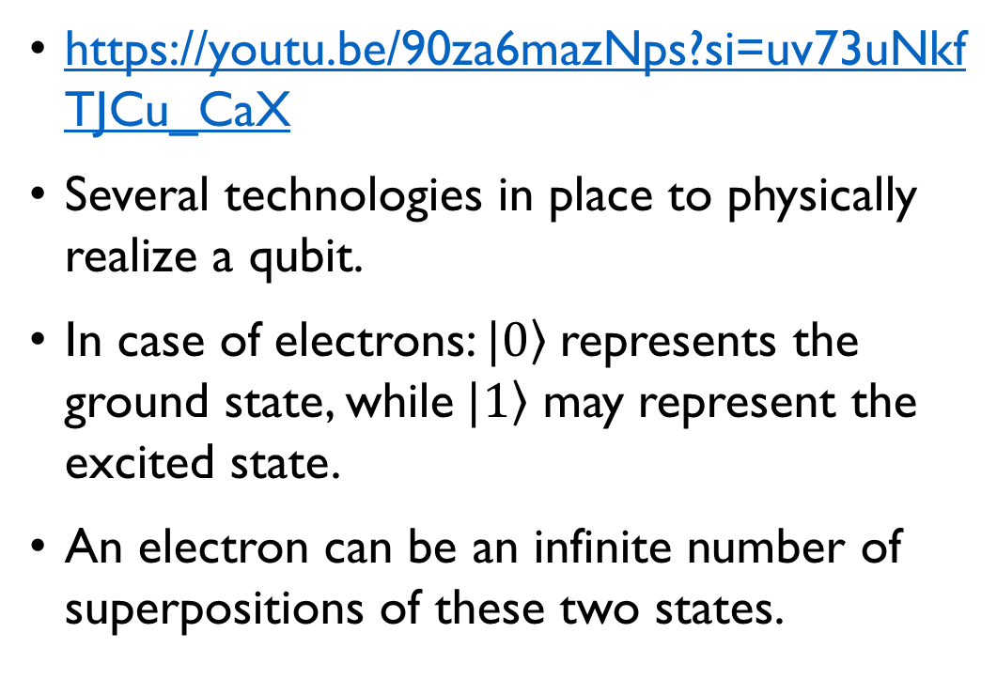
What is a qubit – physically?
https://youtu.be/90za6mazNps?si=uv73uNkfTJCu_CaX
Several technologies in place to physically realize a qubit.
In case of electrons: $|\left.0\right\rangle$represents the ground state, while$|\left.1\right\rangle$ may represent the excited state.
An electron can be an infinite number of superpositions of these two states.

Slide 11
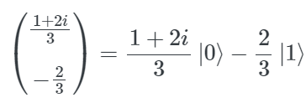

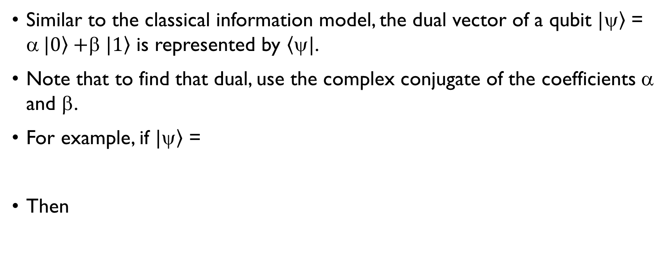
Dual of a Qubit
Similar to the classical information model, the dual vector of a qubit $|\left.\right\rangle$ = α$|\left.0\right\rangle +$β$|\left.1\right\rangle$ is represented by $\left\langle ψ\right.|$.
Note that to find that dual, use the complex conjugate of the coefficients α and β.
For example, if $|\left.\right\rangle$ =
Then

Slide 12
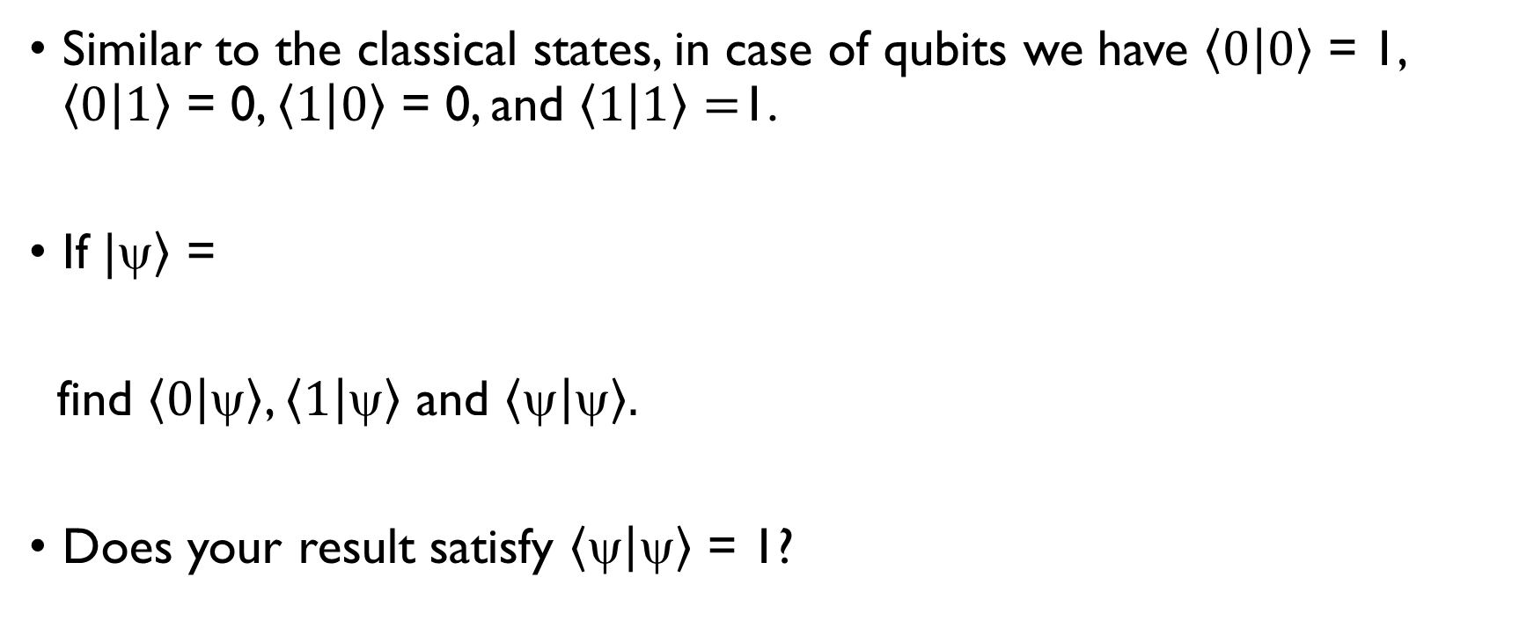
Some Class Exercises
Similar to the classical states, in case of qubits we have $\left\langle 0 | 0\right\rangle$ = 1, $\left\langle 0 | 1\right\rangle$ = 0, $\left\langle 1 | 0\right\rangle$ = 0, and $\left\langle 1 | 1\right\rangle =$1.
If $|\left.\right\rangle$ =
find $\left\langle 0 | \right\rangle$, $\left\langle 1 | \right\rangle$ and $\left\langle  | \right\rangle .$
Does your result satisfy $\left\langle  | \right\rangle$ = 1?

Slide 13
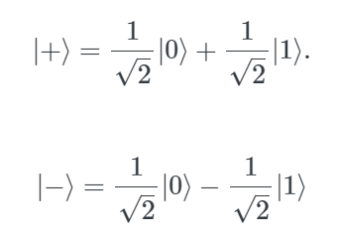
Special Quantum States (or Qubits)
The following states are special states and encountered frequently in quantum computing:

Slide 14
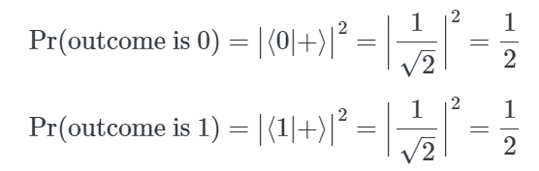
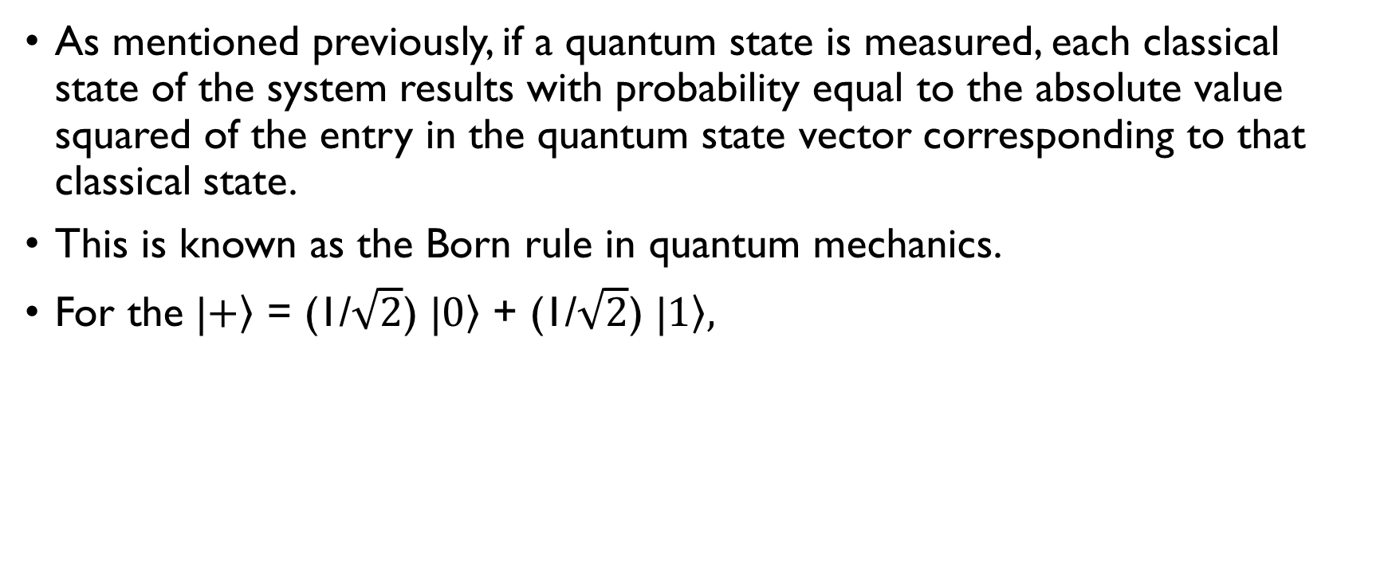

Measurement of |$\left.+\right\rangle$ and $|\left.−\right\rangle$
As mentioned previously, if a quantum state is measured, each classical state of the system results with probability equal to the absolute value squared of the entry in the quantum state vector corresponding to that classical state.
This is known as the Born rule in quantum mechanics.
For the |$\left.+\right\rangle$ = (1/$\sqrt{2}$) |$\left.0\right\rangle$ + (1/$\sqrt{2}$) |$\left.1\right\rangle ,$

Slide 15

Unitary Operations
Similar to the classical case, some types of operations can be applied on a quantum state.
These operations must be unitary operations.
A square matrix U with complex number entries is called a unitary matrix if it satisfies the following condition:
Here U† is the conjugate transpose of U, while 1 is the identity matrix.

Slide 16


Unitary Matrices
Some other properties of unitary matrices:
If U is a unitary matrix, then
Furthermore,

Slide 17

Unitary matrices represent valid operations
The condition that U is unitary is equivalent to the condition that multiplication by U does not change the Euclidean norm of any vector.
That is, an n x n matrix is unitary iff for every n-dimensional column vector with complex number entries,
Thus, multiplying a unitary matrix to a quantum state vector results in another quantum state vector.

Slide 18
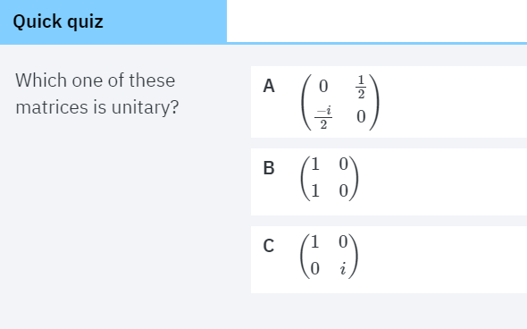
Quick Quiz

Slide 19
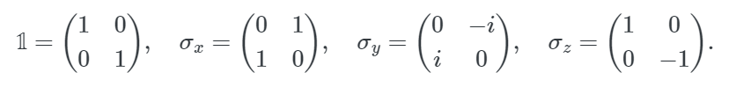
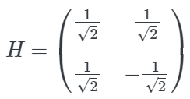

Some well know unitary matrices
Pauli Operations: The four well known Pauli matrices are:
Hadamard Operation: 3. Phase Operation:

Slide 20
Class Exercise
Verify that each of the operations presented in the previous slide is a unitary operation.

Slide 21
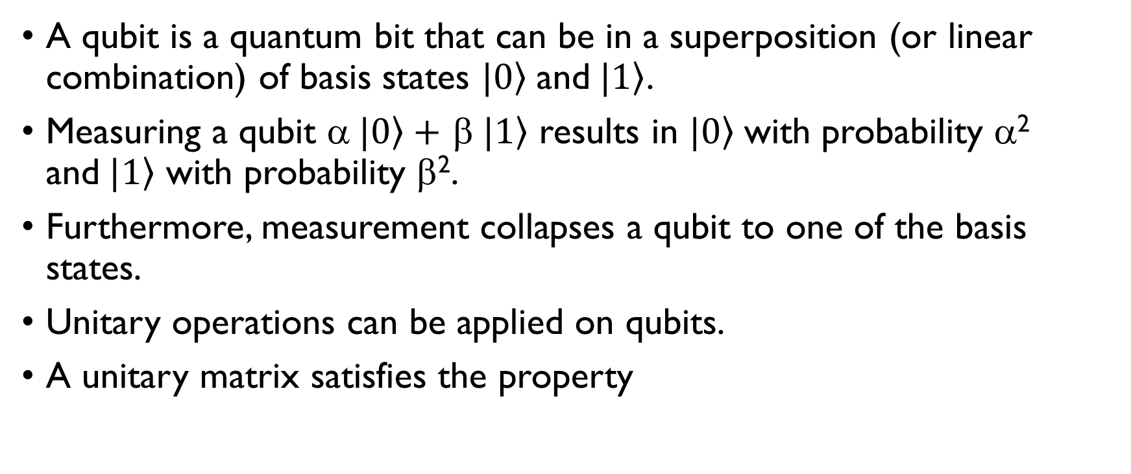
Summary
A qubit is a quantum bit that can be in a superposition (or linear combination) of basis states $|\left.0\right\rangle$and$|\left.1\right\rangle$.
Measuring a qubit α$|\left.0\right\rangle +$ β$|\left.1\right\rangle$ results in $|\left.0\right\rangle$with probability α² and$|\left.1\right\rangle$ with probability β².
Furthermore, measurement collapses a qubit to one of the basis states.
Unitary operations can be applied on qubits.
A unitary matrix satisfies the property

