Slide 1
CS/PHYS-314/300: Quantum Computing Unit 04: Multiple Qubit Systems
Habib University – Shaping Futures
Faisal Alvi
(For any suggested modifications please email: faisal.alvi@sse.habib.edu.pk)

Slide 2
Unit Outline
Multiple Qubit Systems
Total Measurement
Partial Measurement
Entanglement
Summary
[Reference] IBM Qiskit Textbook: Single Qubit Systems https://learn.qiskit.org/course/basics/single-systems

Slide 3
Multiple Qubit Systems
So far we have seen single qubit systems.
We have also studied
Operations (or Quantum Gates) that can be applied on single qubit systems
Bloch Sphere Representation of a Single Qubit.
In this unit we will study multiple qubit systems.
In particular, we will cover the idea of entanglement; as well as several other unitary gates involving multiple qubit systems.

Slide 4
Reading Activity
A good resource to get some background on this unit’s content is:
https://learn.qiskit.org/course/basics/multiple-systems [Section 1]
Section 1 talks about Classical Systems and illustrates several ideas used in Quantum Systems.
Furthermore, we will cover entanglement. A good illustrative video on entanglement is by the Perimeter Institute of Theoretical Physics: https://youtu.be/rqmIVeheTVU?si=VZOGrgpJKDKWHEJh

Slide 5


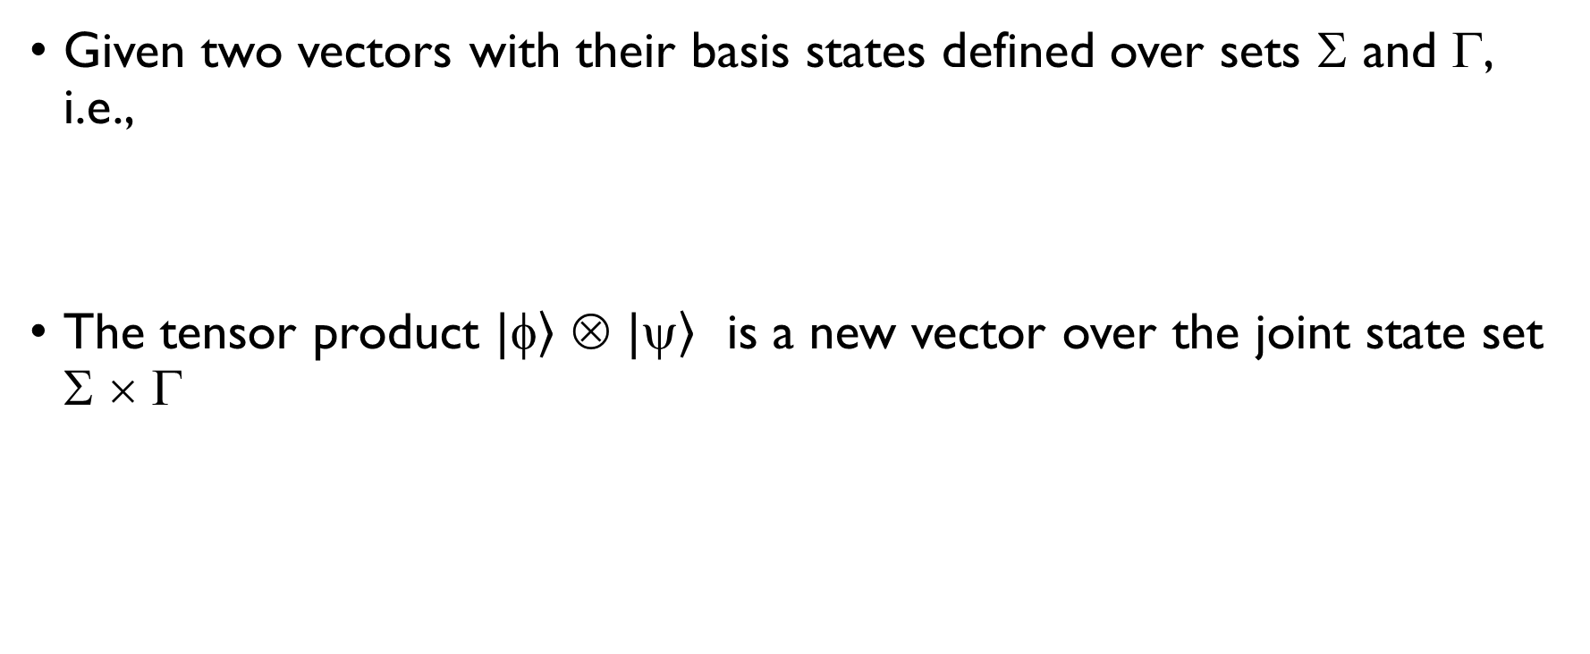
Tensor Products of Vectors
Given two vectors with their basis states defined over sets Σ and Γ, i.e.,
The tensor product $|\left.\right\rangle$ ⊗ $|\left.\right\rangle$ is a new vector over the joint state set Σ × Γ

Slide 6
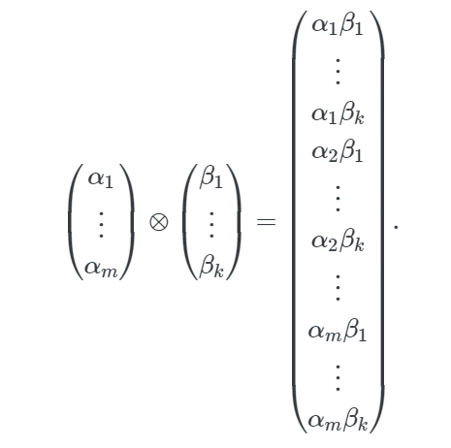
Tensor Products of Two Vectors

Slide 7
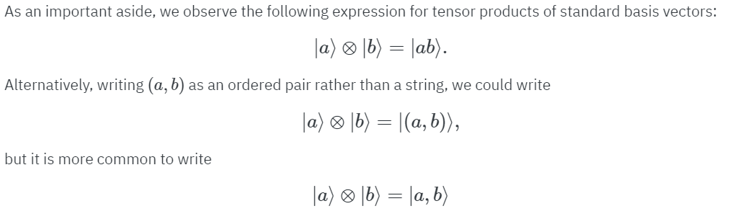
Ways to Express Tensor Products of Vectors

Slide 8
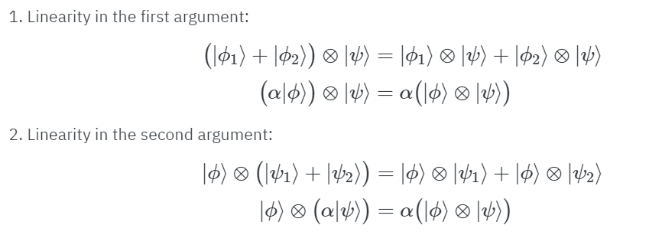
Linearity in Tensor Products of Vectors

Slide 9



Tensor Products of three or more systems
We can also have tensor products of 3 or more systems, i.e., such as
This can be defined by (a₁, a₂, …, a_{n} are basis vectors):
Recursively,

Slide 10
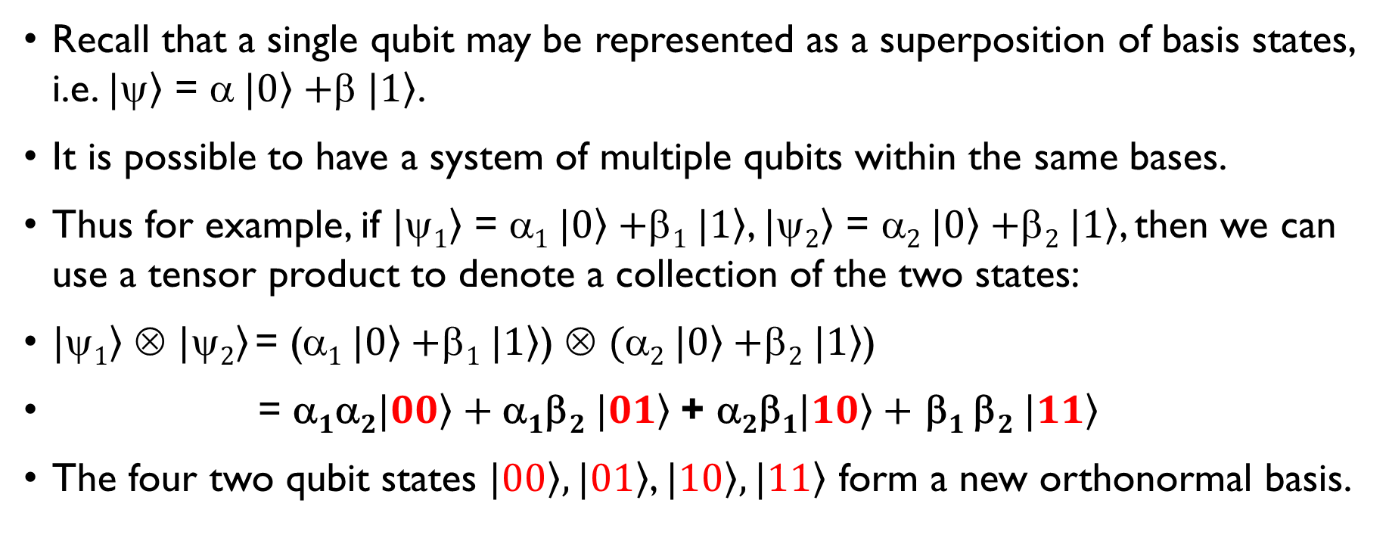
Multiple Qubit Systems
Recall that a single qubit may be represented as a superposition of basis states, i.e. $|\left.\right\rangle$ = α$|\left.0\right\rangle +$β$|\left.1\right\rangle$.
It is possible to have a system of multiple qubits within the same bases.
Thus for example, if $|\left.1\right\rangle$ = α$1 |\left.0\right\rangle +$β$1 |\left.1\right\rangle$, $|\left.2\right\rangle$ = α$2 |\left.0\right\rangle +$β$2 |\left.1\right\rangle$, then we can use a tensor product to denote a collection of the two states:
$|\left.1\right\rangle$ ⊗ $|\left.2\right\rangle$= (α$1 |\left.0\right\rangle +$β$1 |\left.1\right\rangle$) ⊗ $($α$2 |\left.0\right\rangle +$β$2 |\left.1\right\rangle$)
= α$1\text{α}2|\left.00\right\rangle +\text{α}1$β$2 |\left.01\right\rangle$ + α$2\text{β}1|\left.10\right\rangle +$ $\text{}1$β$2 |\left.11\right\rangle$
The four two qubit states $|\left.00\right\rangle , |\left.01\right\rangle$, $|\left.10\right\rangle , |\left.11\right\rangle$ form a new orthonormal basis.

Slide 11
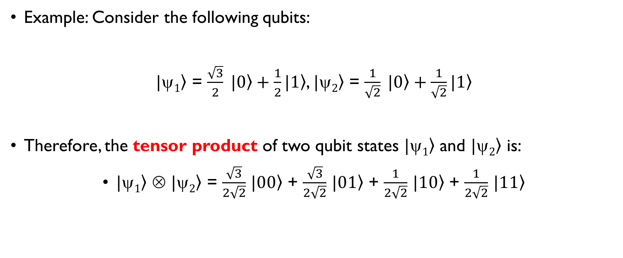
Multiple Qubit Systems
Example: Consider the following qubits:
$|\left.1\right\rangle$ = $\frac{\sqrt{3}}{2} |\left.0\right\rangle +\frac{1}{2}|\left.1\right\rangle$, $|\left.2\right\rangle$ = $\frac{1}{\sqrt{2}} |\left.0\right\rangle +\frac{1}{\sqrt{2}}|\left.1\right\rangle$
Therefore, the tensor product of two qubit states $|\left.1\right\rangle$ and $|\left.2\right\rangle$ is:
$|\left.1\right\rangle$ ⊗ $|\left.2\right\rangle$ = $\frac{\sqrt{3}}{2\sqrt{2}}$ $|\left.00\right\rangle$ + $\frac{\sqrt{3}}{2\sqrt{2}}$ $|\left.01\right\rangle$ + $\frac{1}{2\sqrt{2}}$ $|\left.10\right\rangle$ + $\frac{1}{2\sqrt{2}}$ $|\left.11\right\rangle$

Slide 12
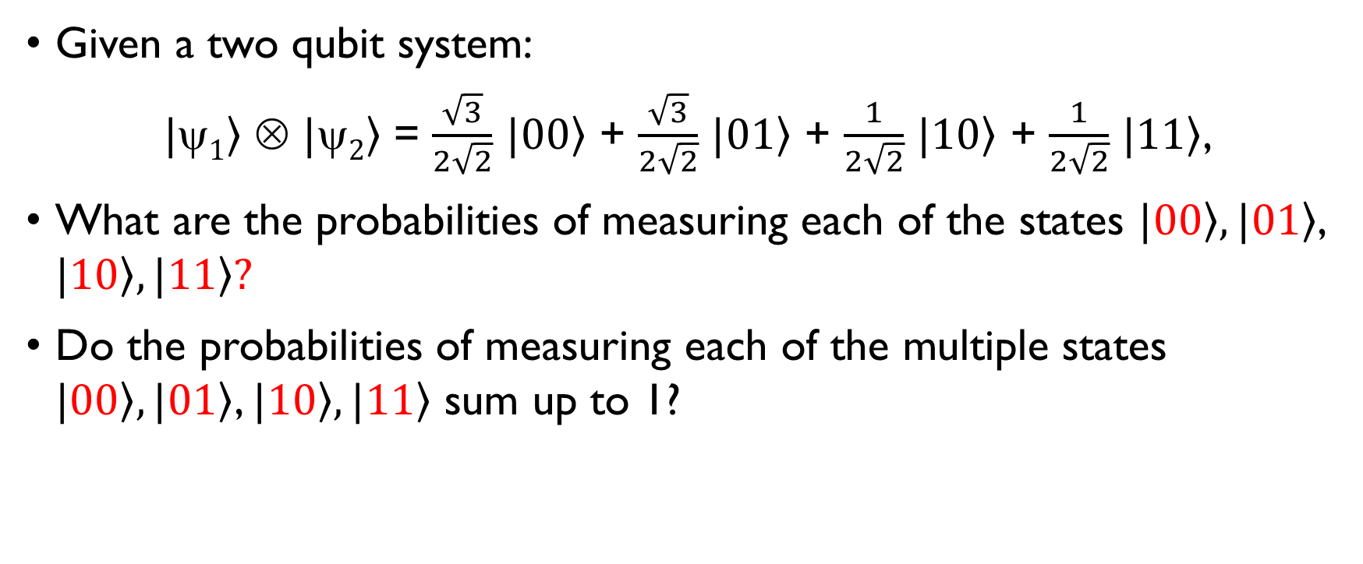
Multiple Qubit Systems
Given a two qubit system:
$|\left.1\right\rangle$ ⊗ $|\left.2\right\rangle$ = $\frac{\sqrt{3}}{2\sqrt{2}}$ $|\left.00\right\rangle$ + $\frac{\sqrt{3}}{2\sqrt{2}}$ $|\left.01\right\rangle$ + $\frac{1}{2\sqrt{2}}$ $|\left.10\right\rangle$ + $\frac{1}{2\sqrt{2}}$ $|\left.11\right\rangle$,
What are the probabilities of measuring each of the states $|\left.00\right\rangle , |\left.01\right\rangle$, $|\left.10\right\rangle , |\left.11\right\rangle ?$
Do the probabilities of measuring each of the multiple states $|\left.00\right\rangle , |\left.01\right\rangle$, $|\left.10\right\rangle , |\left.11\right\rangle$ sum up to 1?

Slide 13
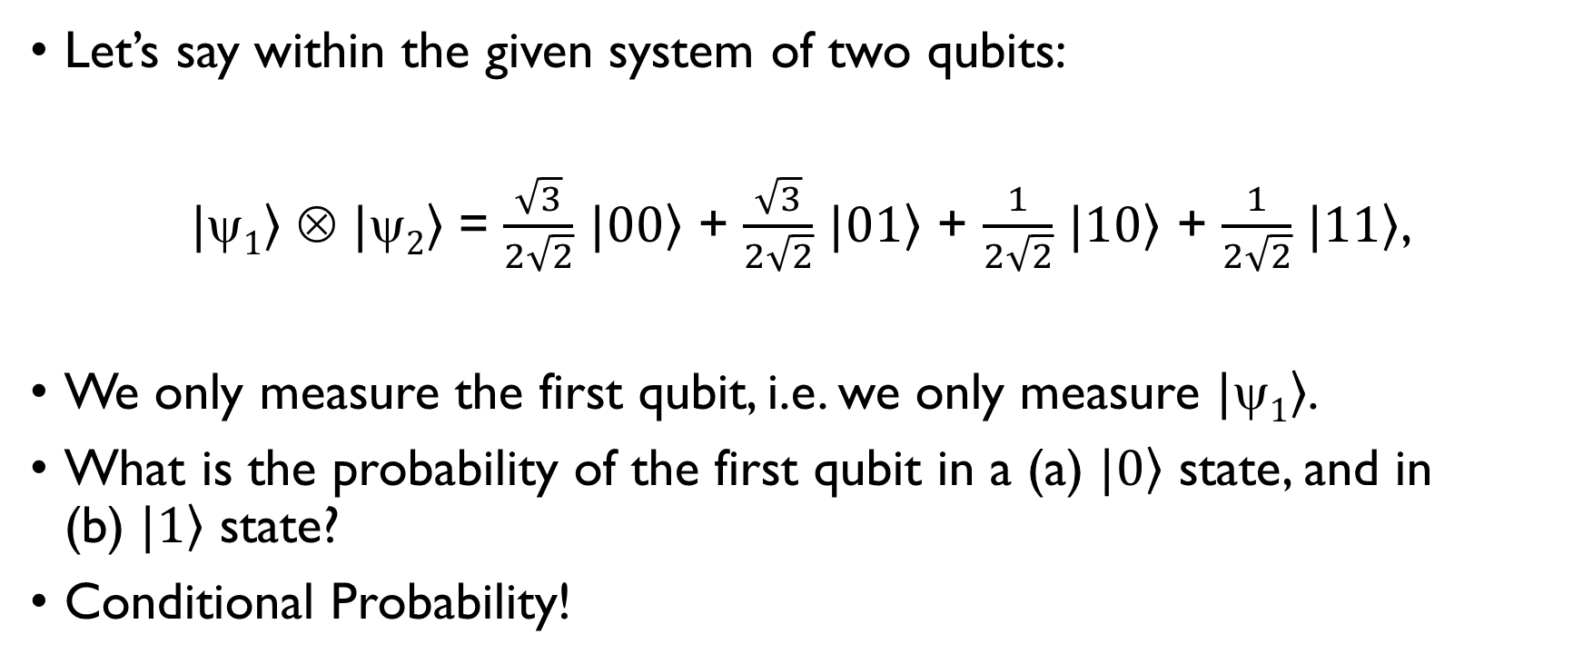
Partial Measurement
Let’s say within the given system of two qubits:
$|\left.1\right\rangle$ ⊗ $|\left.2\right\rangle$ = $\frac{\sqrt{3}}{2\sqrt{2}}$ $|\left.00\right\rangle$ + $\frac{\sqrt{3}}{2\sqrt{2}}$ $|\left.01\right\rangle$ + $\frac{1}{2\sqrt{2}}$ $|\left.10\right\rangle$ + $\frac{1}{2\sqrt{2}}$ $|\left.11\right\rangle$,
We only measure the first qubit, i.e. we only measure $|\left.1\right\rangle$.
What is the probability of the first qubit in a (a) $|\left.0\right\rangle$ state, and in (b) $|\left.1\right\rangle$ state?
Conditional Probability!

Slide 14
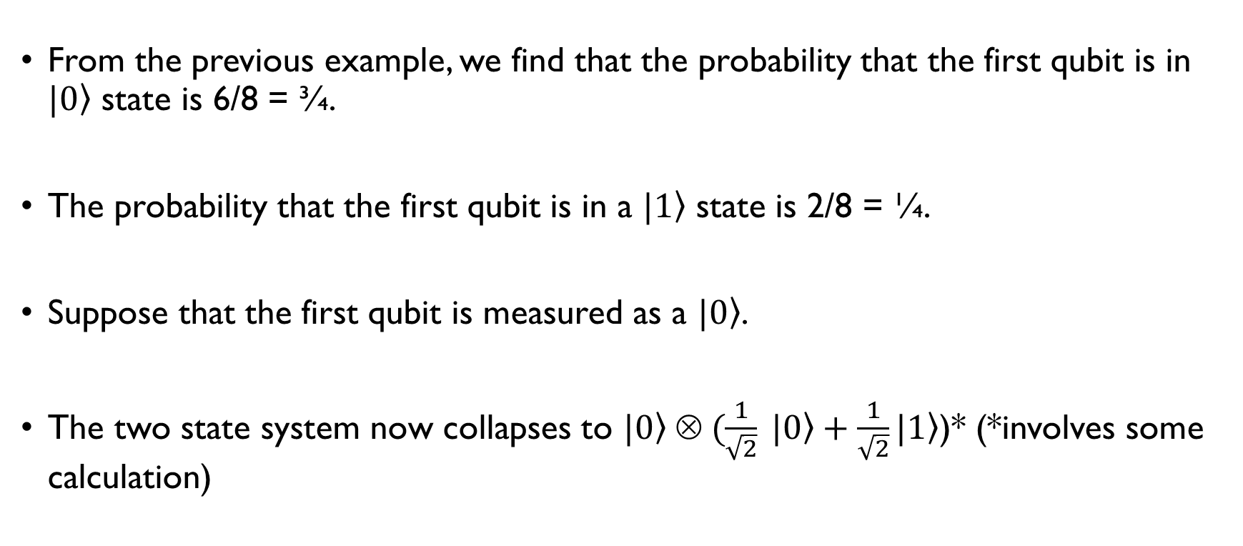
Partial Measurement
From the previous example, we find that the probability that the first qubit is in $|\left.0\right\rangle$ state is 6/8 = ¾.
The probability that the first qubit is in a $|\left.1\right\rangle$ state is 2/8 = ¼.
Suppose that the first qubit is measured as a $|\left.0\right\rangle$.
The two state system now collapses to $|\left.0\right\rangle ⊗ (\frac{1}{\sqrt{2}} |\left.0\right\rangle +\frac{1}{\sqrt{2}}|\left.1\right\rangle$)* (*involves some calculation)

Slide 15
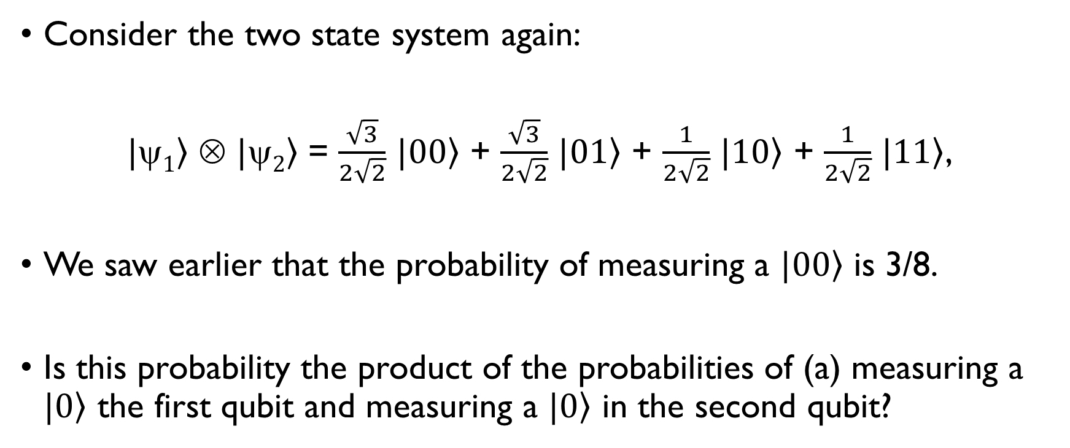
Partial Measurement
Consider the two state system again:
$|\left.1\right\rangle$ ⊗ $|\left.2\right\rangle$ = $\frac{\sqrt{3}}{2\sqrt{2}}$ $|\left.00\right\rangle$ + $\frac{\sqrt{3}}{2\sqrt{2}}$ $|\left.01\right\rangle$ + $\frac{1}{2\sqrt{2}}$ $|\left.10\right\rangle$ + $\frac{1}{2\sqrt{2}}$ $|\left.11\right\rangle$,
We saw earlier that the probability of measuring a $|\left.00\right\rangle$ is 3/8.
Is this probability the product of the probabilities of (a) measuring a $|\left.0\right\rangle$ the first qubit and measuring a $|\left.0\right\rangle$ in the second qubit?

Slide 16
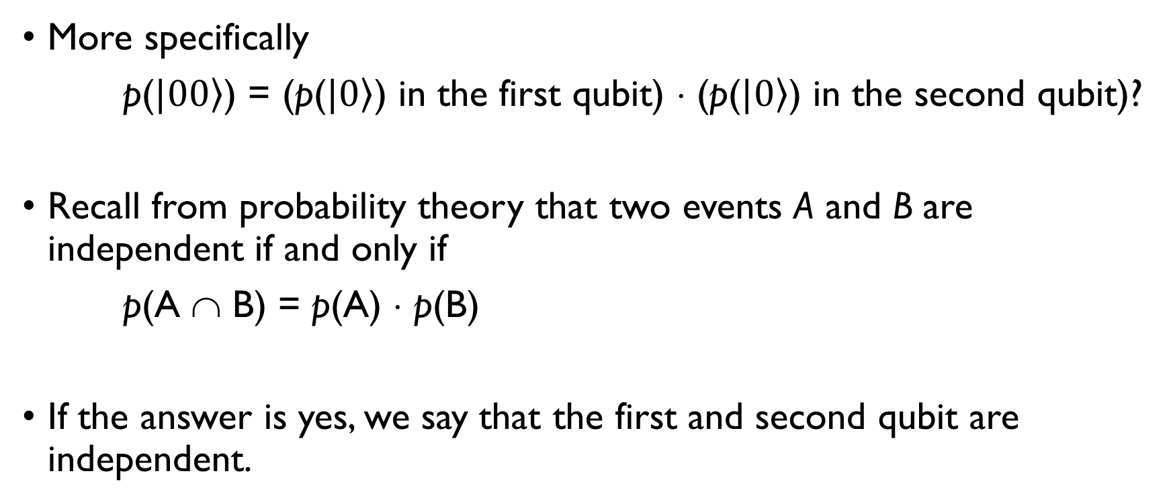
Partial Measurement
More specifically
p($|\left.00\right\rangle$) = (p($|\left.0\right\rangle$) in the first qubit) ⋅ (p($|\left.0\right\rangle$) in the second qubit)?
Recall from probability theory that two events A and B are independent if and only if
p(A ∩ B) = p(A) ⋅ p(B)
If the answer is yes, we say that the first and second qubit are independent.

Slide 17
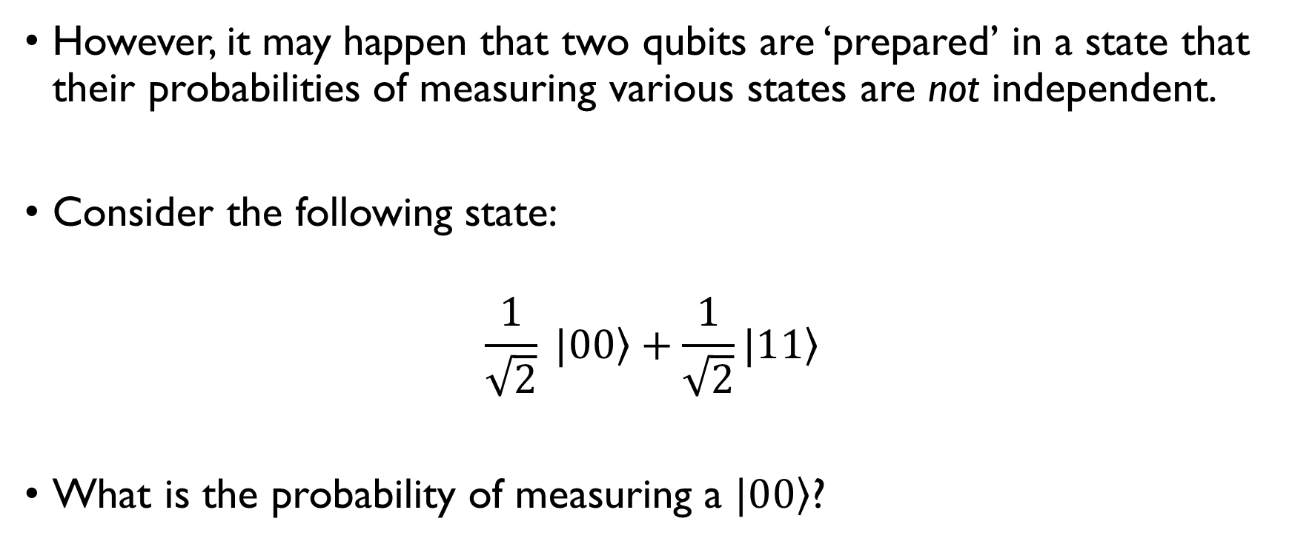
Entanglement
However, it may happen that two qubits are ‘prepared’ in a state that their probabilities of measuring various states are not independent.
Consider the following state:
$$\frac{1}{\sqrt{2}} |0\left.0\right\rangle +\frac{1}{\sqrt{2}}|1\left.1\right\rangle$$
What is the probability of measuring a $|0\left.0\right\rangle$?

Slide 18
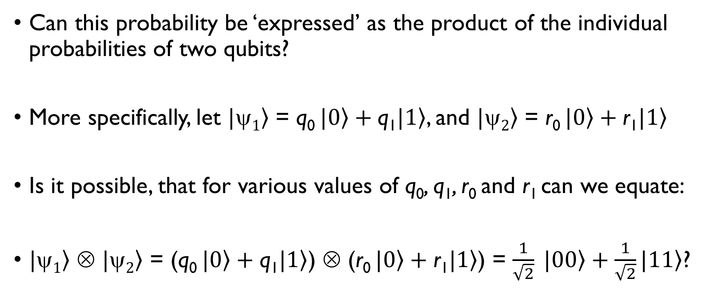
Entanglement
Can this probability be ‘expressed’ as the product of the individual probabilities of two qubits?
More specifically, let $|\left.1\right\rangle$ = q₀ $|\left.0\right\rangle +\text{q}\text{1}|\left.1\right\rangle$, and $|\left.2\right\rangle$ = r₀ $|\left.0\right\rangle +\text{r}\text{1}|\left.1\right\rangle$
Is it possible, that for various values of q₀, $\text{q}\text{1}$, r₀ and $\text{r}\text{1}$can we equate:
$|\left.1\right\rangle$ ⊗ $|\left.2\right\rangle$ = (q₀ $|\left.0\right\rangle +\text{q}\text{1}|\left.1\right\rangle$) ⊗ (r₀ $|\left.0\right\rangle +\text{r}\text{1}|\left.1\right\rangle$) = $\frac{1}{\sqrt{2}} |0\left.0\right\rangle +\frac{1}{\sqrt{2}}|1\left.1\right\rangle$?

Slide 19
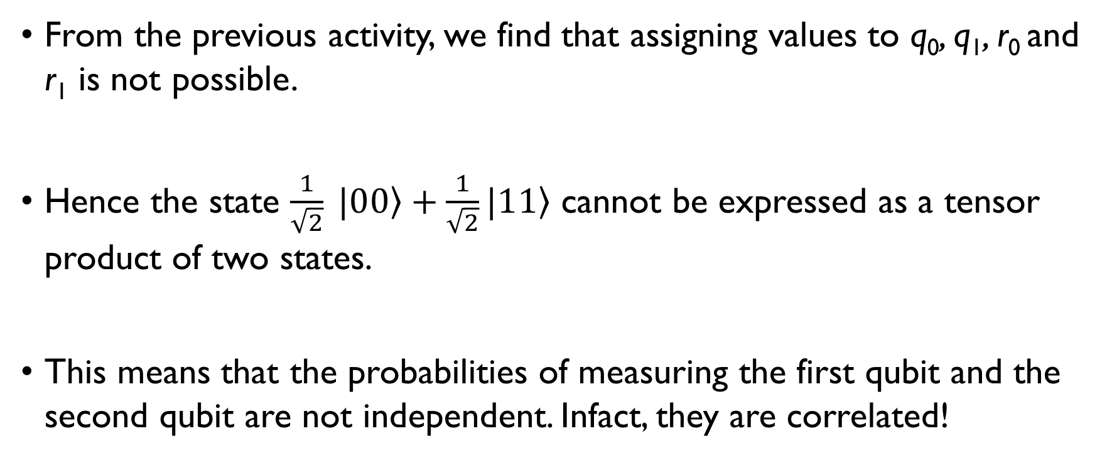
Entanglement
From the previous activity, we find that assigning values to q₀, $\text{q}\text{1}$, r₀ and $\text{r}\text{1}$ is not possible.
Hence the state $\frac{1}{\sqrt{2}} |0\left.0\right\rangle +\frac{1}{\sqrt{2}}|1\left.1\right\rangle$ cannot be expressed as a tensor product of two states.
This means that the probabilities of measuring the first qubit and the second qubit are not independent. Infact, they are correlated!

Slide 20
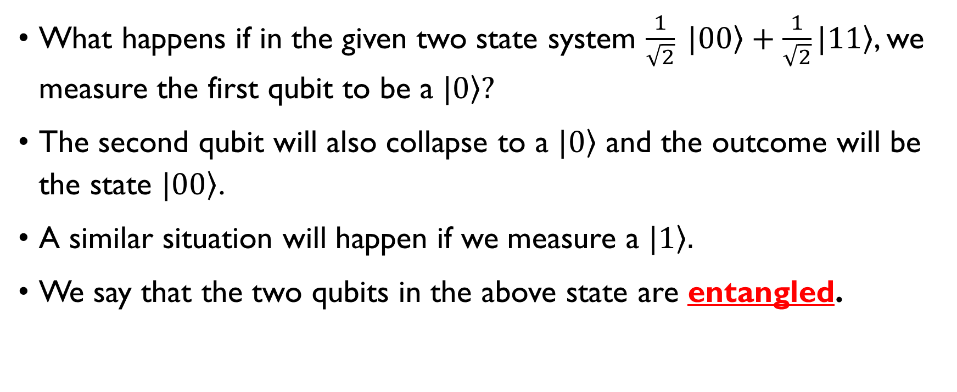
Entanglement
What happens if in the given two state system $\frac{1}{\sqrt{2}} |0\left.0\right\rangle +\frac{1}{\sqrt{2}}|1\left.1\right\rangle$, we measure the first qubit to be a $|\left.0\right\rangle ?$
The second qubit will also collapse to a $|\left.0\right\rangle$ and the outcome will be the state $|0\left.0\right\rangle$.
A similar situation will happen if we measure a $|\left.1\right\rangle .$
We say that the two qubits in the above state are entangled.

Slide 21
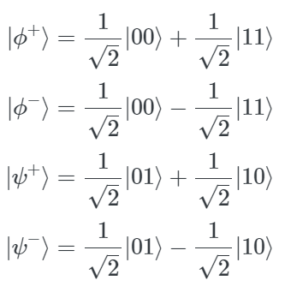
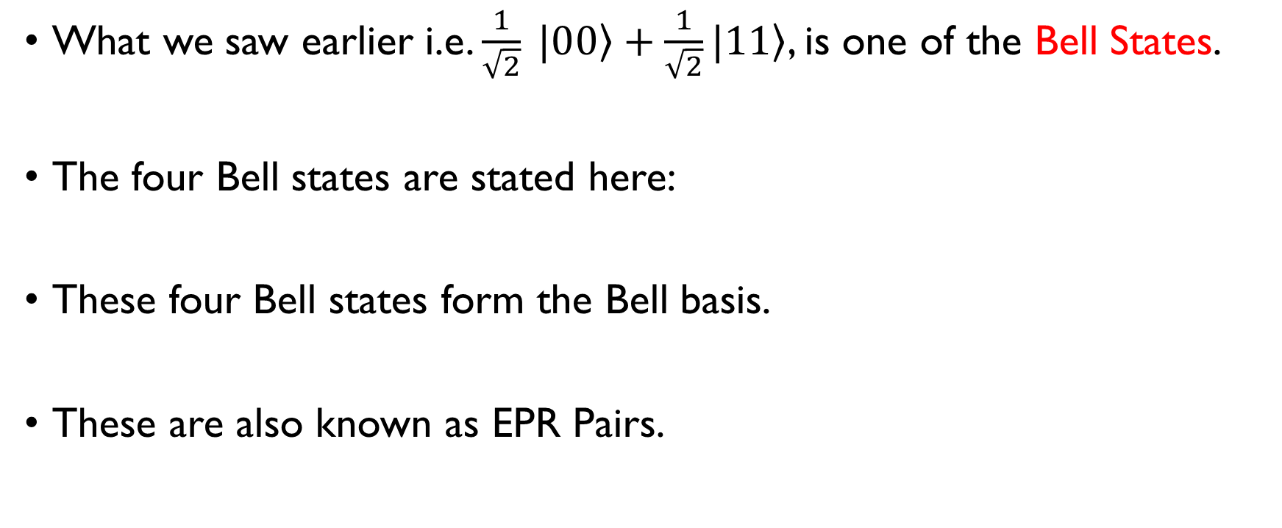
Bell States
What we saw earlier i.e. $\frac{1}{\sqrt{2}} |0\left.0\right\rangle +\frac{1}{\sqrt{2}}|1\left.1\right\rangle$, is one of the Bell States.
The four Bell states are stated here:
These four Bell states form the Bell basis.
These are also known as EPR Pairs.

Slide 22
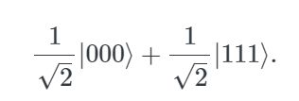

Other Examples of Entangled States
The GHZ State:
The W-State:

Slide 23

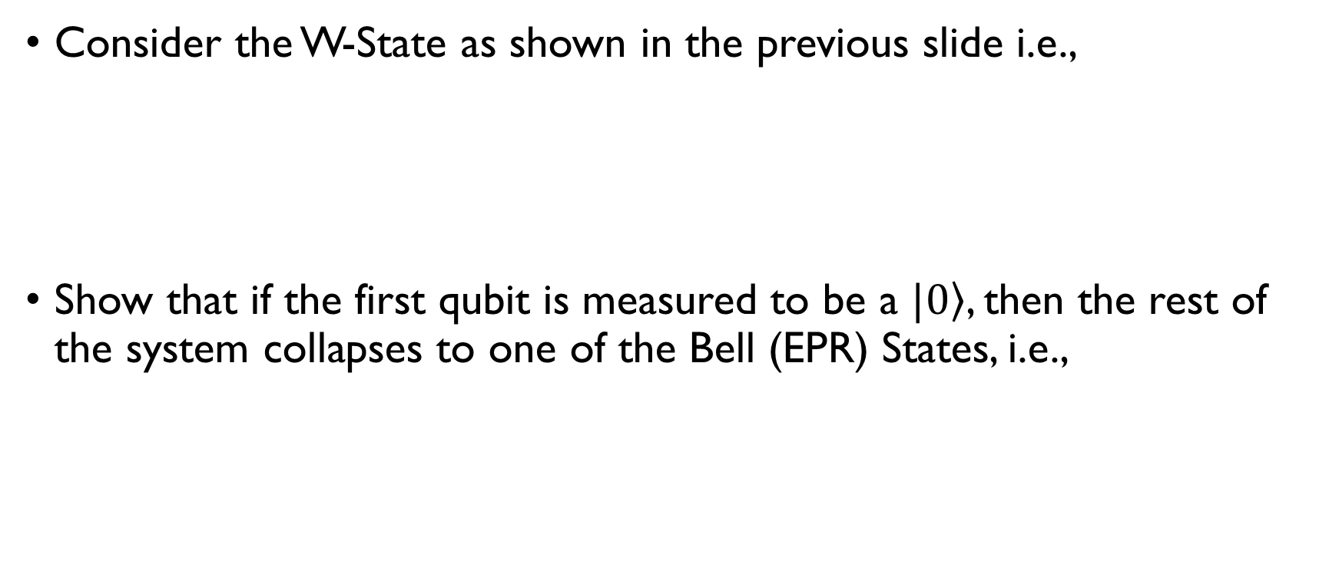
Class Exercise
Consider the W-State as shown in the previous slide i.e.,
Show that if the first qubit is measured to be a $|\left.0\right\rangle$, then the rest of the system collapses to one of the Bell (EPR) States, i.e.,

Slide 24
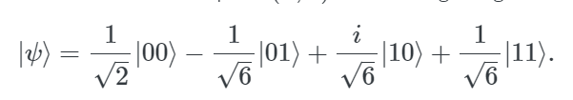
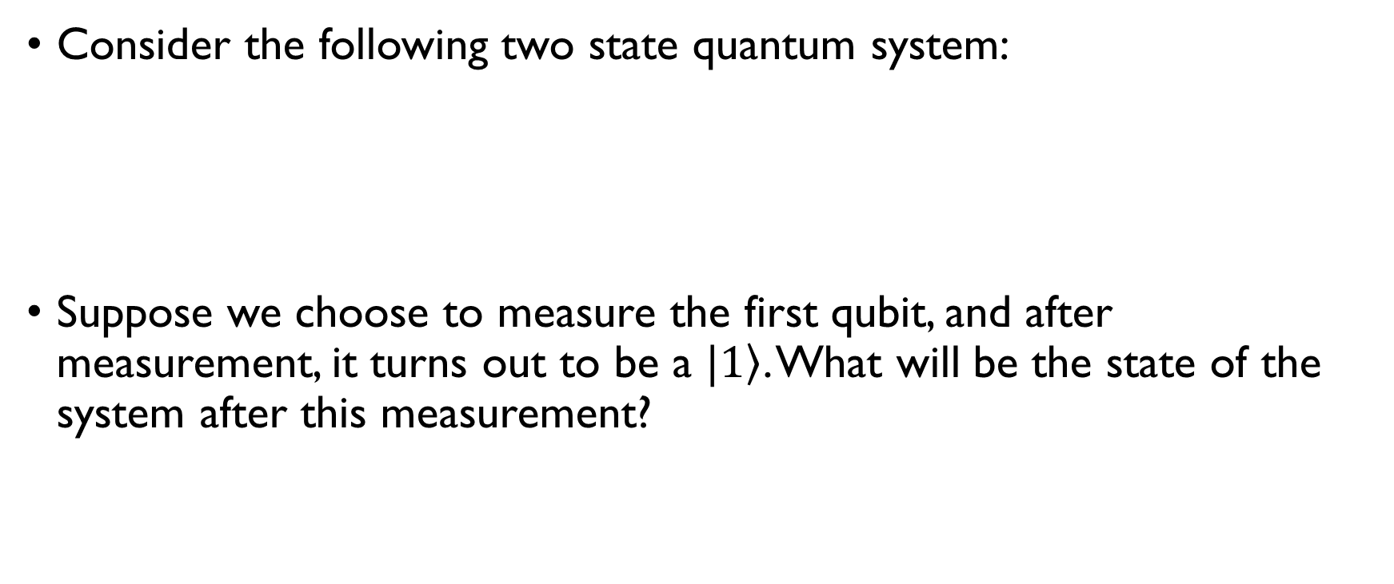
Class Exercise
Consider the following two state quantum system:
Suppose we choose to measure the first qubit, and after measurement, it turns out to be a $|\left.1\right\rangle$. What will be the state of the system after this measurement?

Slide 25
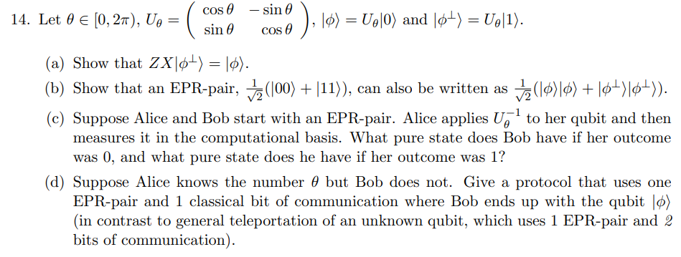
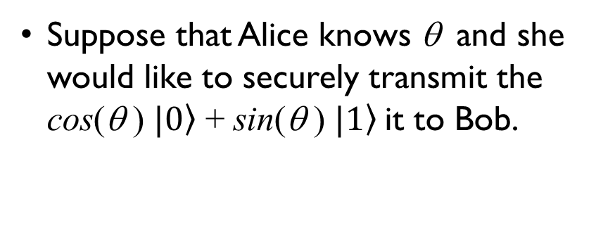
An Application of the EPR States: Class Activity
Suppose that Alice knows θ and she would like to securely transmit the cos(θ ) $|\left.0\right\rangle$ + sin(θ ) $|\left.1\right\rangle$it to Bob.
Using an EPR state and an agreed upon protocol, she can transmit this qubit to Bob by transmitting just one bit!

Slide 26
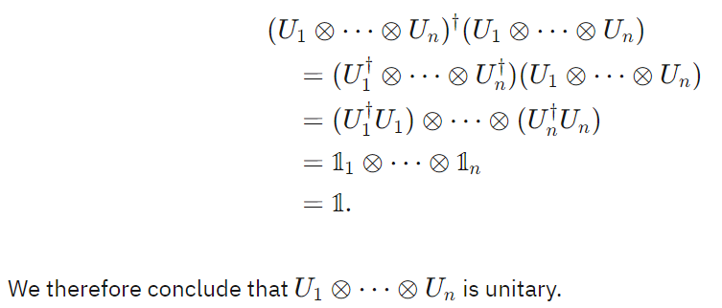
Tensor Product of Unitary Matrices
If U₁, U₂, U₃, … are unitary matrices, then their tensor product is also unitary. More specifically, U₁ ⊗ U₂ ⊗ U₃ ⊗ … U_{n} .
Proof:

Slide 27
Performing Operations on Subsystems
An important situation that often arises is one in which a unitary operation is applied to just one qubit within a larger quantum system.
For example, given two qubits X and Y, we apply a Hadamard operation on X, but do nothing to Y.
That is, "doing nothing" to Y is equivalent to performing the identity operation on Y.

Slide 28
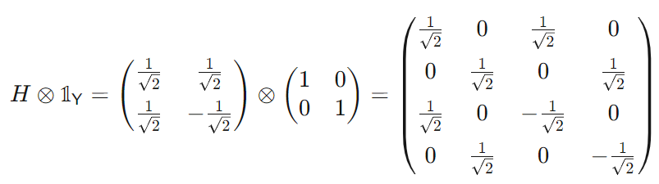
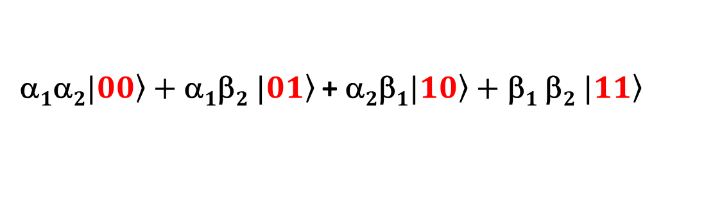
Performing Operations on Subsystems (contd).
Consider the following two qubit system:
Performing a Hadamard on the 1st qubit and doing nothing to the 2nd is equivalent to applying:
α$1\text{α}2|\left.00\right\rangle +\text{α}1$β$2 |\left.01\right\rangle$ + α$2\text{β}1|\left.10\right\rangle +$ $\text{}1$β$2 |\left.11\right\rangle$

Slide 29
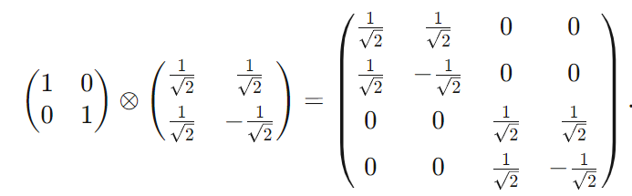
Performing Operations on Subsystems (contd.)
Consider the following two qubit system again:
Doing nothing to the 1st qubit and performing Hadamard to the 2nd is equivalent to applying:
α$1\text{α}2|\left.00\right\rangle +\text{α}1$β$2 |\left.01\right\rangle$ + α$2\text{β}1|\left.10\right\rangle +$ $\text{}1$β$2 |\left.11\right\rangle$

Slide 30

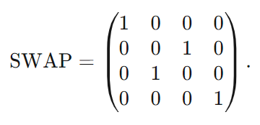

The SWAP Operation
The SWAP operation (for a 2-state system) swaps the contents of the first and the second qubits:
Can be written as:

Slide 31
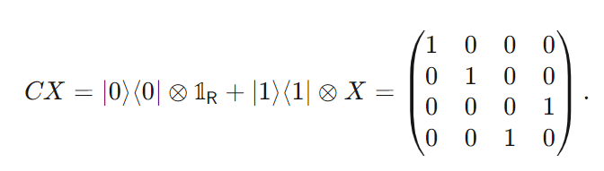

The Controlled NOT (CNOT) Operation
The controlled-NOT operation flips the 2nd qubit if the first qubit is a $|\left.1\right\rangle$, else it leaves the 2nd qubit unchanged.

Slide 32
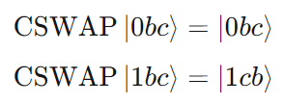
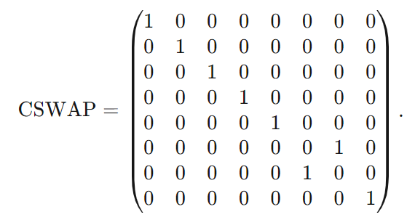
The Fredekin Operation

Slide 33
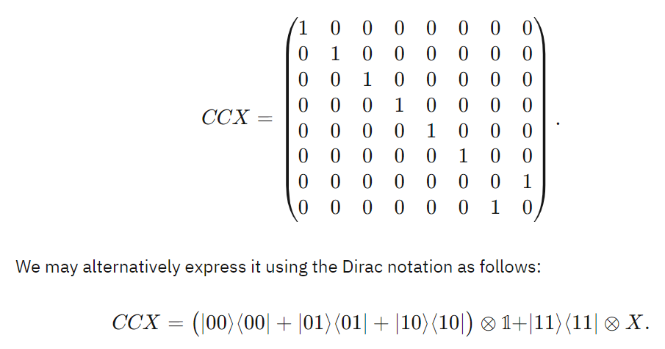
The TOFFOLI Operation

Slide 34
Summary
Multiple Quantum Bits can represent product states which are tensor products of vectors.
They may also represent entangled states, which can be considered as correlated qubits.
Bell States or EPR States represent a basic form of entangled qubits.
Operations (or gates) can be applied to individual qubits.
Some of the more common gates are the SWAP, Fredekin and TOFFOLI gates.

