Slide 1
CS/PHYS-314/300: Quantum Computing Unit 05: Quantum Circuits
Habib University – Shaping Futures
Faisal Alvi
(For any suggested modifications please email: faisal.alvi@sse.habib.edu.pk)

Slide 2
Unit Outline
The Quantum Circuit Model
Basic Quantum Gates
Quantum Gate Symbols
The No-Cloning Theorem
Summary

Slide 3
The Quantum Circuit Model of Computation
The quantum circuit model of computation is a standard description of quantum computations.
In computer science, circuits are models of computation in which information is carried by wires through a network of gates, which represent operations that transform the information carried by the wires.
Quantum circuits are just one example of a model of computation based on this more general concept.

Slide 4
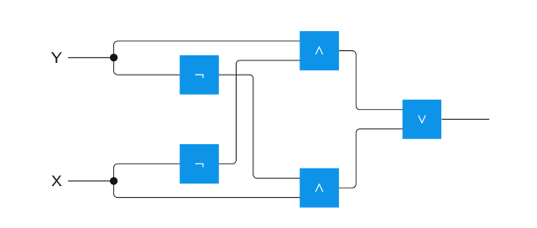
Boolean Circuits

Slide 5

Quantum Circuits
In the quantum circuit model, wires represent qubits and gates represent operations acting on these qubits.
Operations are:
Unitary operations,
Measurement.
Example of a Quantum Circuit:

Slide 6


Quantum Circuit
This circuit represents X $( |\left.\right\rangle$) = $T H S H ( |\left.ψ\right\rangle$ )
The output when $|\left.\right\rangle$ = $|\left.0\right\rangle$is shown in the figure.

Slide 7
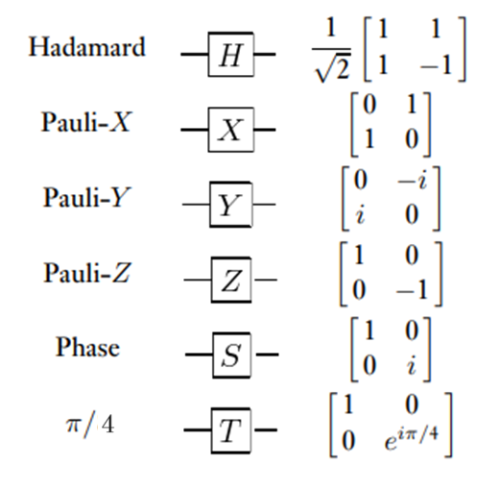
Some Quantum Gates and their symbols

Slide 8

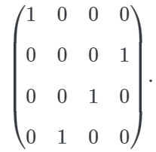
Gate Symbols: The CNOT Gate
The controlled-NOT
Caution! At some places in the Qiskit book, the order of bits is replaced. This results in a controlled-NOT operation being represented by

Slide 9

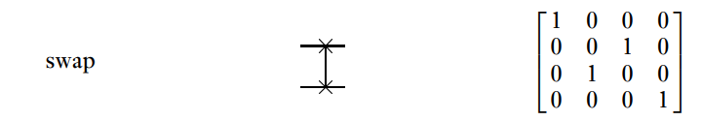
Gate Symbols: The SWAP Gate
Recall from the previous slide set that the swap operation swaps two qubits, i.e.

Slide 10
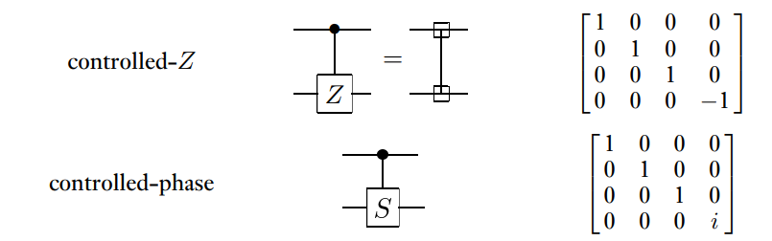
Gate Symbols: More “Controlled” Gates

Slide 11
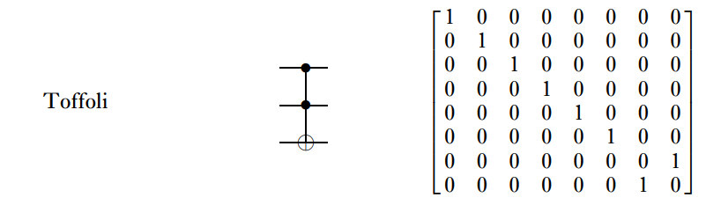
Gate Symbols: The TOFFOLI Gate

Slide 12
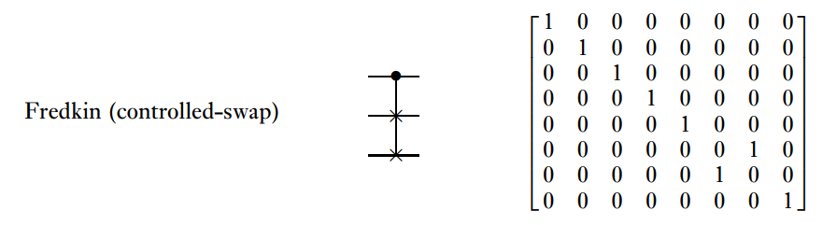
Gate Symbols: The Fredekin Gate

Slide 13
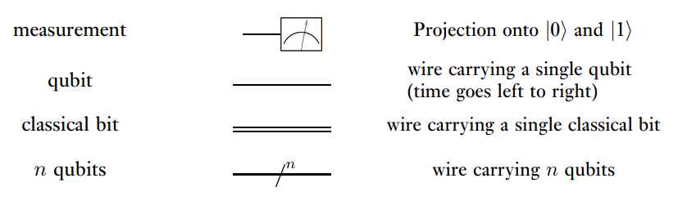
More Symbols

Slide 14
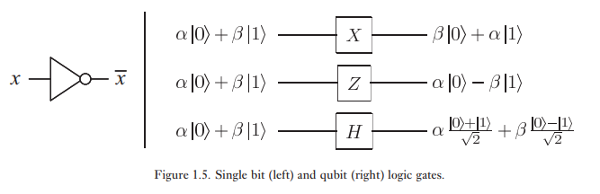
Basic Gate Operations

Slide 15
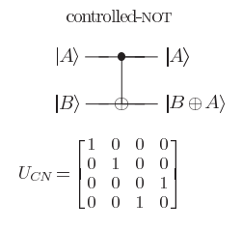

Gate Operations: Controlled-NOT

Slide 16
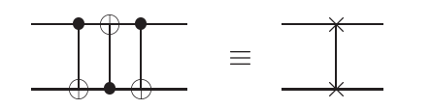

Gate Operations – SWAP Using CNOT
Class Exercise: (a) Use various inputs i.e. ($|\left.00\right\rangle$, $|\left.01\right\rangle$, $|\left.10\right\rangle$, $|\left.11\right\rangle$) to verify the above identity. (b) Use matrices to prove the above identity.

Slide 17
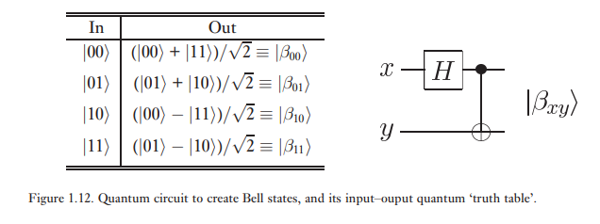
Gate Operations: Bell (EPR) States Using Hadamard and CNOT

Slide 18
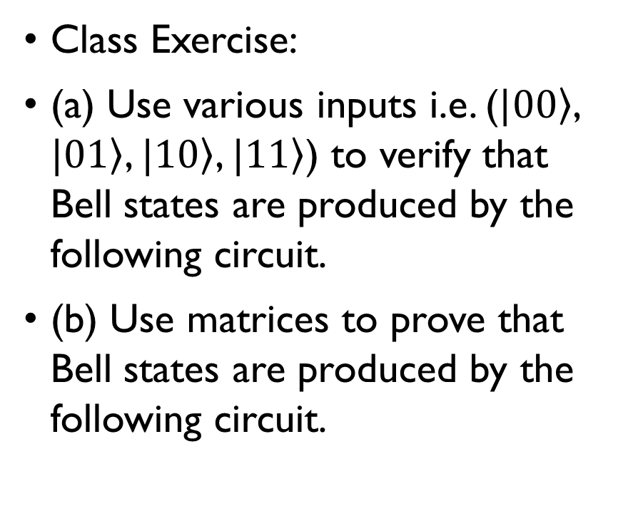
Gate Operations: Bell (EPR) States Using Hadamard and CNOT
Class Exercise:
(a) Use various inputs i.e. ($|\left.00\right\rangle$, $|\left.01\right\rangle$, $|\left.10\right\rangle$, $|\left.11\right\rangle$) to verify that Bell states are produced by the following circuit.
(b) Use matrices to prove that Bell states are produced by the following circuit.

Slide 19

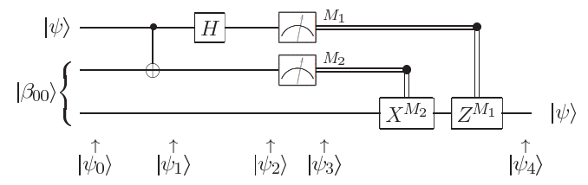
Gate Operations: Circuit With Measurement for Teleportation
Output is a classical bit shown with two lines.
Quantum Circuit for Teleportation

Slide 20
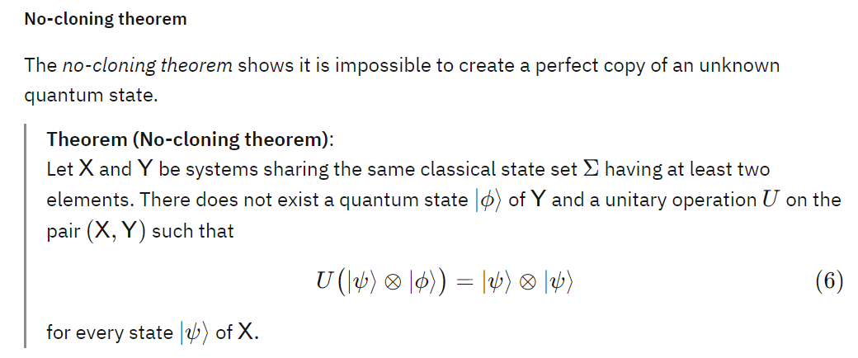
The No-Cloning Theorem
Reading Assignment: Read the last section ‘Inner products, orthonormality, and projections’ of Quantum Circuits on the Qiskit Textbook.

Slide 21
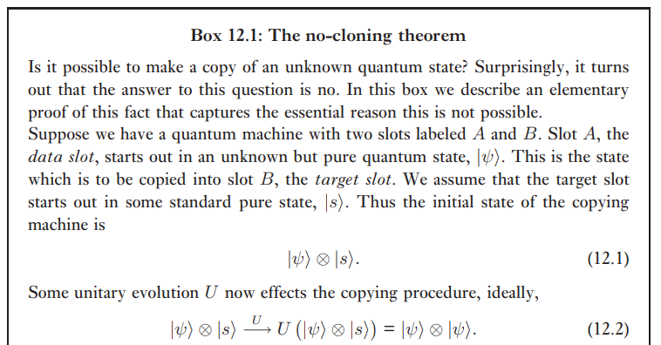
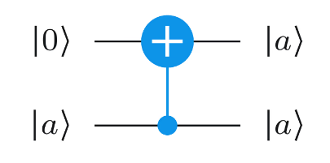
The No-Cloning Theorem – Proof

Slide 22
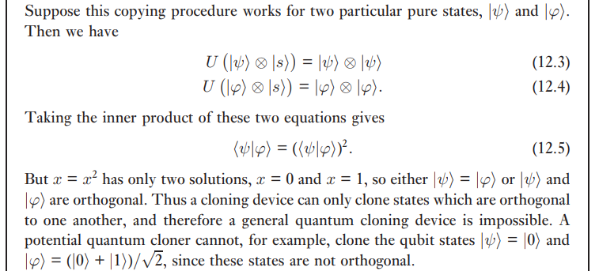

The No-Cloning Theorem – Proof

Slide 23
Summary
The Quantum Circuit Model uses Quantum Operations and Gates.
Several operations are available for quantum circuit design.
The CNOT Gate is one of the most useful and basic gates for quantum circuits.
Quantum circuits may be analyzed using inputs as well as through matrices.

