Slide 1
CS/PHYS-314/300: Quantum Computing Unit 06: Entanglement Applications
Habib University – Shaping Futures
Faisal Alvi
(For any suggested modifications please email: faisal.alvi@sse.habib.edu.pk)

Slide 2
Unit Outline
The Quantum Circuit for Teleportation
Superdense Coding
The CHSH Game
Summary
[Reference] IBM Qiskit Course: Entanglement in Action
https://learning.quantum.ibm.com/course/basics-of-quantum-information/entanglement-in-action

Slide 3
Quantum Teleportation
Quantum teleportation is a protocol where a sender (Alice) transmits a qubit to a receiver (Bob) by making use of
a shared entangled quantum state
and two bits of classical communication.
It must be understood that matter is not teleported in quantum teleportation — what is actually teleported is quantum information.

Slide 4
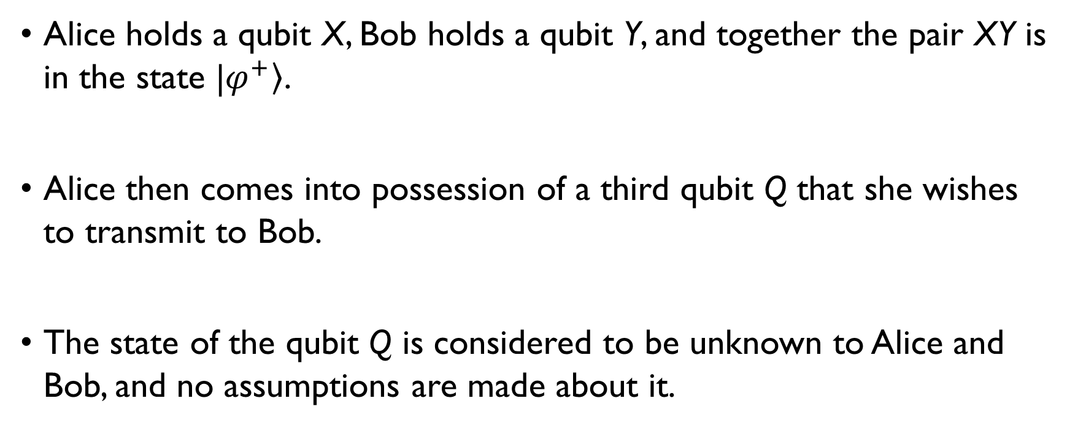
Quantum Teleportation - Setup
Alice holds a qubit X, Bob holds a qubit Y, and together the pair XY is in the state |$\left.φ^{+}\right\rangle$.
Alice then comes into possession of a third qubit Q that she wishes to transmit to Bob.
The state of the qubit Q is considered to be unknown to Alice and Bob, and no assumptions are made about it.

Slide 5
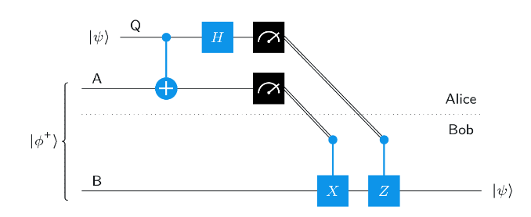
Circuit for Quantum Teleportation

Slide 6
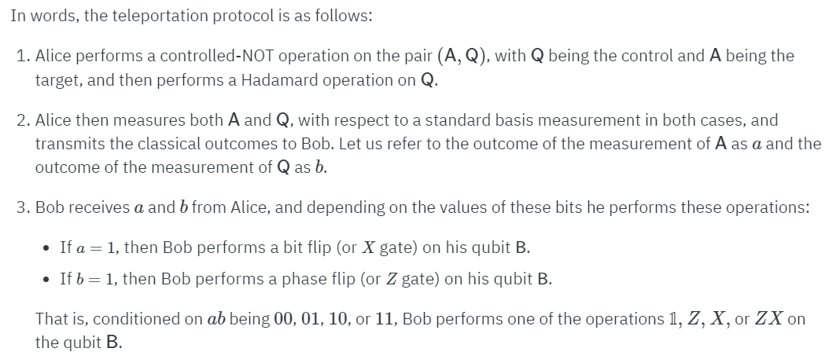
Quantum Teleportation Protocol

Slide 7
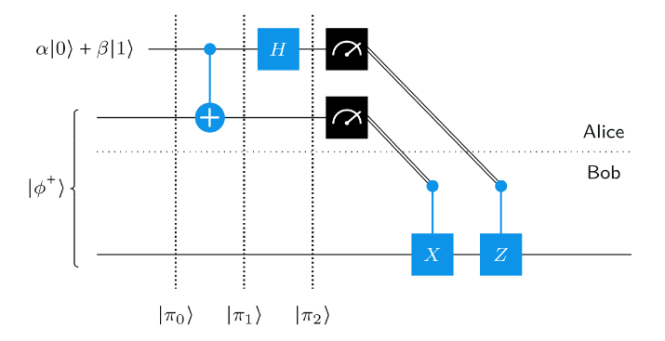
Quantum Teleportation – Analysis* [* Note the order of qubits in the Qiskit Book]

Slide 8

Quantum Teleportation – Analysis* [* Note the order of qubits in the Qiskit Book]

Slide 9
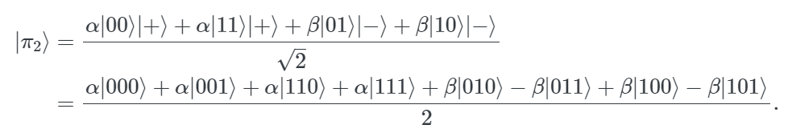
Quantum Teleportation – Analysis* [* Note the order of qubits in the Qiskit Book]

Slide 10
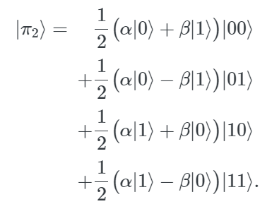
Quantum Teleportation – Analysis* [* Note the order of qubits in the Qiskit Book]

Slide 11
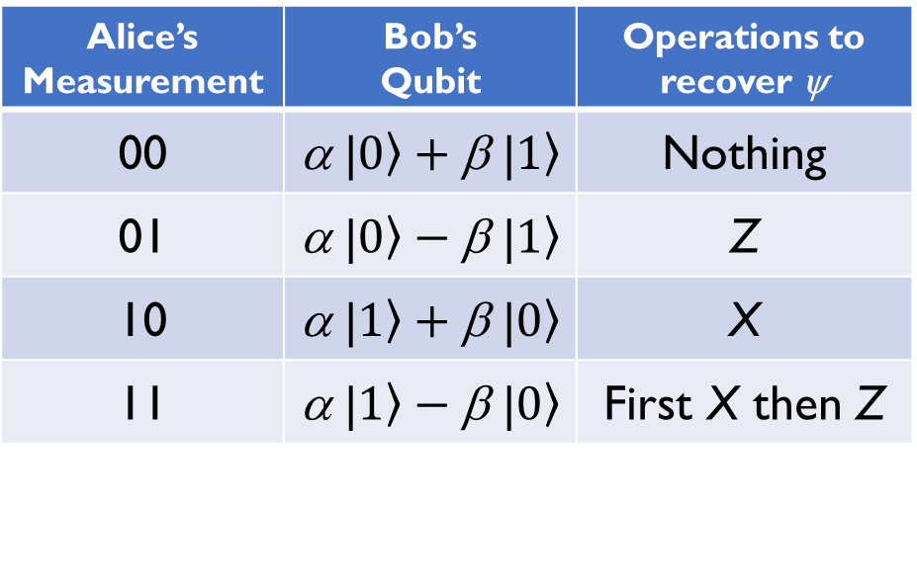
Quantum Teleportation – Analysis* [* Note the order of qubits in the Qiskit Book]
We saw from the previous slide that π₂ is:
When Alice measures her qubit and sends the results to Bob, if the results of here measurement are:
Alice’s Measurement | Bob’s Qubit | Operations to recover ψ
00 | α |$\left.0\right\rangle +\text{β} \text{|}\left.1\right\rangle$ | Nothing
01 | α |$\left.0\right\rangle −\text{β} \text{|}\left.1\right\rangle$ | Z
10 | α |$\left.1\right\rangle +\text{β} \text{|}\left.0\right\rangle$ | X
11 | α |$\left.1\right\rangle −\text{β} \text{|}\left.0\right\rangle$ | First X then Z

Slide 12
Superdense Coding
Superdense coding is a protocol that, in some sense, achieves a complementary aim to teleportation.
Rather than allowing for the transmission of one qubit using two classical bits of communication (at the cost of one e-bit of entanglement), it allows for the transmission of two classical bits using one qubit of quantum communication (again, at the cost of one e-bit of entanglement).

Slide 13
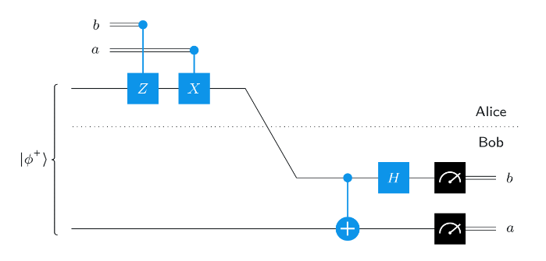
Superdense Coding – Circuit

Slide 14
Superdense Coding – Setup
Alice has two classical bits a and b.
Both Alice and Bob share one qubit of an EPR Pair.
Alice applies some unitary operations to her qubit, based on her classical bits and sends the qubit to Bob.
Bob, after applying some unitary operations to Alice’s qubit, measure both qubits. He recovers a and b, the original classical bits with Alice.

Slide 15
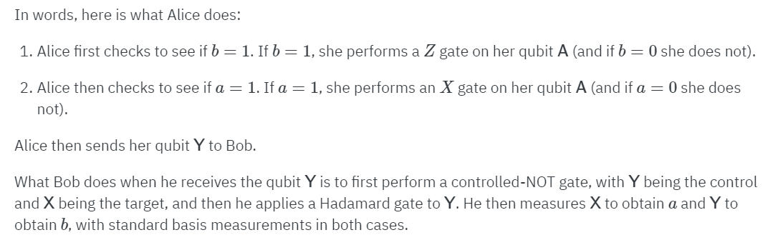
Superdense Coding – Protocol

Slide 16
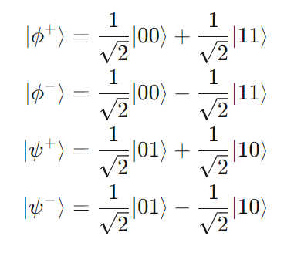
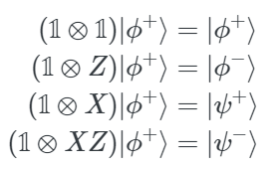
Superdense Coding – Analysis
Note that the symbols for the Bell States are:
Based on the values of a and b, Alice applies the following operations on her qubit.
The following represents these operations with the results shown.
a = 0, b = 0
a = 0, b = 1
a = 1, b = 0
a = 1, b = 1

Slide 17
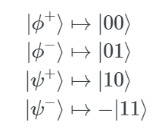
Superdense Coding – Analysis
Bob, after receiving Alice’s qubit applies a CNOT followed by a Hadamard on the received as well as his qubit.
He then measures these two qubits.
The results are shown here.
As a result of this measurement, he recovers a and b.

Slide 18
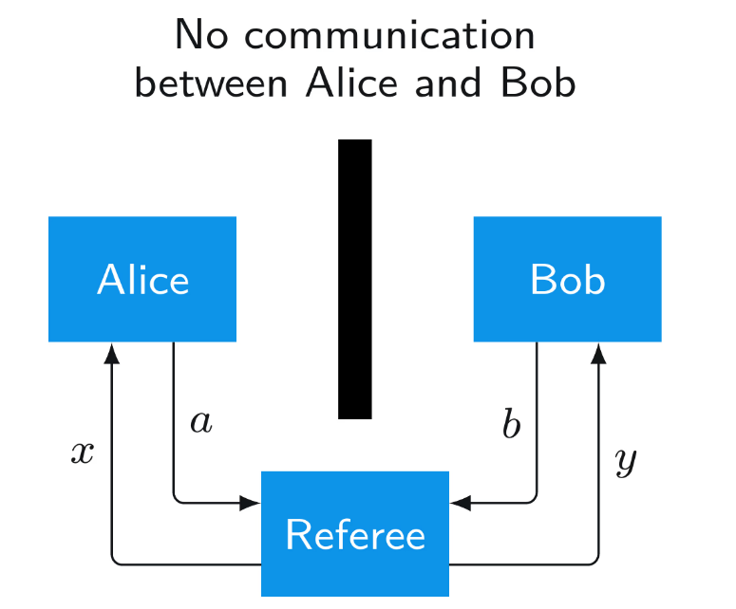
The CHSH Game
Here we just give an overview of the game.
Alice and Bob are in two separate places with no communication between them.
A Referee communicates with Alice and Bob, and they in turn communicate with the referee.
The referee asks questions x and y with Alice and Bob.
Alice and Bob reply with answers a and b.

Slide 19
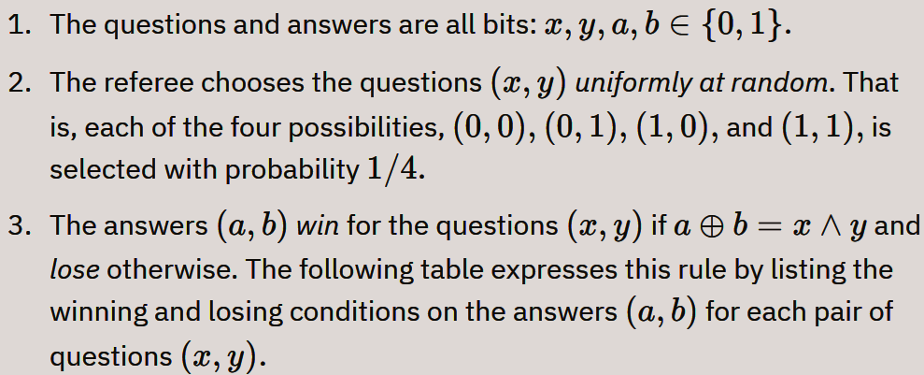
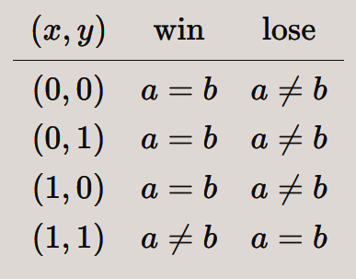
The CHSH Game

Slide 20
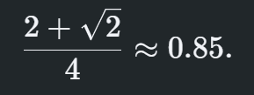
The CHSH Game
The best classical strategy gives a winning probability of ¾ = 75%.
Using a quantum strategy gives a winning probability of
This is a significant improvement over the classical strategy.
Details of the analysis can be found in https://learning.quantum.ibm.com/course/basics-of-quantum-information/entanglement-in-action

Slide 21
Summary
In this unit, we studied quantum teleportation as well superdense coding as applications of entanglement.
We observed that both of these can be defined as complementary operations.
We also presented the no-cloning theorem, which states that it is not possible to clone an arbitrary quantum state.

