Slide 1
CS/PHYS-314/300: Quantum Computing Unit 07: Quantum Frameworks
Habib University – Shaping Futures
Faisal Alvi
(For any suggested modifications please email: faisal.alvi@sse.habib.edu.pk)

Slide 2
Unit Outline
Quantum Computing Frameworks
Cirq ^{[Reference]} and Terminology
Qiskit
Summary
[Reference] https://quantumai.google/cirq/

Slide 3
Quantum Computing Frameworks
So far we have studied the fundamentals of quantum computation.
From a practical perspective, there are several frameworks available for programming. Some of the more well known ones are:
IBM Qiskit
Google Cirq
Microsoft Q#
For quantum computation, we will be working with IBM Qiskit.
However, a gentle introduction to Cirq is also presented.

Slide 4
Cirq - Terminology
Cirq has three main ways of defining qubits:
cirq.NamedQubit: used to label qubits by an abstract name.
cirq. cirq.LineQubit: qubits labelled by number in a linear array.
GridQubit: qubits labelled by two numbers in a rectangular lattice.

Slide 5
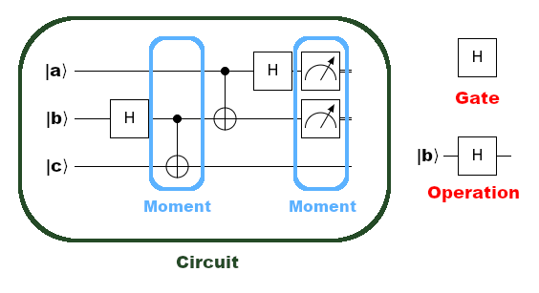
Cirq - Terminology

Slide 6
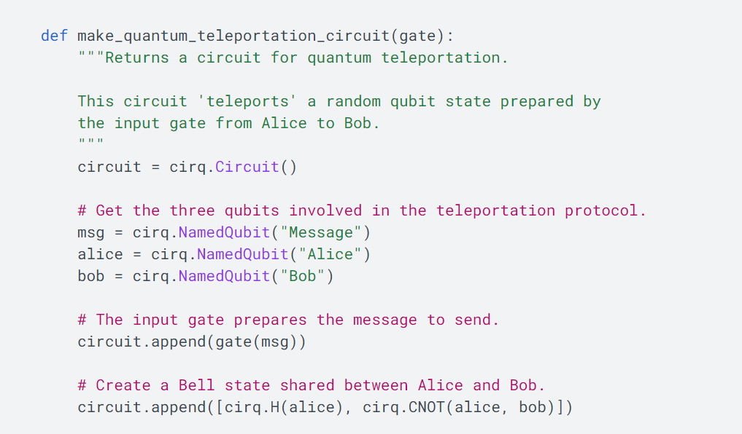
Cirq – Example Circuit for Teleportation

Slide 7
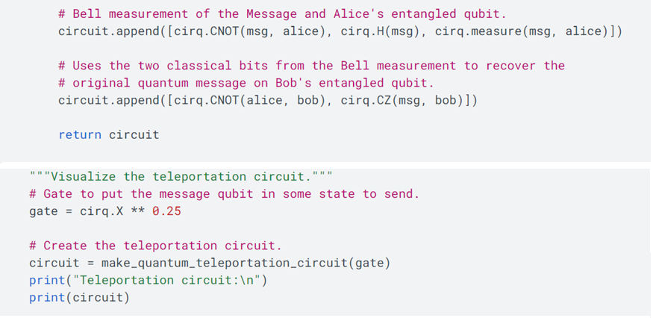

Cirq – Example Circuit for Teleportation

Slide 8
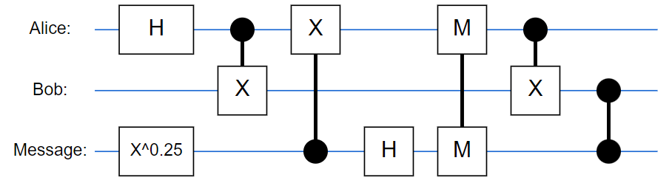
Cirq – The Teleportation Circuit
To run the simulation, please see: https://quantumai.google/cirq/experiments/textbook_algorithms

Slide 9
IBM Qiskit
Qiskit stands for Quantum Information Science Kit.
It is an Open Source model.
Developed by IBM.
Can be used with both simulators as well as quantum hardware (upto a specified number of qubits).
Follows the Quantum Circuit Model.
Recall our first notebook on Qiskit
https://colab.research.google.com/drive/1e_E5AnIGNt34LOWXX1ZHJSBSDGKpVnUS

Slide 10
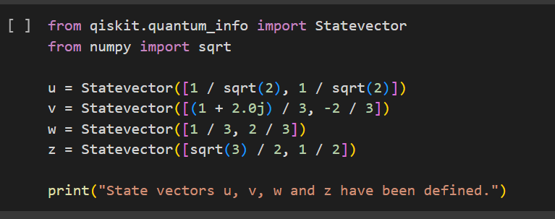
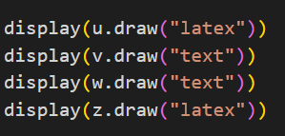



Qiskit – Notebook – Main features
A “ket” is represented as a StateVector.
To state the vector, use:

Slide 11
Qiskit Notebooks – Google Colab
Notebook 1
https://colab.research.google.com/drive/1e_E5AnIGNt34LOWXX1ZHJSBSDGKpVnUS?usp=sharing
Notebook 2
https://colab.research.google.com/drive/1xvRbnJUilPSYlqS2UrIo2axElmuIWEHS?usp=sharing

Slide 12
The Quantum Query Model
The Quantum Query Model is one of the models in use to elucidate the advantage of quantum computers in terms of efficiency.
In essence, a quantum circuit is provided a function that can be accessed using queries.
Sometimes the terms oracle and black box are also used to describe the function.
Input Output
Black Box:
f(x)

Slide 13

The Quantum Query Model
The function f(x) is typically defined on bitstrings, with the domain as a bitstring of length n and the codomain as a bitstring of length m,
A query is just an evaluation of f on certain input.
The efficiency of a quantum algorithm is measured using the number of queries required for the input function f.

Slide 14
The Quantum Query Model
Some Examples of Query Problems
Given a function f: Σ^{n} → Σ, the function evaluates to a ‘1’ if f(x) = 1, and 0 otherwise. In simpler words, find whether f(x) = 1? Alternatively, onsider the outputs as 2^{n} bit strings. The problem is then to find the bitwise OR of these strings.
[Query Problem with a Promise] Given a f: Σ^{n} → Σ, we are promised that f(x) = 1 for exactly one value of x with f(x) = 0 for all other inputs. The task is to find this unique string x.

Slide 15
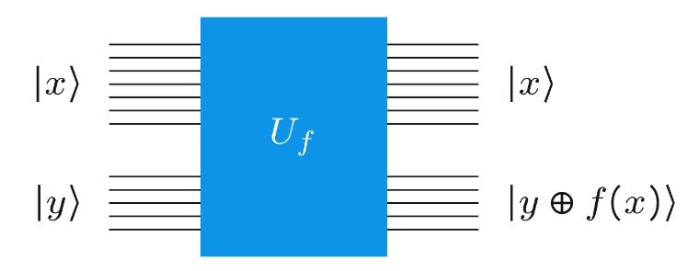
Query Gates
A query gate is of the form:
Here f(x) is a function on Σ^{n} → Σ^{m}
U_{f} computes the XOR of y with f(x) where both y and f(x) are m bit strings.

Slide 16
Query Gates – General Case
A query gate is simply a permutation (more specifically of order 2) of its input.
In other words, U_{f} is a permutation matrix (of order 2).
Since the transpose of a permutation matrix is its inverse, hence U_{f} is unitary.

Slide 17
Class Activity
Prove the statements in the previous slide, i.e.
U_{f} is a permutation matrix.
U_{f} is unitary.

Slide 18
Summary
Several Quantum Frameworks are available.
We will use Qiskit by IBM.
The Quantum Query Model is used to measure complexity of quantum algorithms.

