Slide 1
CS/PHYS-314/300: Quantum Computing Unit 08: Quantum Algorithms: Deutsch and Deutsch Jozsa Algorithm
Habib University – Shaping Futures
Faisal Alvi
(For any suggested modifications please email: faisal.alvi@sse.habib.edu.pk)

Slide 2
Unit Outline
Deutsch Algorithm
Analysis
Deutsch-Jozsa Algorithm
Analysis
Class Activities
Summary

Slide 3
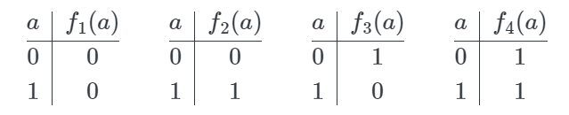
Balanced and Constant Functions
Consider the following function: The function f is defined on a single bit and produces either constant or balanced output.
More specifically, f is one of the following four functions:
Observe that f₁ and f₄ are constant functions; while f₂ and f₃ are balanced functions.

Slide 4
Deutsch Algorithm: Classical Solution
The problem under consideration is to determine whether the function f is balanced or constant using the fewest number of queries for f.
Note that classically, the minimum number of queries required is 2, since just querying f(0) or f(1) only will not resolve the problem.
However, using quantum circuits and the quantum query model, it is possible to determine whether f is constant or balanced using just a single query!

Slide 5
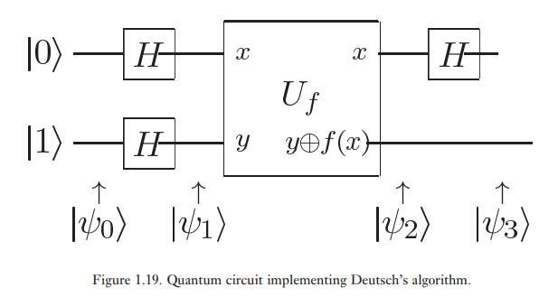

Deutsch Algorithm – The Quantum Approach
The quantum circuit for Deutsch Algorithm is as follows:
Here f(x) is the function that is to be determined to be constant or balanced.

Slide 6

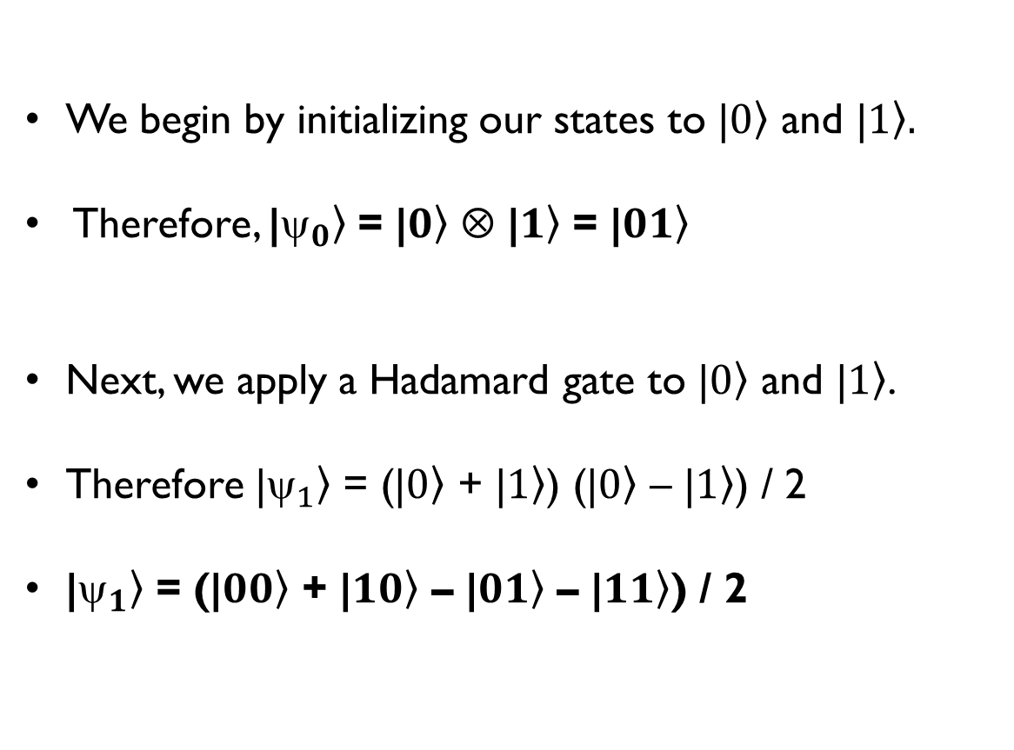
Deutsch Algorithm
We begin by initializing our states to |$\left.0\right\rangle$ and |$\left.1\right\rangle .$
Therefore, |$\left._{0}\right\rangle$ = |$\left.0\right\rangle$ ⊗ |$\left.1\right\rangle$ = |$\left.01\right\rangle$
Next, we apply a Hadamard gate to |$\left.0\right\rangle$ and |$\left.1\right\rangle$.
Therefore |$\left._{1}\right\rangle$ = (|$\left.0\right\rangle$ + |$\left.1\right\rangle$) (|$\left.0\right\rangle$ – |$\left.1\right\rangle$) / 2
|$\left._{1}\right\rangle$ = (|$\left.00\right\rangle$ + |$\left.10\right\rangle$ – |$\left.01\right\rangle$ – |$\left.11\right\rangle$) / 2

Slide 7
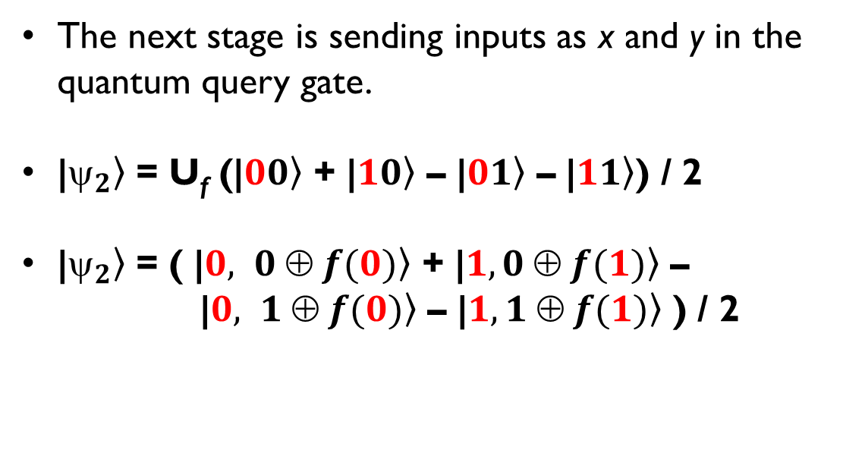
Deutsch Algorithm
The next stage is sending inputs as x and y in the quantum query gate.
|$\left._{2}\right\rangle$ = U_{f} (|$\left.00\right\rangle$ + |$\left.10\right\rangle$ – |$\left.01\right\rangle$ – |$\left.11\right\rangle$) / 2
|$\left._{2}\right\rangle$ = ( |$\left.0, 0 ⊕ f(0)\right\rangle$ + |$\left.1, 0 ⊕ f(1)\right\rangle$ –
|$\left.0, 1 ⊕ f(0)\right\rangle$ – |$\left.1, 1 ⊕ f(1)\right\rangle$ ) / 2
The above step is computed within one step due to superposition.
That is, it takes a single query to compute both f(0) and f(1).

Slide 8
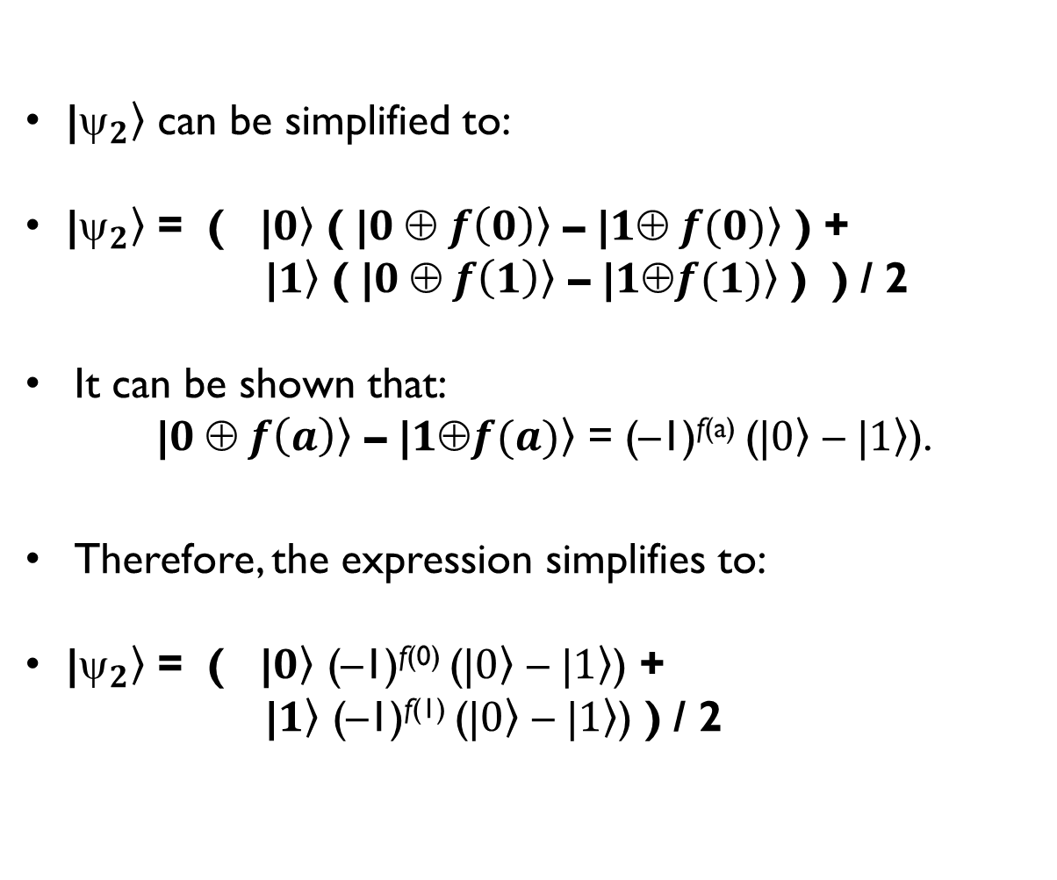
Deutsch Algorithm
|$\left._{2}\right\rangle$ can be simplified to:
|$\left._{2}\right\rangle$ = ( |$\left.0\right\rangle$ ( |$\left.0 ⊕ f\left(0\right)\right\rangle$ – |$\left.1⊕ f(0)\right\rangle$ ) +
|$\left.1\right\rangle$ ( |$\left.0 ⊕ f\left(1\right)\right\rangle$ – |$\left.1⊕f(1)\right\rangle$ ) ) / 2
It can be shown that:
|$\left.0 ⊕ f\left(a\right)\right\rangle$ – |$\left.1⊕f(a)\right\rangle$ = (–1)^{f(a)} (|$\left.0\right\rangle$ – |$\left.1\right\rangle$).
Therefore, the expression simplifies to:
|$\left._{2}\right\rangle$ = ( |$\left.0\right\rangle$ (–1)^{f(0)} (|$\left.0\right\rangle$ – |$\left.1\right\rangle$) +
|$\left.1\right\rangle$ (–1)^{f(1)} (|$\left.0\right\rangle$ – |$\left.1\right\rangle$) ) / 2

Slide 9

Class Exercise
Show that: |$\left.0 ⊕ f\left(a\right)\right\rangle$ – |$\left.1 ⊕ f(a)\right\rangle$ = (–1)^{f(a)} (|$\left.0\right\rangle$ – |$\left.1\right\rangle$).

Slide 10
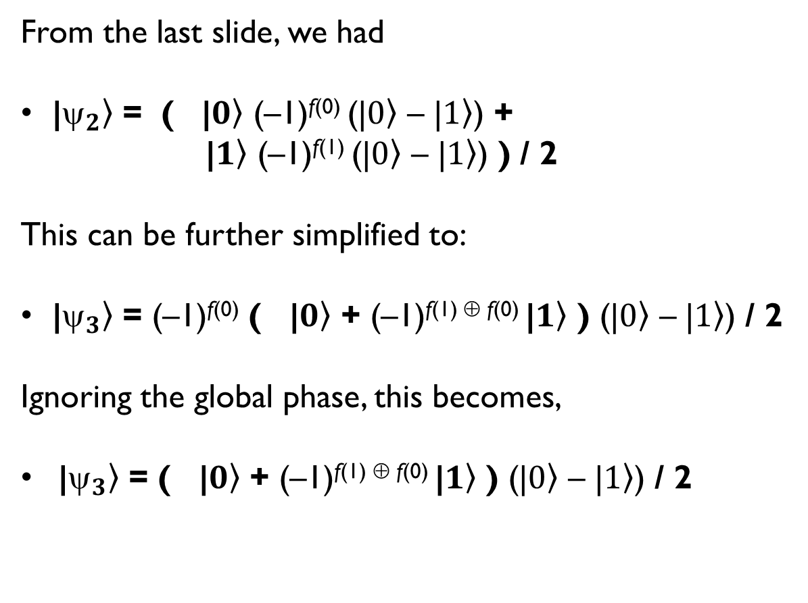
Deutsch Algorithm
From the last slide, we had
|$\left._{2}\right\rangle$ = ( |$\left.0\right\rangle$ (–1)^{f(0)} (|$\left.0\right\rangle$ – |$\left.1\right\rangle$) +
|$\left.1\right\rangle$ (–1)^{f(1)} (|$\left.0\right\rangle$ – |$\left.1\right\rangle$) ) / 2
This can be further simplified to:
|$\left._{3}\right\rangle$ = (–1)^{f(0)} ( |$\left.0\right\rangle$ + (–1)^{f(1) ⊕ f(0)} |$\left.1\right\rangle$ ) (|$\left.0\right\rangle$ – |$\left.1\right\rangle$) / 2
Ignoring the global phase, this becomes,
|$\left._{3}\right\rangle$ = ( |$\left.0\right\rangle$ + (–1)^{f(1) ⊕ f(0)} |$\left.1\right\rangle$ ) (|$\left.0\right\rangle$ – |$\left.1\right\rangle$) / 2

Slide 11
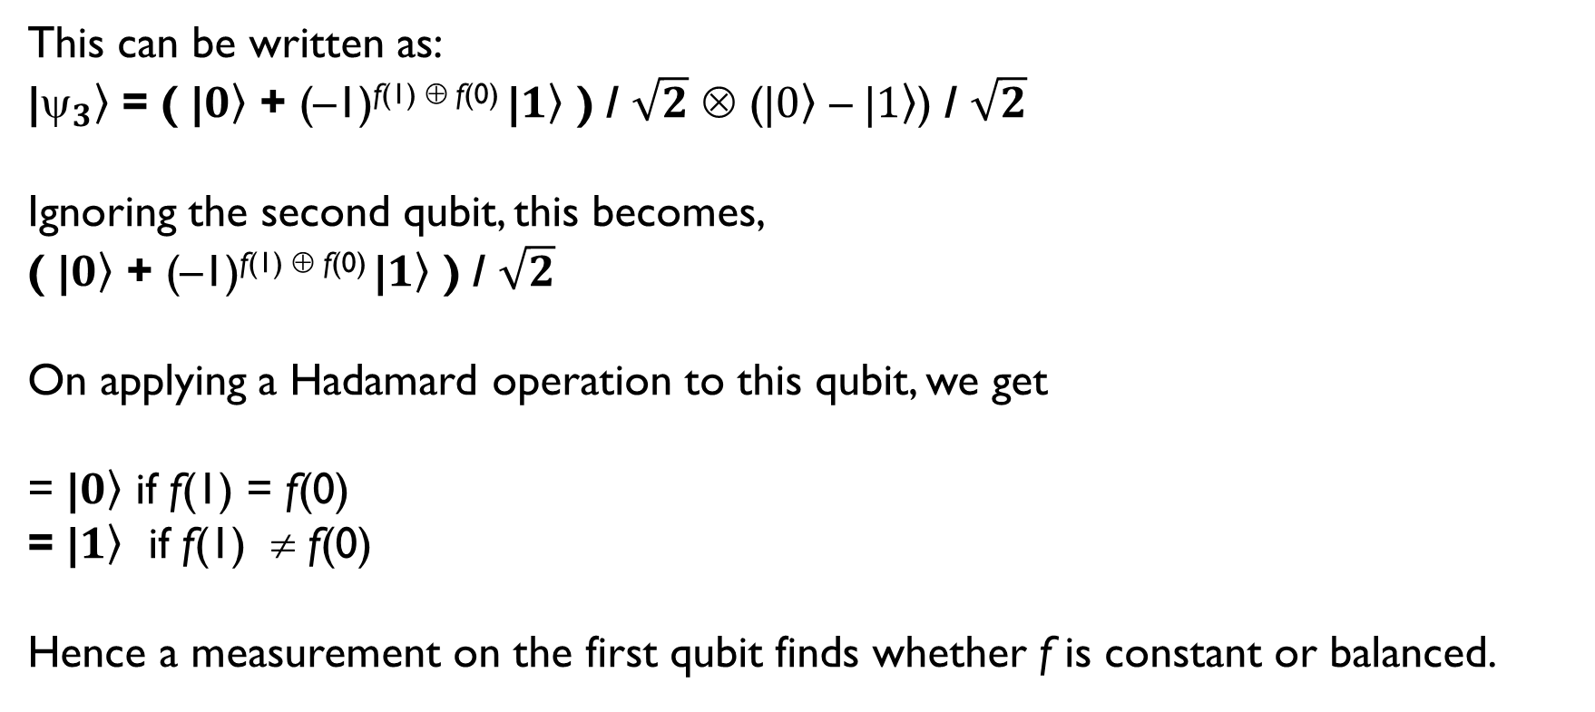
Deutsch Algorithm
This can be written as:
|$\left._{3}\right\rangle$ = ( |$\left.0\right\rangle$ + (–1)^{f(1) ⊕ f(0)} |$\left.1\right\rangle$ ) / $\sqrt{2}$ ⊗ (|$\left.0\right\rangle$ – |$\left.1\right\rangle$) / $\sqrt{2}$
Ignoring the second qubit, this becomes,
( |$\left.0\right\rangle$ + (–1)^{f(1) ⊕ f(0)} |$\left.1\right\rangle$ ) / $\sqrt{2}$
On applying a Hadamard operation to this qubit, we get
= |$\left.0\right\rangle$ if f(1) = f(0)
= |$\left.1\right\rangle$ if f(1) ≠ f(0)
Hence a measurement on the first qubit finds whether f is constant or balanced.

Slide 12
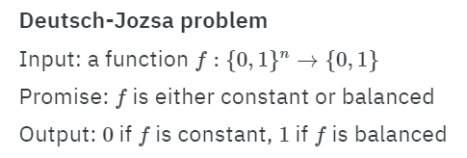
The Deutsch-Jozsa Algorithm
The Deutsch Jozsa Algorithm is a more general version of the Deutsch Algorithm.
We have a function f: Σ^{n} → Σ which is either constant or balanced. That is, f(x) = 0 for all x OR f(x) = 0 for half of the inputs, and f(x) = 1 for the other half.
The problem is to determine, with as fewest queries as possible, whether f(x) is constant or balanced.
Note that the classical solution requires 2^{n – 1} + 1 queries.

Slide 13
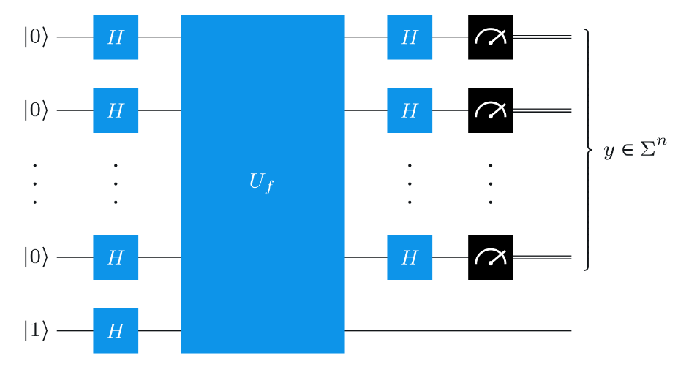
The Deutsch-Jozsa Algorithm – Circuit

Slide 14
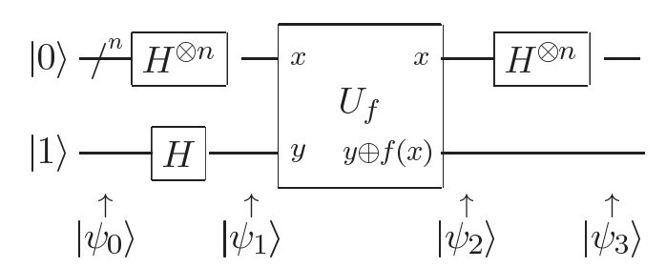


The Deutsch-Jozsa Algorithm – Analysis

Slide 15

The Deutsch-Jozsa Algorithm – Analysis

Slide 16

The Deutsch-Jozsa Algorithm – Analysis

Slide 17

The Deutsch-Jozsa Algorithm – Analysis

Slide 18
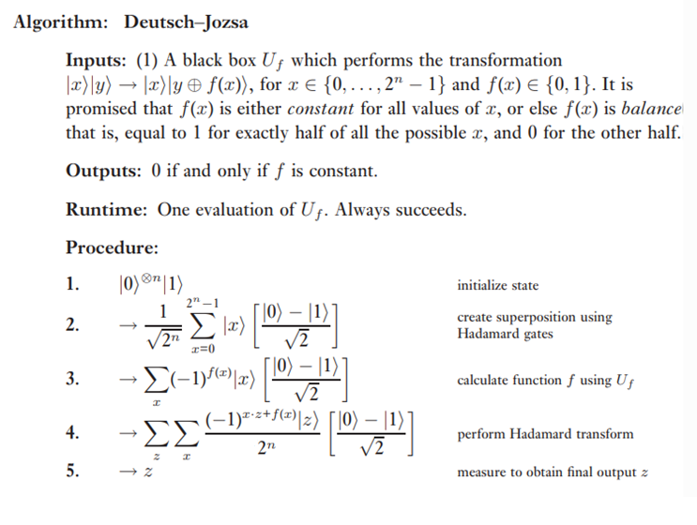
The Deutsch-Jozsa Algorithm

Slide 19
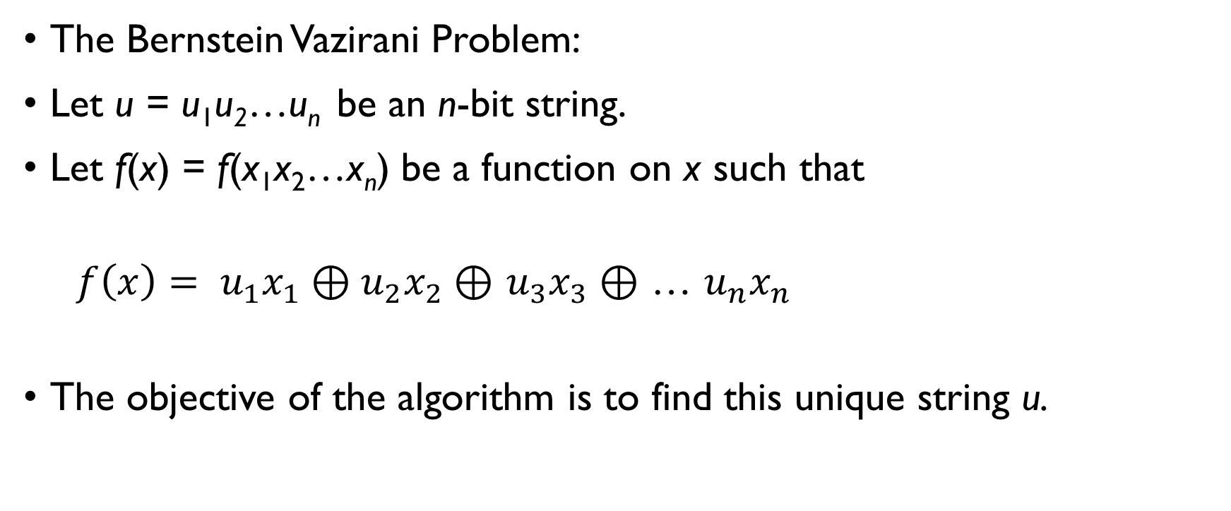
The Bernstein-Vazirani Problem
The Bernstein Vazirani Problem:
Let u = u₁u₂…u_{n} be an n-bit string.
Let f(x) = f(x₁x₂…x_{n}) be a function on x such that
${f\left(x\right)= u}_{1}x_{1}⊕u_{2}x_{2}⊕$ $u_{3}x_{3}⊕$ … $u_{n}x_{n}$
The objective of the algorithm is to find this unique string u.

Slide 20
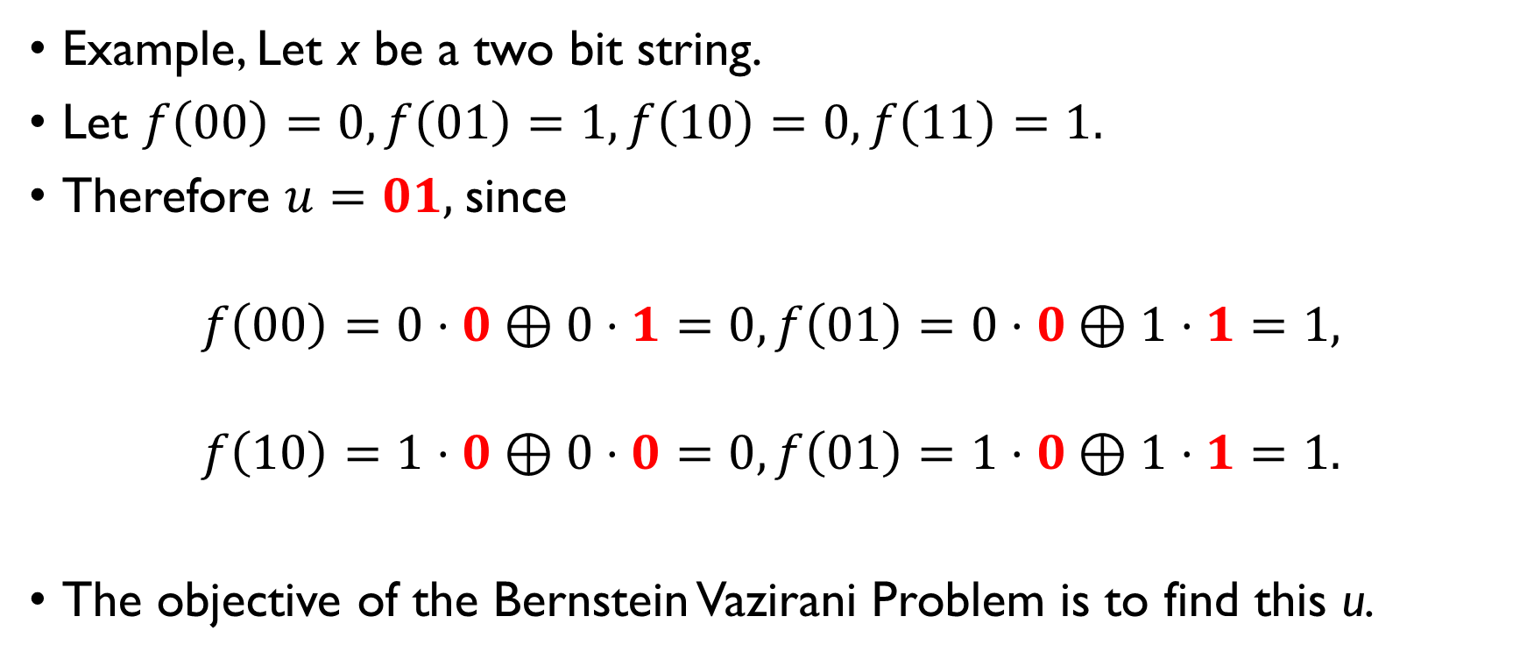
The Bernstein Vazirani Problem
Example, Let x be a two bit string.
Let $f\left(00\right)=0, f\left(01\right)=1, f\left(10\right)=0, f\left(11\right)=1.$
Therefore $u=01,$since
$$f\left(00\right)=0⋅0⊕0⋅1=0, f\left(01\right)=0⋅0⊕1⋅1=1,$$
$$f\left(10\right)=1⋅0⊕0⋅0=0, f\left(01\right)=1⋅0⊕1⋅1=1.$$
The objective of the Bernstein Vazirani Problem is to find this u.

Slide 21
The Bernstein Vazirani Algorithm
The Bernstein Vazirani Algorithm follows almost same steps as the Deutsch Jozsa Algorithm, except for the last step.
In the last step, measurement of the output yields the string u.
The circuit for the Bernstein Vazirani Algorithm is exactly the same as the Deutsch Jozsa Algorithm.

Slide 22
The Bernstein Vazirani Algorithm - Analysis

Slide 23
The Bernstein Vazirani Algorithm – Analysis

Slide 24
The Bernstein Vazirani Algorithm – Analysis

Slide 25
The Bernstein Vazirani Algorithm – Analysis

Slide 26
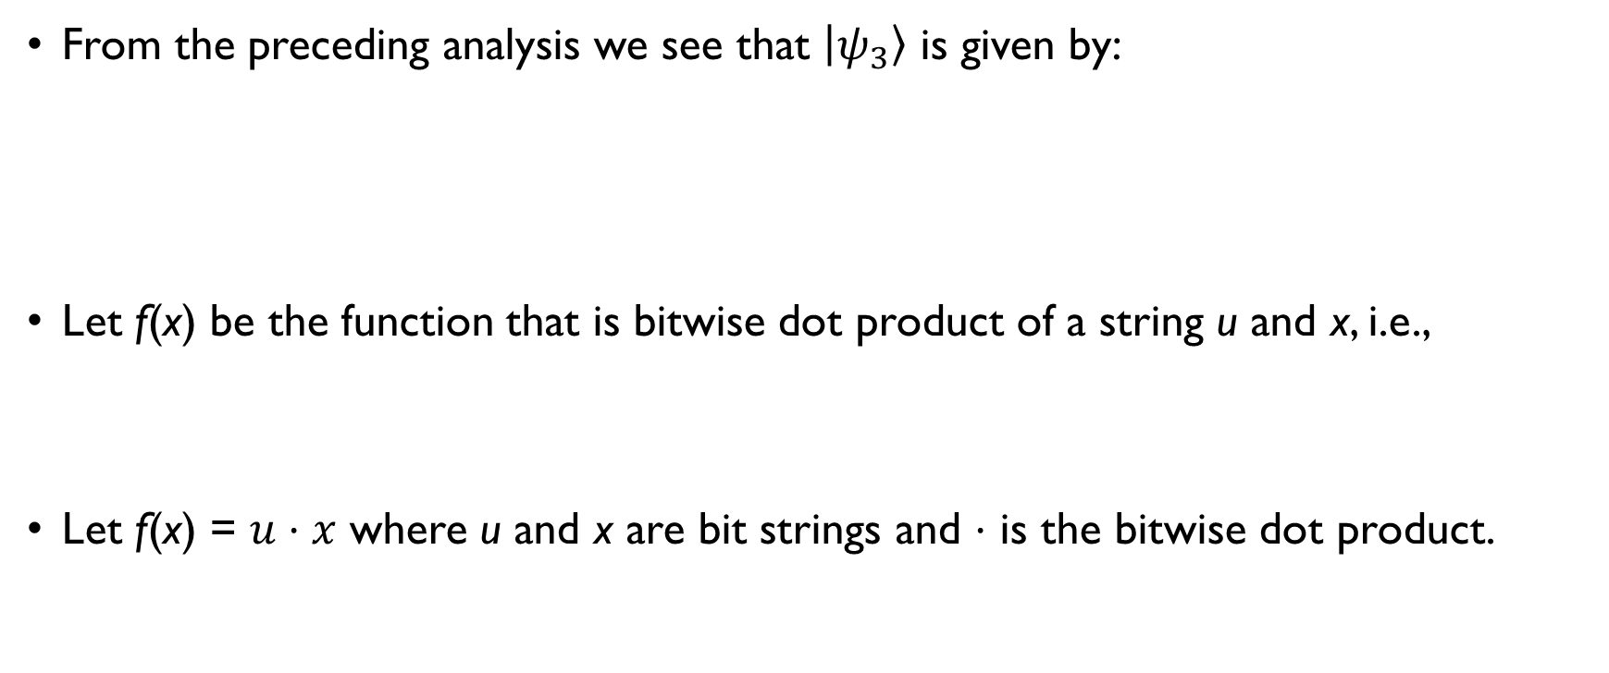
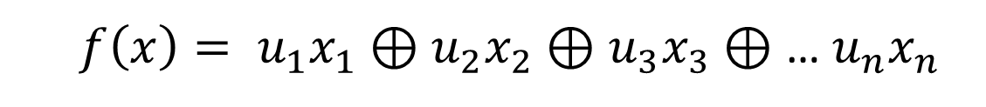
The Bernstein Vazirani Algorithm - Analysis
From the preceding analysis we see that $\left|ψ_{3}\right\rangle$ is given by:
Let f(x) be the function that is bitwise dot product of a string u and x, i.e.,
Let f(x) = $u⋅x$ where u and x are bit strings and $⋅$ is the bitwise dot product.
${f\left(x\right)= u}_{1}x_{1}⊕u_{2}x_{2}⊕$ $u_{3}x_{3}⊕$ … $u_{n}x_{n}$

Slide 27
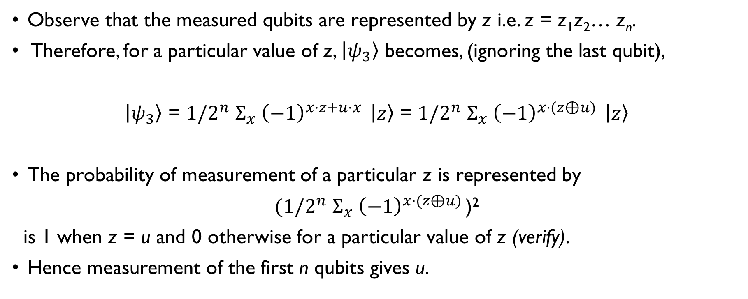
The Bernstein Vazirani Algorithm - Analysis
Observe that the measured qubits are represented by z i.e. z = z₁z₂… z_{n}.
Therefore, for a particular value of z, $\left|ψ_{3}\right\rangle$ becomes, (ignoring the last qubit),
$\left|ψ_{3}\right\rangle$ = $1/2^{n}$ $Σ_{x} {\left(−1\right)}^{x⋅z+u⋅x } \left|z\right\rangle$ = $1/2^{n}$ $Σ_{x} {\left(−1\right)}^{x⋅(z⊕u) } \left|z\right\rangle$
The probability of measurement of a particular z is represented by
$(1/2^{n}$ $Σ_{x} {\left(−1\right)}^{x⋅(z⊕u) }$)²
is 1 when z = u and 0 otherwise for a particular value of z (verify).
Hence measurement of the first n qubits gives u.

Slide 28
Summary
In this unit we saw the most basic algorithm i.e, the Deutsch Algorithm exhibiting the quantum advantage.
The Deutsch-Jozsa Algorithm is a simple extension of the Deutsch Algorithm.
Both the Deutsch and the Deutsch Jozsa Algorithm require one evaluation of Uf in contrast to their classical solutions.
The Bernstein Vazirani Problem is different, although the algorithm for solving it requires a similar algorithm.

