Slide 1
CS/PHYS-314/300: Quantum Computing Unit 09: The Quantum Search Algorithm
Habib University – Shaping Futures
Faisal Alvi
(For any suggested modifications please email: faisal.alvi@sse.habib.edu.pk)

Slide 2
Unit Outline
The Quantum Search Problem
The Quantum Search Algorithm
Oracle
Grover Diffusion Operator
Class Activities
Summary
[Reference] https://quantumai.google/cirq/

Slide 3
Search in an unstructured database
Recall the search problem in linearly unordered data.
We want to find an element x in a list of elements A[1..n], not necessarily sorted.
The best known (classical) algorithm is linear search.
This has time complexity O(n) since we need to inspect every element.

Slide 4
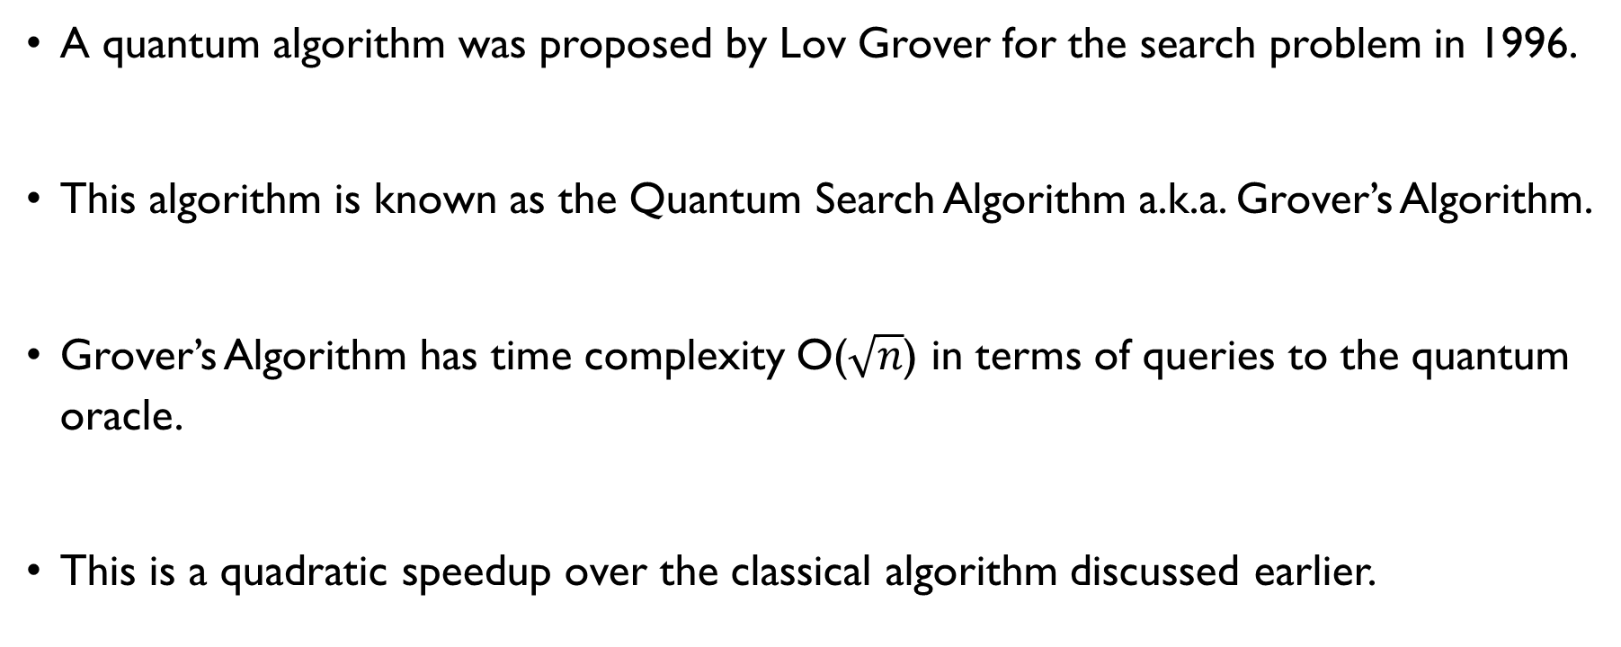
The Quantum Search Problem
A quantum algorithm was proposed by Lov Grover for the search problem in 1996.
This algorithm is known as the Quantum Search Algorithm a.k.a. Grover’s Algorithm.
Grover’s Algorithm has time complexity O($\sqrt{n}$) in terms of queries to the quantum oracle.
This is a quadratic speedup over the classical algorithm discussed earlier.

Slide 5
The Quantum Search Algorithm
Description: Let the input be a list of items from x from 0 to 2^{n} – 1.
More formally, let the input consist of a list of items x such that x is an index to a data item.
Let
f(x) = 1 for the item that we are searching for, (i.e. when x = ω) and,
f(x) = 0 otherwise.
Our objective is to find the index ω.

Slide 6
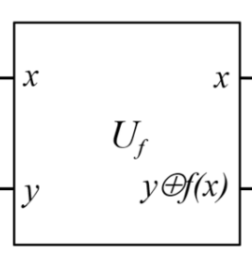
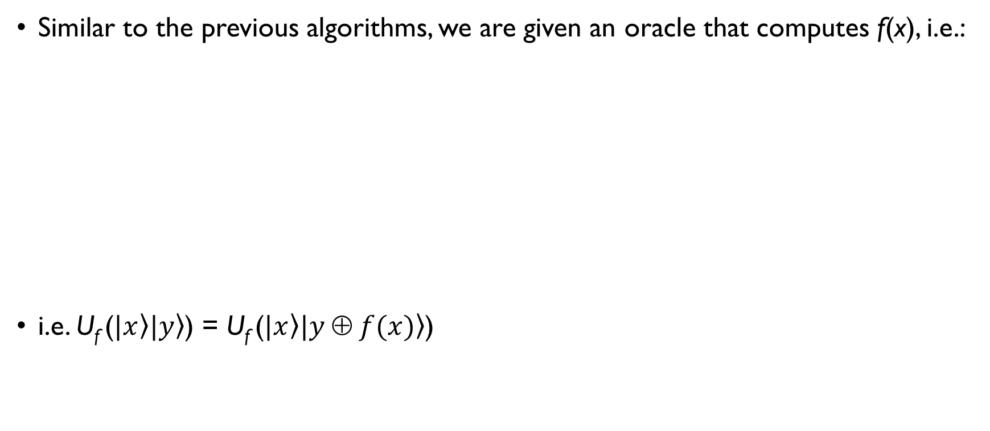
The Quantum Search Algorithm
Similar to the previous algorithms, we are given an oracle that computes f(x), i.e.:
i.e. U_{f} ($\left.|x\right\rangle \left.|y\right\rangle$) = U_{f} ($\left.|x\right\rangle \left.|y ⊕ f(x)\right\rangle$)

Slide 7
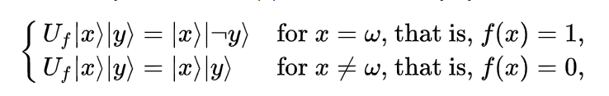


U_{f} for the Quantum Search Algorithm
Observe that:
Let $\left.|y\right\rangle$ = $\left.|−\right\rangle$= 1/$\sqrt{2}$ $\left.( |0\right\rangle$ – $\left.|1\right\rangle$ ) (Similar to the previous algorithms), then:
[Class Activity] Can you simplify the expression for U_{f} in that case?
U_{f} ($\left.|x\right\rangle \left.|−\right\rangle$) = ( –1)^{f(x)} $\left.|x\right\rangle \left.|−\right\rangle$

Slide 8
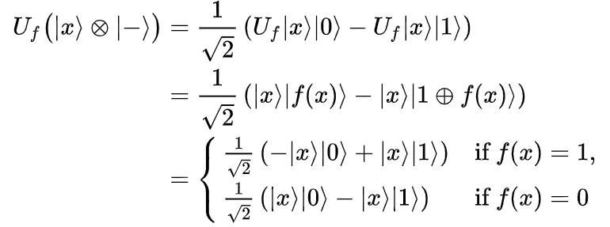


U_{f} for the Quantum Search Algorithm
Observe that
Hence, if we define,
Then U_{f(x)} =

Slide 9
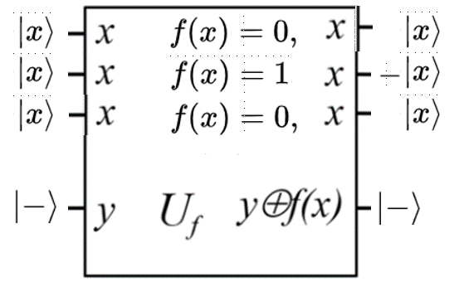

The Oracle
The foregoing analysis shows that
For f(x) = 0, the output on$\left|x\right\rangle$ is the same, while for f(x) = 1, there is a phase change.

Slide 10
U_{f} for the Quantum Search Algorithm
The effect of U_{f(x)} is to invert the sign of the search element.
Example: Let’s suppose we have a list of 8 items and we are searching for the 5th item, i.e. (the list is indexed from 000 to 111).
Let f(100) = 1, with f(x) = 0 otherwise. What will be the effect of applying U_{f(x)} on an initial state “all possible 3 bit states followed by a 1”?
[Class Activity], What is the effect of a repeated application of U_{f(x)}?

Slide 11
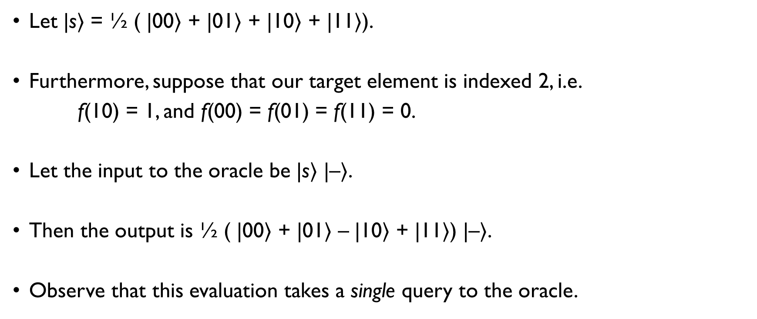
U_{f} for the Quantum Search Algorithm
Let |s$⟩$ = ½ ( |00$⟩$ + |01$⟩$ + |10$⟩$ + |11$⟩$).
Furthermore, suppose that our target element is indexed 2, i.e.
f(10) = 1, and f(00) = f(01) = f(11) = 0.
Let the input to the oracle be |s$⟩$ |–$⟩$.
Then the output is ½ ( |00$⟩$ + |01$⟩$ – |10$⟩$ + |11$⟩$) |–$⟩$.
Observe that this evaluation takes a single query to the oracle.

Slide 12


The Quantum Search Algorithm – The Grover Diffusion Operator
Let us define the second part of our quantum circuit: The Grover Diffusion Operator.
Let s be a superposition of all states, i.e.,
Then, the Grover operator G is defined as

Slide 13
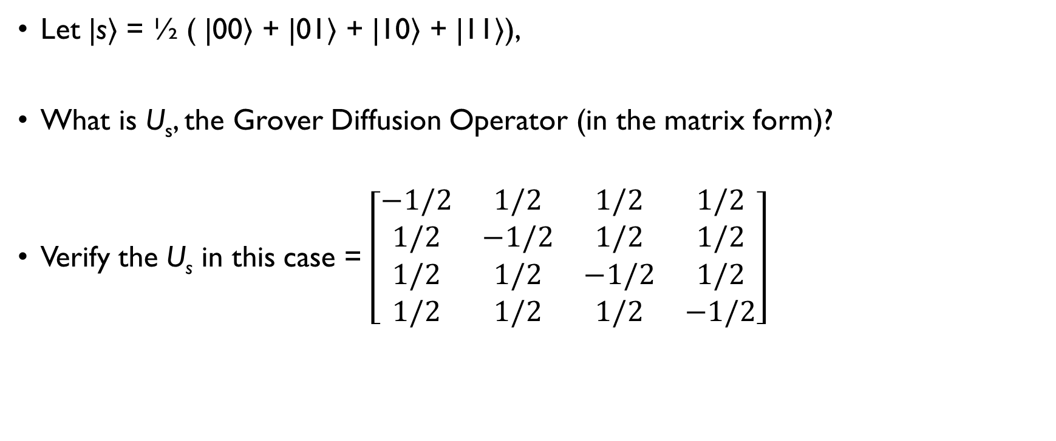
The Quantum Search Algorithm – The Grover Diffusion Operator
Let |s$⟩$ = ½ ( |00$⟩$ + |01$⟩$ + |10$⟩$ + |11$⟩$),
What is U_{s}, the Grover Diffusion Operator (in the matrix form)?
Verify the U_{s} in this case = $\left[\begin{matrix}−1/2 & 1/2 & 1/2 & 1/2 \\ 1/2 & −1/2 & 1/2 & 1/2 \\ 1/2 & 1/2 & −1/2 & 1/2 \\ 1/2 & 1/2 & 1/2 & −1/2\end{matrix}\right]$

Slide 14
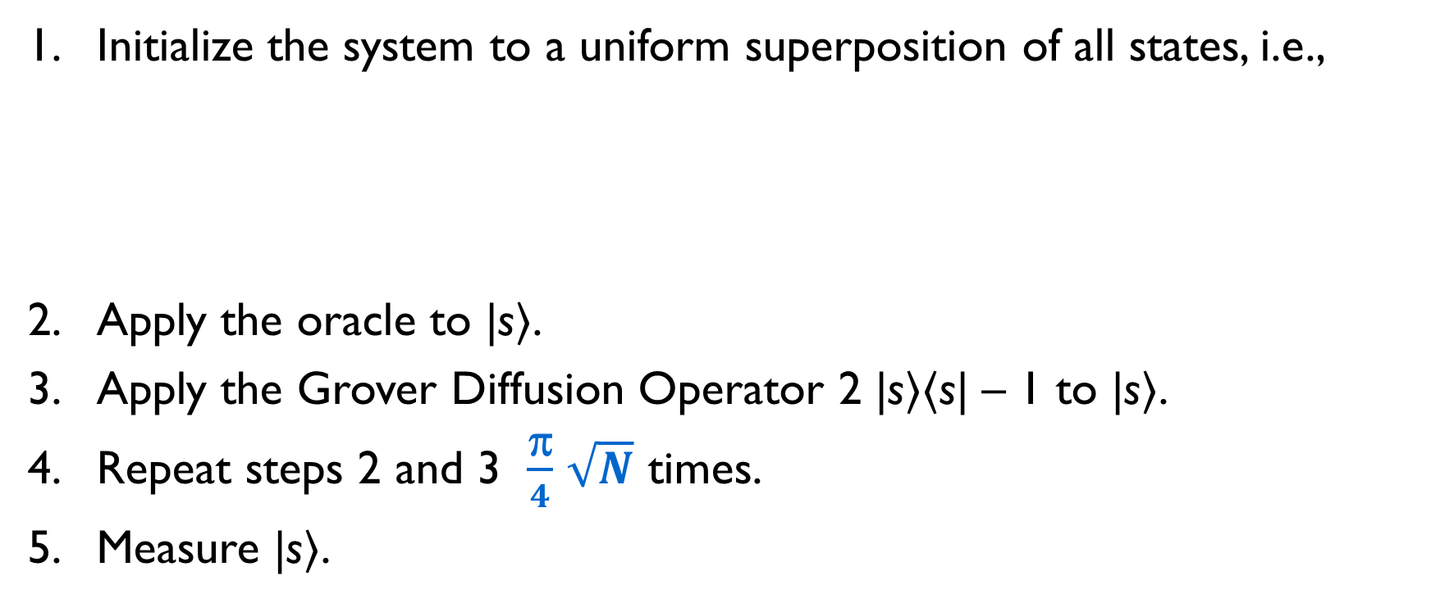
Grover’s Algorithm – Steps
Initialize the system to a uniform superposition of all states, i.e.,
Apply the oracle to |s$⟩$.
Apply the Grover Diffusion Operator 2 |s$⟩⟨$s| – 1 to |s$⟩$.
Repeat steps 2 and 3 $\frac{\text{π}}{4}$ $\sqrt{N}$ times.
Measure |s$⟩$.

Slide 15
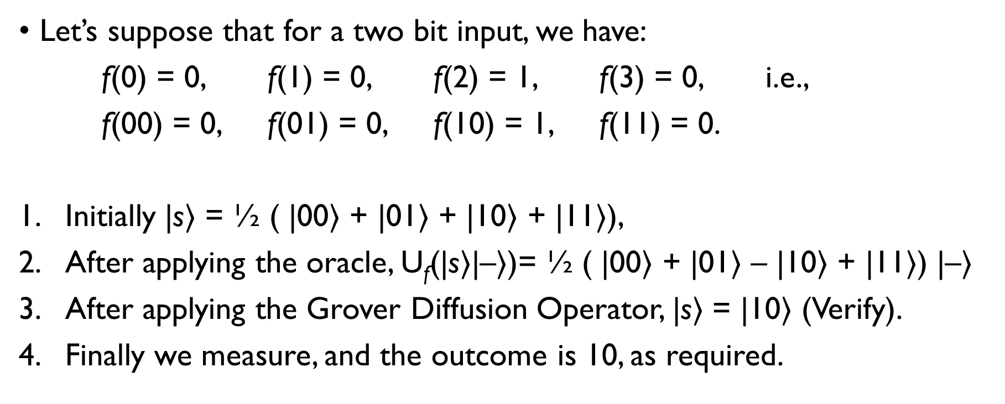
Grover’s Algorithm – Worked Example
Let’s suppose that for a two bit input, we have:
f(0) = 0, f(1) = 0, f(2) = 1, f(3) = 0, i.e.,
f(00) = 0, f(01) = 0, f(10) = 1, f(11) = 0.
Initially |s$⟩$ = ½ ( |00$⟩$ + |01$⟩$ + |10$⟩$ + |11$⟩$),
After applying the oracle, U_{f}(|s$⟩$|–$⟩$)= ½ ( |00$⟩$ + |01$⟩$ – |10$⟩$ + |11$⟩$) |–$⟩$
After applying the Grover Diffusion Operator, |s$⟩$ = |10$⟩$ (Verify).
Finally we measure, and the outcome is 10, as required.

Slide 16
Phase Shift and Amplitude Amplification

Slide 17
Amplitude Amplification
Grover’s Algorithm uses amplitude amplification to increase the amplitude of the required search item.
It does so by a combination of phase shift and amplitude increase.
This is now a standard technique in quantum computation and has given rise to a host of quantum algorithms.

Slide 18
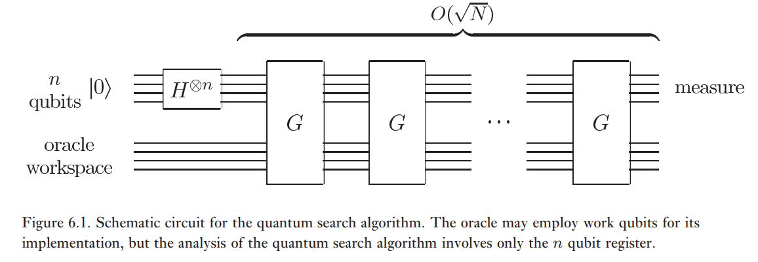
Grover’s Algorithm – The Circuit

Slide 19
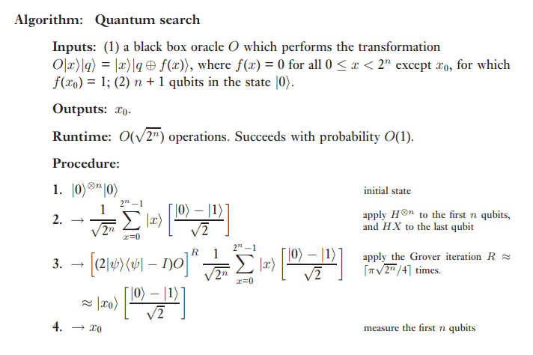
Grover’s Algorithm

Slide 20
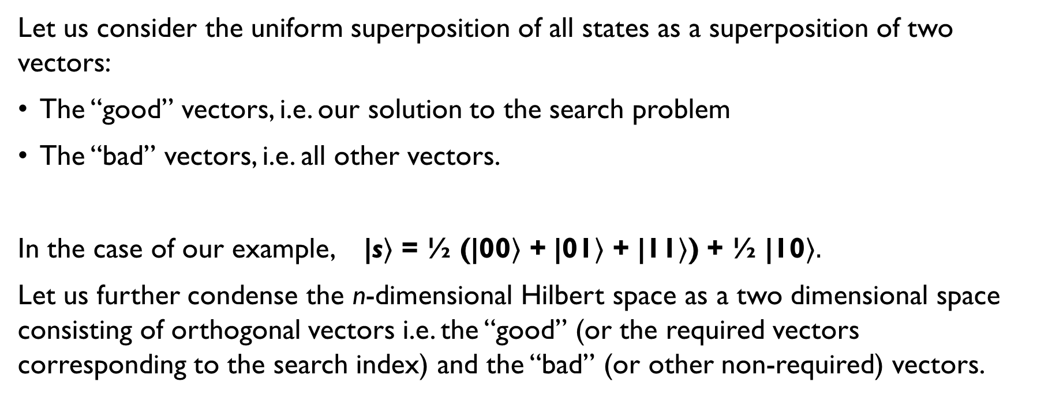
Grover’s Algorithm – Analysis
Let us consider the uniform superposition of all states as a superposition of two vectors:
The “good” vectors, i.e. our solution to the search problem
The “bad” vectors, i.e. all other vectors.
In the case of our example, |s$⟩$ = ½ (|00$⟩$ + |01$⟩$ + |11$⟩$) + ½ |10$⟩.$
Let us further condense the n-dimensional Hilbert space as a two dimensional space consisting of orthogonal vectors i.e. the “good” (or the required vectors corresponding to the search index) and the “bad” (or other non-required) vectors.

Slide 21
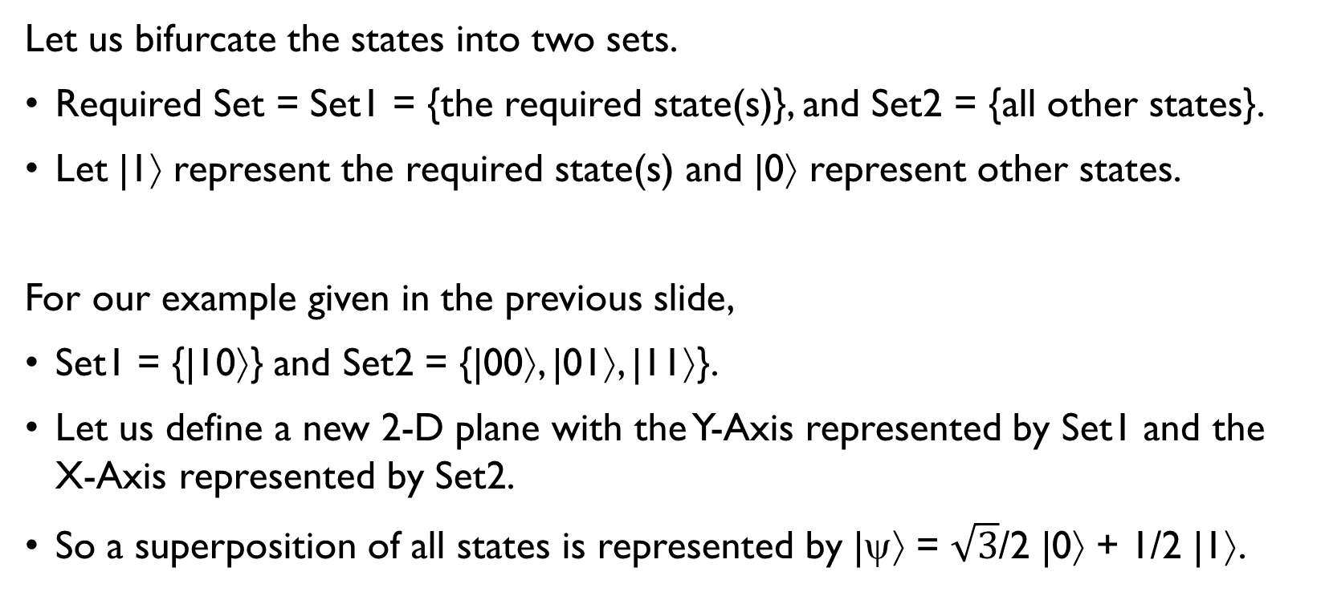
Grover’s Algorithm – Analysis
Let us bifurcate the states into two sets.
Required Set = Set1 = {the required state(s)}, and Set2 = {all other states}.
Let |1⟩ represent the required state(s) and |0⟩ represent other states.
For our example given in the previous slide,
Set1 = {|10⟩} and Set2 = {|00⟩, |01⟩, |11⟩}.
Let us define a new 2-D plane with the Y-Axis represented by Set1 and the X-Axis represented by Set2.
So a superposition of all states is represented by |ψ⟩ = $\sqrt{3}$/2 |0⟩ + 1/2 |1⟩.

Slide 22
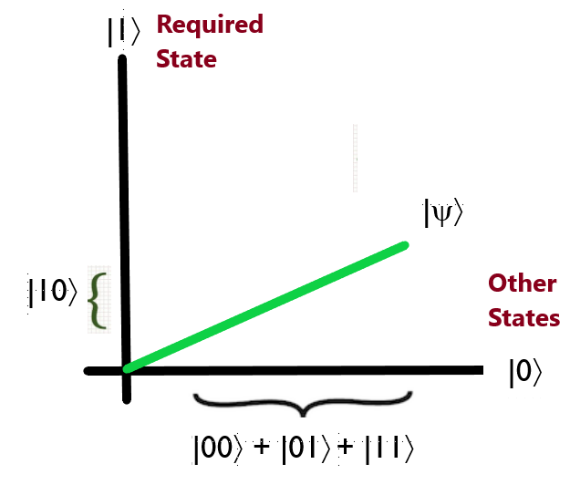
The Required-State, Other States Hyperplane

Slide 23
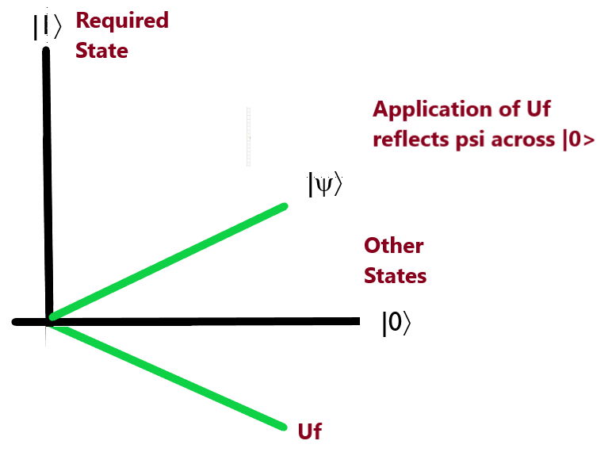
The Required-State, Other States Hyperplane
After the application of U_{f}, |ψ⟩ is reflected across |0⟩

Slide 24
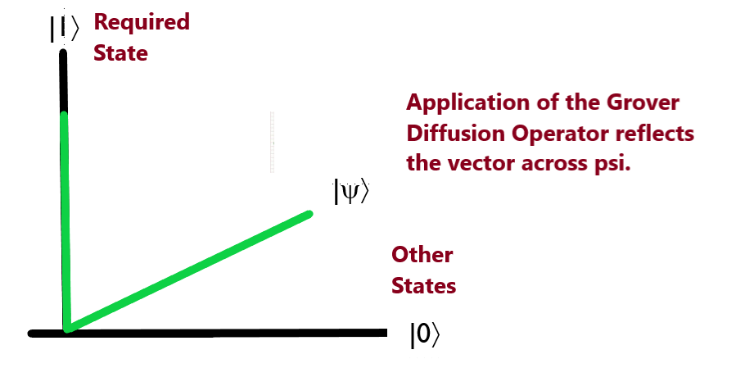
The Required State, Other States Hyperplane

Slide 25
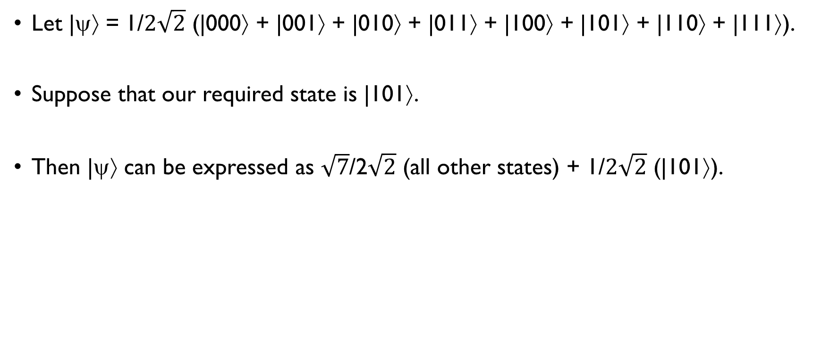
Grover’s Algorithm – 3 states
Let |ψ⟩ = 1/$2\sqrt{2}$ (|000⟩ + |001⟩ + |010⟩ + |011⟩ + |100⟩ + |101⟩ + |110⟩ + |111⟩).
Suppose that our required state is |101⟩.
Then |ψ⟩ can be expressed as $\sqrt{7}$/2$\sqrt{2}$ (all other states) + 1/$2\sqrt{2}$ (|101⟩).

Slide 26
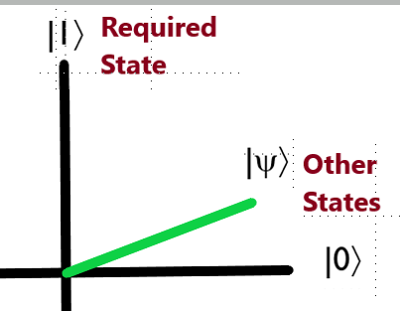
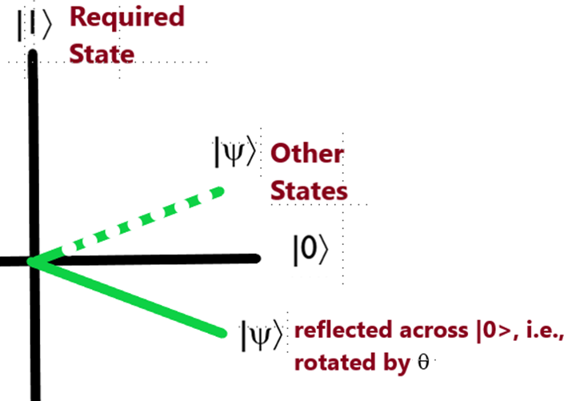
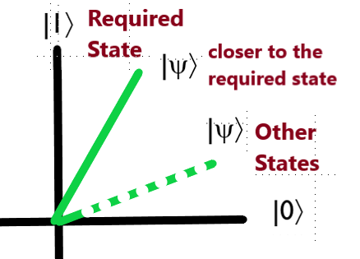
Grover’s Algorithm – 3 states
The angle between
|ψ> and |0> is θ/2

Slide 27

Grover’s Algorithm – Analysis
Let us suppose that we have N = 2^{n} states out of which M states are required states.
Therefore N – M states are other states.
Let |α⟩ be the “other” states and |β⟩ be the required states.
Therefore, |ψ⟩ can be expressed as

Slide 28
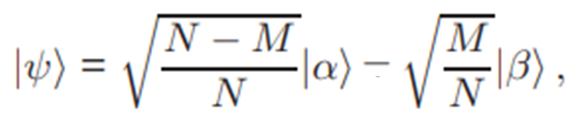


Grover’s Algorithm – Analysis
Application of the Oracle results in
Application of the Grover Diffusion Operator results in,
where

Slide 29

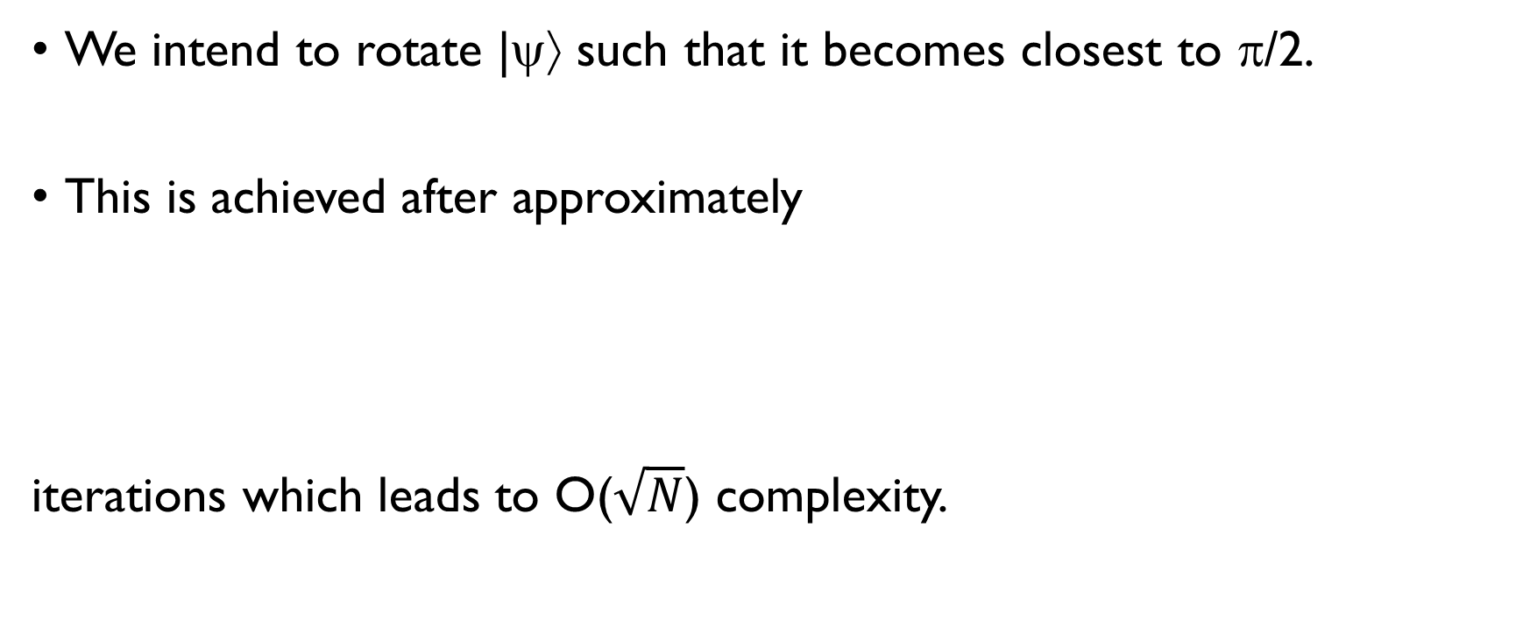
Grover’s Algorithm
We intend to rotate |ψ⟩ such that it becomes closest to π/2.
This is achieved after approximately
iterations which leads to O($\sqrt{N}$) complexity.

