Slide 1
CS/PHYS-314/300: Quantum Computing Unit 11: The Quantum Fourier Transform
Habib University – Shaping Futures
Faisal Alvi
(For any suggested modifications please email: faisal.alvi@sse.habib.edu.pk)

Slide 2
Unit Outline
The Classical (Discrete) Fourier Transform
The Quantum Fourier Transform
Circuit for the Quantum Fourier Transform
Complexity
Applications
Summary

Slide 3
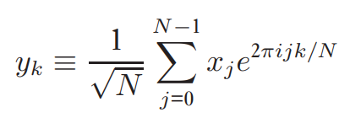
The Classical (Discrete) Fourier Transform
The Discrete Fourier Transform is a transformation of a vector of complex numbers x₀, x₁, …, x_{N – 1} into a transformed vector of complex numbers y₀, y₁, …, y_{N – 1} such that
Here e^{2πi/N} is the Nth root of unity.
The Discrete Fourier Transform has widespread applications in signal processing, speech recognition, etc.

Slide 4
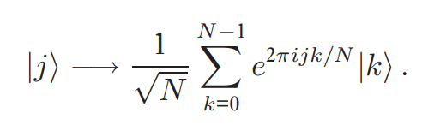
The Quantum Fourier Transform
The Quantum Fourier Transform is the quantum analog of the classical fourier transform.
Given an orthonormal basis |0⟩, |1⟩, …, |N – 1⟩, the quantum fourier transform is a linear operator with the following action on these basis states:

Slide 5
The Quantum Fourier Transform
Given the state |00⟩, what is its expansion in terms of the quantum fourier transform.
Solution:
Note e^{2πi/4} = e^{π/2} = i.
Therefore
|00⟩ → ½ ( (i)^{0.0} |00⟩ + (i)^{0.1} |01⟩ + (i)^{0.2} |10⟩ + (i)^{0.3} |11⟩)
→ ½ ( |00⟩ + |01⟩ + |10⟩ + |11⟩ )
Class Activity: What is the QFT expansion of |01⟩, |10⟩ and |11⟩?

Slide 6
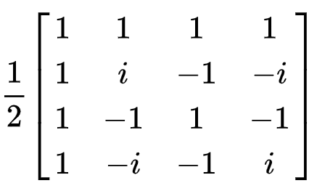
The Quantum Fourier Transform
It can be seen that the matrix corresponding to the expansion of |00⟩, |01⟩, |10⟩, |11⟩ is:
Class Activity: Is the above matrix unitary?

Slide 7
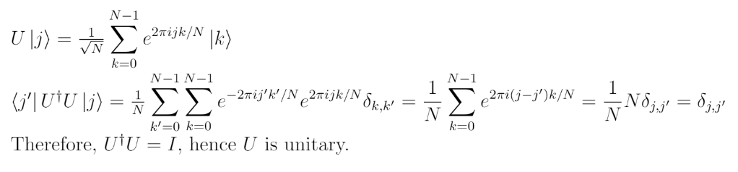
The Quantum Fourier Transform
The Quantum Fourier Transform is a unitary operator.
To see this, consider the inverse quantum fourier transform.
A proof follows here:

Slide 8
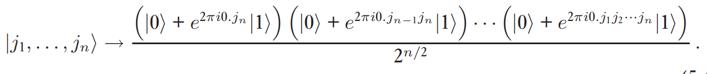


Circuit for the Quantum Fourier Transform
If the quantum fourier transform is a unitary operator, then surely a quantum circuit can be constructed corresponding to it.
This proceeds as follows:
The Quantum Fourier Transform can be expressed as:
Note that =
This useful representation can be used to construct a circuit.

Slide 9
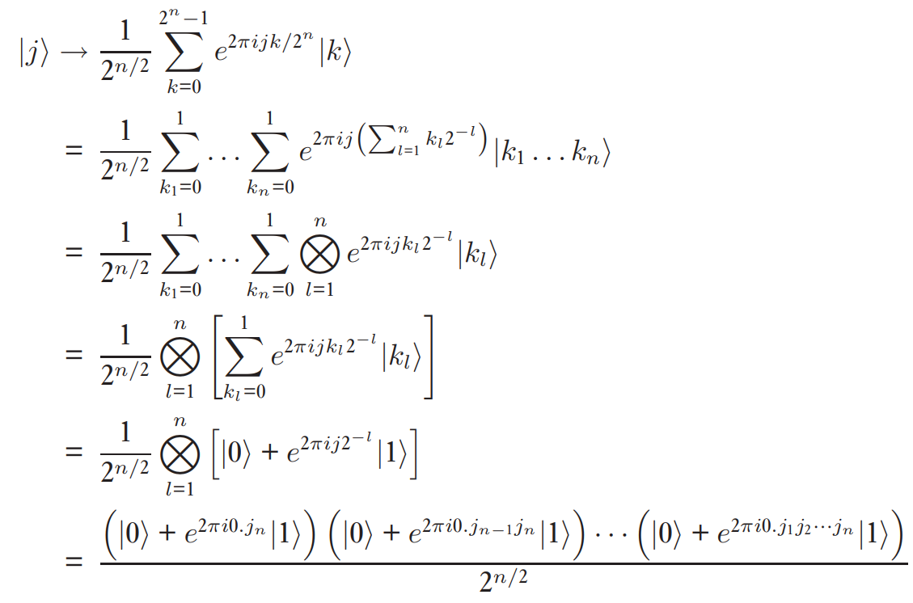
Proof of the Construction in the Previous Slide

Slide 10
Class Activity
Use the following formula:
to find the QFT of all two bit qubit states, i.e. |00⟩, |01⟩, |10⟩, |11⟩.

Slide 11
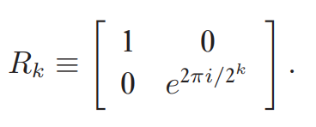
Circuit for Quantum Fourier Transform
Using the following gate:
and the Hadamard Transform, the circuit for generating QFT of an arbitrary state is:

Slide 12
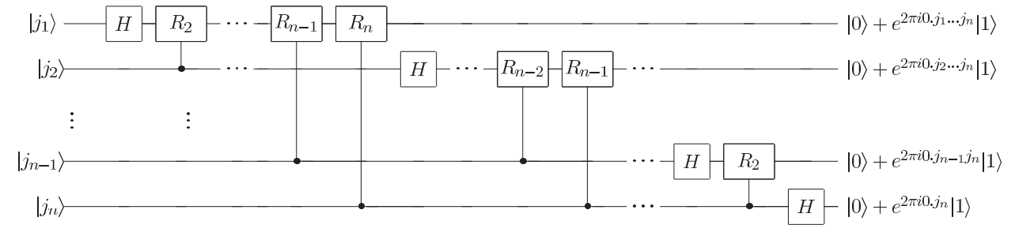
Circuit for the QFT

Slide 13
Class Activity
Using the previous construction, find and draw the circuit for two bit qubits.

Slide 14
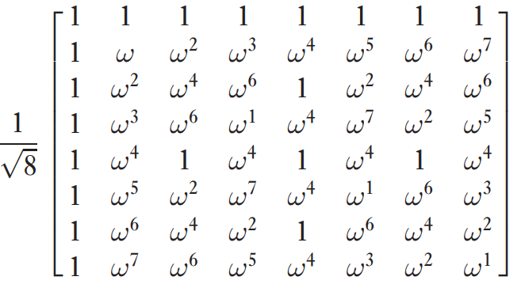

QFT for 3 bit qubits
As a concrete example, the QFT for 3 qubits is, where ω = $\sqrt{i}$:

Slide 15
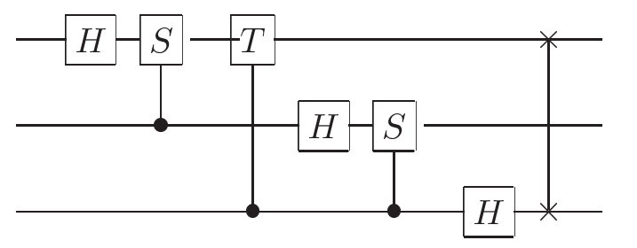
QFT for 3 bit qubits:
And the circuit is:

Slide 16
QFT – Number of Gates - Complexity
How many gates does this circuit use?
We start by doing a Hadamard gate and n − 1 conditional rotations on the first qubit – a total of n gates.
This is followed by a Hadamard gate and n − 2 conditional rotations on the second qubit, for a total of n + (n − 1) gates.
Continuing in this way, we see that n + (n − 1) +··· +1 = n(n + 1)/2 gates.
It also requires swaps (At most n/2 swaps)
The complexity is Θ(n²).

Slide 17
Summary
The Quantum Fourier Transform is a forms the basis of many number theoretic algorithms, such as the order finding algorithm.
The QFT is a unitary transformation.
Its circuit can be constructed using an algebraic expression for the QFT.
The circuit takes Θ(n²) operations.

