Slide 1
CS/PHYS-314/300: Quantum Computing Unit 12: The (Quantum) Phase Estimation Problem
Habib University – Shaping Futures
Faisal Alvi
(For any suggested modifications please email: faisal.alvi@sse.habib.edu.pk)

Slide 2
Unit Outline
The Inverse Quantum Fourier Transform
Eigen Values and Eigen Vectors
The Phase Estimation Problem
The Phase Estimation Algorithm
Applications
Summary
[Reference] https://quantumai.google/cirq/

Slide 3
Outline of the Session
Recall from the last class that we covered the quantum fourier transform.
We also constructed the circuit for the quantum fourier transform.
In this session we will give a brief overview of the inverse operation – the inverse quantum fourier transform.
We will then give a description of what are eigenvalues and eigenvectors.
This will be followed by a description of the phase estimation problem and its algorithm with some applications.

Slide 4
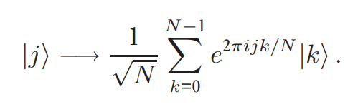
(Review) The Quantum Fourier Transform
The Quantum Fourier Transform is the quantum analog of the classical fourier transform.
Given an orthonormal basis |0⟩, |1⟩, …, |N – 1⟩, the quantum fourier transform is a linear operator with the following action on these basis states:

Slide 5
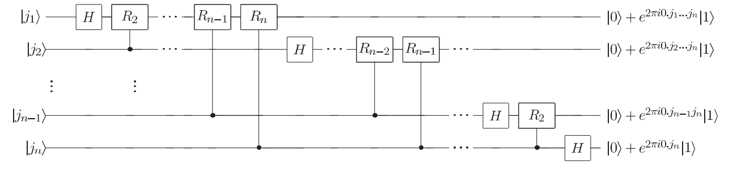
Circuit for the QFT
Note: This circuit also includes swaps at the end (not shown here) which swap each qubit from position k to position (n – k + 1). So for example, | j₁⟩ should move to position n, | j₂ ⟩ to position n – 1, etc.

Slide 6
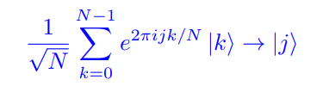
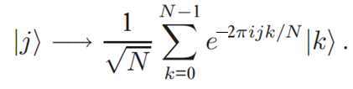
The Inverse Quantum Fourier Transform
Since the quantum fourier transform is a unitary operation, its inverse exists.
The inverse operation, also called the inverse quantum fourier transform can be defined as:
OR
Given a set of states with the amplitudes as shown above the inverse quantum fourier transform recovers the original state(s) | j ⟩.

Slide 7
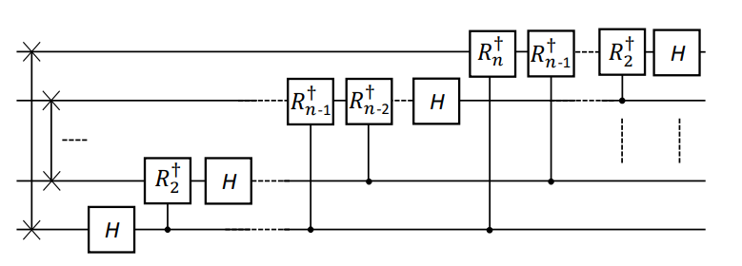
Circuit for Inverse Quantum Fourier Transform

Slide 8
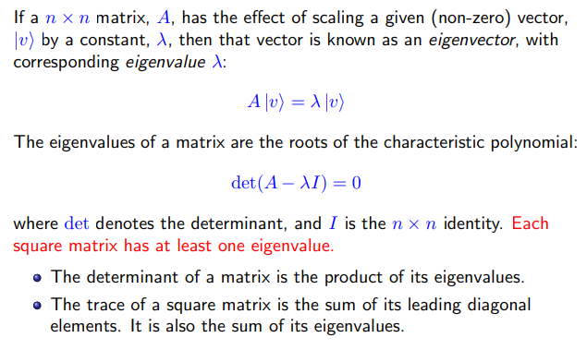
EigenVectors and EigenValues

Slide 9
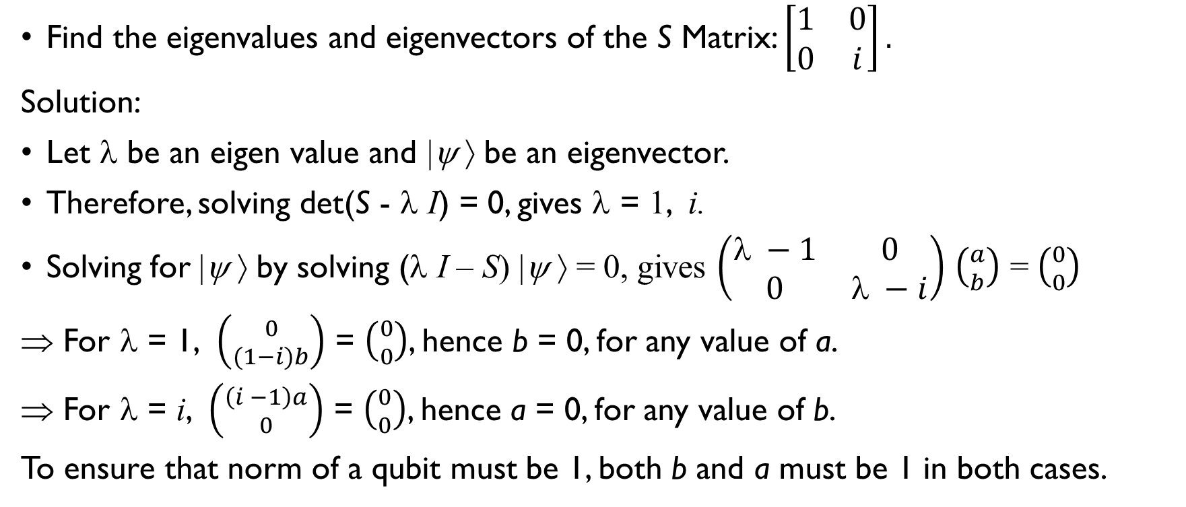
Class Activity
Find the eigenvalues and eigenvectors of the S Matrix: $\left[\begin{matrix}1 & 0 \\ 0 & i\end{matrix}\right].$
Solution:
Let λ be an eigen value and |ψ ⟩ be an eigenvector.
Therefore, solving det(S - λ I) = 0, gives λ = 1, i.
Solving for |ψ ⟩ by solving (λ I – S) |ψ ⟩ = 0, gives $\left(\begin{matrix} −1 & 0 \\ 0 & λ −i\end{matrix}\right)$ $\left({a \atop b}\right)$ = $\left({0 \atop 0}\right)$
⇒ For λ = 1, $\left({0 \atop (1−i)b}\right)$ = $\left({0 \atop 0}\right)$, hence b = 0, for any value of a.
For λ = i, $\left({\left(i −1\right)a \atop 0}\right)$ = $\left({0 \atop 0}\right)$, hence a = 0, for any value of b.
To ensure that norm of a qubit must be 1, both b and a must be 1 in both cases.

Slide 10
The Phase Estimation Problem
Given a unitary U with an eigen value λ and an eigen vector |u⟩, our objective is to estimate λ.
Recall that since U is unitary, its eigenvalue will always be 1.
The goal then is to estimate the phase of the eigenvalue, i.e. θ in e^{2πi θ}, where θ varies between 0 and 1.
We will show the phase estimation algorithm when θ has an n-bit binary expansion beyond the binary point.
The algorithm gives a good estimate for θ when θ has a higher precision.

Slide 11
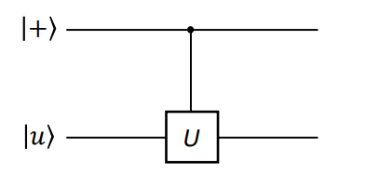
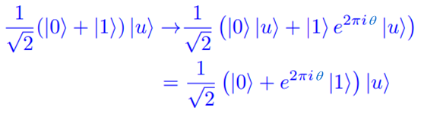
The Phase Estimation Problem – Single Qubit
Consider the operator U acting on the qubit |u⟩, where U has an eigen value of λ for |u⟩.
Since unitary operators preserve the norm, of a qubit (which is 1) it is obvious that U |u⟩ = e^{2πi θ}. |u⟩. The goal here is to estimate the value of θ.
Consider the following circuit: Its action is,
Note that |u⟩ comes out unchanged as a result of this process.

Slide 12
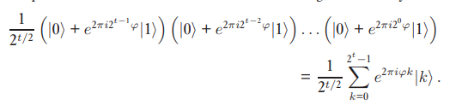

The Phase Estimation Algorithm – Preliminaries
Class Activity: Verify that in the previous circuit if U² was used (i.e. U applied twice) then the final state will be $\frac{1}{\sqrt{2}} ($|0⟩ + e^{2π i 2θ} |1⟩) |u⟩.
Another Class Activity:
Verify that (we are using θ and ϕ interchangeably for the phase):

Slide 13
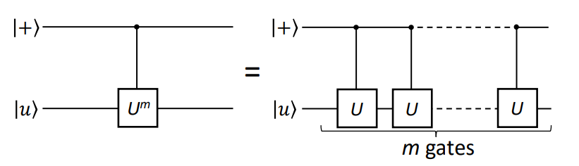
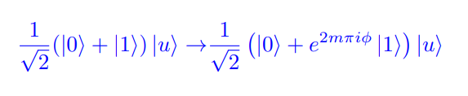
Repeated Applications of U

Slide 14
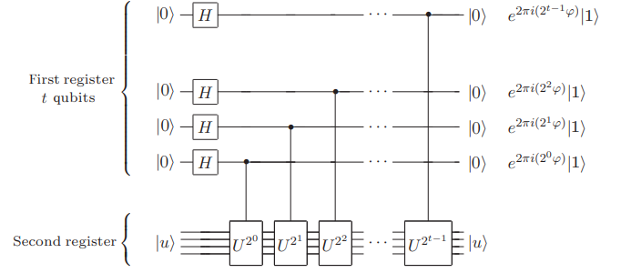
The Phase Estimation Algorithm – Circuit
Now, consider the following circuit for the phase estimation algorithm.

Slide 15
Applying the Inverse QFT to the Circuit
Observe that if ϕ has a binary expansion 0.j₁ j₂ j₃ … j_{t} then,
exp( 2 π i 2^{t – 1} ϕ ) = exp( 2 π i 0. j_{t} )
exp( 2 π i 2^{t – 2} ϕ ) = exp( 2 π i 0. j_{t – 1} j_{t} )
. . .
exp( 2 π i 2 ϕ ) = exp( 2 π i 0. j ₂ … j_{t – 1} j_{t} )

Slide 16
Circuit for Inverse Quantum Fourier Transform
Recall that the circuit for the inverse quantum fourier transform is just the reverse of the circuit for the QFT (Observe the circuit from right to left):

Slide 17
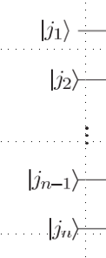
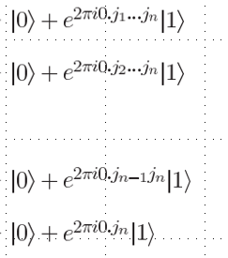
Inverse QFT
In other words,
Inverse Quantum Fourier Transform

Slide 18
Therefore…
Applying the Phase Estimation Circuit followed by Inverse QFT gives us the value of θ (or ϕ), provided it has a t (or n) bit expansion after the binary point.
Inverse Quantum Fourier Transform
SWA P S

Slide 19
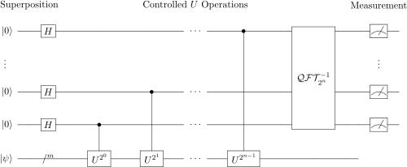
Quantum Phase Estimation – Circuit

Slide 20
QPE – Final Comments
We showed the quantum phase estimation algorithm when θ (or ϕ) has a t-bit expansion.
The case when θ (or ϕ) is a real number is similar. Its error analysis shows that QPE provides a good approximation to within one-half the value of the next integer with probability at least 4/π².
Phase Estimation is used as a subroutine for many quantum algorithms such as the order finding algorithm and the Shor’s Algorithm.
Phase Estimation gives a good estimate for θ (or ϕ), when θ (or ϕ) does not have a t (or n) bit expansion after the binary point.

