Slide 1
CS/PHYS-314/300: Quantum Computing Unit 13: Order Finding and Shor’s Algorithm
Habib University – Shaping Futures
Faisal Alvi
(For any suggested modifications please email: faisal.alvi@sse.habib.edu.pk)

Slide 2
Unit Outline
The Quantum Phase Estimation Procedure - Review
The Order Finding Algorithm
Shor’s Algorithm
Summary
[Reference] https://quantumai.google/cirq/

Slide 3
Overview of the Phase Estimation Procedure
Recall from the last class that we covered the phase estimation procedure.
The phase estimation procedure finds the phase of the eigenvalue λ of an operator U on an its eigenvector |u⟩ .
More specifically, let U |u⟩ = λ |u⟩. Furthermore, let λ = e^{2πiθ}. Then the phase estimation procedure gives a good estimate for the phase θ.
If θ has an exact binary expansion with n bits, we get the exact value of θ.
However, if θ is an arbitrary real number, QPE gives a good approximation.

Slide 4
Order Finding Problem
Let N be an integer and let a be coprime to N (i.e. gcd(a, N) = 1).
Then, the order r of a modulo N is the smallest positive integer such that
a^{r} ≡ 1 (mod N).
Example: Let N = 15 and a = 7. By trial and error, we find that,
7¹ mod 15 = 7,
7² mod 15 = 49 mod 15 = 4,
7³ mod 15 = 343 mod 15 = 13,
7⁴ mod 15 = 1.
Hence the order of 7 modulo 15 is r = 4.

Slide 5
Class Exercise
Let N = 15. Find the order of
8 modulo 15, and
(b) 11 modulo 15.
Given the order r of N what can be inferred about a^{r/2} – 1 and a^{r/2} + 1 (mod N)?

Slide 6
Using the QPE Algorithm for order finding
Consider the following unitary operator:
U |y⟩ = | x y (mod N)⟩, where x is coprime to N and 1 ≤ y ≤ N – 1 .
[For y ≥ N, U |y⟩ = y, and for y = 0].
Given a state y, the matrix for U is a permutation matrix.
Therefore it is a unitary operation.
Secondly, U² |y⟩ = U ( U |y⟩) = U ( | x y (mod N)⟩ ) = U ( | x² y (mod N)⟩ )
In general, U^{k} |y⟩ = ( | x^{k} y (mod N)⟩ ).
Suppose that the order of x mod N is r, i.e., x^{r} mod N = 1, or x^{r} ≡ 1 (mod N).

Slide 7
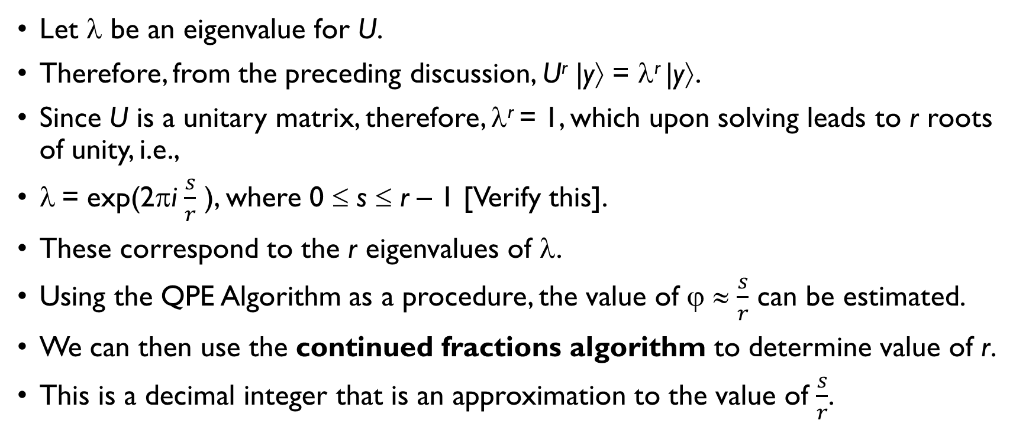
Using Eigenvalues for Order Finding
Let λ be an eigenvalue for U.
Therefore, from the preceding discussion, U^{r} |y⟩ = λ^{r} |y⟩.
Since U is a unitary matrix, therefore, λ^{r} = 1, which upon solving leads to r roots of unity, i.e.,
λ = exp(2πi $\frac{s}{r}$ ), where 0 ≤ s ≤ r – 1 [Verify this].
These correspond to the r eigenvalues of λ.
Using the QPE Algorithm as a procedure, the value of ϕ ≈ $\frac{s}{r}$ can be estimated.
We can then use the continued fractions algorithm to determine value of r.
This is a decimal integer that is an approximation to the value of $\frac{s}{r}$.

Slide 8
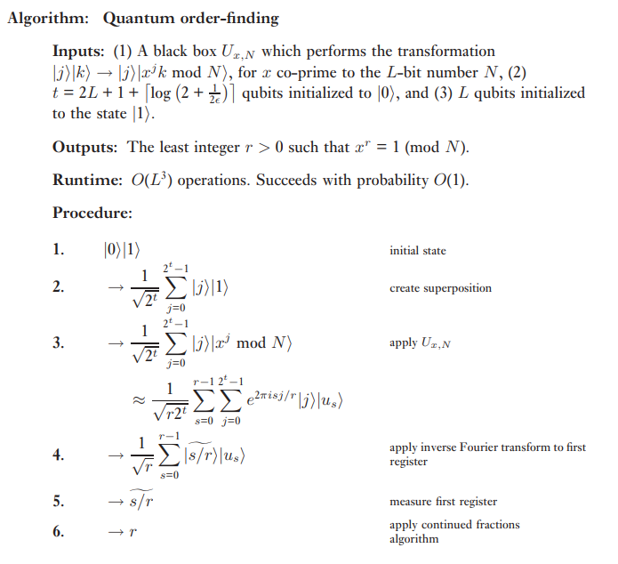
Quantum Order Finding – Algorithm

Slide 9
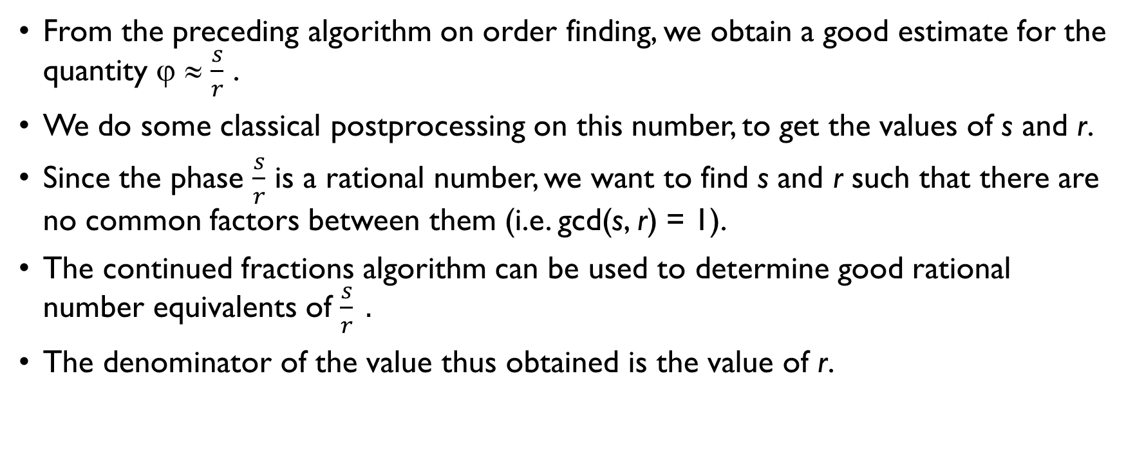
The Continued Fractions Algorithm
From the preceding algorithm on order finding, we obtain a good estimate for the quantity ϕ ≈ $\frac{s}{r}$ .
We do some classical postprocessing on this number, to get the values of s and r.
Since the phase $\frac{s}{r}$ is a rational number, we want to find s and r such that there are no common factors between them (i.e. gcd(s, r) = 1).
The continued fractions algorithm can be used to determine good rational number equivalents of $\frac{s}{r} .$
The denominator of the value thus obtained is the value of r.

Slide 10
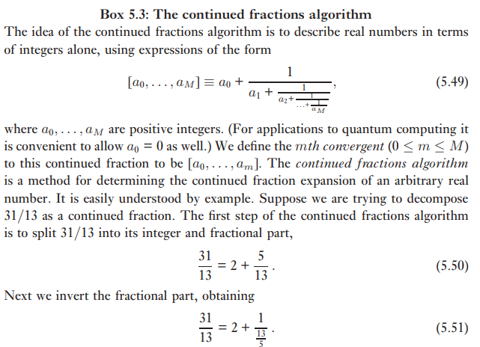
The Continued Fractions Algorithm - I

Slide 11
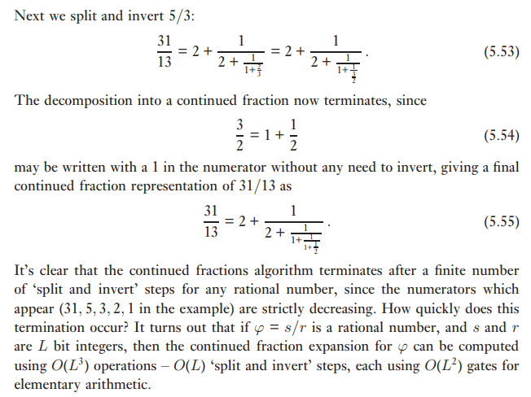
The Continued Fractions Algorithm – II

Slide 12
Shor’s Algorithm
Now we have all the elements in place to explain Shor’s Algorithm for factorization.
Given the order r to the base a of an integer N, i.e.,
a^{r} ≡ 1 (mod N).
This can be factorized into (provided r is even),
(a^{r/2} – 1)(a^{r/2} + 1) ≡ 0 (mod N).
Then N | (a^{r/2} – 1)(a^{r/2} + 1) i.e. N divides (a^{r/2} – 1)(a^{r/2} + 1).
We find gcd(a^{r/2} – 1, N) and gcd(a^{r/2} + 1, N) and one of these can give a non-trivial factor of N.

Slide 13
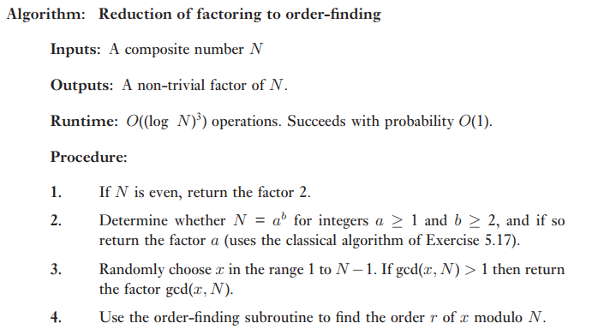
Shor’s Algorithm – Steps
Observe that step 4 is the “quantum” step in the algorithm.
All of the other steps are classical steps.

Slide 14
Shor’s Algorithm – Class Activity
Let us try to factorize 511 using Shor’s Algorithm.
First of all let us insure that 511 is not of the form a^{b}.
Next, pick a number a such that gcd(a, N) = 1 (say a = 2).
What is the order of 511 w.r.t 2?
r = 9 (it’s odd!).
Next let’s try the order of 511 w.r.t. 3:
r = 12 (it’s even!)
Therefore, compute gcd(3⁶ – 1, 511) and gcd(3⁶ + 1, 511) for a factor of 511.
Interestingly, both the expressions give a factor of 511.

Slide 15
Shor’s Algorithm - Conclusion
Shor’s Algorithm computes the factor of N in polynomial time using quantum computing.
The key to this speedup is the order finding algorithm which finds the order of an integer due to quantum parallelism.
A number of details have been left out in these slides to give a broad overview.
Details related to error analysis for QPE, efficiency considerations can be found in Nielsen and Chuang, Chapter 5.

