Slide 1
CS/PHYS-314/300: Quantum Computing Unit 14: Quantum Error Correction
Habib University – Shaping Futures
Faisal Alvi
(For any suggested modifications please email: faisal.alvi@sse.habib.edu.pk)

Slide 2
Unit Outline
Introduction
Noise In Quantum Computing
3-qubit bit flip code
3-qubit phase flip code
Shor Code
[Reference & Acknowledgement] Some of the slides in this unit as well as in the last unit have been referenced from the Quantum Computing course at Cambridge University available at:
https://www.cl.cam.ac.uk/teaching/1920/QuantComp/materials.html

Slide 3
Noise in Quantum Computing
Noise in Quantum Computing:
Several possible sources
Disturbances in Earth's magnetic field
Local radiation from Wi-Fi or mobile phones
Cosmic rays
Thermal fluctuations
Electromagnetic interference
Imperfections in quantum gates
Interactions with the environment
The influence of neighboring qubits

Slide 4
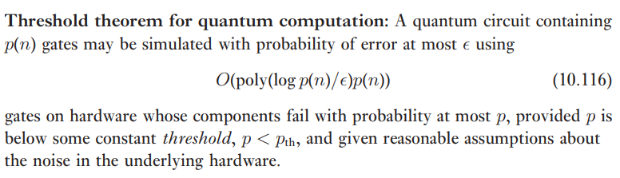
Fault Tolerant Quantum Computing – The Ideal Scenario
In quantum computing, the threshold theorem (or quantum fault-tolerance theorem) states that a quantum computer with a physical error rate below a certain threshold can, through application of quantum error correction schemes, suppress the logical error rate to arbitrarily low levels.

Slide 5
Noisy Intermediate Scale Quantum Era – The Current State
The current state of quantum computing is referred to as the noisy intermediate-scale quantum (NISQ) era
We have Quantum processors containing up to 1000 qubits which are not advanced enough yet for fault-tolerance or large enough to achieve quantum supremacy.
These processors, which are sensitive to their environment (noisy) and prone to quantum decoherence, are not yet capable of continuous quantum error correction.

Slide 6
Quantum Error Correction
Quantum Error Correction is used to mitigate the effects of decoherence.
Decoherence can be stated as the loss of information from the system into the environment.
Techniques such as quantum error correction can be used to correct errors introduced within qubits.

Slide 7
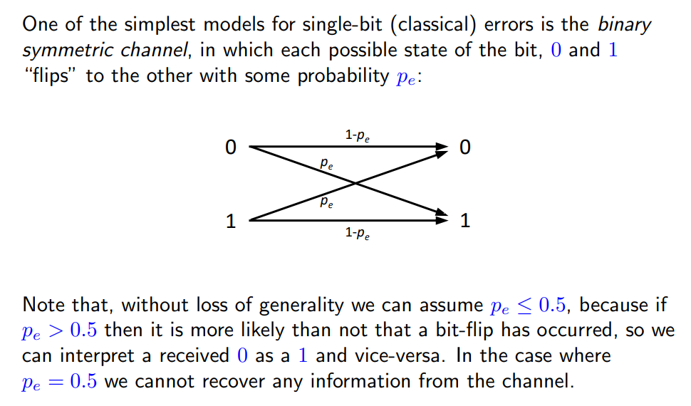
Classical Error Correction

Slide 8
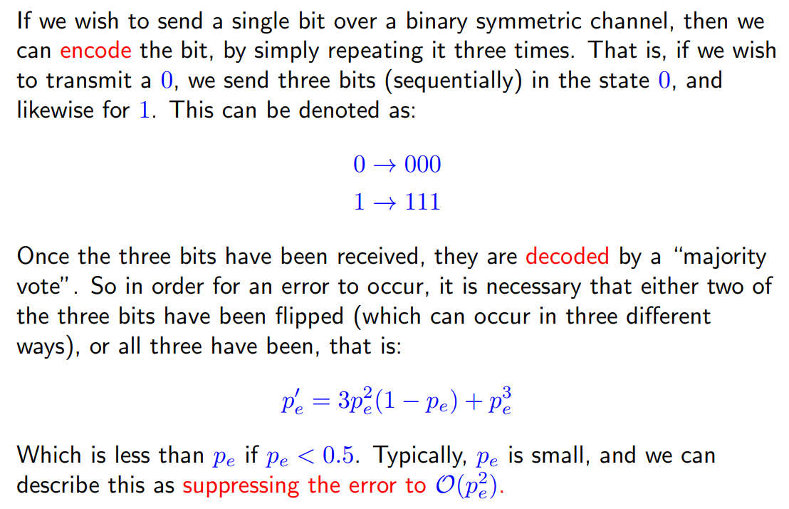
Classical Error Correction – Repetition of bits

Slide 9
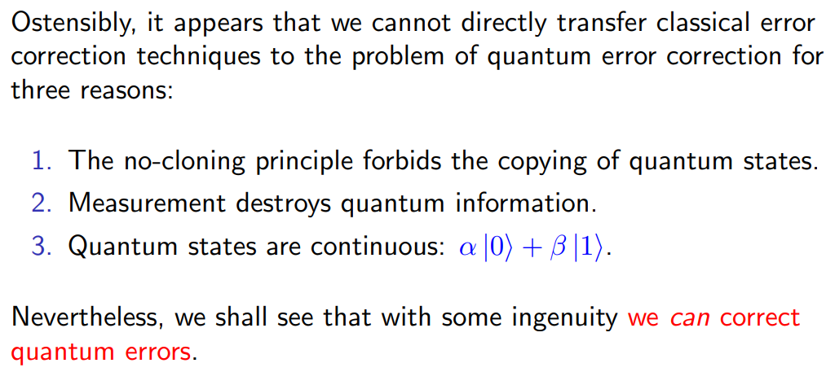
Quantum Error Correction – Limitations

Slide 10
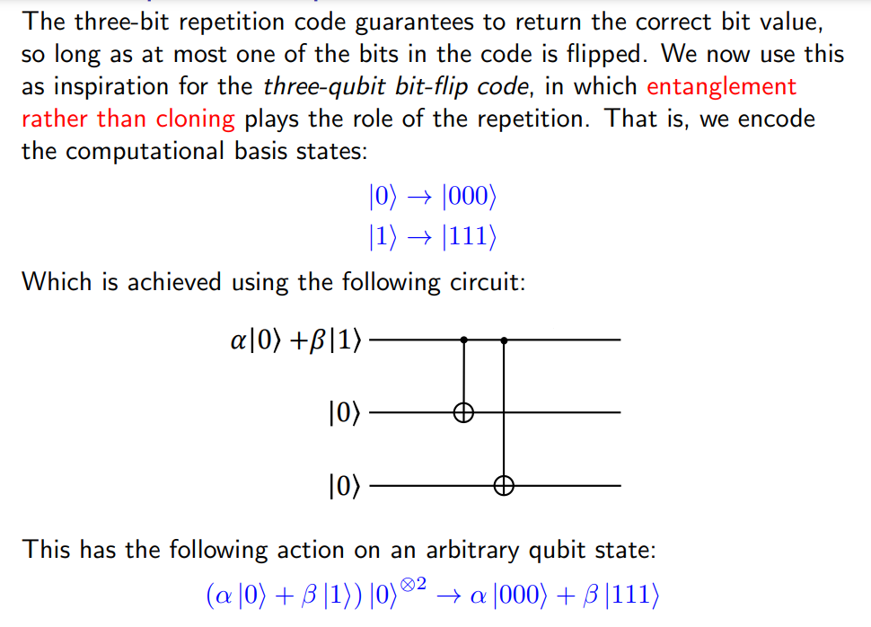
The 3-qubit bit flip code

Slide 11
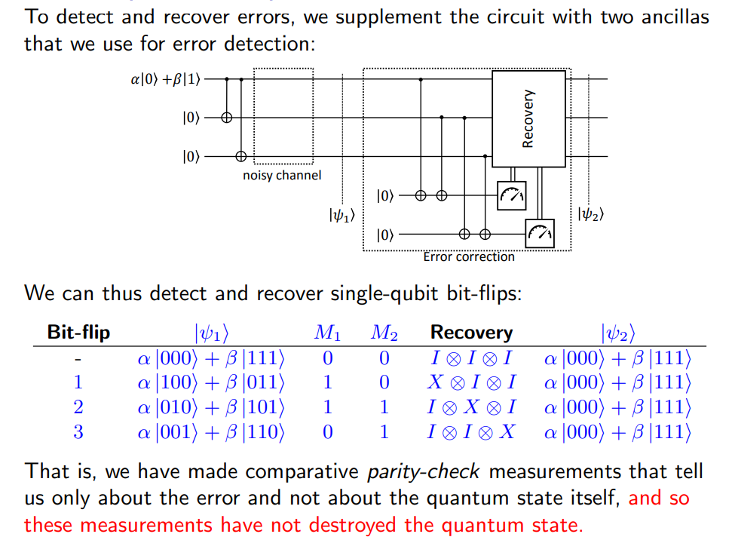
3-qubit bit flip code: Error Detection and Recovery

Slide 12
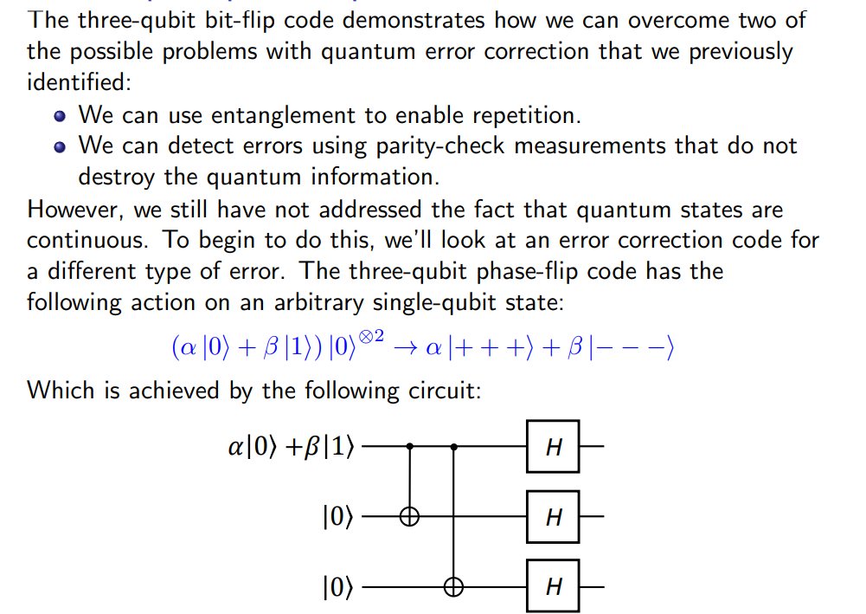
The 3-qubit phase flip code

Slide 13
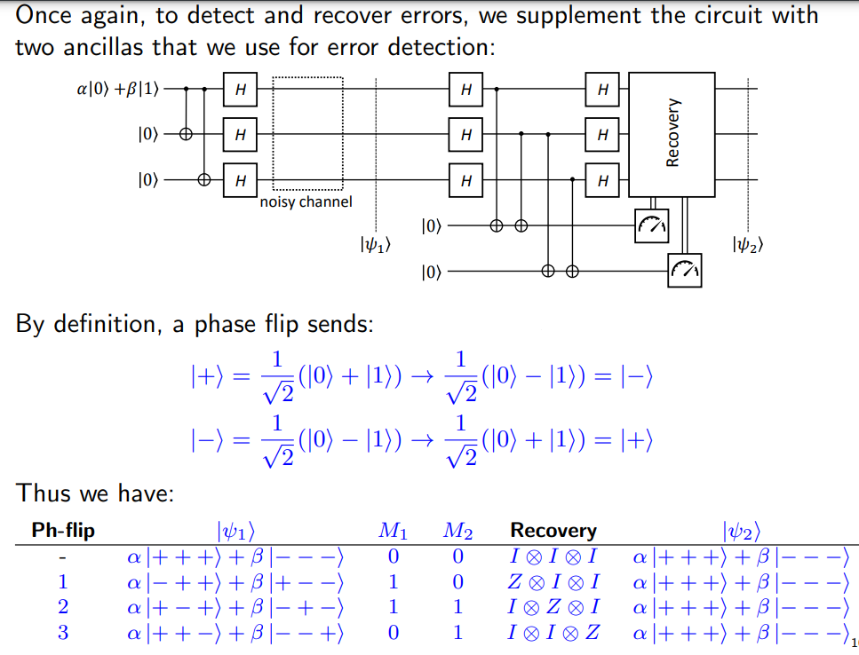
The 3-qubit phase flip code: Error Detection and Recovery

Slide 14
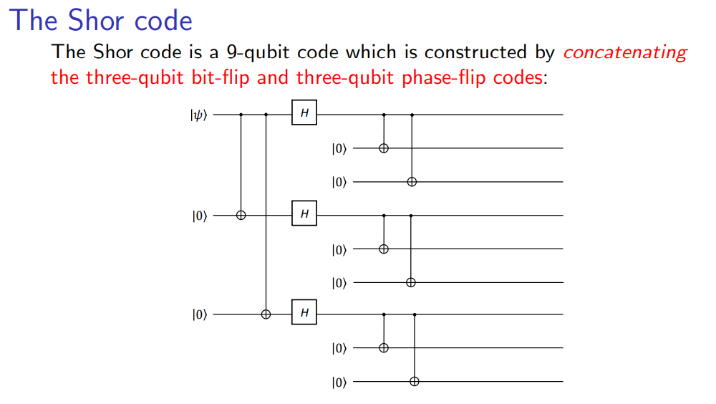
The Shor Code: can correct both bit and phase flips

Slide 15
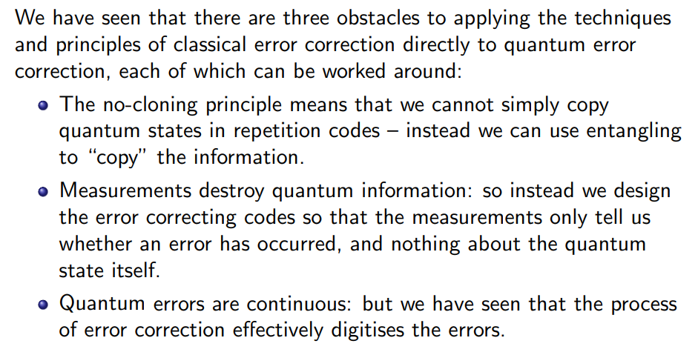
Summary

