Slide 1
Number Theory Chapter 4
Discrete Mathematics, Kenneth Rosen, 7th Edition

Slide 2
Introduction
Number Theory is the part of mathematics devoted to the study of the set of integers and their properties.
Topics that we cover include:
4.1 Divisibility of Integers
4.1 Modular Arithmetic
4.2 Integer Representations and Algorithms
4.3 Primes
4.3 Greatest Common Divisors and Least Common Multiple
4.4 Solving Congruences
4.5 Applications of Congruences
4.6 Cryptography
Some, Not all

Slide 3
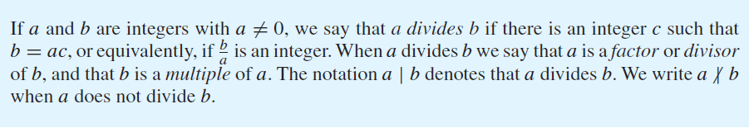
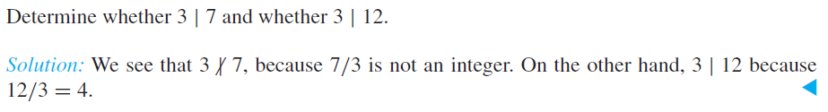
4.1: Divisibility

Slide 4
Divisibility Theorem
THEOREM 1: Let a, b, and c be integers, where a ≠ 0. Then
(i) if a | b and a | c, then a | (b + c),
(ii) if a | b, then a | bc for all integers c,
(iii) if a | b and b | c, then a | c.
Proof (i) if a | b, then b = am for some integer m.
if a | c, then c = an for some integer n.
Therefore b + c = am + an = a(m + n) and hence a | (b + c).
Class Activity: Prove (ii) and (iii)
COROLLARY: If a | b and a | c, then a | (mb + nc) for some integers m and n

Slide 5
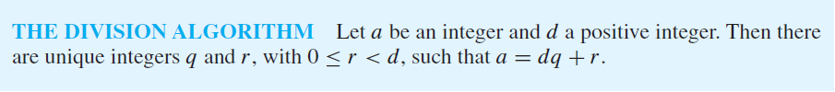
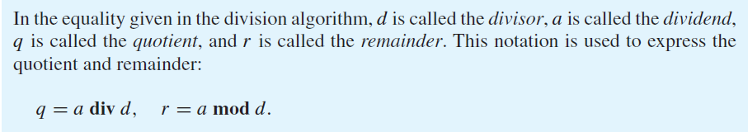
4.1 The Division Algorithm
Example: When 101 is divided by 11, 101 = 11x9 + 2, hence q = 9, r = 2.
Example: When -11 is divided by 3, -11 = 3x(-4) + 1, hence q = -4 , r = 1.

Slide 6
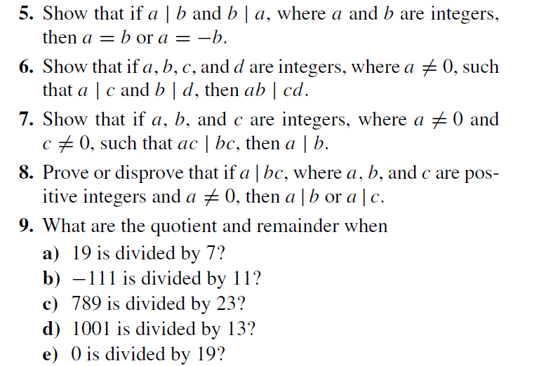
Exercises (Try some of these in class)

Slide 7
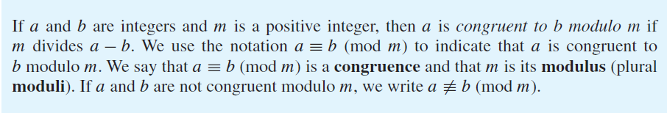
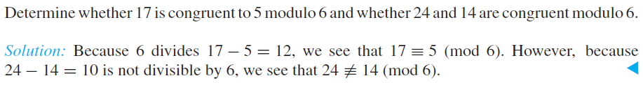

Modular Arithmetic

Slide 8
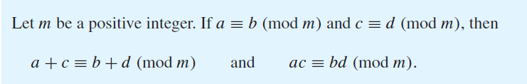
Theorems
1) Let m be a positive integer. The integers a and b are congruent modulo m if and only if there is an integer k such that a = b + km.
Proof: By definition, if a ≡ b (mod m), then m divides a – b.
Therefore a – b = mk for some integer k. Hence a = b + km.
2)
Proof: Class Exercise

Slide 9
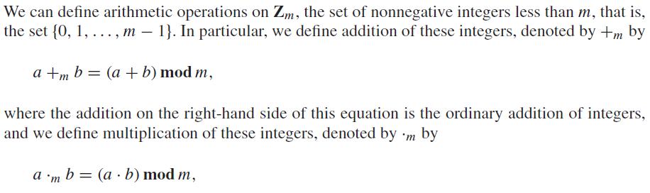
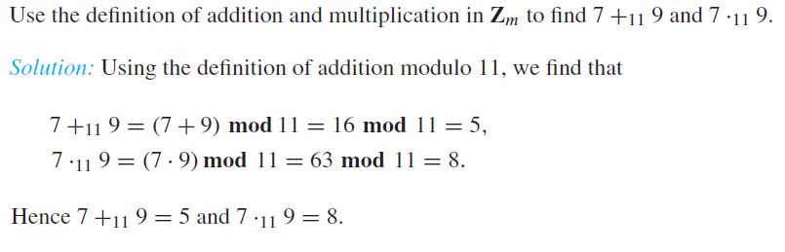
Operations modulo m

Slide 10
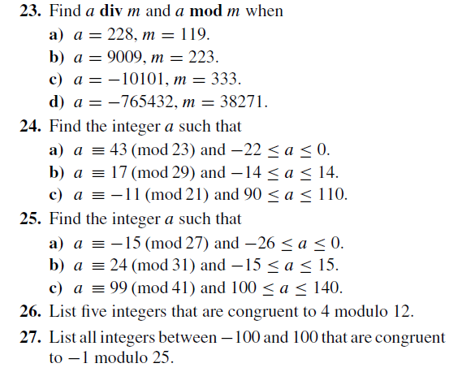
Exercises

Slide 11
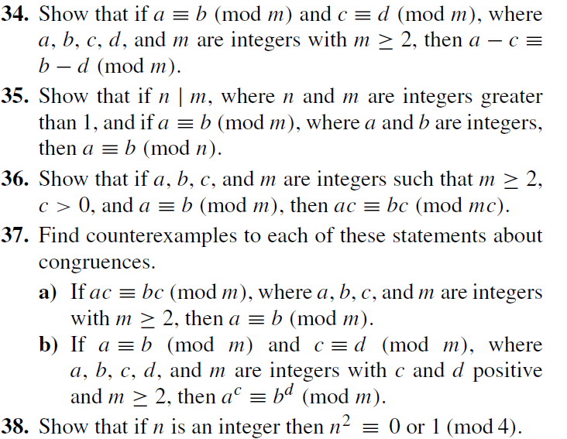
Some Exercise Proofs

Slide 12
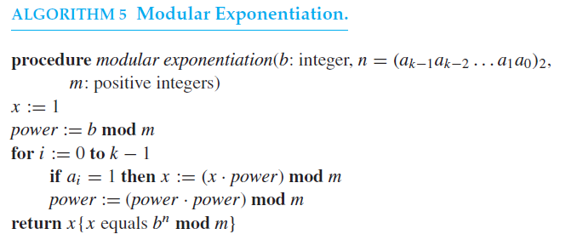
Modular Exponentiation

Slide 13
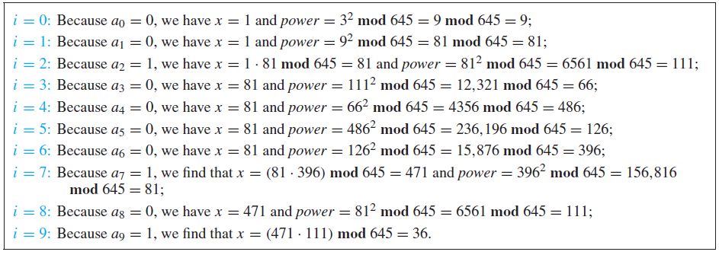
Example
Use Algorithm 5 to find x = 3⁶⁴⁴ mod 645.

Slide 14
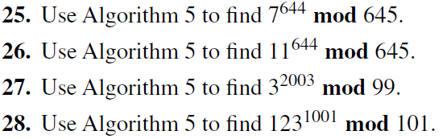
Exercises

Slide 15
Divisibility Proofs
Q. 31 Show that a positive integer is divisible by 3 if and only if the sum of its decimal digits is divisible by 3.
Here we will try to prove that
if the sum of digits of an integer is divisible by 3, then the integer is divisible by 3.
Let an integer n be represented as a_{k} a_{k – 1} a_{k – 2} … a₂ a₁ a₀ .
Therefore,
n = 10^{k} a_{k} + 10^{k – 1}a_{k – 1} + … + 10a₁ + a₀
if the sum of digits is divisible by 3, this means
3 | (a_{k} + a_{k – 1} + a_{k – 2} + … + a₂ + a₁ + a₀ ).
=> (a_{k} + a_{k – 1} + a_{k – 2} + … + a₂ + a₁ + a₀ ) = 3c

Slide 16
Proof (Continued)
Since
n = 10^{k} a_{k} + 10^{k – 1}a_{k – 1} + … + 10a₁ + a₀
n = (10^{k} – 1)a_{k} + (10^{k – 1} – 1)a_{k – 1} + … + 9a₁ + (a_{k} + a_{k – 1} + … + a₁ + a₀ )
n = (999… (k digits))a_{k} + (999…(k – 1 digits)) a_{k – 1} + … + 9a₁ + 3c
as each of the integers of the form 10^{x} – 1 is of the form 999…9.
Since each of the integers in the above expression is divisible by 3,
Therefore n is divisible by 3. PROVED.
The other direction is left for you to prove as an exercise.
Note: The same proof can be given much easily using modular arithmetic

Slide 17
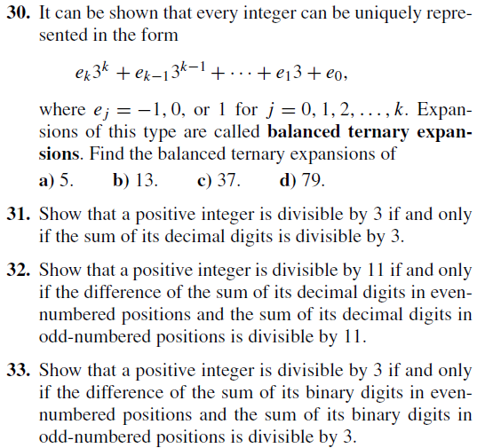
Divisibility Proofs

Slide 18
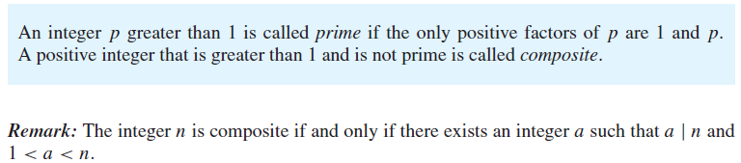
4.3 Primes and Greatest Common Divisors
Example:
Between 91 and 100 inclusive, the only prime integer is 97, since
91 = 7 x 13, 92 = 2 x 2 x 23, 93 = 3 x 31,
94 = 2 x 47, 95 = 5 x 19 96 = 2 x 2 x 2 x 2 x 2 x 3,
97 = 1 x 97, 98 = 2 x 7 x 7, 99 = 3 x 3 x 11,
100 = 2 x 2 x 5 x 5

Slide 19
Theorem for Primality Testing
Theorem: If n is a composite integer, then n has a prime factor less than or equal to √n.
Proof (by contradiction)
Suppose that n is a composite integer, with all of its factors greater than √n.
In particular, if n = ab, where a > √n and b > √n.
Then n = ab > √n x √n > n, which is a contradiction.
Example: Find the prime factorization of 931.
Since (931)^{1/2}= 30.5, we will do trial division of 931 with all primes <= 30.5.
Upon trial division we find that 931 = 7 x 133.
Furthermore, 133 = 7 x 19.
Therefore 931 = 7 x 7 x 133.

Slide 20
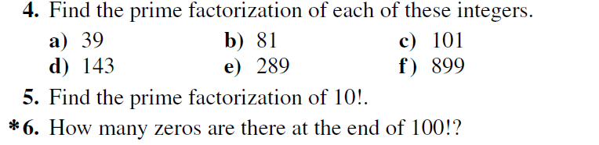
Mersenne Primes
If p is a prime, then the integer 2^{p} – 1 may be a prime integer. Such primes are called Mersenne primes.
Example: 2³ – 1 = 7 is a prime, while 2¹¹ – 1 = 2047 is not (What are the prime factors of 2047?)
Exercises

Slide 21
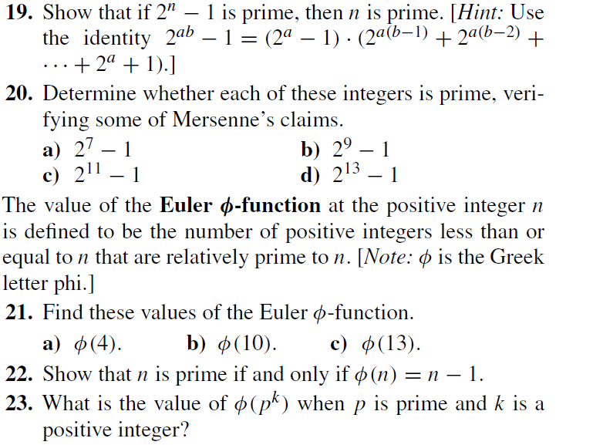
More Exercises

Slide 22

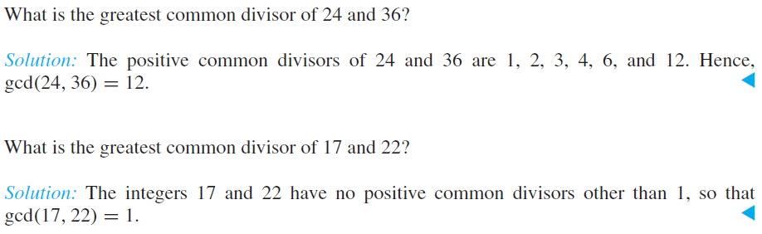
GCD and LCM

Slide 23
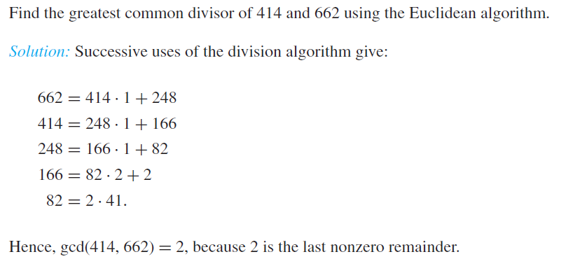
Euclidean Algorithm for GCD

Slide 24

GCD and LCM
Class Exercise: What is the least common multiple of 24 and 36?

Slide 25
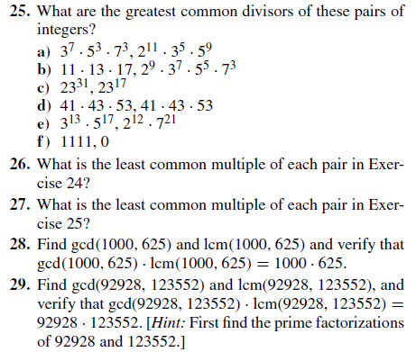
Exercises

Slide 26
GCD as a Linear Combination
Theorem:
If a and b are positive integers, then there exists integers s and t such that
gcd(a, b) = sa + tb.
Example:
Express gcd(252, 198) = 18 as a linear combination of 252 and 198.
Solution:
Using the Euclidean Algorithm, we find that:
252 = 1*198 + 54
198 = 3*54 + 36
54 = 1*36 + 18
36 = 2*18.
Therefore gcd(252, 198) = 18, since 18 is last nonzero remainder.

Slide 27
GCD as a linear combination
Using the 3rd division, we express gcd(252, 198) = 18 as a linear combination of 54 and 36.
We get
18 = 54 – 1*36.
The second division tells us that
36 = 198 – 3*54.
Substituting for 36 into the previous equation, we get
18 = 54 – 1*36 = 54 – 1*(198 – 3*54) = 4*54 – 1*198.
The first division tells us that
54 = 252 – 1*198.
Substituting for 54 into the previous equation, we get
18 = 4*(252 – 1*198) – 1*198 = 4*252 – 5*198.
Therefore, gcd(252, 198) = 18 = 4(252) – 5(198)
252 = 1*198 + 54
198 = 3*54 + 36
54 = 1*36 + 18
36 = 2*18.

Slide 28
Theorem
Theorem
If a, b, and c are positive integers such that gcd(a, b) = 1 and a | bc, then a | c.
Proof:
Since gcd(a, b) = 1, by Theorem 1 there are integers s and t such that
sa + tb = 1.
Multiplying both slides of this equation by c, we obtain
sac + tbc = c.
Using Theorem 1 of Section 3.4, we can use this last equation to show that a | c.
By part 2 of that theorem, a | tbc. Since a | sac and a | tbc, by part 1 of that
theorem, we conclude that a divides sac + tbc, and hence a | c.

Slide 29
Another Theorem
Theorem
Let m be a positive integer, and let a, b, and c be integers.
If ac ≡ bc(mod m) and gcd(c, m) =1, then a ≡ b (mod m).
Proof:
Since ac ≡ bc (mod m), m | ac – bc = c(a – b).
By the previous result, since gcd(c, m) = 1, it follows that m | a – b.
We conclude that a ≡ b (mod m).

Slide 30
Inverse Modulo m
Let a and m be two relatively prime integers.
If
a . x ≡ 1 (mod m)
Then x is called the inverse of a modulo m.
It must be noted that the inverse exists if and only if gcd(a, m) = 1.
The inverse x is unique modulo m. i.e. there exists exactly one value of x such that 0 ≤ x ≤ m.
Example:
The inverse of 5 modulo 7 is 3 since 5 . 3 ≡ 1 (mod 7)
Example:
The inverse of 6 modulo 2 does not exist, since gcd(6, 2) ≠ 1.

Slide 31
Inverse Modulo m
Theorem
If a and m are relatively prime integers and m > 1, then an inverse of
a modulo m exists. Furthermore, this inverse is unique modulo m.
Proof:
By Theorem 1, since gcd(a, m) = 1, there are integers s and t such that sa + tm = 1.
This implies that sa + tm ≡ 1 (mod m).
Since tm ≡ 0 (mod m), it follows that sa ≡ 1 (mod m).
Consequently, s is an inverse of a modulo m.

Slide 32
Inverse Modulo m
Example:
Find the inverse of 3 modulo 7.
Solution
Since gcd(3, 7) = 1.
Using Euclidean algorithm: 7 = 2*3 + 1.
From this equation we see that –2*3 + 1*7 = 1.
This shows that –2 is an inverse of 3 modulo 7.
Every integer congruent to –2 modulo 7 is also an inverse of 3, such as 5, –9, 12, …

Slide 33
Linear Congruences
Linear Congruences:
A congruence of the form ax ≡ b (mod m)
where m is a positive integer, a and b are integers, and x is a variable, is called a
linear congruence. Such congruences arise throughout number theory and its
applications.
How to solve a linear congruence of the form ax ≡ b (mod m)?
First, find the inverse of a modulo m. Let’s call this inverse a ^{– 1}.
Therefore a . a^{– 1} ≡ 1 (mod m)
By multiplying both sides of the above congruence by a^{– 1} , we get,
a . a^{– 1} . x ≡ a ^{– 1} b (mod m)
=> 1 . x = (a ^{– 1} b) (mod m)
Hence the solution to ax ≡ b (mod m) is x = (a ^{– 1} b) (mod m)
Note that if a^{– 1} does not exist, then the congruence has no solution.

Slide 34
Linear Congruences
Example:
What are the solutions of the linear congruence 3x ≡ 4 (mod 7)?
Solution:
By the previous example, –2 is an inverse of 3 modulo 7.
The unique value of the inverse modulo 7 is 5.
Therefore, 5*3x ≡ 5*4 (mod 7).
=> (15) x ≡ (20) (mod 7).
Since 15 ≡ 1 (mod 7) and 20 ≡ 6 (mod 7), it follows that
x ≡ 20 ≡ 6 (mod 7).
In general x = 7k + 6, where k is any integer.
Verification:
3x ≡ 3*6 = 18 ≡ 4 (mod 7),
Therefore, x ≡ 6 (mod 7), namely, 6, 13, 20, … and –1, –8, –15, …..

Slide 35
Chinese Remainder Theorem
The Chinese Remainder Theorem:
Let m₁, m₂, …, m_{n} be pairwise relatively prime positive integers. The
system:
x ≡ a₁ (mod m₁)
x ≡ a₂ (mod m₂)
.
.
.
x ≡ a_{n} (mod m_{n})
has a unique solution modulo m = m₁m₂…m_{n} (i.e. there is a solution x with
0 ≤ x < m, and all other solutions are congruent modulo m to this solution)

Slide 36
Chinese Remainder Theorem
Proof:
We need to show that a solution exists and that it is unique modulo m. Here, we will only show that a solution exists. We do this by describing a way to construct a solution. To do that, first let M_{k} = m/m_{k} for k = 1, 2, … , n.
That is, M_{k} is the product of the moduli except for m_{k}. Since m_{i} and m_{k} have no common factors greater than 1 when i ≠ k, if follows that gcd(m_{k}, M_{k}) = 1.
Consequently, by Theorem 3, we know that there is an integer y_{k}, an inverse of M_{k} modulo m_{k} such that M_{k} y_{k} ≡ 1 (mod m_{k}).
To construct a simultaneous solution, form the sum
x = a₁M₁y₁ + a₂M₂y₂ + …… + a_{n}M_{n}y_{n}.
Now, we show that x is a simultaneous solution. First, note that since
M_{j} ≡ 0 (mod m_{k}) whenever j ≠ k, all terms except the kth term in this sum are
congruent to 0 modulo m_{k}. Since M_{k}y_{k} ≡ 1 (mod m_{k}) we see that
x ≡ a_{k}M_{k}y_{k} ≡ a_{k} (mod m_{k}), for k = 1, 2, … , n.
We have shown that x is a simultaneous solution to the n congruences.

Slide 37
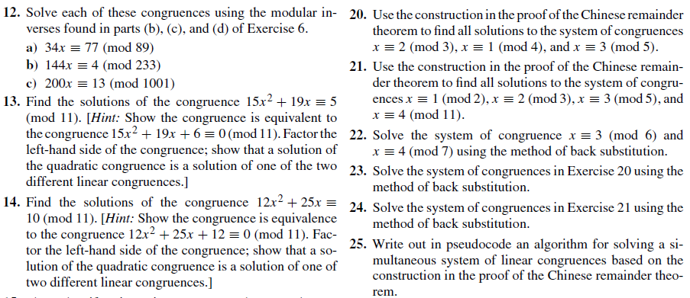
Exercises

Slide 38
Chinese Remainder Theorem
Example: Solve the system of congruences,
x ≡ 2 (mod 3), x ≡ 3 (mod 5), x ≡ 2 (mod 7).
To solve the system of congruences, first let m = 3*5*7 = 105,
M₁ = m/3 = 35, M₂ = m/5 = 21, M₃ = m/7 = 15.
35 ≡ 2 (mod 3) ➔ 2 is an inverse of M₁ = 35 modulo 3.
21 ≡ 1 (mod 5) ➔ 1 is an inverse of M₂ = 21 modulo 5.
15 ≡ 1 (mod 7) ➔ 1 is an inverse of M₃ = 15 modulo 7.
The solutions to this system are those x such that
x ≡ a₁M₁y₁ + a₂M₂y₂ + a₃M₃y₃ = 2*35*2 + 3*21*1 + 2*15*1 (mod 105)
= 233 ≡ 23 (mod 105).
If follows that 23 is the smallest positive integer that is a simultaneous solution.
We conclude that 23 is the smallest positive integer that leaves a remainder of 2
when divided by 3, a remainder of 3 when divided by 5 and a remainder of 2 when
divided by 7.

Slide 39
Computer Arithmetic With Large Integers
Computer Arithmetic with Large Integers:
How do we perform arithmetic with large integers?
In particular, if a computer’s registers support only integers represented in 64-bit binary form, how are arithmetic operations carried out on integers larger than 64-bits?
One solution is provided by using the chinese remainder theorem.
Suppose that m₁, m₂, … , m_{n} are pairwise relatively prime integers greater than or equal to 2 and let m be their product. By the Chinese Remainder Theorem, we can show that an integer a with 0 ≤ a < m can be uniquely represented by
(a mod m₁, a mod m₂, … , a mod m_{n})

Slide 40
Computer Arithmetic With Large Integers
Example:
What are the pairs used to represent the nonnegative integers less than 12 when
they are represented by the ordered pair where the first component is the
remainder of the integer upon division by 3 and the second component is the
remainder of the integer upon division by 4?
0 = (0, 0) 4 = (1, 0) 8 = (2, 0)
1 = (1, 1) 5 = (2, 1) 9 = (0, 1)
2 = (2, 2) 6 = (0, 2) 10 = (1, 2)
3 = (0, 3) 7 = (1, 3) 11 = (2, 3)

Slide 41
Computer Arithmetic With Large Integers
Example: Find the sum of the sum of 123,684 and 413,456 using 2-digit representation
The numbers 99, 98, 97 and 95 are pairwise relatively prime. By the Chinese Remainder Theorem, every nonnegative integer less than 99*98*97*95 = 89,403,930 can be represented uniquely by its remainders when divided by these four moduli. For example, we can represent 123,684 as
123,684 = (123684 mod 99, 123684 mod 98, 123684 mod 97, 123684 mod 95)
= (33, 8, 9, 89)
Similarly, we can represent 413,456 as (32, 92, 42, 16)
Therefore, 123,684 + 413,456 = (33, 8, 9, 89) + (32, 92, 42, 16)
= (65 mod 99, 100 mod 98, 51 mod 97, 105 mod 95) = (65, 2, 51, 10).
To find the sum we need to solve the system
x ≡ 65 (mod 99)
x ≡ 2 (mod 98)
x ≡ 51 (mod 97)
x ≡ 10 (mod 95)
The integer 537,140 is the unique nonnegative solution of this system less than 98,403,930.

Slide 42
Fermat’s Little Theorem
Fermat’s Little Theorem:
If p is a prime and a is an integer not divisible by p, then
a^{p – 1} ≡ 1 (mod p).
Furthermore, for every integer a we have
a^{p} ≡ a (mod p).
Note that if p is a prime (e.g. p = 3), 2^{p – 1} ≡ 1 (mod p),
but not necessarily the other way around as the following example shows.
Example:
The integer 341 is a pseudoprime since it is composite (341 = 11*31)
2340 = 1 (mod 341).

Slide 43
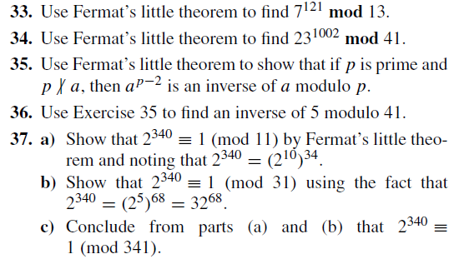
Exercises

Slide 44
Public Key Cryptography
Public Key Cryptography:
In private key cryptosystems, one can quickly find the decryption key if knowing the encryption key (e.g. encryption based on congruence introduced in 3.4)
In public key cryptography, everyone can have the publicity to know the encryption key. Only the decryption keys are kept secret, and only the intended recipient of a message can decrypt it. (e.g. RSA encryption)
RSA is a public key cryptosystem introduced by three researchers at MIT in 1976 – Ronald Rivest, Adi Shamir and Leonard Adleman.

Slide 45
RSA (Section 4.6)
RSA Cryptosystem
The RSA Cryptosystem is based on the concept of public key cryptography.
Each user of the system has a pair of keys:
a public key e which is known to all users of the system
a private or secret key d which is only known to the user alone.
the pair of keys (e, d) forms a complete pair of keys for the user.
Key Generation
Choose an integer n which has two large prime factors p and q. An example is n = 10403 which has factors p = 101 and q = 103.
Choose an integer e that is relatively prime to (p – 1)(q – 1). This is the public key e.
The inverse of e modulo (p – 1)(q – 1) is the private key d, i.e.,
de ≡ 1 (mod (p – 1)(q – 1))

Slide 46
RSA Encryption
RSA Encryption:
- Each letter in the message is translated into an integer. Those integers are
grouped together to form larger integers, each representing a block of letters.
- We encrypt by transforming the integer M, representing the original message, to
an integer C, representing the encrypted message using the function
C = M ^{e} mod n.
where e is the encryption key or the public key of the receiver.

Slide 47
RSA Decryption
RSA Decryption:
The original message can be easily recovered when the decryption key d, an
inverse of e modulo (p – 1)(q – 1), is known. To see this, note that if
de ≡ 1 (mod (p – 1)(q – 1)),
there is an integer k such that de = 1 + k(p – 1)(q – 1).
It follows that C ^{d} = (M ^{e}) ^{d} = M ^{de} = M ^{1 + k(p – 1)(q – 1)}.
By Fermat’s Little Theorem, M ^{p – 1} ≡ 1 (mod p) and M ^{q – 1} ≡ 1 (mod q).
Consequently,
C ^{d} ≡ M (M ^{q – 1}) ^{k (p – 1)} ≡ M * 1 ≡ M (mod p) and
C ^{d} ≡ M (M ^{q – 1}) ^{k (p – 1)} ≡ M * 1 ≡ M (mod q).
Since gcd(p, q) = 1, if follows by the Chinese Remainder Theorem that
C ^{d} ≡ M (mod pq)

Slide 48
Example
Example:
Encrypt the message ‘STOP’ using the RSA cryptosystem with p = 43 and q = 59,
so that n = 43*59 = 2537, and with e = 13. Note that
gcd(e, (p – 1)(q – 1)) = gcd(13, 42*58) = 1.
We translate the letters into their numerical equivalents and then group the numbers
into blocks of four. We obtain 1819 1415.
We encrypt each block using the mapping
C = M¹³ mod 2537.
Computations using fast modular multiplication show that 181913 mod 2537 = 2081
and 141513 mod 2537 = 2182. The encrypted message is 2081 2182.

Slide 49
Example
Example:
Decrypt the message 0981 0461 using the RSA cipher used in the previous example.
n = 43*59, e = 13.
d = 937(see Exercise 10) is an inverse of 13 modulo 42*58 = 2436.
We use 937 as our decryption exponent. Consequently, to decrypt a block C, we
compute P = C⁹³⁷ mod 2537.
To decrypt the message, we use the fast modular exponentiation algorithm to
compute 0981937 mod 2537 = 0704 and 0461937 mod 2537 = 1115. Consequently,
the numerical version of the original message is 0704 1115. Translating this back to
English letters, we see that the message is HELP.

Slide 50
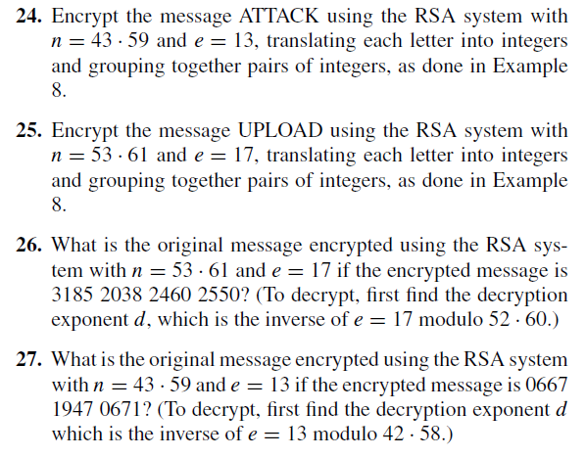
Exercises

