Slide 1
Conversion of HTML Template to WordPress theme
WordPress

Slide 2
What is WordPress?
WordPress is an open-source and free web publishing application, content management system(CMS) or a web software.
It is a framework, allow users to create a blog, a small website, or build a custom website that may be updated.
Wordpress started in 2003. Now it is the largest blogging tool used by many to let the world know what they think…

Slide 3
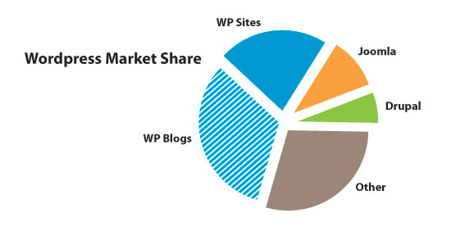
Why WordPress??
1) It is the most popular CMS in the World.
WordPress is used by 73 million websites as (WordPress Stats) and it holds the largest market share in the CMS market.

Slide 4
2) It is opensource
WordPress can be self-hosted so there are no cost associated with downloading, installing, and upgrading.
3) Highly customizable
WordPress is popular because its flexible framework allow designers and developers to create and modify layouts and applications.

Slide 5
4) Designed for everyone, not just developers
Most of user-interface components are user-friendly for users there are written and recorded manuals available for you to easily learn how to use WordPress.
5) Lower setup and maintenance cost
WordPress incurs less setup, customization, and maintenance cost in comparison to other Open Source CMS such as Drupal and Joomla.

Slide 6

Conversion
HTML to Wordpress

Slide 7
What is WP Theme?
A basic theme contains following files:-
Index.php
Header.php
Footer.php
Sidebar.php
Page.php
Page-template.php
Single.php
Comments.php
Front-page.php
category.php
Functions.php
Archive.php
Search.php
Style.css
Screenshot.png
404error.php

Slide 8
Template Hierarchy

Slide 9
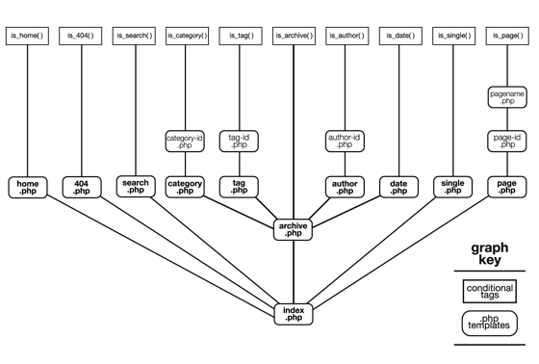

Slide 10
Common Pages of theme
Home Page
index.php
front-page.php
Page Display
custom-template.php
page.php
Single Post Display
single.php
Archive Display
category.php
index.php
archive.php

Slide 11

Files in my HTML Template
index.html
about.html
misc.html
gallery.html
column.html
typography.html
post.html
contact.html
style.css
 | A folder containing all images and necessary files for theme

Slide 12
Files in Custom Theme
A folder which containing all necessary supported files of theme
Index.php
Header.php
Footer.php
Sidebar.php
Functions.php
Category.php
Comments.php
Front-page.php
Search.php
Single.php
Page.php
Page-custom.php
Style.css
Screenshot.png

Slide 13
Index.html
Our index.html file split into four php files
header.php
index.php
sidebar.php
footer.php

Slide 14
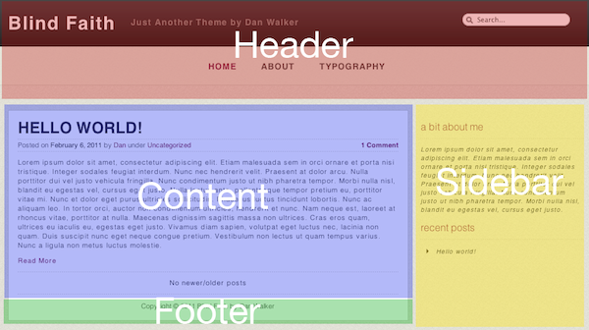

Slide 15


Header.php
Populating the header file from index.html
Open index.html and select everything from the opening DOCTYPE declaration to the opening div class="main" tag. Copy this and paste it to header.php.
This is header

Slide 16
<!DOCTYPE HTML>
<html lang="en-US">
<head>
<meta charset="UTF-8">
<title>Serendipity</title>
.
css and js files for styling and effects
<link rel="stylesheet" type="text/css" href="style.css" media="all" />
<script type="text/javascript" src="style/js/jquery-1.7.1.min.js"></script>
<body>
<div id="page">
<ul>
<div id="menu" class="menu">
<ul id="tiny">
<li><a href="index.html">Blog</a>
<ul>
<li><a href="post.html">Blog Post</a></li>
</ul>
</li>
<li><a href="gallery.html">Gallery</a></li>
<li><a href="misc.html">Styles</a>
<ul>
<li><a href="misc.html">Misc</a></li>
<li><a href="columns.html">Columns</a></li>
<li><a <href="typography.html">Typography</a></li>
</ul>
</li>
<li><a href="about.html">About</a></li>
<li><a href="contact.html">Contact</a></li>
</ul>
</div> .
<div class=”main”><!--main content-->

Slide 17
Functions used in header.php
<?php language_attributes(); ?>
this function is used for displays the language attributes for html tag.
<?php bloginfo(‘parameter’); ?>
this function is used for display information about your site and always print a result to the browser.
charset:- displays the encoding for pages.
template_directory:- it will return the active theme’s directory
stylesheet_url:- displays the primary css file for the active theme(like style.css).
<?php wp_title( ); ?>
this function is used for display the title of site
<?php wp_head(); ?>
It is a template tag to print whatever plugin / theme specific function used by wordpress action.
<? php wp_get_archives(); ?>
this function displays date-based archives list.

Slide 18
<?php echo get_option(‘home’); ?>
This is used for blog's home web address; set in General Options.
<?php wp_nav_menu( array(
'theme_location' => 'main-menu', //location of the theme
'container' => '', // (optional) Whether to wrap the ul, and what to wrap it with. Allowed tags are div and nav.
'menu_class' => 'nav', //this class is applied to ul elements
'fallback_cb' => 'wp_page_menu‘ //if menu doesn’t exist. Default menu used
)); ?>
this function is used to display the navigation menu on the site which is create in MENU panel of the wordpress

Slide 19
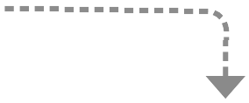
Footer.php
Populating the footer file from index.html
Open index.html and select everything from the end of main division </div><!--main content--> declaration and all footer content. Now copy this and paste it to footer.php.
This is footer

Slide 20
</div><!-- main -->
<footer id="colophon" role="contentinfo">
<div id="supplementary" class="four">
…......................................................
…......................................................
….....................................................
….....widgets area where user ….....
….....can call widgets if user ….......
…..................want it........................
…....................................................
…...................................................
</div><!-- #supplementary -->
<div id="site-generator">
Copyright 2012 - Serendipity
</div>
</footer><!-- #colophon -->
</div><!-- #wrapper -->
</div><!-- #page -->
</body>
</html>

Slide 21
Functions used in footer.php
<?php if ( is_active_sidebar( ‘widgets_index' ) ) : ?>
Any sidebar that contains widgets will return TRUE, whereas any sidebar that does not contain any widgets will return FALSE.
<?php dynamic_sidebar( 'footer-left' ); ?>
This function calls each of the active widget callbacks in order, which prints the markup for the sidebar
<?php wp_footer(); ?>
The wp_footer action is triggered near the </body> tag of the user's template by the wp_footer() function. the default output for this function is the admin panel which will be shown in the top of the theme.

Slide 22
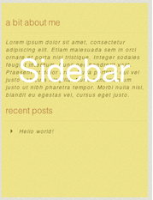
Sidebar.php
Populating the sidebar from index.html
Open index.html and select the aside class="sidebar" element and everything inside it. Now copy this and paste it to sidebar.php.
This is sidebar

Slide 23
<!-- the sidebar - in WordPress this will be populated with widgets -->
<aside class="sidebar widget-area one-third right" role="complementary">
<div class="widget-container">
<h3 class="widget-title">A sidebar widget</h3>
<p>This is a sidebar widget, in your WordPress theme you can set these up to display across your site.</p>
</div><!-- .widget-container -->
<div class="widget-container">
<h3 class="widget-title">Another sidebar widget</h3>
<p>A second sidebar widget, maybe you could use a plugin to display a social media feed, or simply list your most recent posts.</p>
</div><!-- .widget-container →
</aside>

Slide 24
Functions used in sidebar.php
<div id="supplementary" class="four">
<?php if ( is_active_sidebar( 'sidebar' ) ) : ?>
<?php dynamic_sidebar( 'sidebar' ); ?>
<?php endif; ?>
It is not compulsory to use sidebar on every template.

Slide 25
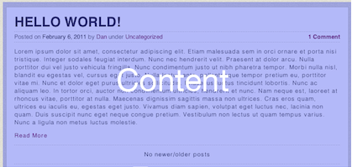
Index.php
Populating the index content from index.html
open your index.html file again and select all of the code between the opening div class="main" element and the sidebar
This is content of index page

Slide 26
<div class="two-thirds" id="content">
<article class="post" id="01">
<h2 class="entry-title">This is the title of a post or page</h2>
<img class="size-large" alt="" src="images/featured-image.jpg" />
<section class="entry-meta">
<p>Posted on 5 November by Rachel McCollin</p>
</section><!-- .entry-meta -->
<section class="entry-content">
<p>This is the content of the post. On an archive page it might be an excerpt of the post or you might include the entire content.</p>
<h3>Images in WordPress</h3>
<img class="alignright" alt="" src="images/another-image.jpg" />
<p>This post has some images included - once you've converted this html to a WordPress theme you'll be able to get WordPress to handle images for you and life will be so much easier!</p>
<p>It also has a featured image - again, WordPress will handle these for you and you'll never go back to static html again. you'll learn how to set up a custom archive page in Part 11.</p>
</section><!-- .entry-content -->
<section class="entry-meta">
<h3>Post Categories and Tags</h3>
<p>In this section you can display information about the categories ast, you'll learn how to do this using WordPress template tags in Part 4 of this series.</p>
</section><!-- .entry-meta -->
</article><!-- #01-->
</div><!-- #content-->

Slide 27
Merge all files together
The final step is to set up index.php file. You'll have to add some PHP functions which WordPress uses to include the header, sidebar and footer.
<?php get_header(); ?>
content of index file
<?php get_sidebar(); ?>
<?php get_footer(); ?>

Slide 28
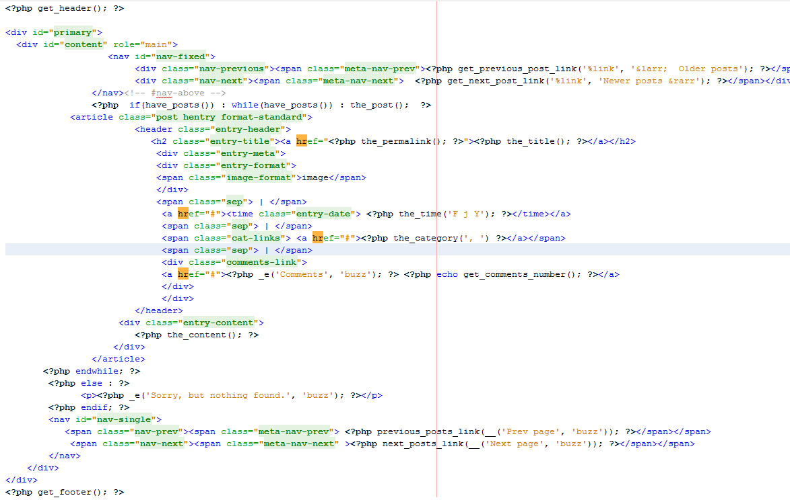

Slide 29
Front-page.php
This file is used for frontpage of site which display all blog-posts in it.

Slide 30
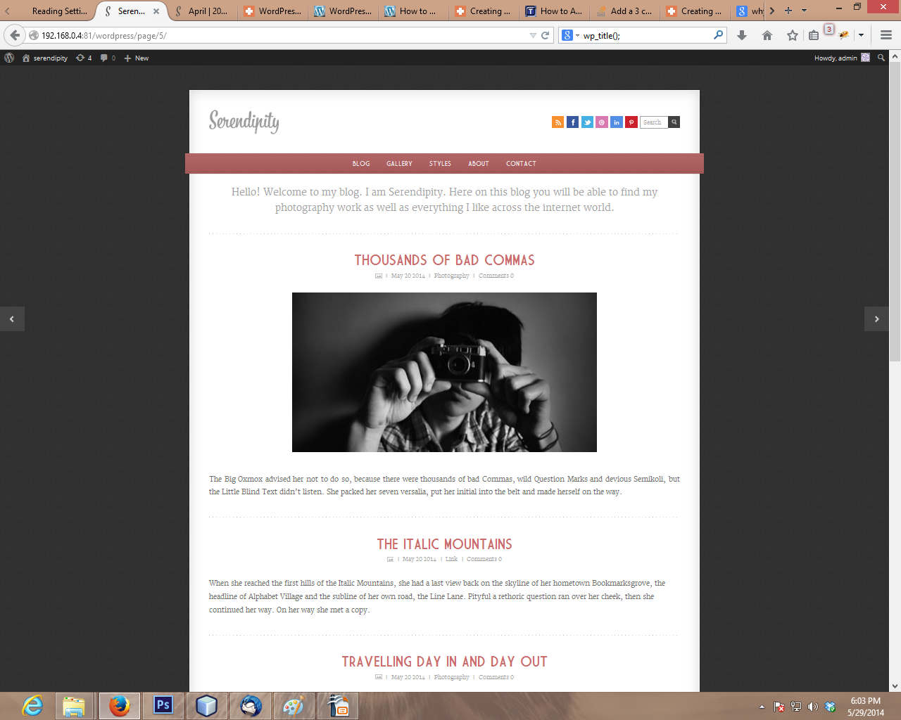

Slide 31
Functions used in front-page.php
<?php get_previous_posts_link(); ?>
This function is used to navigate from current posts page to previous posts page.
<?php get_next_posts_link(); ?>
This function is used to navigate from current posts page to next posts page.
<?php have_posts(); ?>
The have_post() function is used to check whether a post exist or not. If exists than return true otherwise false.
<?php the_post(); ?>
It display the post. Iterates the post index in the loop
<?php the_permalink(); ?>
Displays the URL to the post, without creating a link
<?php the_time(); ?>
This function is used for display the current time of the post.

Slide 32
<?php the_category(); ?>
This function is used to display category or categories a post belongs to.
<?php _e('$text', '$domain'); ?>
This functionn is used to display the returned translated text.
<?php get_comments_number(); ?>
This function returns the total number of comments for a post.
<?php the_content(); ?>
This function displays the content of the current post or page. It must be in the loop.

Slide 33
Single.php
This file is used to display a single post with its comment and related posts.

Slide 34
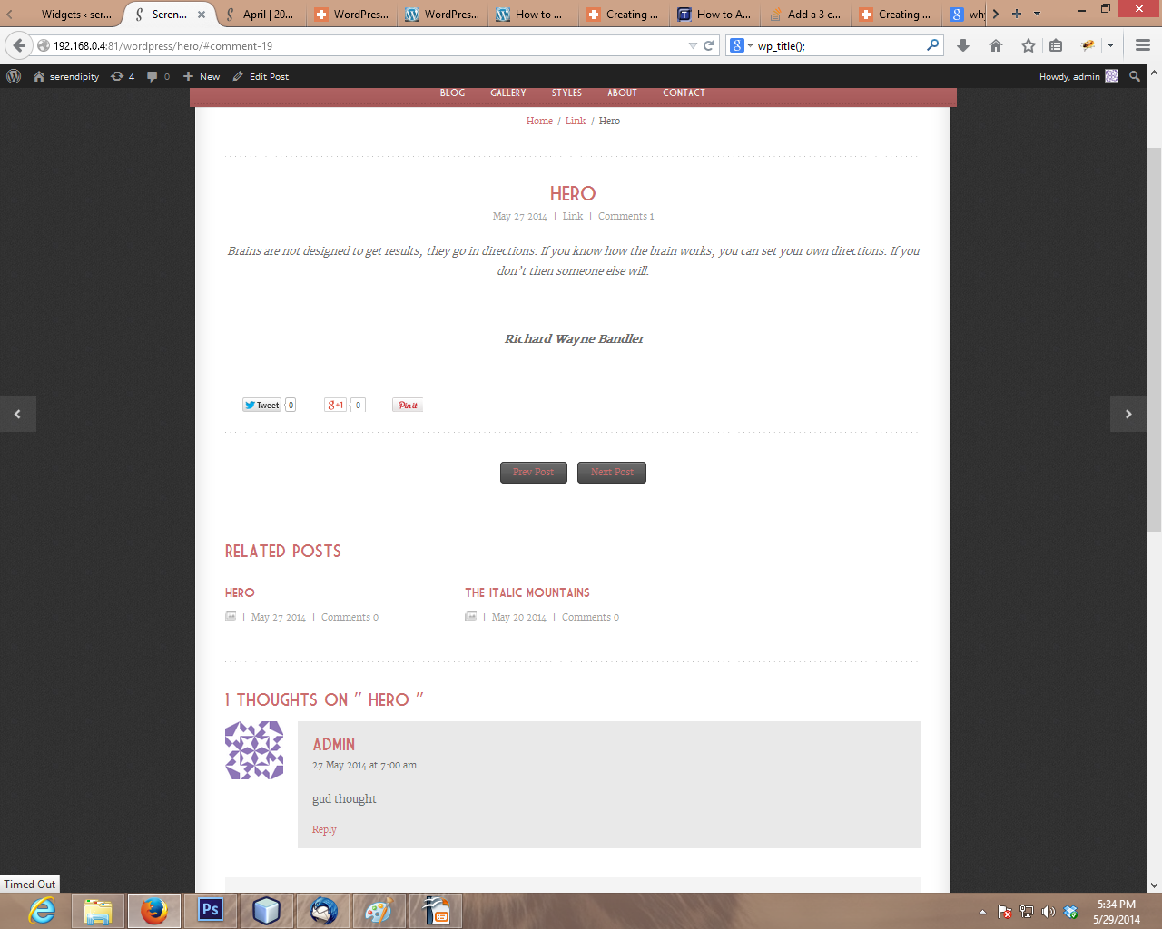

Slide 35
Fonction used in single.php
<?php previous_post_link(); ?>
Used for display previous post link from the current post.
<?php next_post_link(); ?>
Used for display the next post link from the current post.
<?php get_posts(); ?>
It retrieves all posts matching this criteria. For example
<?php wp_get_post_categories(); ?>
It retrieves list of categories for post.
<?php get_the_post_thumbnail(); ?>
Get the featured image as set in post's or page's edit screen.
<?php the_title(); ?>
Displays the title of the current post.
<?php the_tags(); ?>
Displays the link to the tag or tags belongs to a post.

Slide 36
<?php comments_open(); ?>
Its a boolean function, checks comments are allowed for the current post.
<?php comments_template(); ?>
Loads the comments template. For use in single post or page displays.
<?php wp_link_pages(); ?>
Displays page links for paginated posts.

Slide 37
Category.php
This file is used to display all posts category wise

Slide 38
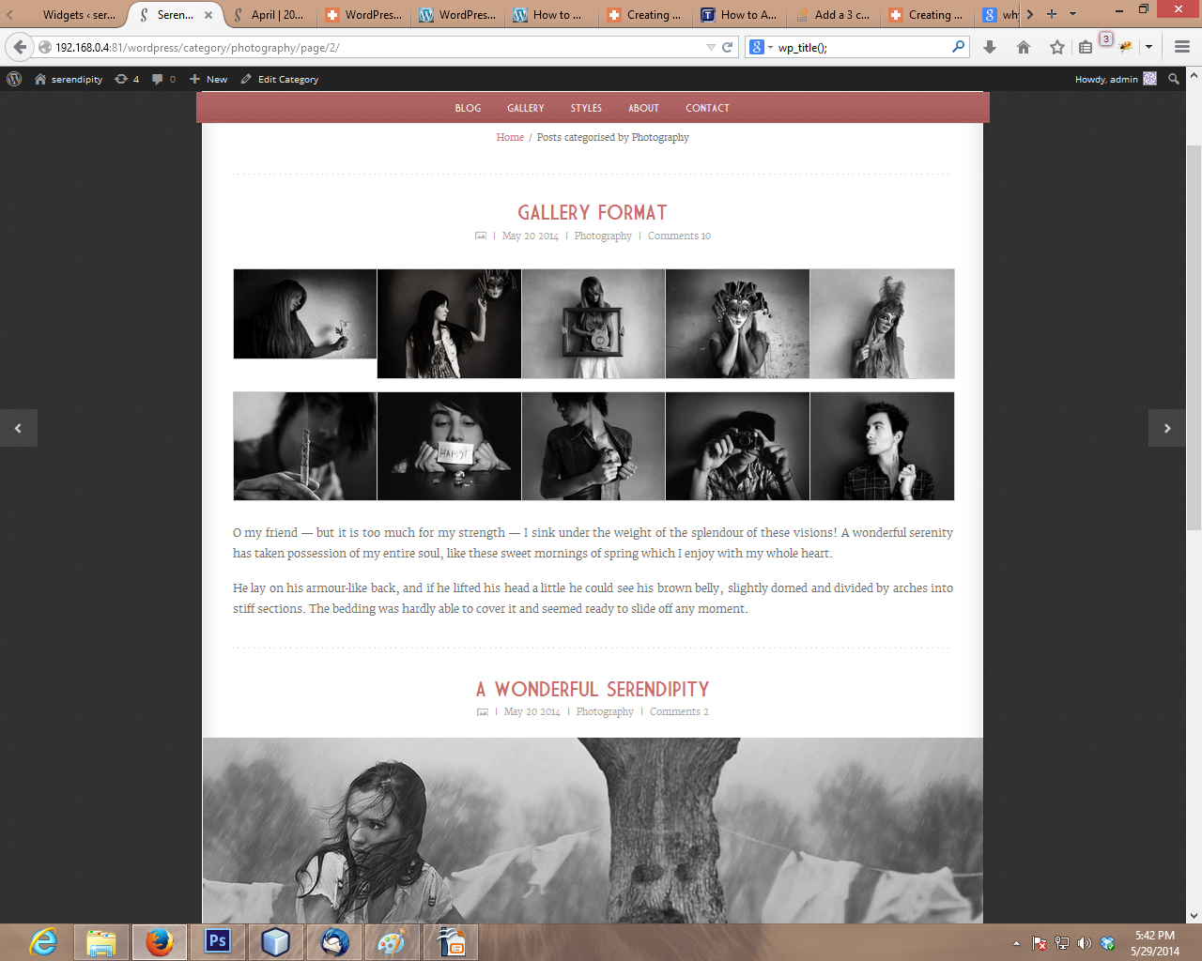

Slide 39
Functions used in category.php
<?php single_cat_title(); ?>
Displays page title if a category or tag archieve is queried.
    Rest of all functions are same as single.php

Slide 40
Comments.php
This file is used to display the comments and comment reply form for user and admin

Slide 41
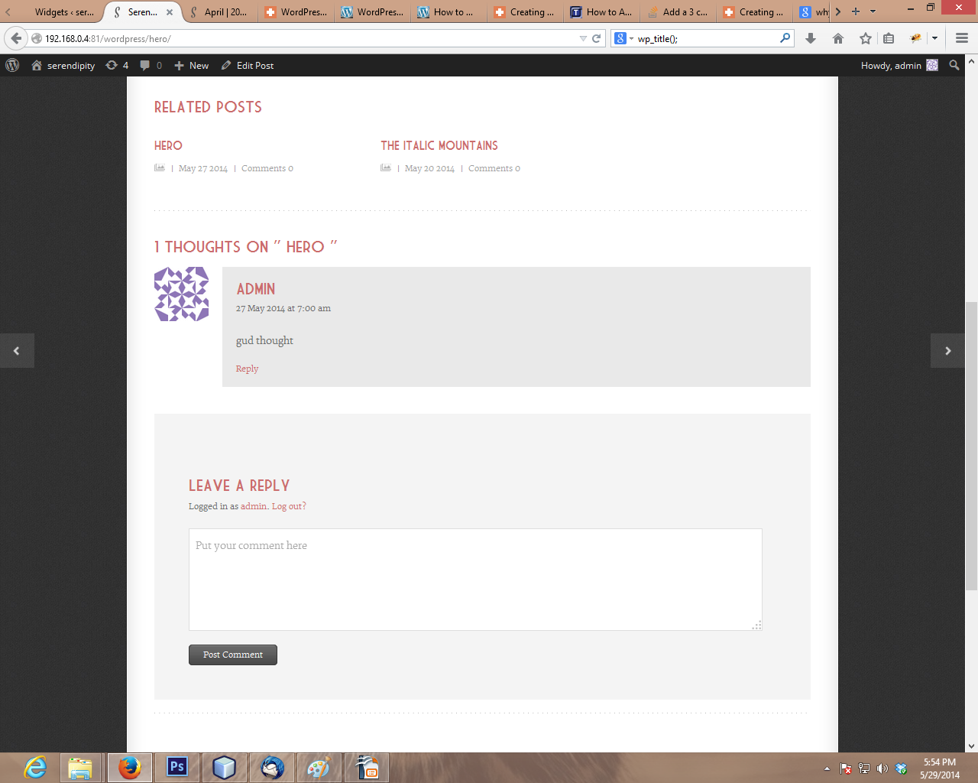

Slide 42
Functions used in comments.php
<?php have_comments(); ?>
It is a boolean function, checks comments are exist or not.
<?php wp_list_comments(); ?>
Displays all comments for a post or page.
<?php wp_login_url(); ?>
Returns the URL that allows user to login in to the site.
<?php wp_logout_url(); ?>
Returns the URL tha allows user to logout of the site.
<?php comment_form($args); ?>
Outputs a complete commenting form for use within a template. Define all fields and styling elements in array and pass to the parameter.

Slide 43
Page.php
This file is used for pages of theme (example as about, contact, gallery pages)
This file using same functionality as single post page without related post and comments option.

Slide 44
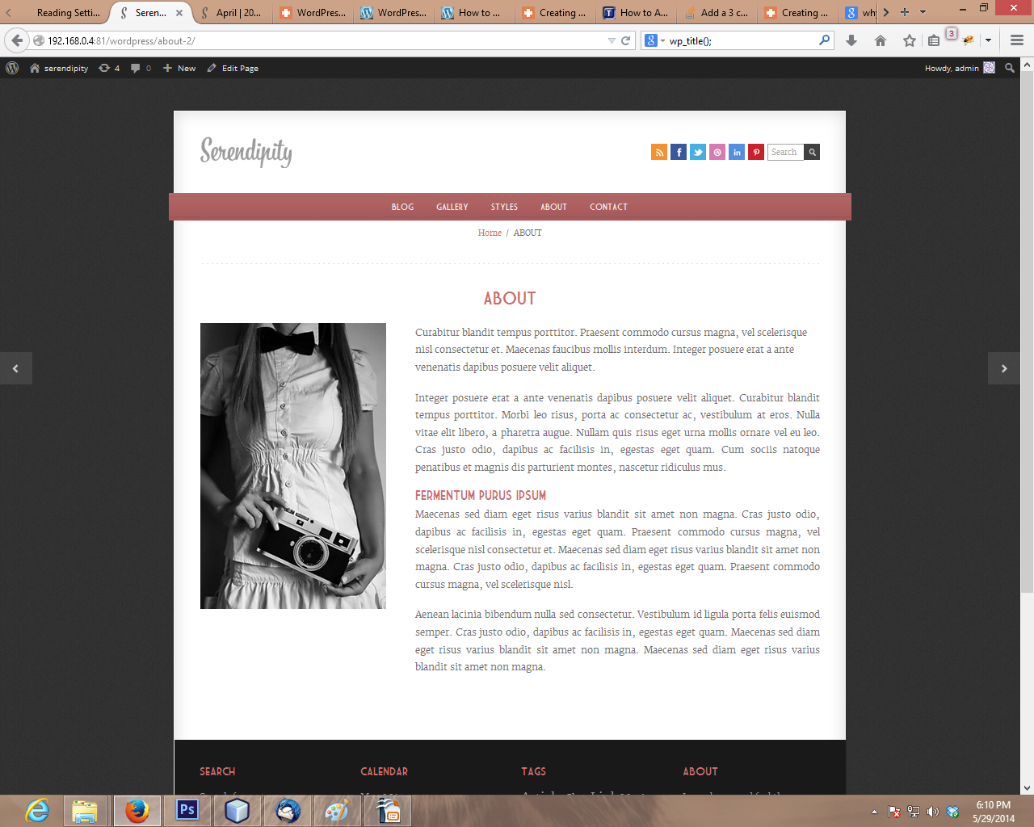

Slide 45
Search.php
This file is used to display search result.

Slide 46
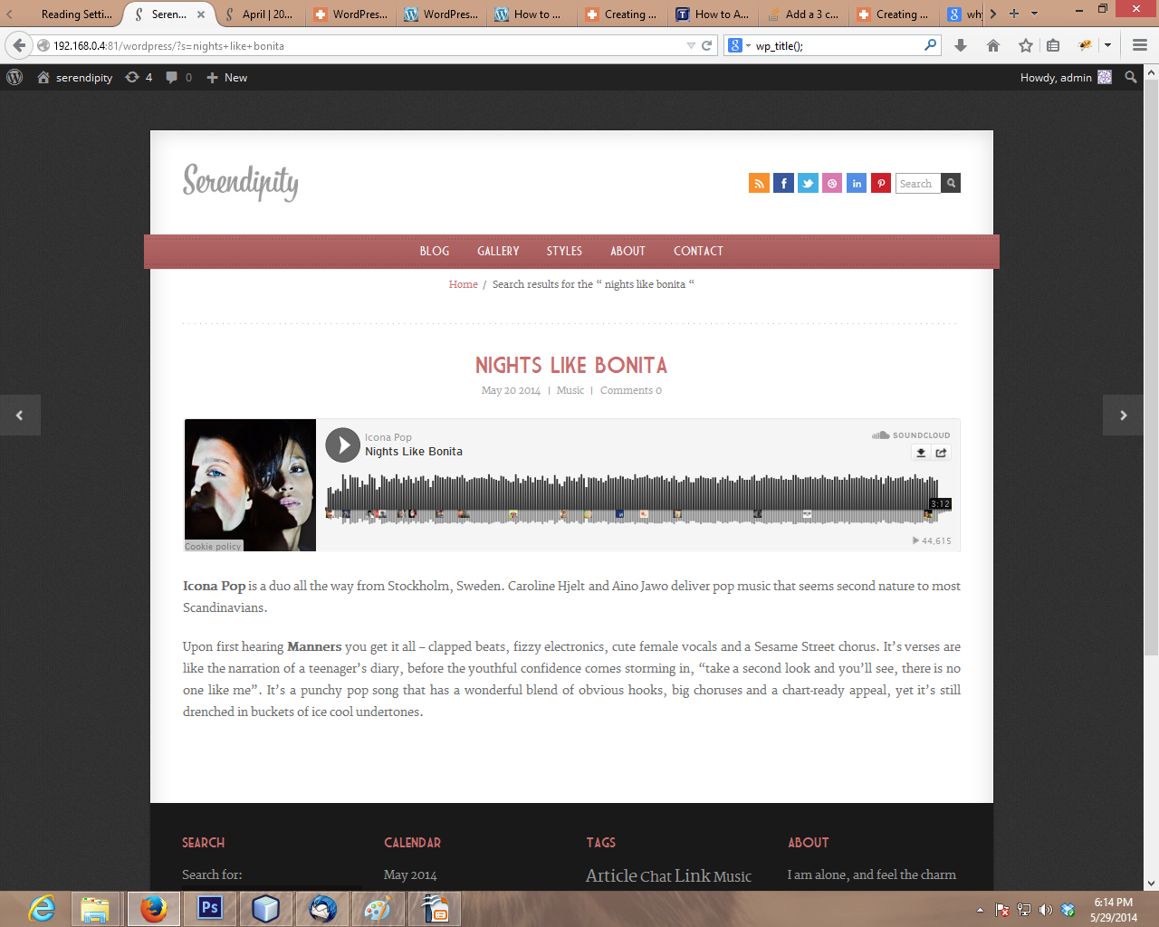

Slide 47
Functions.php
This file is a root file of theme. It controls all the methods of theme we are using for.
This file currently using :-
theme setup, menu registration, widgets handling, comments outlook and shortcodes.

Slide 48
Functions used in functions.php
<?php add_action( 'after_setup_theme', 'theme_setup' ); ?>
connects a function to a specific action. 'after-setup_theme' is name of the action to which function is connected and 'theme_setup' is function name.
<?php register_nav_menu($location, $description); ?>
This is used for register the navigation menu. First parameter defines the location and the second is description or name of the menu.
<?php add_editor_style(); ?>
Allow theme developers to add custom stylesheet to visual editor.
<?php add_theme_support('post-thumbnails'); ?>
Allow theme to register support of a certain theme features. Post-thumbnail feature support for posts thumbnails.

Slide 49
<?php theme_widgets_init(); ?>
This is used for add widgets in theme.
<?php register_sidebar(array(
'name' => __('Footer left', 'serendipity'), //name of the widget sidebar
'id' => 'footer-left', //id of the widget
'before_title' => '<h5 class="widget-title">', //title styling class defines here
'after_title' => '</h5>',
'before_widget' => '<div id="unq-id" class="widget-class">', //widget container
'after_widget' => '</div>'); ?>
This method is used for register the sidebar widget.

Slide 50
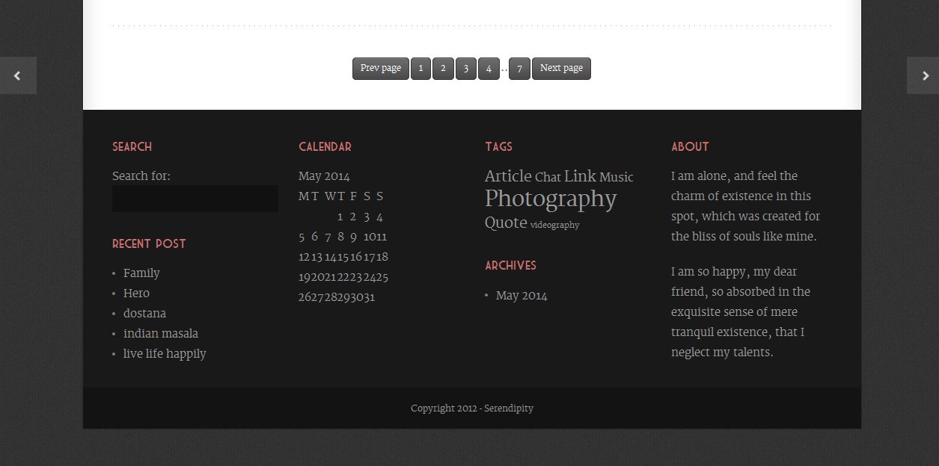

Slide 51
<?php get_avatar($id, $size); ?>
This is used to display avatar for user ID. This is mostly used in comment section.
<?php comment_id(); ?>
This is used for fetch the numeric id of comment
<?php get_comment_author_link(); ?>
Displays the author name in the comment box
<?php comment_text(); ?>
Displays the comment text.
<?php comment_reply_link(); ?>
Displays the comment reply link

Slide 52
Thank You

