Slide 1
Matrix equation

Slide 2
Matrix Equation
view a linear combination of vectors as the product of a matrix and a vector

Slide 3
Matrix Equation

Slide 4
example

Slide 5
Existence of a solution
First: 1, 2, 3 are mathematically equivalent

Slide 6
Proof

Slide 7
Proof

Slide 8
example

Slide 10
SOLUTION SETS OF LINEAR SYSTEMS

Slide 11
Homogeneous Linear Systems
Goal: uses vector notation to give explicit and geometric descriptions of such solution sets
Homogeneous Linear Systems
Ax = 0
x = 0
trivial solution
whether there exists a nontrivial solution
The homogeneous equation Ax = 0 has a nontrivial solution if and only if the
equation has at least one free variable.

Slide 12
Example
Determine if the following homogeneous system has a nontrivial solution. Then describe the solution set.

Slide 13
Example
parametric vector form

Slide 14
Example
parametric vector form
Describe all solutions of the homogeneous “system”
Solution set of a homogeneous equation Ax=0 can always be expressed explicitly as Span {v1; : : : ; vp} for suitable vectors v1,…, vp.

Slide 15
Nonhomogeneous Systems
When a nonhomogeneous linear system has many solutions, the general solution can be written in parametric vector form as one vector plus an arbitrary linear combination of vectors that satisfy the corresponding homogeneous system
WRITING A SOLUTION SET (OF A CONSISTENT SYSTEM) IN PARAMETRIC
VECTOR FORM
1. Row reduce the augmented matrix to reduced echelon form.
2. Express each basic variable in terms of any free variables appearing in an
equation.
3. Write a typical solution x as a vector whose entries depend on the free
variables, if any.
4. Decompose x into a linear combination of vectors (with numeric entries) using the free variables as parameters.

Slide 16
Nonhomogeneous Systems
Example: Describe all solutions of Ax = b, where

Slide 17
parametric vector form
parametric vector form
solution set of Ax = 0 has the parametric vector equation
vector p itself is just one particular solution of Ax = b
Geometric Descriptions

Slide 18
Geometric Descriptions
two free variables

Slide 19
Theorem

Slide 20
LINEAR INDEPENDENCE & matrix equations

Slide 21
Linear independency
Studying Linear dependency
Studying a homogeneous linear system
Linear Independence of Matrix Columns
The columns of a matrix A are linearly independent if and only if the equation
Ax = 0 has only the trivial solution.

Slide 22
Example

Slide 23
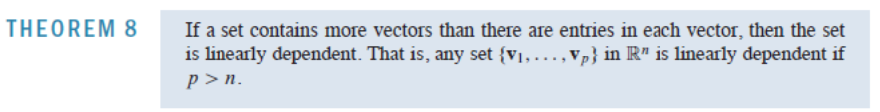

Linear independency
An indexed set S of two or more vectors is linearly dependent if and only if at least one of the vectors in S is a linear combination of the others.
every vector in a linearly dependent set is a linear combination of the preceding vectors.
Proof : ?
Linear
dependent

Slide 24
Linear independency
Theorem 8 says nothing about the case in which the number of vectors in
the set does not exceed the number of entries in each vector.

Slide 25
APPLICATIONS OF LINEAR SYSTEMS: Network Flow

Slide 26
Network Flow
flow of some quantity through a network:
pattern of traffic flow in a grid of city streets
flow through electrical circuits
…
A network consists of a set of points called junctions, or nodes, with lines or arcs
called branches connecting some or all of the junctions.
The direction of flow in each branch is indicated, and the flow amount (or rate) is either shown or is denoted by a variable.
basic assumption of network flow is that the total flow into the network equals the total flow out of the network
&
total flow into a junction equals the total flow out of the junction

Slide 27
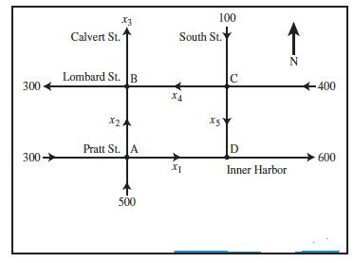
Examples

Slide 28
Example

Slide 29
INTRODUCTION TO LINEAR TRANSFORMATIONS

Slide 30
Introduction to linear mappings
set of all images T(x) is called the range of T

Slide 31
example
difference

Slide 32
Introduction to linear mappings

Slide 33
Introduction to linear mappings
Linear ?
proof

Slide 34
example

Slide 35
Geometric Linear Transformations of R²

Slide 36
Geometric Linear Transformations of R²
Linear Transform?

Slide 37
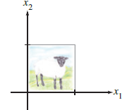
Geometric Linear Transformations of R²

Slide 38
Definitions

