Slide 1
File System Implementation
Hamid R. Zarandi
h_zarandi@aut.ac.ir

Slide 2
File system structure
Why file system?
Provided user interface to storage, mapping logical to physical
Provides efficient and convenient access to disk by allowing data to be stored, located, retrieved easily
File control block
Storage structure consisting of information about a file
Device driver
Controls the physical device

Slide 3
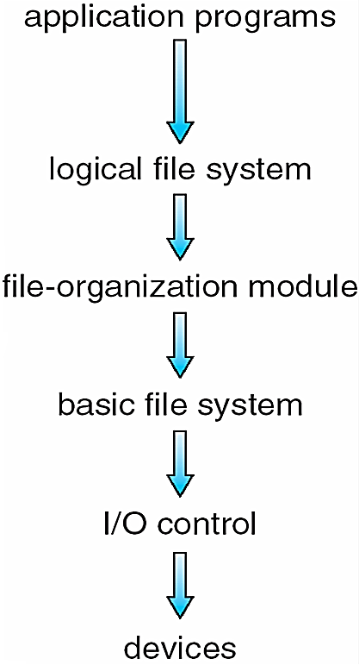
Layered file system
Logical file system manages metadata information
Translates file name into file number, file handle, location by maintaining file control blocks (inodes in UNIX), FCB and metadata
Directory management
Protection
File organization module understands files, logical address, and physical blocks
Translates logical block # to physical block #
Manages free space, disk allocation
Basic file system given command like “retrieve block 123” translates to device driver
Device drivers manage I/O devices at the I/O control layer
Given commands like “read drive1, cylinder 72, track 2, sector 10, into memory location 1060” outputs low-level hardware specific commands to hardware controller
Interrupt Service Routines
Layered design
Reduction of complexity and redundancy
Overheads and performance penalty translation of file to disk

Slide 4
File system layers
Each with its own format
CD-ROM: ISO 9660
Unix: UFS, FFS
Windows: FAT, FAT32, NTFS as well as floppy, CD, DVD Blu-ray file systems
Linux: more than 40 types (extended file system ext2 and ext3)
+distributed file systems
New ones still arriving – ZFS, GoogleFS, Oracle ASM, FUSE
File systems should have
1) How to boot?
2) Total # of blocks?
3) # and location of free blocks?
4) Directory structures?
5) Files?

Slide 5
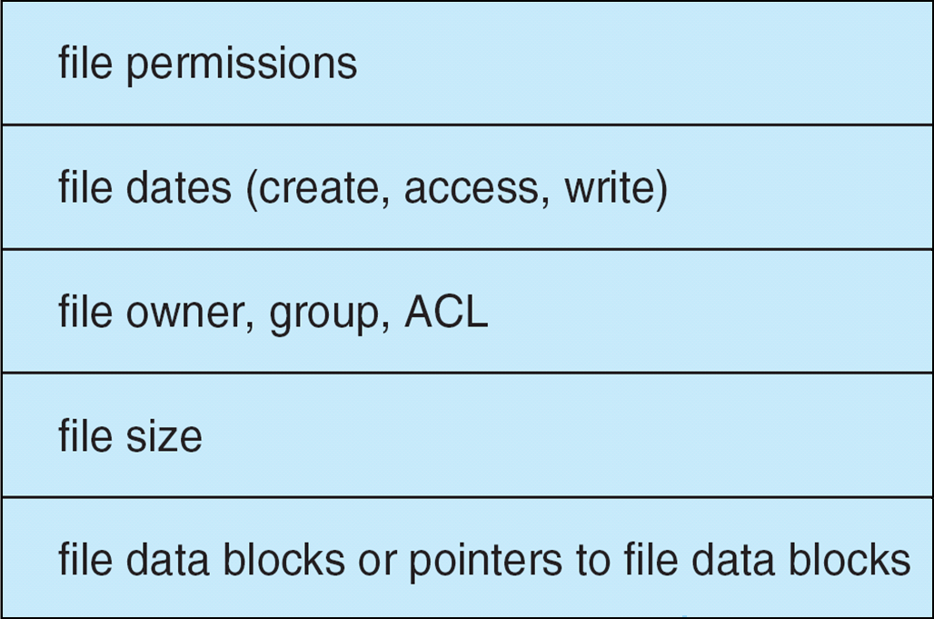
File system implementation
Boot control block (Boot sector)
Contains info needed by system to boot OS from that volume
Needed if volume contains OS, usually first block of volume
Volume control block (superblock, master file table)
Contains volume details
Total # of blocks, # of free blocks, block size, free block
pointers or array
Per-file File Control Block (FCB)
Contains many details about the file
File Control Block

Slide 6
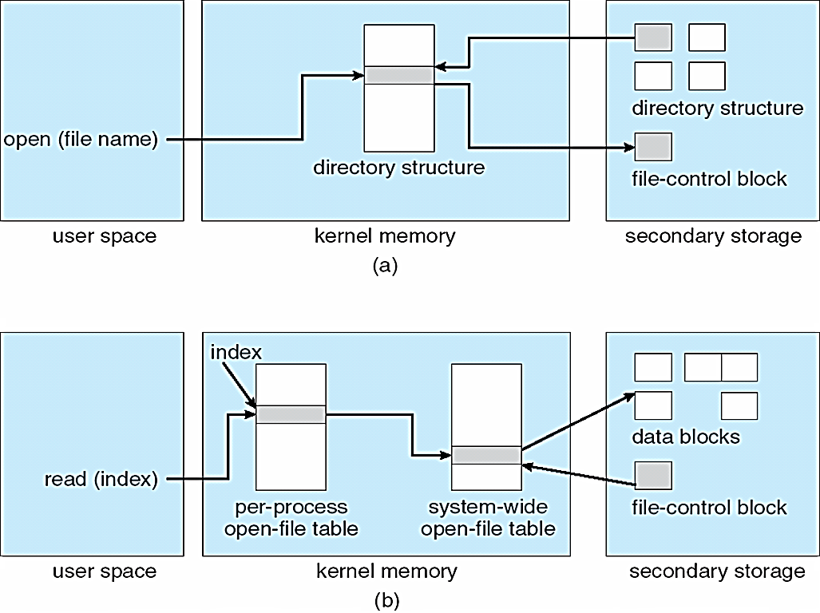
In-memory file system structures
Mount table
System wide open file table
per-process open file table

Slide 7
Partitions and mounting
Boot loader
Root partition
Contains the OS
Other partitions can hold other Oses, other file systems, or be raw
Mounted at boot time
Other partitions can mount automatically or manually

Slide 8
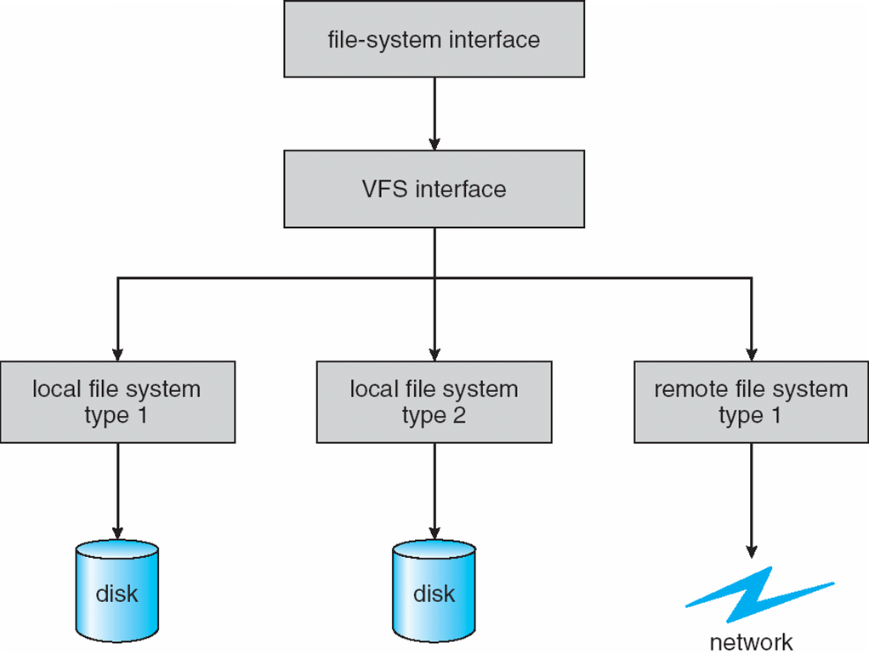
Virtual file systems (VFS)
Virtual File Systems (VFS) on Unix
Provide an object-oriented way of implementing file systems
VFS allows the same system call interface (API) to be used for different types of file systems
Separates file-system generic operations from implementation details
Implementation can be one of many file systems types, or network file system
Then dispatches operation to appropriate file system implementation routines

Slide 9
Directory Implementation

Slide 10
Directory implementation
1) Linear list of file names with pointer to the data blocks
Simple to program
Time-consuming to execute (Why?)
Linear search time
Could keep ordered alphabetically via linked list or use B+ tree
What would happen if a file is deleted?
Problem with fragmentation
Problem of limited size
2) Hash Table
Linear list with hash data structure
Decreases directory search time
Hash is used to map file name to a number
Collisions – situations where two file names hash to the same location
Only good if entries are fixed size, or use chained-overflow method

Slide 11
Allocation Methods

Slide 12
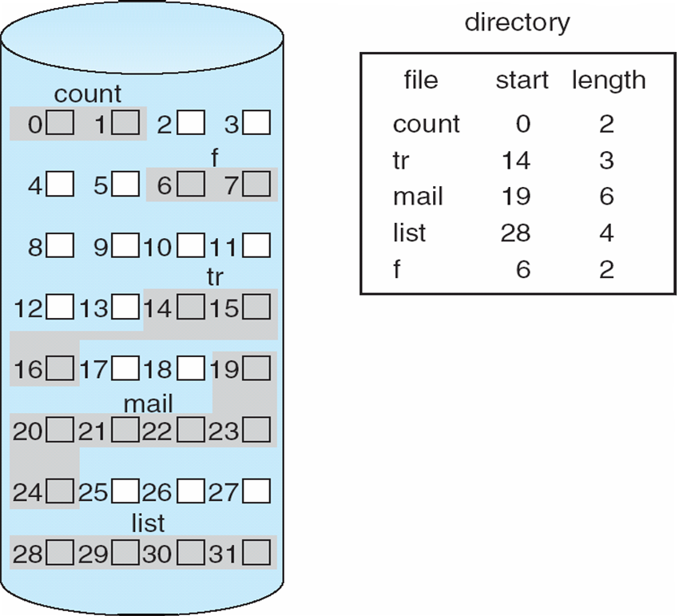
1) Contiguous allocation
Contiguous allocation
Each file occupies set of contiguous blocks
Best performance in most cases
Simple – only starting location (block #) and length (number of blocks) are required
Problems include
Finding space for file
Knowing file size
External fragmentation
Need for compaction off-line (downtime) or on-line

Slide 13
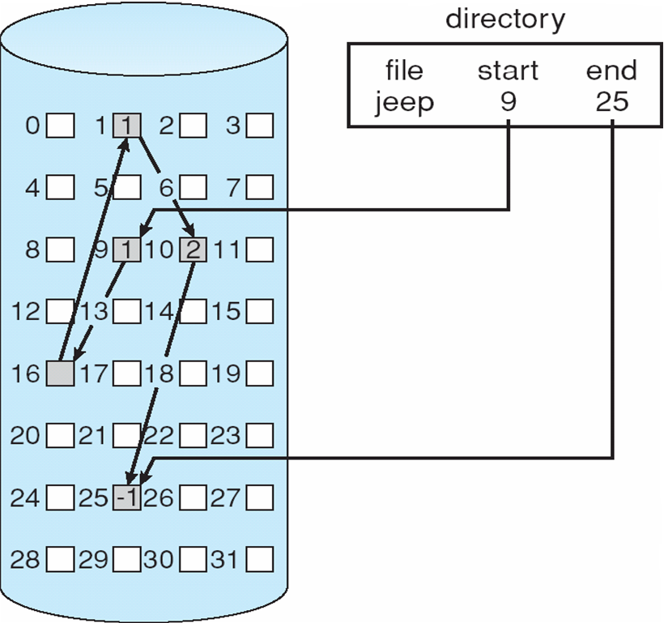
2) Linked allocation
Linked allocation
Each file a linked list of blocks
File ends at nil pointer
No external fragmentation
Each block contains pointer to next block
No compaction, external fragmentation
Free space management system called when new block needed
Improve efficiency by clustering blocks into groups but increases internal fragmentation
Reliability can be a problem (How?)
Locating a block can take many I/Os and disk seeks
4 byte pointer in 512 byte block = 0.78% overhead
Use of cluster
Internal fragmentation

Slide 14
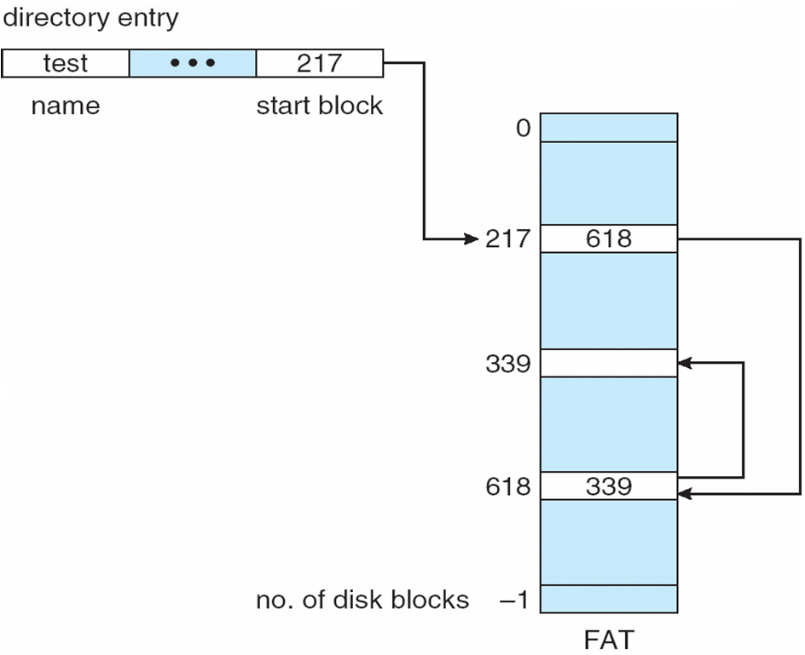
FAT in linked allocation
Windows FAT
File Allocation Table

Slide 15
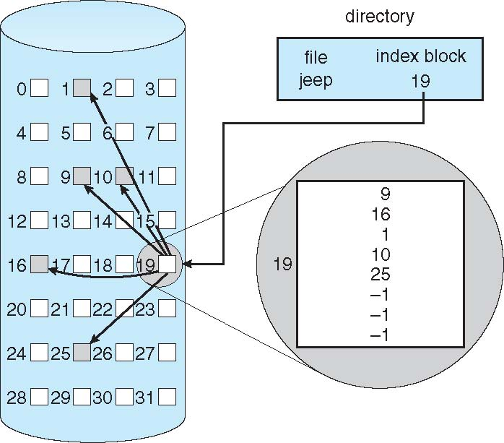
3) Indexed allocation
Indexed allocation
Each file has its own index block(s) of pointers to its data blocks
Need index table
Random access
Dynamic access without external fragmentation, but have overhead of index block
Mapping from logical to physical in a file of unbounded length (block size of 512 words)
Linked scheme
Link blocks of index table (no limit on size)

Slide 16
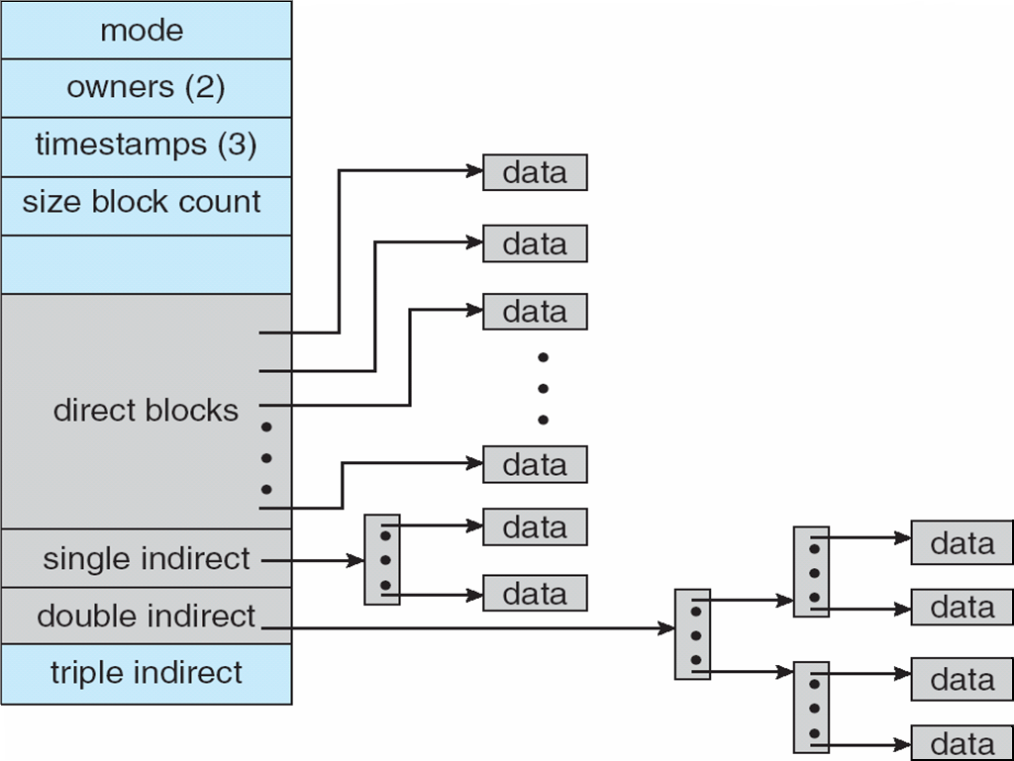
4) Combined allocation
Example:
UNIX UFS
4K bytes per block, 32-bit addresses
More index blocks than can be addressed with 32-bit file pointer

Slide 17
Free Space Management

Slide 18
1) Bit vector (bit map)
File system maintains free-space list to track available blocks/clusters
(Using term “block” for simplicity)
Bit vector or bit map (n blocks)
Bit map requires extra space
Example:
block size = 4KB = 2¹² bytes
disk size = 2⁴⁰ bytes (1 terabyte)
n = 2⁴⁰/2¹² = 2²⁸ bits (or 32MB)
if clusters of 4 blocks -> 8MB of memory
Easy to get contiguous files
0
1
2
n-1
…
1 ⇒ block[i] free
0 ⇒ block[i] occupied
bit[i] =


Slide 19
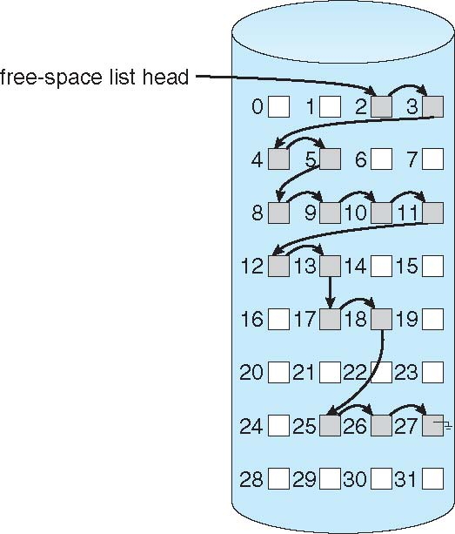
2) Linked list
Linked list (free list)
Cannot get contiguous space easily
No waste of space
No need to traverse the entire list
(if # free blocks recorded)
FAT is better to contain free blocks

Slide 20
3) Others: grouping, counting
Grouping
Modify linked list to store address of next n-1 free blocks in first free block, plus a pointer to next block that contains free-block-pointers (like this one)
(Similar to index block)
The last free block contains address of another m free blocks
Counting
Because space is frequently contiguously used and freed, with contiguous-allocation allocation, extents, or clustering
Keep address of first free block and count of following free blocks
Free space list then has entries containing addresses and counts

Slide 21
Performance
Performance
Keeping data and metadata close together
Buffer cache
Separate section of main memory for frequently used blocks
Synchronous writes sometimes requested by apps or needed by OS
No buffering / caching – writes must hit disk before acknowledgement
Asynchronous writes more common, buffer-able, faster
Free-behind and read-ahead
Techniques to optimize sequential access
Reads frequently slower than writes

Slide 22
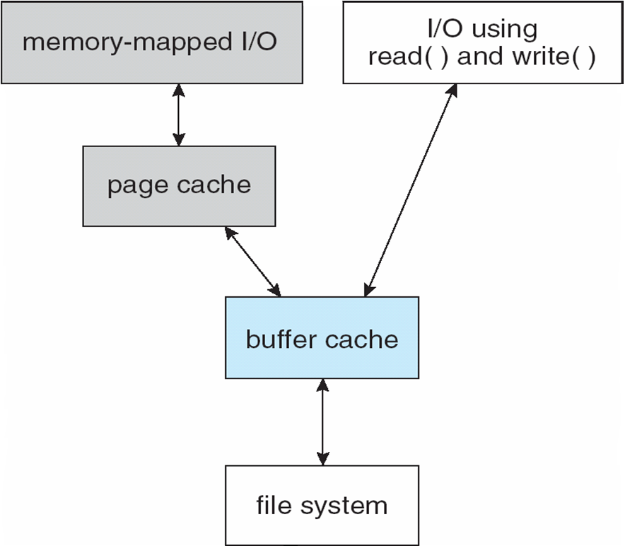
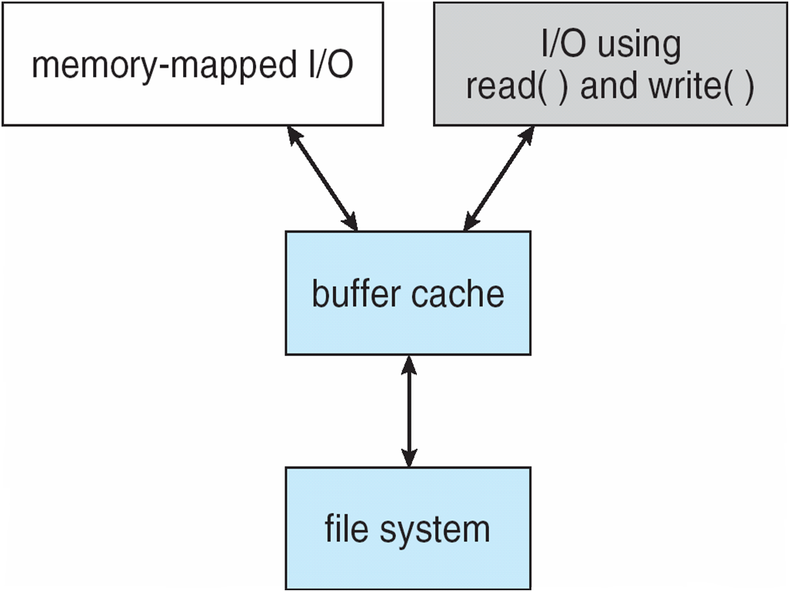
Unified vs. non-unified buffer cache
I/O Without a Unified Buffer Cache
Wastes mem+CPU+IO
I/O Using a Unified Buffer Cache
Solaris, Linux, Windows

Slide 23
Failure Recovery

Slide 24
1) Consistency checking
Consistency checking – compares data in directory structure with data blocks on disk, and tries to fix inconsistencies
Can be slow and sometimes fails
Human based!
Use system programs to back up data from disk to another storage device (magnetic tape, other magnetic disk, optical)
Recover lost file or disk by restoring data from backup

Slide 25
2) Log structured file systems
Similar to database log-based recovery algorithm
Log structured (or journaling) file systems record each metadata update to the file system as a transaction
All transactions are written to a log
Transactions can be
Committed
Rolled back
If the file system crashes, all remaining transactions in the log must still be performed
Where logs should be stored?

Slide 26
3) Backup and restore
Back up data from disk to another storage device, such as a magnetic tape or other hard disk
Recovery from the loss of an individual file, or of an entire disk, may then be a matter of restoring the data from backup
A typical backup schedule:
Day 1. full backup: copy all files from the disk to a backup medium.
Day 2. incremental backup: copy all files changed since day 1 to another medium.
Day 3. incremental backup: copy all files changed since day 2 to another medium.
...
Day N. incremental backup: copy all files changed since day N-1 to another medium. Then go back to day 1

Slide 27
Network File System

Slide 28
The Sun Network File System (NFS)
An implementation & a specification of a software system for accessing remote files across LANs (or WANs)
The implementation is part of the Solaris and SunOS operating systems running on Sun workstations using an unreliable datagram protocol (UDP/IP protocol and Ethernet)

Slide 29
NFS
A remote directory is mounted over a local file system directory
The mounted directory looks like an integral subtree of the local file system, replacing the subtree descending from the local directory
Specification of the remote directory for the mount operation is nontransparent; the host name of the remote directory has to be provided
Files in the remote directory can then be accessed in a transparent manner
Subject to access-rights accreditation, potentially any file system (or directory within a file system), can be mounted remotely on top of any local directory
This independence is achieved through the use of RPC primitives built on top of an External Data Representation (XDR) protocol used between two implementation-independent interfaces

Slide 30
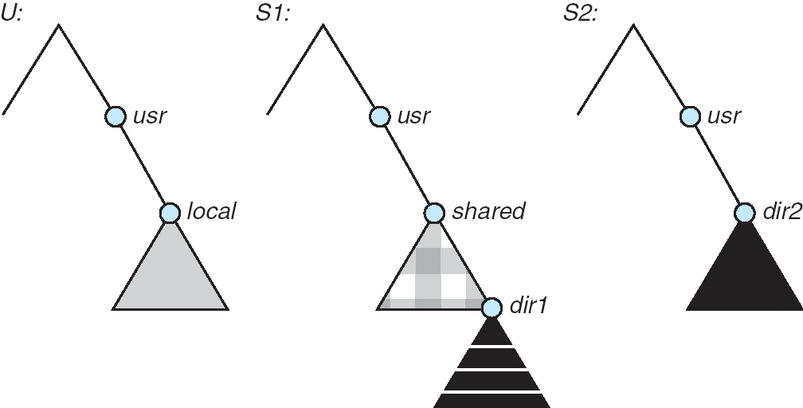
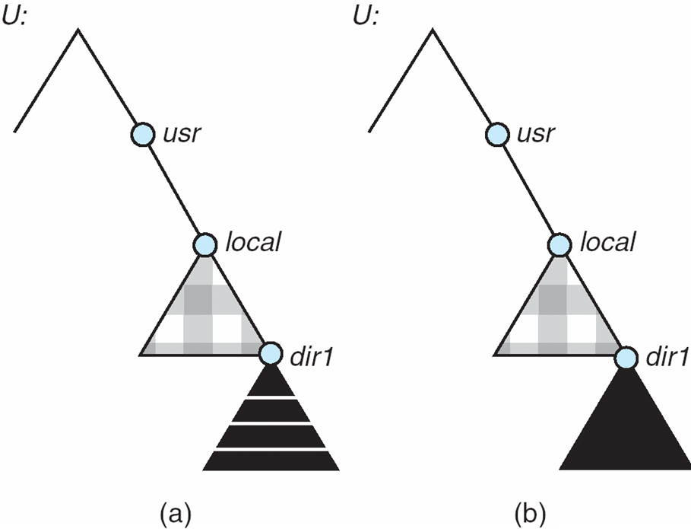
Three independent file systems & mounting
Mounts
Cascading mounts

Slide 31
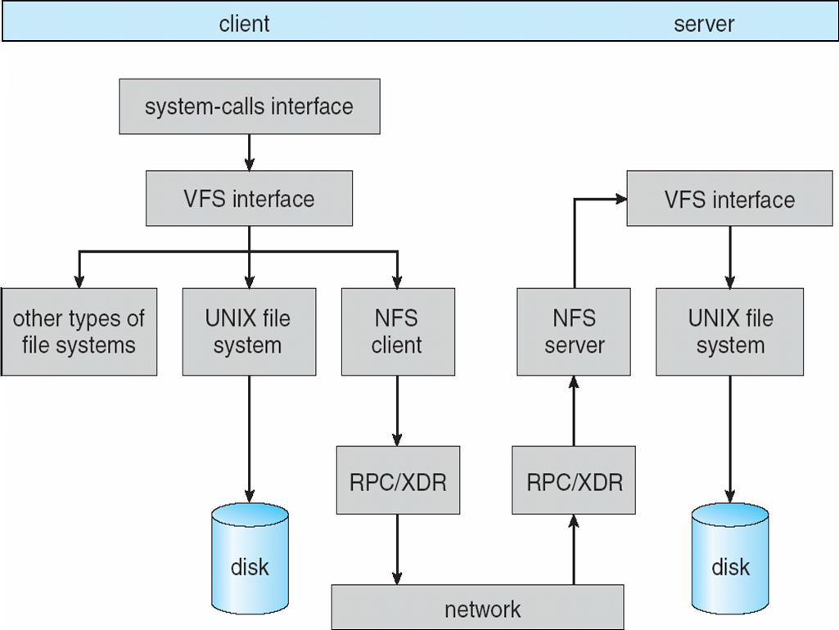
Schematic view of NFS architecture
NFS write procedure call is atomic
NFS servers are state-less (why?)
No open() and close() routines
All routines are RPC for robustness
Writes are synchronous (NVM used)

Slide 32

Questions?

