Slide 1
SW Interaction

Slide 2
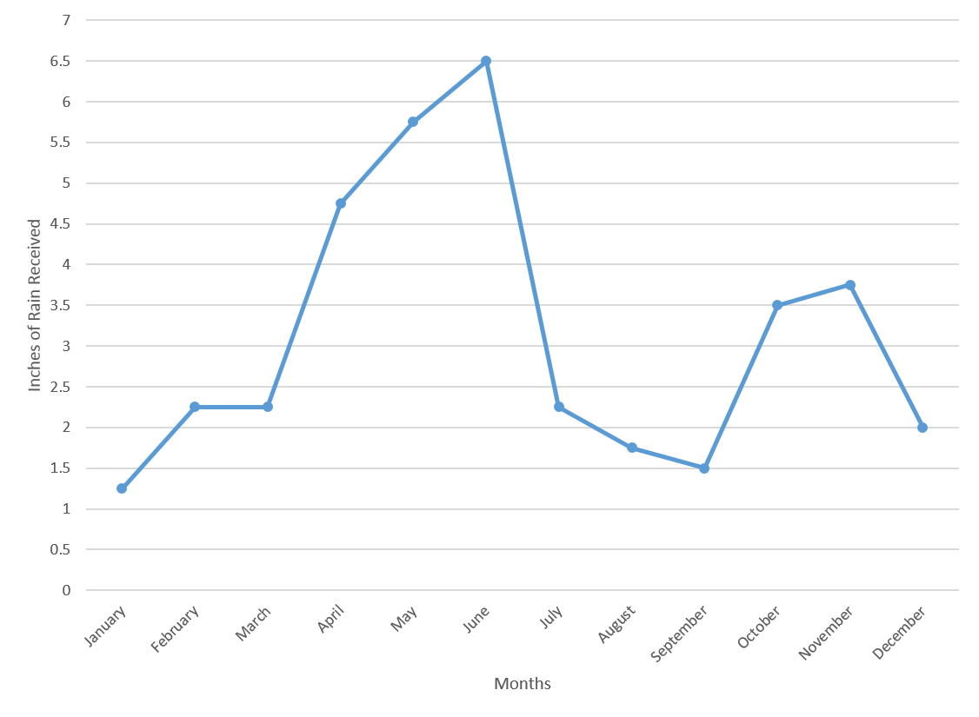
This is about interaction with line graphs on smartwatches
This is about y-values (not x-values) - It can be generalized to x-axis later
Line graphs is one of the best and common ways to represent time-series data (e.g., heart rate) on SWs

Slide 3
The problem with line graphs is that there are many empty spaces around the graph. This is important on small screen of smartwatches and we can take the advantage of these empty spaces to interact with the chart

Slide 4
In the first step we can divide the entire graph into equal sections

Slide 5
Let’s say I want to know the value of indicated data point in this graph

Slide 6
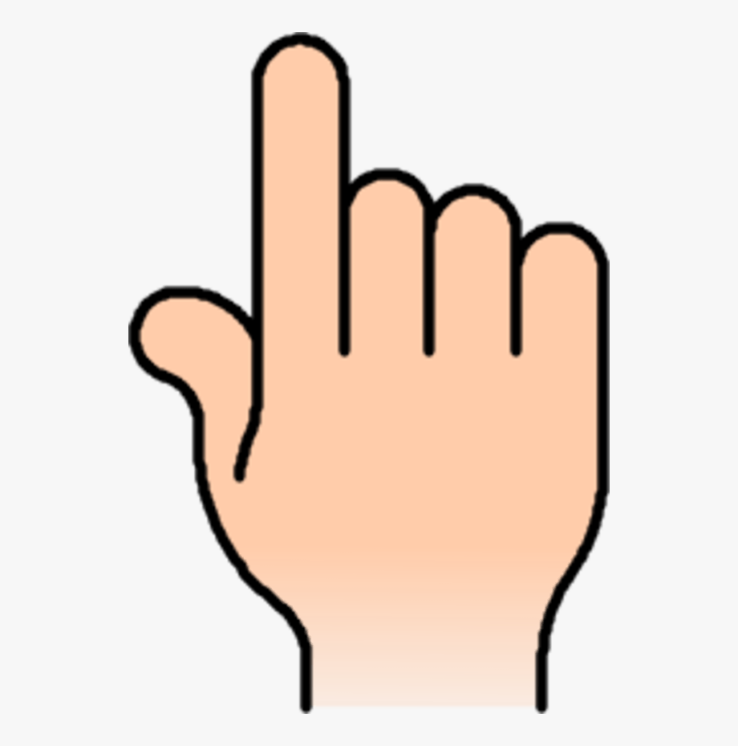
Showing a line on the local maximum point (here in this example) or local minimum point (in a specific window). This line would be the place to represent the values of data points in that window.
If the shape of the graph in a specific window is like ^ , we put the line on the local maximum. If the shape of the graph in that specific window is like V, we put the line on the local minimum in that window.
3.7
If the shape of the graph in a specific window is not like ^ or V, we can make decision about the place of the line based on the available empty space around the chart in that specific window. This defines which area the user can interact with the chart.
The guideline appears as soon as the user interacts with the watch (in just that specific window). It will be disappeared after interaction

Slide 7
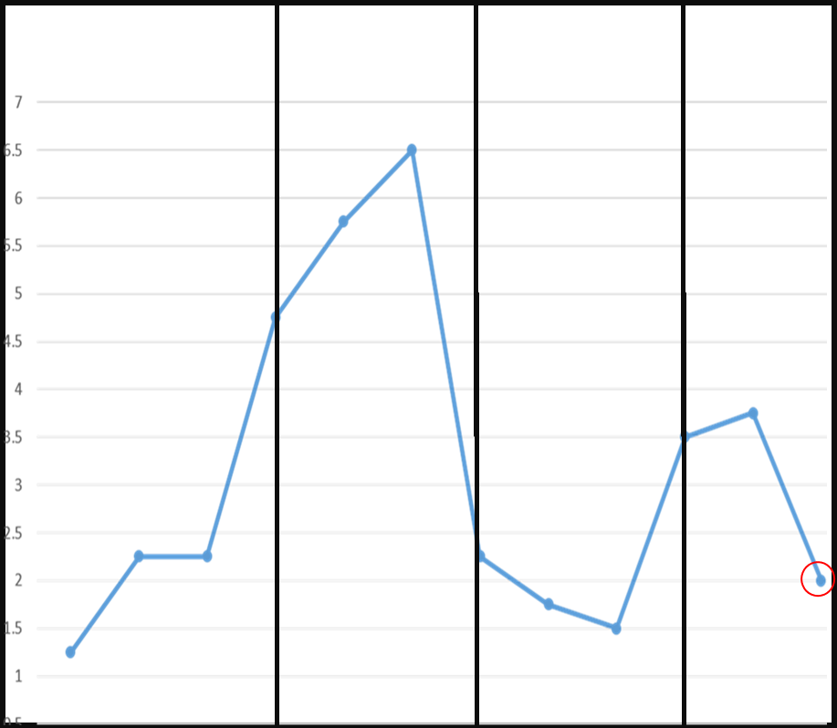
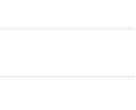
Example : V shape => local maximum
3.7
2

Slide 8
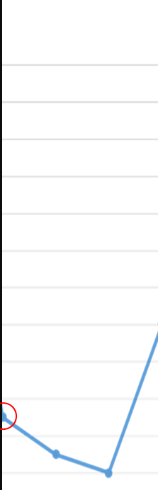
^ shape => local Minimum
1.5
2.7

Slide 9
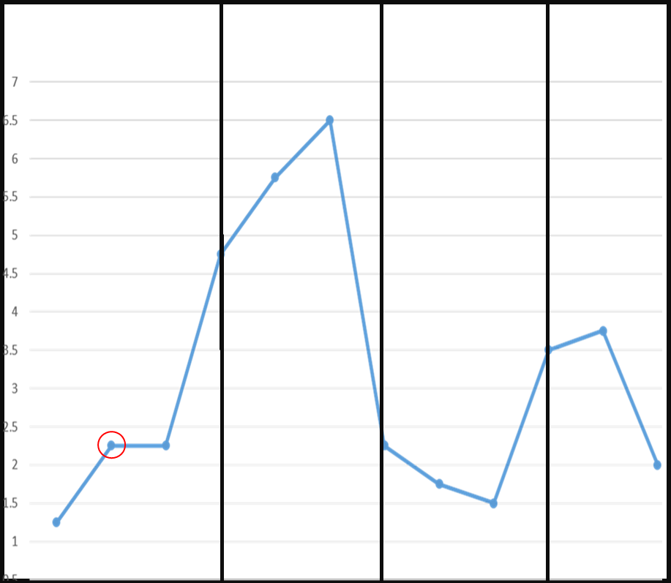
Not V or ^
1.3
2.4

Slide 10
Instead of putting the guide line on the local max/min in each window, we can put this line on the average of the data points in that window.
In this case the average moving of the graph decreases as the user don’t need to move the graph to the local max/min point.
Local Max/Min
Mean of Data Points

Slide 11
We can divide the graph on the y-axis too
v

Slide 12
Use case of the windows : Data Comparison
It can be beneficial to compare the y-values of two or even more data points (which one is higher and how much)

Slide 13
Use case of the windows : Data Comparison
Method 1

Slide 14
Use case of the windows : Data Comparison
Method 1

Slide 15
Use case of the windows : Data Comparison
Method 2

Slide 16
Use case of the windows : Data Comparison
Method 2
Step 1

Slide 17
Use case of the windows : Data Comparison
Method 2
Step 2
1.2
We can apply the same concept for the graph with horizontal lines

Slide 18
Factors
Data Density (High, medium, low)
How many sections (4, 6, 8)
Horizontal / Vertical

Slide 19
Study 1: Purpose
In the first study we can investigate what could be the best configuration by testing the factors in previous slide using simple tasks. (not using actual charts) and then in the second study we can use the best configuration on actual graphs and comparing it with common ways of interacting with line charts like selecting data points or even shift.

Slide 20
Study 1 : Task
Random Point and random line in a specific window and participant should move this point on the line.

Slide 21
Study1 Tasks

Slide 22
Task: Data comparison
We’ll do the same for 8 windows (or maybe 16 windows) + horizontal windows

Slide 23
Study 2 : Evaluation
Comparing the real graphs with our interaction method with the best configuration measured in study 1, with common ways to interact with graphs (e.g., selecting data points or shift)

