Slide 1


UniQueue
Campus Resource Reservation System
A centralized, role-based platform that unifies study room reservations, office hour bookings and transit line schedules, providing a seamless experience.
Notes:
1

Slide 2
Our Motivation
University life is often complicated by a highly fragmented scheduling landscape, leading to unnecessary stress and inefficiency for students. This friction stems from the absence of unified systems.
Dispersed Office Hours
Study Room Conflicts
Outdated Transit Info
Students struggle to track and coordinate with professors' varying availability for office hours.
The frequent unavailability of study rooms leads to frustration and wasted time.
Absence of real-time updates for campus bus schedules results in missed connections and unpredictable commute times.
These disconnected services create significant barriers to a seamless and productive campus experience.
Notes:
2

Slide 3
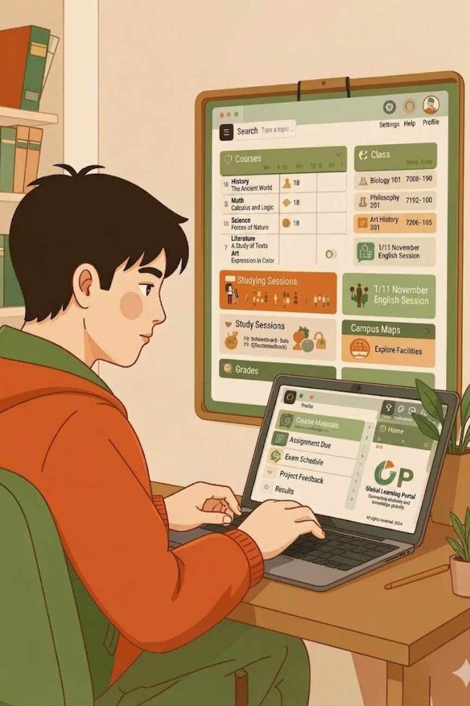

Why UniQueue Matters
The current fragmented landscape has significant consequences, impacting both individual productivity and overall campus well-being. UniQueue solves these critical issues with a single platform.
1
Optimize Time
Efficient scheduling frees up student time, boosting academic focus and reducing stress by simplifying resource access.
2
Enhance Campus Efficiency
Centralized management allows for more efficient allocation of resources, which minimizes bottlenecks and reduces administrative expenses for staff.
3
Ensure Equal Access
Improved communication and integrated waitlist features provide fair and transparent access to all essential campus services and opportunities.
Notes:
3

Slide 4
Project Aims
The UniQueue project is built around four core objectives that together create a seamless campus scheduling ecosystem.
Centralized Scheduling
Role-Based Access Control
A single platform for booking office hours and study rooms across the entire campus.
Distinct permissions for Students, Lecturers, Bus Drivers, and Administrator.
Equal User Experience
Automated Notifications
Prevention multiple bookings for the same resource and establishing a dynamic waitlist for fully booked resources.
Real-time alerts for canceled bookings, waitlist promotions, and transit changes.
Notes:
4

Slide 5
Related Work & What Makes UniQueue Different
Existing Solutions
UniQueue's Novel Advantages
Several tools exist in the scheduling space today:
Unified Campus Experience
Calendly / Microsoft Bookings
Combines academic needs (office hours), facility needs (study rooms), and logistical needs (campus transit) into one cohesive system.
Handle generic meeting scheduling well, but lack campus-specific context.
Automated Waitlisting
Skedda / LibCal
When a lecturer cancels a session or a bus driver removes a route, affected students are immediately notified.
A feature rarely found in standalone booking tools.
Used for room reservations, but lacks academic and transit needs.
Notes:
5

Slide 6

Scope: Constraints & Assumptions
System Constraints
System Assumptions
Designed purely for internal university use and no external payment gateways or public access portals.
All users are verified members with accounts pre-provisioned or verified via an email address.
Transit management is limited to scheduling; live GPS tracking of buses is not included in the current scope.
Lecturers and Bus Drivers can mange only their self-owned resources within the system.
These boundaries ensure UniQueue remains focused, secure, and maintainable within the university ecosystem.
Notes:
6

Slide 7
Methodology & Technical Approach
Solution Approach
1
UniQueue addresses campus resource congestion by centralizing bookings into one real-time web platform. Users can view availability, make reservations, and join a FIFO waitlist when capacity is full. Role-Based Access Control ensures students, lecturers, and bus drivers only access the functions and resources relevant to their roles.
Resources (Hardware & Data)
2
No specialized hardware is required. The system runs on standard cloud servers and is accessible through a web browser on any modern device. It relies on three core data types: user profiles, resource capacities and schedules, and timestamped reservation records that support booking history and waitlist order.
Technologies & Methods
3
The system follows a client-server architecture with a Node.js and Express backend, a Vanilla JavaScript frontend, and a Microsoft SQL Server database. Pessimistic SQL locking is used to preserve data integrity during concurrent bookings. JWT handles authentication, while bcrypt secures passwords through hashing.
Notes:
7

Slide 8
Technologies & Methods
Frontend (Client-Side)
1
HTML5: Provides the semantic structure and layout of the web application.
Vanilla CSS3: Handles all styling, theming, and responsive design without the need for external CSS frameworks.
Vanilla JavaScript (ES6+): Controls the client-side logic, DOM manipulation, and dynamic UI updates.
Backend (Server-Side)
2
Node.js: The JavaScript runtime environment that executes the server-side code.
Express.js: A fast, minimalist web framework for Node.js used to set up the RESTful API routes, handle HTTP requests/responses, and manage server middleware.
Database
3
Microsoft SQL Server (MSSQL): A relational database management system used to store all persistent data (users, resources, reservations, and notifications).
mssql (Node Package): The official database driver used to connect the Node.js backend to the SQL Server.
Security & Authentication
4
SON Web Tokens (JWT via jsonwebtoken): Used for stateless, secure user authentication.
Bcrypt (bcrypt): A cryptographic library used to securely hash user passwords before they are stored in the database. It prevents passwords from being readable even if the database is compromised.
Notes:
8

Slide 9
Tasks Accomplished
The following core phases of the UniQueue project have been successfully completed and are fully operational.
Database Initialization
The complete MS SQL schema has been built, and the tables for Users, Resources, Reservations, and Notifications have been populated with seed data.
Authentication System
Secure email/password login using hashed passwords (bcrypt) and JWT generation fully implemented.
Role-Based Middleware
API routes are secured so that lecturers can only manage their own office hours, and students cannot access the admin tools.
Reservation Logic
Core booking engine ensures that users can only have one active booking per resource. It automatically routes excess requests to a waitlist, which seamlessly promotes users whenever a booked slot is canceled.
Notification Engine
System dispatches internal notifications when resources are modified or waitlisted students are promoted.
All five core phases are complete and tested, forming a fully functional reservation and notification backend.
Notes:
9

Slide 10
Implementation & Screenshots
The following slides walk through the key screens of the UniQueue application, demonstrating the user experience for each role and core workflow.
1
Login Screen
2
Student Dashboard
3
Lecturer Dashboard
4
Bus Driver Dashboard
5
Admin Dashboard
Notes:
10

Slide 11

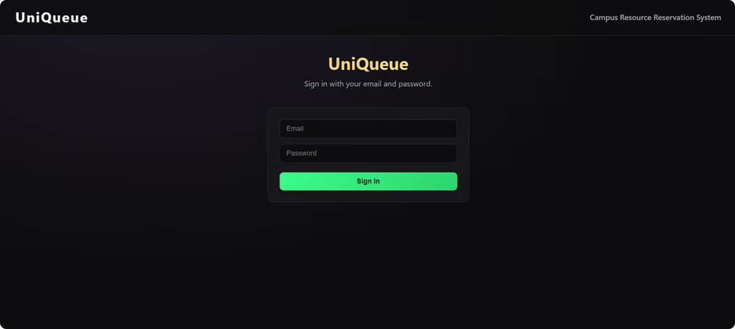
Login Screen
The secure entry point where users enter their email and password. After successful authentication, the system automatically redirects them to the specific dashboard associated with their assigned role.
Notes:
11

Slide 12

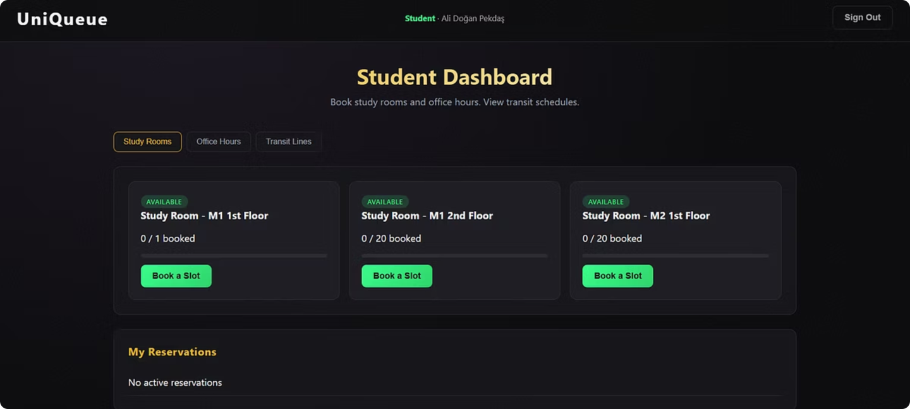
Student Dashboard
A multi-tab interface where students can browse and book Study Rooms or Office Hours, and view Transit Line schedules. It also includes dedicated sections to track their active reservations and view real-time system notifications.
Notes:
12

Slide 13

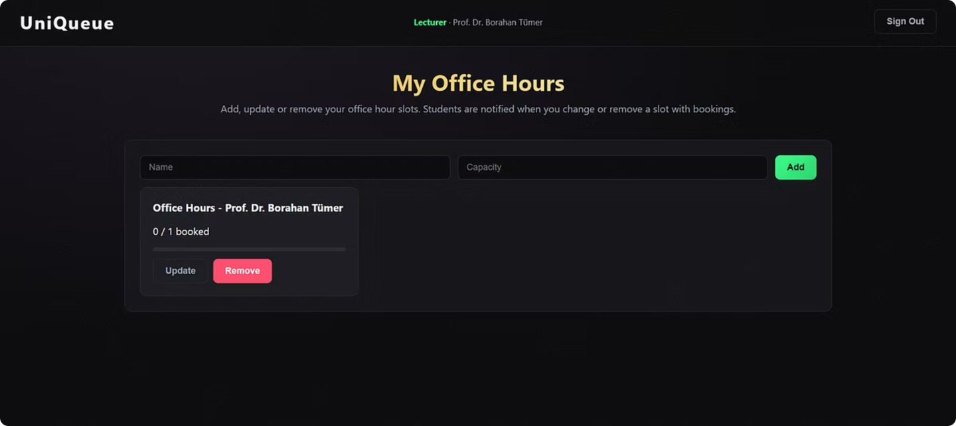
Lecturer Dashboard
A management interface exclusively for lecturers to create, update, or remove their own Office Hour slots. It allows them to set maximum student capacities and manage their availability directly.
Notes:
13

Slide 14

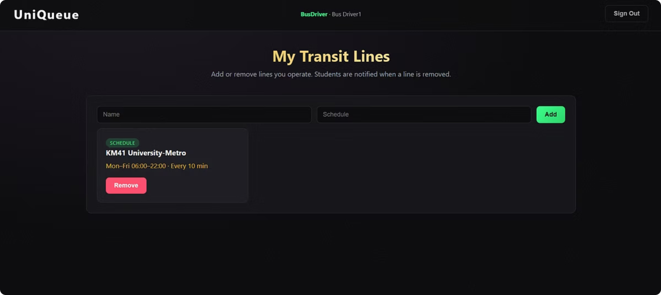
Bus Driver Dashboard
A streamlined screen where drivers can add, and remove specific campus transit lines and their running schedules for students to view.
Notes:
14

Slide 15

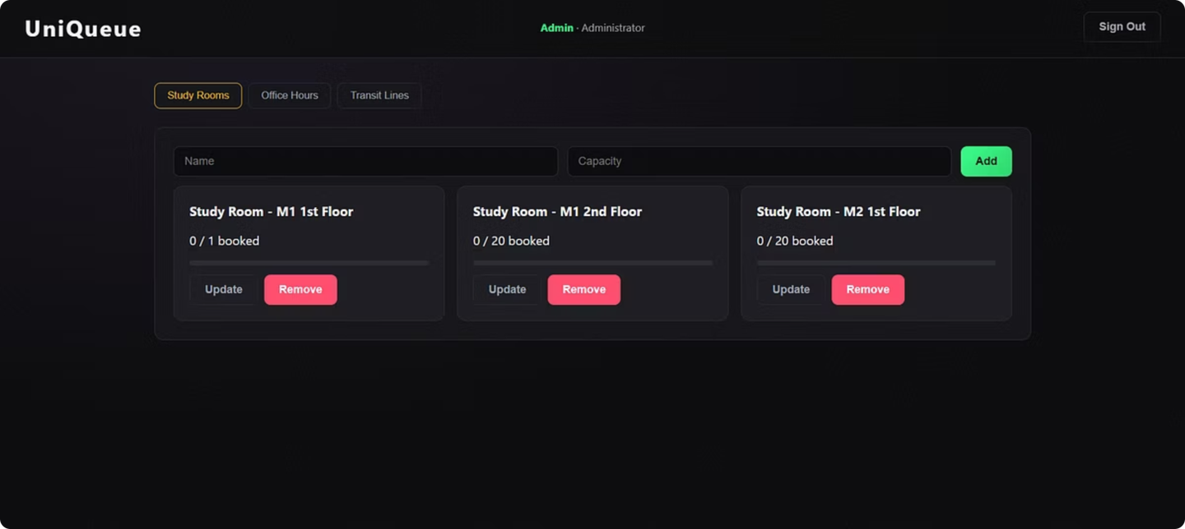
Admin Dashboard
A centralized, high-level control panel. Admins have access to all categories (Study Rooms, Office Hours, and Transit Lines) and hold the authority to create, manage, or delete any resource.
Notes:
15

