Slide 1

Speech Emotion Recognition
3rd report
17th July
2022

Slide 2
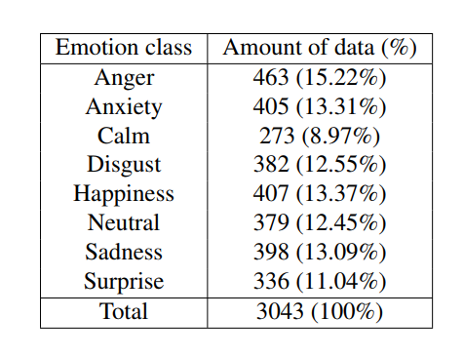
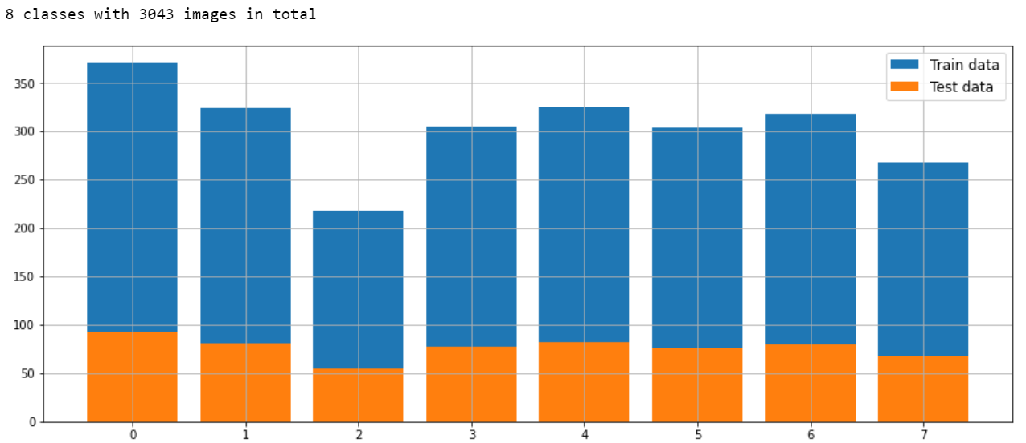
FSER - Dataset
RAVDESS – EMODB – EMOVO – SAVEE

Slide 3
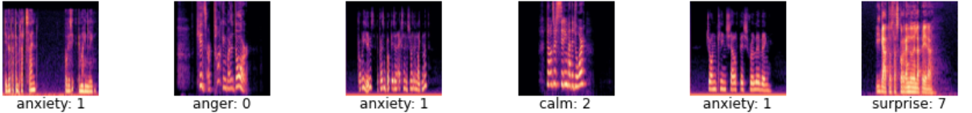
FSER - Data Processing
We used 512 as length of the FFT window, 512 as the hop-length (number of samples between successive frames) and a hanning windows size is set to the length of FFT window.
mel_spect = librosa.feature.melspectrogram(y =x,win_length=512, hop_length=512, window='hann')
mel_spect = librosa.power_to_db(mel_spect, ref=np.max)
librosa.display.specshow(mel_spect, y_axis='mel', x_axis='time');

Slide 4
FSER - Data Augmentation
To each input image (mel-spectrogram) object, we applied width and height shifting, zooming and horizontal flipping, using the keras.preprocessing.image module from the Keras deep learning framework.
from keras.preprocessing.image import ImageDataGenerator
train_datagen = ImageDataGenerator
zoom_range=0.1,
width_shift_range=0.1,
height_shift_range=0.1,
horizontal_flip=True
)

Slide 5
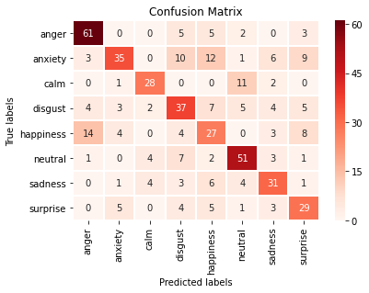
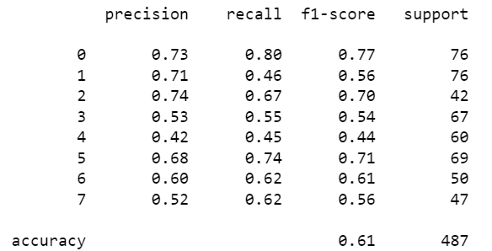
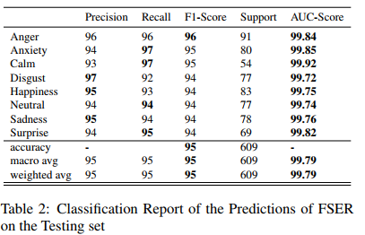
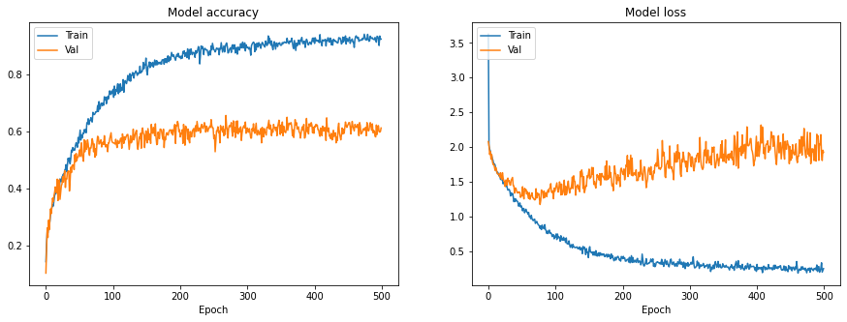
FSER(95,05%) – Results
DIFFERENT CNN ARCHITECTURES!

Slide 6
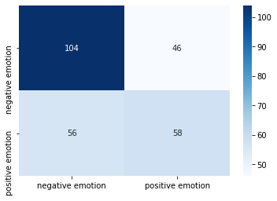
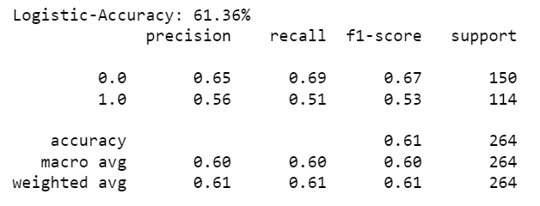
DeepInsight
Ravdess (Audio length = Minimum length)
HAPPY + SURPRISE / ANGER + FEARFUL
Features = Audio Data

Slide 7
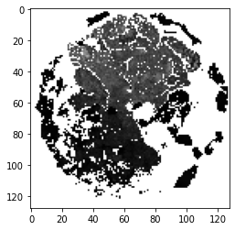

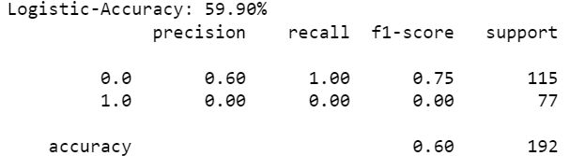
DeepInsight
Ravdess (Audio length = Maximum length)
import cv2
height, width, _ = image.shape
for i in range(height):
for j in range(width):
if image[i, j].sum() == 0:
image[i, j] = [255, 255, 255]
plt.imshow(cv2.cvtColor(image, cv2.COLOR_BGR2RGB))

Slide 8

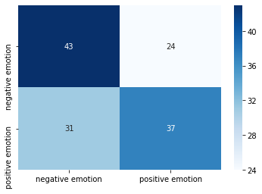
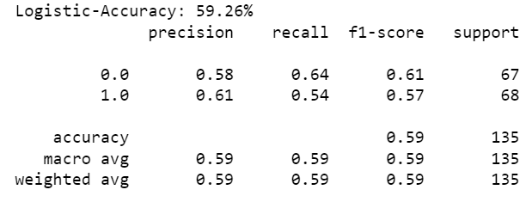

DeepInsight
Ravdess ( Data = Extracted features)

Slide 9
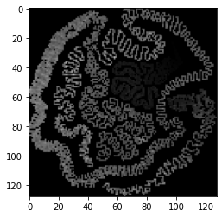
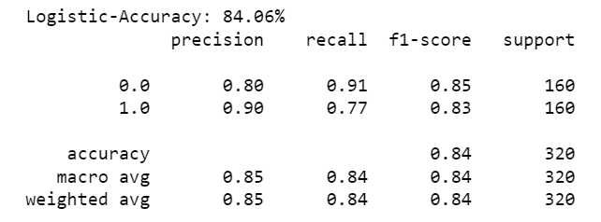
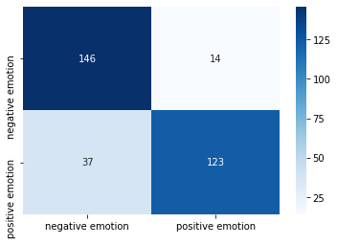
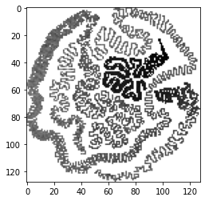
DeepInsight
TESS ( Data = AUDIO ; duration = 1.25 ; angry + fear / happy + surprised)

Slide 10
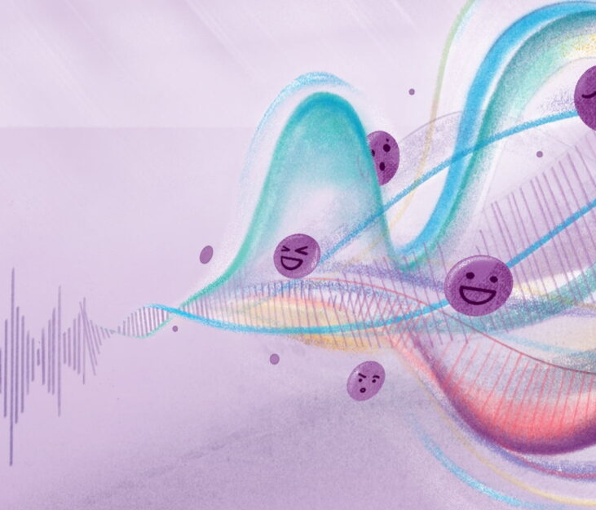
THANK YOU!

