Slide 1


Level-Crossing Analog to Digital Converter
LC-ADC
Presenter: Ali Qorbani Fard
Supervisor: Dr. Hossein Shamsi
Analog to Digital Conversion [1]
[1] Marcel J.M Pelgrom, “Analog-to Digital Conversion”, 4th ed. Stiphout, the Netherlands: Springer, 2021.
1/18

Slide 2

TABLE Of Contents
INTRODUCTION………………………………………….3
OVERVIEW OF ADC ARCHITECTURES / Flash .……..4
OVERVIEW OF ADC ARCHITECTURES / SAR……….5
OVERVIEW OF ADC ARCHITECTURES / Pipeline……6
Synchronous VS Asynchronous ADC……………………..7
Digital to Analog Converter – DAC……………………….8
Comparator……………………………………………….....9
Article 1............................................................................... 10
Article 2…………………………………………….12
Future Works………………………………………15
REFERENCES……………………………………..16
2/18

Slide 3
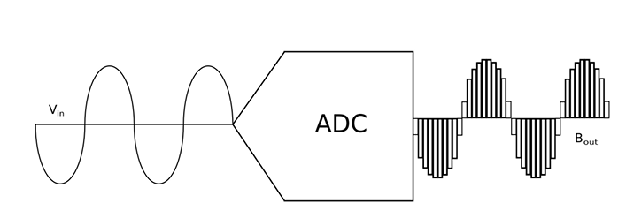
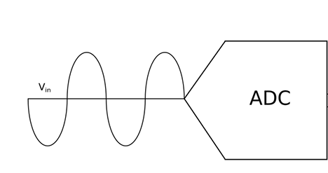
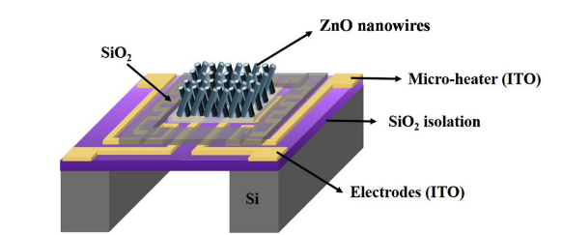
INTRODUCTION
Introduction
0101100101010
Simplified diagram of ADC [2]
Analog to Digital Converter
Modified Version of [2]
What is ADC?
Quantization
ADC Application
ADC & Sensors
Gas sensor [3]
[2] Anthony Troxell , “DESIGN AND LAYOUT OF A FIXED WINDOW 6-BIT LEVEL CROSSING ANALOG-TO-DIGITAL CONVERTER,”,M.S thesis, Dept. of Electrical Eng., California State University, Spring 2023.
[3] Ting-Jen Hsueha, Chien-Hua Pengb, Wei-Shou Chenc, "A transparent ZnO nanowire MEMS gas sensor prepared by an ITO micro-heater," Elsevier , October. 2019.
3/18

Slide 4
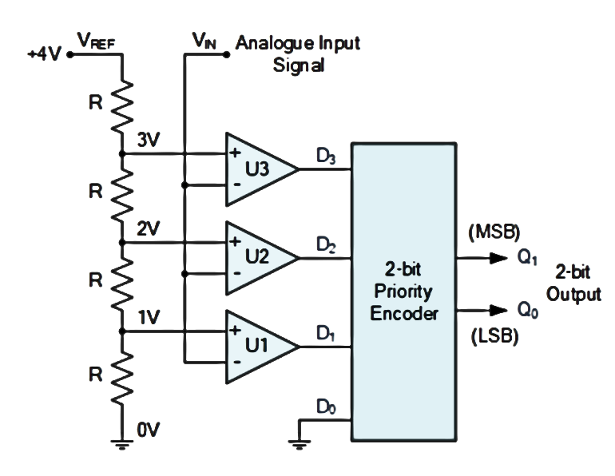
OVERVIEW OF ADC ARCHITECTURES / Flash
Pros:
Extremely Fast Conversion
Simple Architecture
(for Low Bit-Depth)
Cons:
Exponential Hardware Need
High Power Consumption
Large Chip Area
Thermal and Process Sensitivity
Flash ADC, modified Version of [1]
V_{in} = 2.3 V
[1] Marcel J.M Pelgrom, “Analog-to Digital Conversion”, 4th ed. Stiphout, the Netherlands: Springer, 2021.
4/18

Slide 5
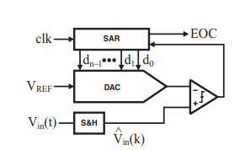
OVERVIEW OF ADC ARCHITECTURES / SAR
Pros:
Cost effective
smaller area
higher resolution is available
Cons:
Slower conversion speed
Requires DAC
Successive approximation ADC
SAR ADC [4]
[4] Gabriele Manganaro, “Advanced Data Converters”, 1st ed. Cambridge: Cambridge University press, 2012.
5/18

Slide 6
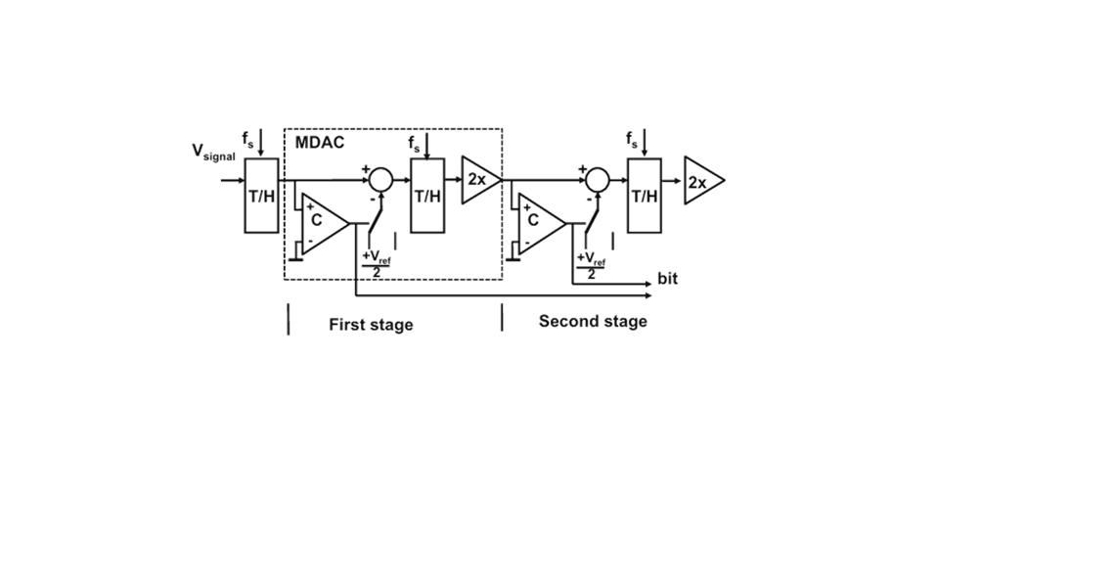

OVERVIEW OF ADC ARCHITECTURES / Pipeline
OVERVIEW OF ADC ARCHITECTURES / Pipeline
Cons:
Latency
Power Consumption
Pros:
Speed–Resolution Trade-off
Efficient Hardware
Scalable Architecture
Pipeline ADC, Modified Version of [1]
SAR ← Pipeline → Flash
[1] Marcel J.M Pelgrom, “Analog-to Digital Conversion”, 4th ed. Stiphout, the Netherlands: Springer, 2021.
6/18

Slide 7
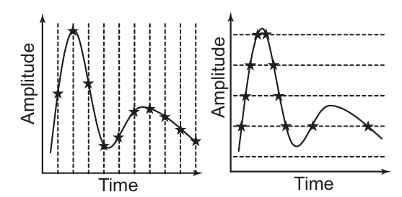
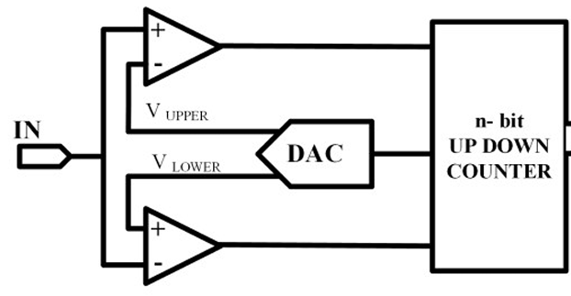
OVERVIEW OF ADC ARCHITECTURES / Pipeline
Synchronous VS Asynchronous ADC
output
Synchronous VS Asynchronous ADC [5]
Basic architecture of Level Crossing ADC (Asynchronous)
[6]
[5] Mario Renteria-Pinon, Xiaochen Tang, Jaime Ramirez-Angulo, and WEI TANG, “Fully Digital Second-order Level-crossing Sampling ADC for Data Saving in Sensing Sparse Signals,” in “arXiv.”, New York, USA, 2023.
[6] Sreenivasulu polineni, Anil Kumar Gupta, “8-bit Nano Watt Level Crossing ADC for Bio-Medical Application Medical Application ” in “IEEE International Conference on Computer, Communication and Control”, Kurukshetra, India , 2015.
7/18

Slide 8
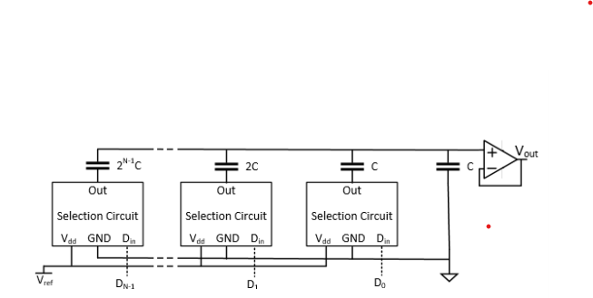
OVERVIEW OF ADC ARCHITECTURES / Pipeline
Digital to Analog Converter - DAC
High matching accuracy due to capacitor ratios
Common in SAR ADCs
Fast, low-power
Needs precise capacitor layout (unit capacitor arrays)
DAC Block Diagram [7]
[7] Kieren Pa, “SYNCHRONOUS LEVEL CROSSING ADC FOR BIOMEDICAL RECORDING APPLICATIONS,” M.S. thesis, Department of Electrical Engineering, University of North Texas, Texas, USA, 2021.
8/18

Slide 9
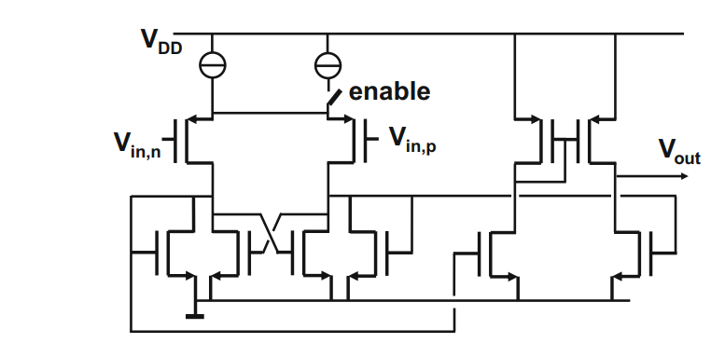
OVERVIEW OF ADC ARCHITECTURES / Pipeline
Comparator
Vin,p > Vin,n → Vout = VDD
Vin,p < Vin,n → Vout = VSS
Parallel NMOS → discharge & speed increase
Comparator [1]
[1] Marcel J.M Pelgrom, “Analog-to Digital Conversion”, 4th ed. Stiphout, the Netherlands: Springer, 2021.
9/18

Slide 10
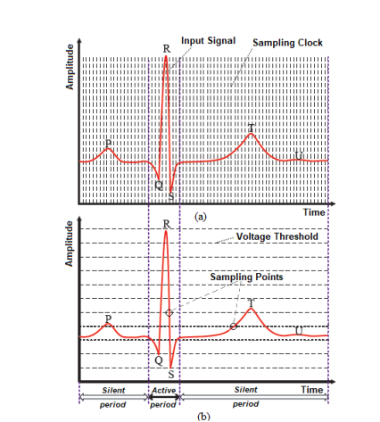
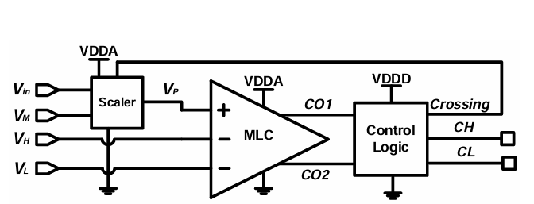
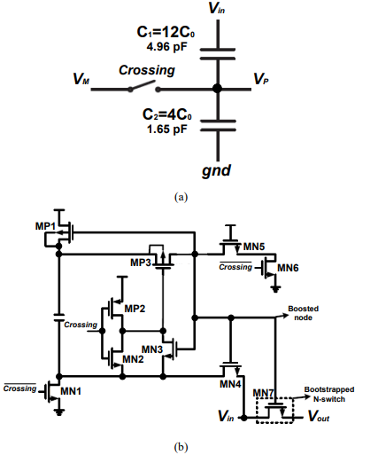
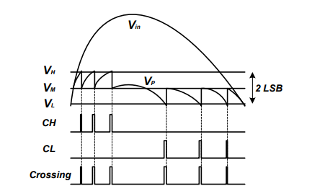
OVERVIEW OF ADC ARCHITECTURES / Pipeline
Article 1/2 [8]
Block diagram of the proposed LC-ADC
Nyquist sampling
(b) Level crossing sampling.
The Scaler
(b) The schematic of bootstrapped switch
Example waveforms.
[8] Yuting Hou, Khalil Yousef, Mohamed Atef, Guoxing Wang, Yong Lian,"A 1-to-1-kHz, 4.2-to-544-nW, Multi-Level Comparator Based Level-Crossing ADC for IoT Applications," IEEE Transactions on Circuits and Systems II: Express Briefs Volume: 65, Issue: 10, October 2018, pp. 1390 - 1394.
.
10/18

Slide 11
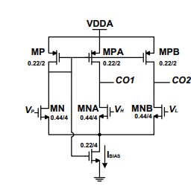
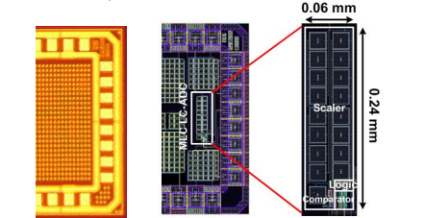
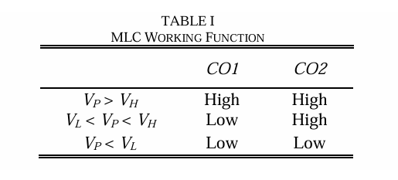
OVERVIEW OF ADC ARCHITECTURES / Pipeline
Article 1/2 [8]
Block diagram of the proposed LC-ADC
The schematic of self-biased multi-level comparator
The die and layout of proposed LC-ADC (the top layer of the die is full
of dummy pattern)
[8] Yuting Hou, Khalil Yousef, Mohamed Atef, Guoxing Wang, Yong Lian,"A 1-to-1-kHz, 4.2-to-544-nW, Multi-Level Comparator Based Level-Crossing ADC for IoT Applications," IEEE Transactions on Circuits and Systems II: Express Briefs (Volume: 65, Issue: 10, October 2018) , pp. 1390 - 1394.
.
11/18

Slide 12
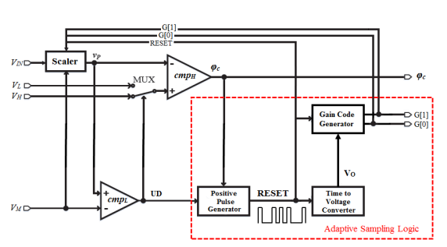
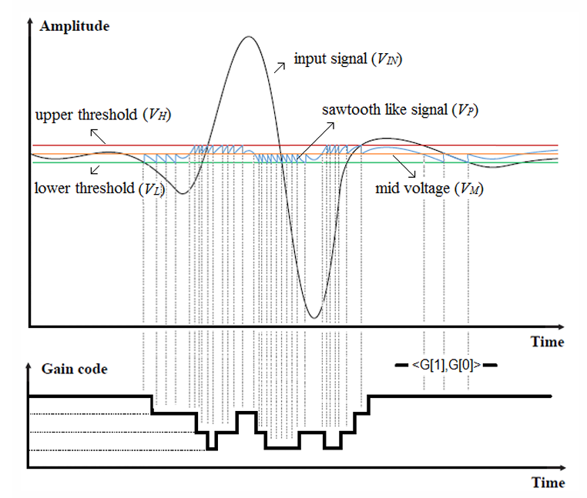
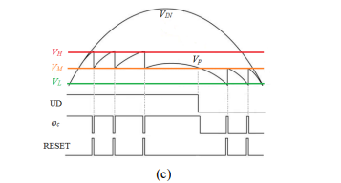
OVERVIEW OF ADC ARCHITECTURES / Pipeline
Article 2/2 [9]
UD, output sampling and RESET signals
Block diagram of the proposed LC-ADC
LC-ADC sampling
process and generated gain code
[9] Yuting Hou, Jiali Qu, Zhenzhen Tian, Mohamed Atef, Khalil Yousef, Yong Lian, “ A 61-nW Level-Crossing ADC With Adaptive Sampling for Biomedical Applications," IEEE Transactions on Circuits and Systems II: Express Briefs Volume: 66, Issue: 1, January ,2019, pp. 56 - 60.
12/18

Slide 13
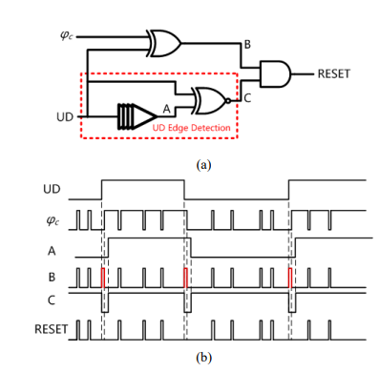
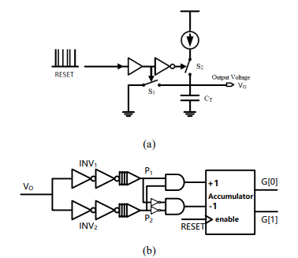
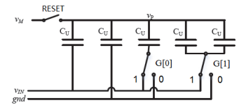
OVERVIEW OF ADC ARCHITECTURES / Pipeline
Article 2/2 [9]
(a)The block diagram of Time to Voltage Converter;
(b) Block
diagram of Gain Code Generator;
Positive Pulse Generator
(a) block diagram;
(b) transient waveforms
The structure of Scaler
[9] Yuting Hou, Jiali Qu, Zhenzhen Tian, Mohamed Atef, Khalil Yousef, Yong Lian“ A 61-nW Level-Crossing ADC With Adaptive Sampling for Biomedical Applications," IEEE Transactions on Circuits and Systems II: Express Briefs Volume: 66, Issue: 1, January ,2019, pp. 56 - 60.
13/18

Slide 14
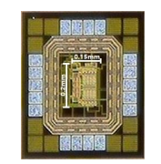
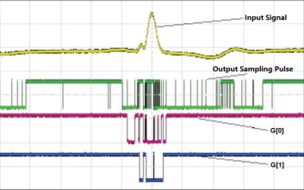
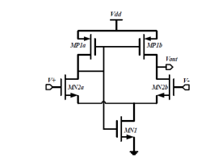
OVERVIEW OF ADC ARCHITECTURES / Pipeline
Article 2/2 [9]
LC-ADC chip micrograph
The measured adaptive sampling method
The schematic of sampling window comparator
[9] Yuting Hou, Jiali Qu, Zhenzhen Tian, Mohamed Atef, Khalil Yousef, Yong Lian“ A 61-nW Level-Crossing ADC With Adaptive Sampling for Biomedical Applications," IEEE Transactions on Circuits and Systems II: Express Briefs Volume: 66, Issue: 1, January ,2019, pp. 56 - 60.
14/18

Slide 15
OVERVIEW OF ADC ARCHITECTURES / Pipeline
Future Works
Design optimized low-power comparators
Optimize DAC circuit
System-level validation with real signals
Investigate ultra-low power techniques
15 /18

Slide 16
OVERVIEW OF ADC ARCHITECTURES / Pipeline
REFERENCES
[1] Marcel J.M Pelgrom, “Analog-to Digital Conversion”, 4th ed. Stiphout, the Netherlands: Springer, 2021.
[2] Anthony Troxell , “DESIGN AND LAYOUT OF A FIXED WINDOW 6-BIT LEVEL CROSSING ANALOG-TO-DIGITAL CONVERTER,”,M.S thesis, Dept. of Electrical Eng., California State University, Spring 2023.
[3] Ting-Jen Hsueha, Chien-Hua Pengb, Wei-Shou Chenc, "A transparent ZnO nanowire MEMS gas sensor prepared by an ITO micro-heater," Elsevier, October. 2019.
[4] Gabriele Manganaro, “Advanced Data Converters”, 1st ed. Cambridge: Cambridge University press, 2012.
[5] Mario Renteria-Pinon, Xiaochen Tang, Jaime Ramirez-Angulo, and WEI TANG, “Fully Digital Second-order Level-crossing Sampling ADC for Data Saving in Sensing Sparse Signals,” in “arXiv.”, New York, USA, 2023.
[6] Sreenivasulu polineni, Anil Kumar Gupta, “8-bit Nano Watt Level Crossing ADC for Bio-Medical Application Medical Application ” in “IEEE International Conference on Computer, Communication and Control”, Kurukshetra, India , 2015.
16/ 18

Slide 17
OVERVIEW OF ADC ARCHITECTURES / Pipeline
REFERENCES
[7] Kieren Pa, “SYNCHRONOUS LEVEL CROSSING ADC FOR BIOMEDICAL RECORDING APPLICATIONS,” M.S. thesis, Department of Electrical Engineering, University of North Texas, Texas, USA, 2021.
[8] Yuting Hou, Khalil Yousef, Mohamed Atef, Guoxing Wang, Yong Lian,"A 1-to-1-kHz, 4.2-to-544-nW, Multi-Level Comparator Based Level-Crossing ADC for IoT Applications," IEEE Transactions on Circuits and Systems II: Express Briefs (Volume: 65, Issue: 10, October 2018) , pp. 1390 - 1394.
[9] Yuting Hou, Jiali Qu, Zhenzhen Tian, Mohamed Atef, Khalil Yousef, Yong Lian“ A 61-nW Level-Crossing ADC With Adaptive Sampling for Biomedical Applications," IEEE Transactions on Circuits and Systems II: Express Briefs Volume: 66, Issue: 1, January ,2019, pp. 56 - 60.
17/18

Slide 18
Thank You For Your Attention
18/18

