Slide 1
Predicting Retail Fraud: Customer Payments October 6, 2022
Presented by:
Ali Rampurawala
Legendary Preds Inc.

Slide 2
Business Problem
Fitris LLP’s (law firm) retail shopping client is losing over 10% to fraudulent payments each year
Asked to develop a model that will identify potentially fraudulent payments
Objective: Predict which customer payments are potentially fraudulent and rank these transactions in order

Slide 3
Source Data
Payment Transaction Data (~500,000 payments)
Potential limitations
Fields Includes:
Day
Gender
Age group
Category of purchase
Amount

Slide 4
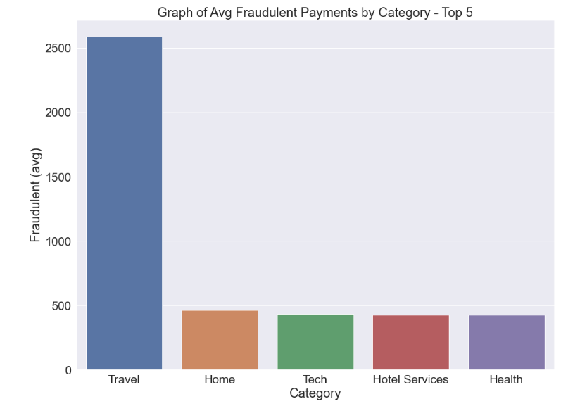
Avg. Fraud Transaction ($)
Travel has highest fraud
Other categories are much less

Slide 5
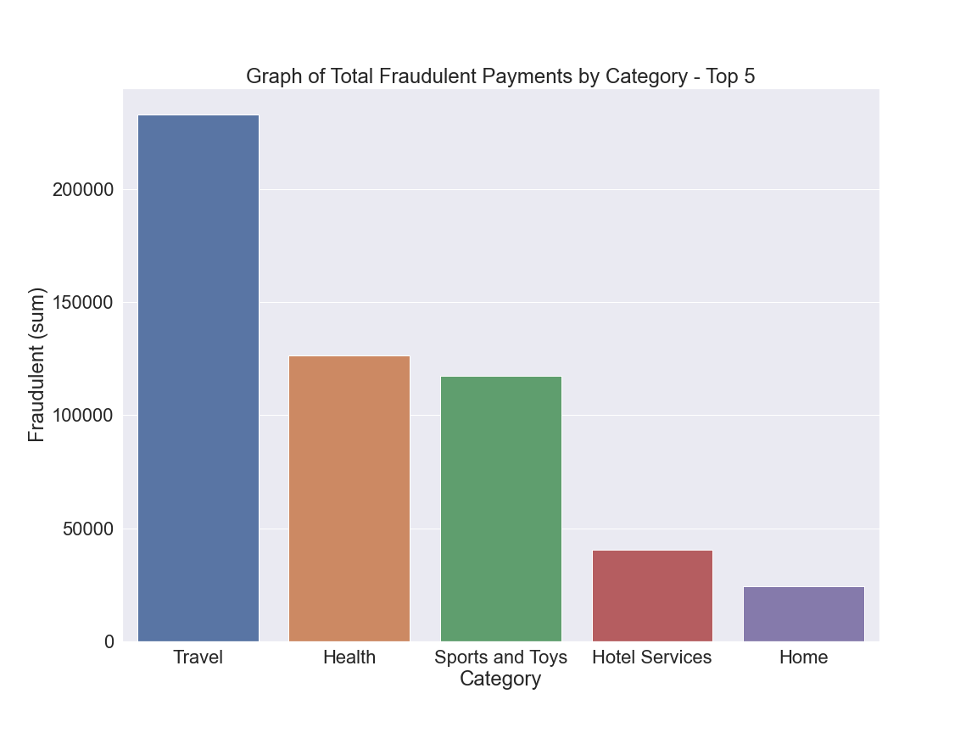
Highest Total Fraud ($)
Travel
Health
Sports and Toys

Slide 6
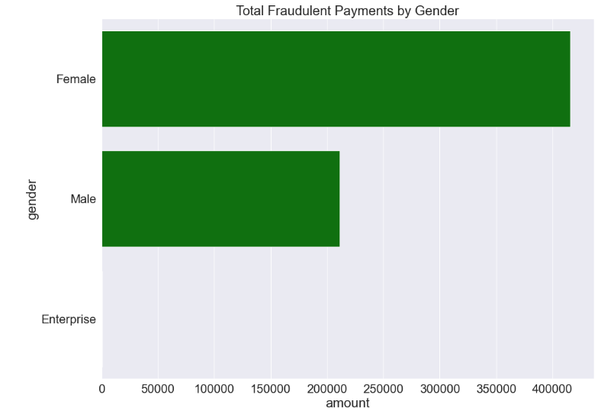
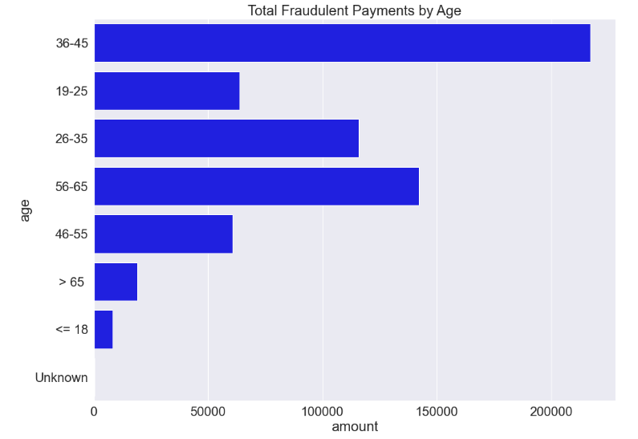
Fraud by Gender and Age

Slide 7
Final Fraud Detection Model
Final Accuracy Score: 99%
Using Logistic Regression

Slide 8
Other Key Results
Precision: 78% on identifying fraud
Recall: 75% on identifying fraud
F1-score: 76% on identifying fraud

Slide 9
Recommendations
At the end of each weekly or two-week period, feed the Final Logistic Regression model with payment detail
Continuously update the model to include additional locations (i.e. zipcode)
Investigate the identified transactions and prevent delivery of any product or service unless payment has been verified

Slide 10
Closing thoughts
Things to explore
If given additional time…
Further tune the model to increase the overall precision score
Continue to add payment data each quarter and update model
Consider NLP of chats to identify bad actors before they place an order

Slide 11
Thank You…
Any questions?
Email: Ali.Rampurawala@gmail.com
Github Link
LinkedIn

