Slide 1
Predicting Fraudulent Transactions October 6, 2022
Presented by:
Ali RampurawalA - CPA, CFE, CFF

Slide 2
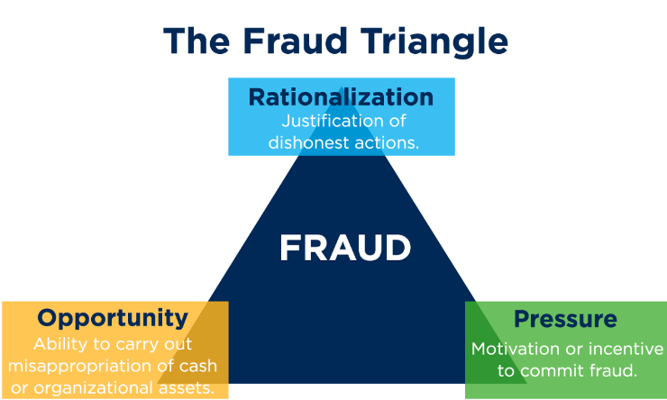
My Background
Certified Public Accountant (CPA)
Specialized in Financial Forensics (CFF) and Fraud Examination (CFE)
10+ years of investigation and anti-fraud consulting experience

Slide 3
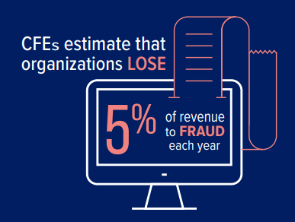
Business Problem
Fitris LLP’s (law firm) retail shopping client is losing over 10% to fraudulent transactions each year
Develop a model that will identify potentially fraudulent transactions
Objective: Predict which customer transactions are potentially fraudulent

Slide 4
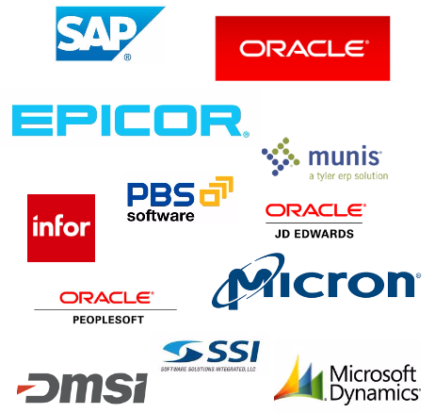
Source Data
General Ledger - Payment Data for Online Retailer (~500,000 transactions)
Potential limitations
Fields Includes:
Day
Gender
Age group
Category of purchase
Amount

Slide 5
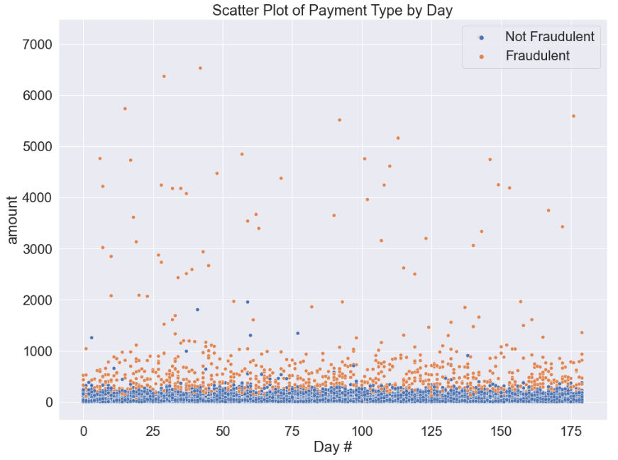
Initial Observations
Fraud = 1.2%
Avg. Fraud > Avg. Transaction
Consistent throughout period

Slide 6
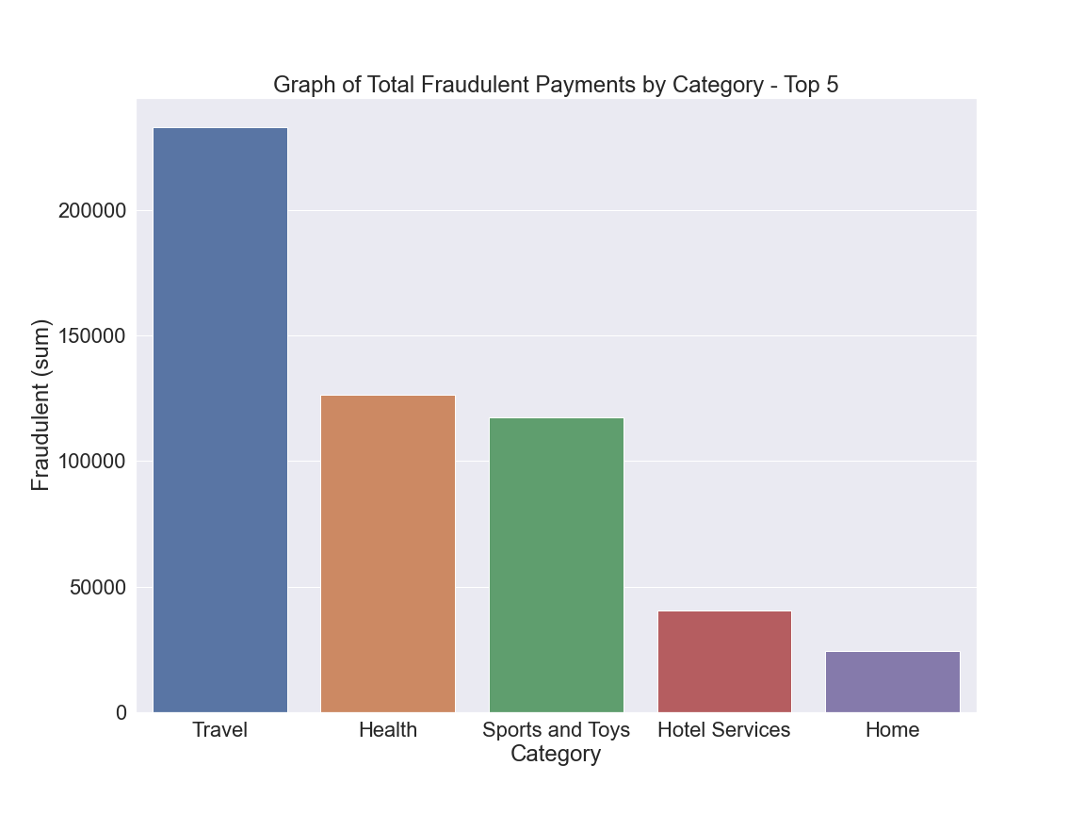
Highest Total Fraud ($)
Travel
Health
Sports and Toys

Slide 7
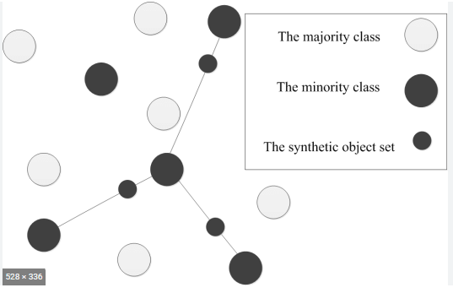
Applying ‘SMOTE’
Fraud is not common (1.2%)
Synthetic data
Oversampling
Notes:
SMOTE - Synthetic Minority Oversampling Technique

Slide 8
Final Fraud Detection Model
Final Accuracy Score: 99.3%
Using Logistic Regression

Slide 9
Other Key Results
Precision: 78% on identifying fraud
Recall: 75% on identifying fraud
F1-score: 76% on identifying fraud

Slide 10
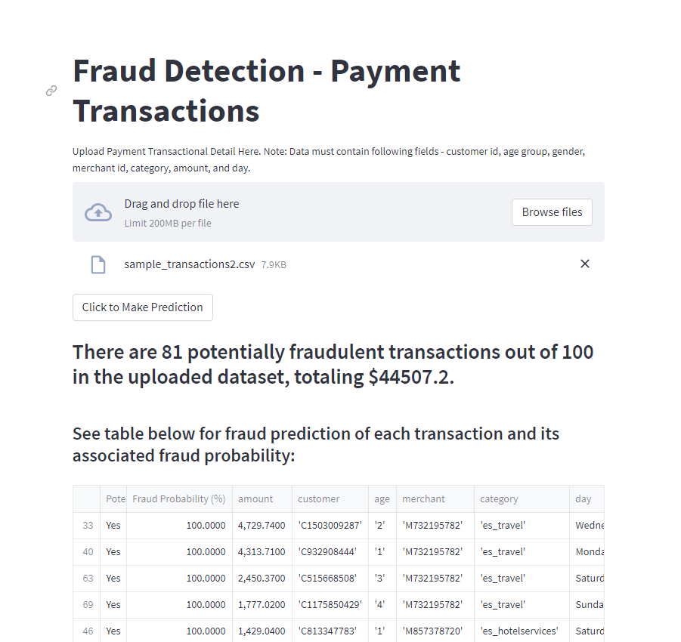
Using the Online Application
https://alirampur-flatiron-capstone-streamlit-capstone-yx8toc.streamlitapp.com/

Slide 11
Recommendations and Next Steps
At the end of each week or day, upload transaction detail to the online tool
Investigate the identified transactions and prevent delivery of any product or service unless payment has been verified and received
Continuously update the model to include additional locations (i.e. zip code)

Slide 12
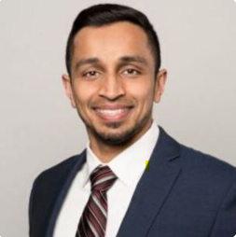
Thank You…Any Questions?
Email: Ali.Rampurawala@gmail.com
Github Link
LinkedIn

