Slide 1
Predicting Disbursement Fraud October 6, 2022
Presented by:
Ali Rampurawala
Legendary Preds Inc.

Slide 2
Business Problem
Fitris LLP’s retail shopping center is losing over 10% to fraudulent payments
Asked me to develop a model that will identify potential fraudulent payments
Objective: Predict which customer payments are potentially fraudulent and rank these transactions

Slide 3
Data
Payment Transaction Data (~500,000 payments)
Potential limitations
Fields Includes:
Day
Gender
Age group
Category of purchase
Amount

Slide 4
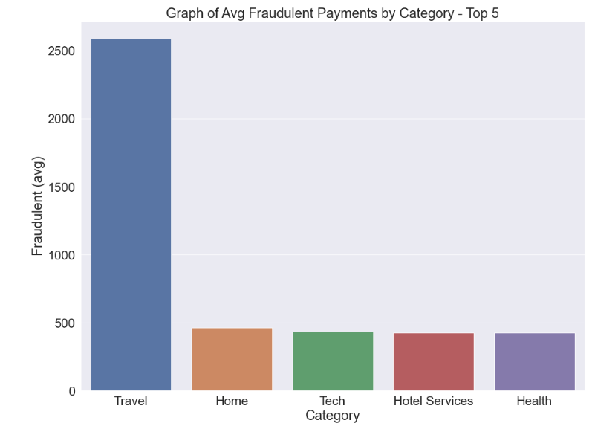
Avg. Fraud Transaction
Travel has highest avg. fraud
Other categories are much less

Slide 5
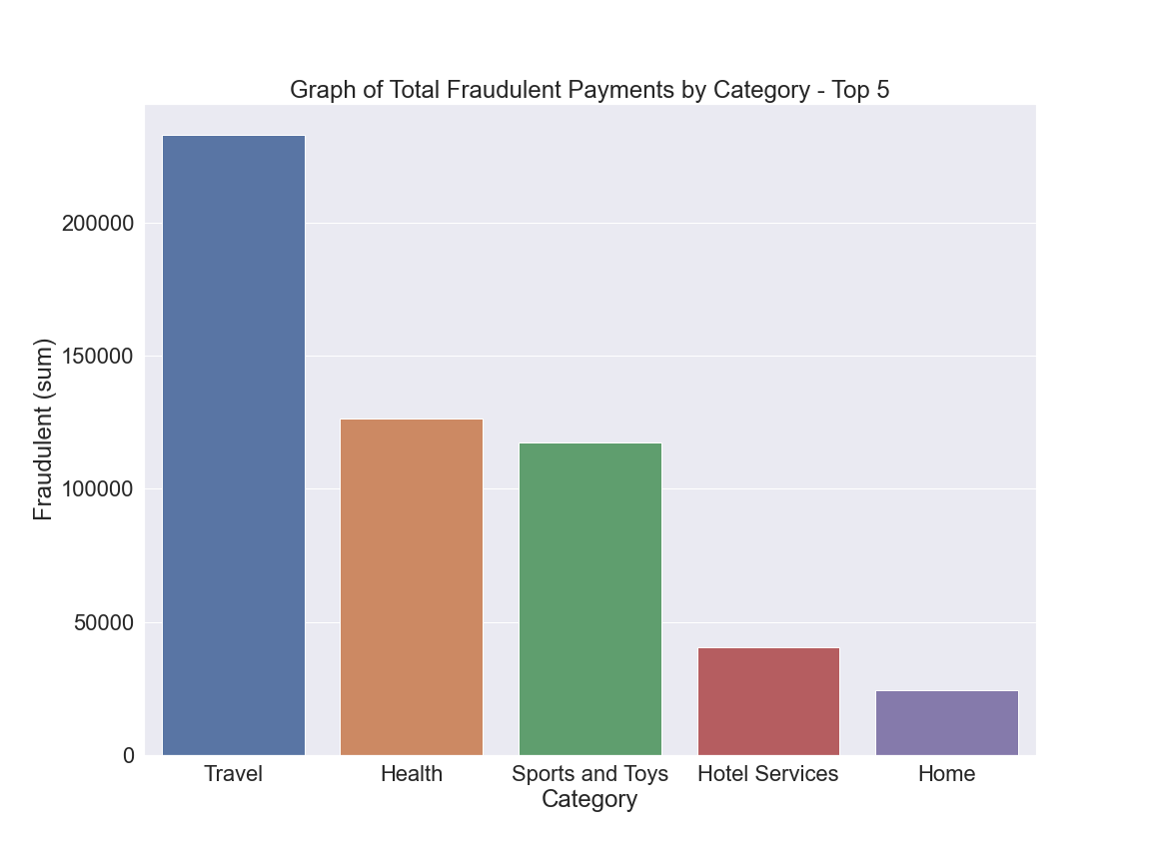
Highest Total Fraud
Travel
Health
Sports and Toys

Slide 6
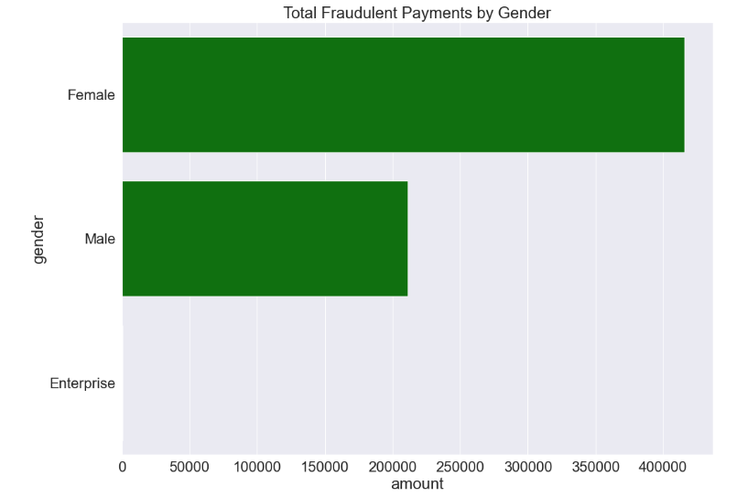
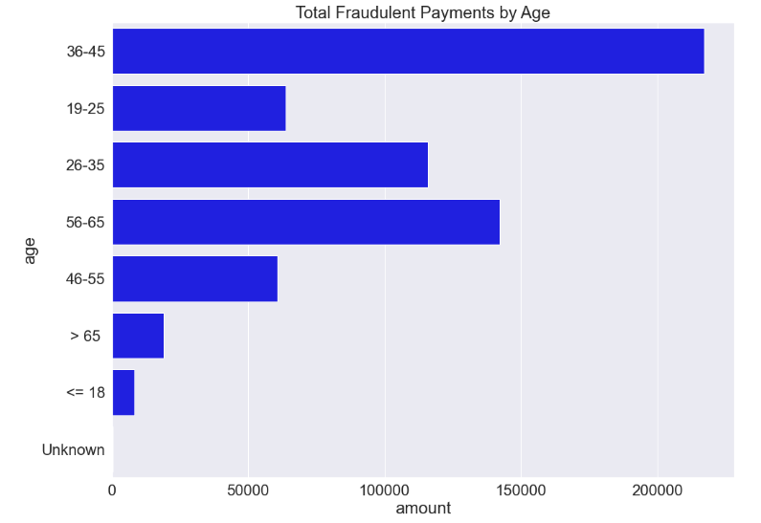
Fraud by Gender and Age

Slide 7
Final Model
After running hundreds of model iterations…
Final Accuracy Score: 99%
Using Logistic Regression

Slide 8
Other Key Results
Precision: 78% on identifying fraud
Recall: 75% on identifying fraud
F1-score: 76% on identifying fraud

Slide 9
Recommendations
At the end of each weekly or two-week period, feed the Final Logistic Regression model with payment data
I can update the model to include additional locations (i.e. zipcode)
Investigate the identified transactions and prevent delivery of any product or service unless payment has been made

Slide 10
Closing thoughts
Things to explore
If given additional time…
Further tune the model to increase the overall precision score
Continue to add payment data each quarter and update model
Consider adding NLP/Chat data if available

Slide 11
Thank You….
Any questions?
Email: Ali.Rampurawala@gmail.com
Github Link

