Slide 1
Google: User Sentiment Analysis September 19, 2022
Presented by:
Ali Rampurawala
Legendary Preds Inc.

Slide 2
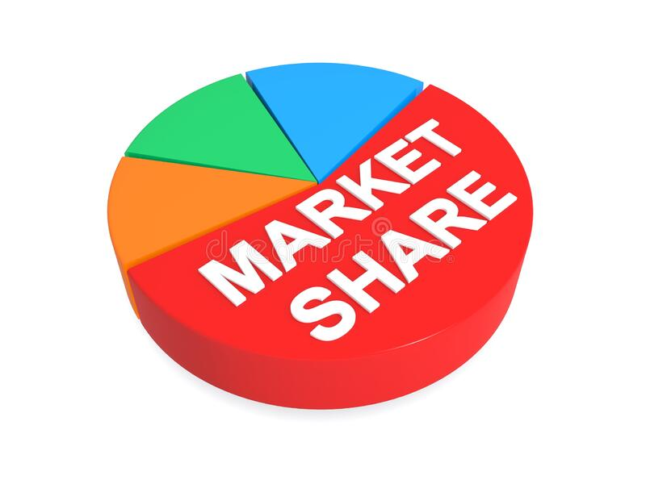
Business Problem
Trying to build Android’s market share (compared to Apple/IOS)
Focus on current Android users and IOS users who seem disappointed
Objective: Predict which tweets (and users) indicate negative and positive emotions toward Google and Apple

Slide 3
Data
Twitter Data (~9,000 Tweets)
Includes:
Tweet text
Google or Apple product
User emotion (negative, positive, none)

Slide 4
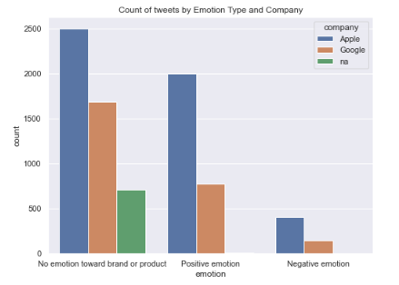
Initial Observations
Positive emotion toward Apple
Generally, less negative emotion

Slide 5
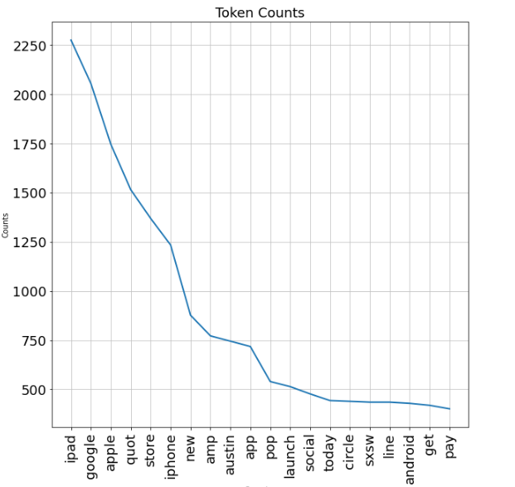
Most Common Words
iPad
Google
Apple

Slide 6
Final Model
After running hundreds of model iterations…
Final Accuracy Score: 70%
So…what does this mean?

Slide 7

Key Take Away
The final model can predict 70% accuracy across:
Negative Apple
Negative Google
All other (positive, no emotion, no Apple/Google)

Slide 8
Recommendations
At the end of each weekly or two-week period, feed NLP model with Tweet data from multiple regions or events (e.g. #sxsw = South by Southwest)
Focus on regions or events with high negative emotion to Apple or Google products that are identified by the model.
Setup temporary ‘Google’ branded (Android, etc.) advertisements, ‘give aways’ or other campaigns at the event.

Slide 9
Closing thoughts
Things to explore
If given additional time…
Further tune the model to increase the overall accuracy score
Continue to add Tweet data each quarter and update model
Consider more advanced NLP models

Slide 10
Thank You….
Any questions?
Email: Ali.Rampurawala@gmail.com
Github Link

