Slide 1
Artificial Intelligence Project
Student GPA Predictor
Using Linear Regression & 5-Fold Cross Validation
BCS-4D | Muhammad Ali Raza (24K-0794) · Muhammad Sarim Hussain (24K-0861) · Aakif Abrar Awan (24K-0889)

Slide 2
01
PROJECT OBJECTIVES
🧹
Clean & Preprocess
Introduction
& Objectives
Handle missing values, remove duplicates, encode categorical features
🔍
Analyze Relationships
Explore correlations between lifestyle factors and GPA via EDA
Why This Project?
🤖
Build Linear Regression Model
Academic performance depends on many factors — study habits, attendance, sleep, extracurriculars, and prior GPA. Understanding these relationships helps institutions support student success.
Train a predictive model on the cleaned academic dataset
📐
Evaluate with Cross-Validation
Use 5-Fold CV with R², MAE, and RMSE metrics
🎯
Predict GPA
Create an input system where students can enter their data

Slide 3
02 DATASET DESCRIPTION
What Data Was Used?
INPUT FEATURES
🎯
📚
📊
🎓
TARGET VARIABLE
Study Hours/Week
Attendance Rate
Major
College GPA
Predicted College GPA as a continuous value, calculated using academic and lifestyle features through the regression model.
📋
🏃
💼
High School GPA
Extracurricular Activities
Part-Time Job
📖
💻
😴
Library Usage/Week
Online Coursework
Sleep Hours/Night

Slide 4
03 DATA PREPROCESSING
Cleaning & Preparing the Dataset
🔧
STEP 01
🗑️
STEP 02
Missing Values
Duplicate Removal
Numerical columns filled with column mean. Categorical columns filled with mode (most frequent value). No data is lost.
All duplicate rows identified and removed using drop_duplicates(keep='first') to ensure data quality.
🔢
STEP 03
⚖️
STEP 04
Encoding
StandardScaler
Part-Time Job → Binary Encoding (0/1).
Major → One-Hot Encoding with drop_first to avoid multicollinearity.
All features normalized to zero mean and unit variance, so no single feature dominates the model due to scale differences.

Slide 5
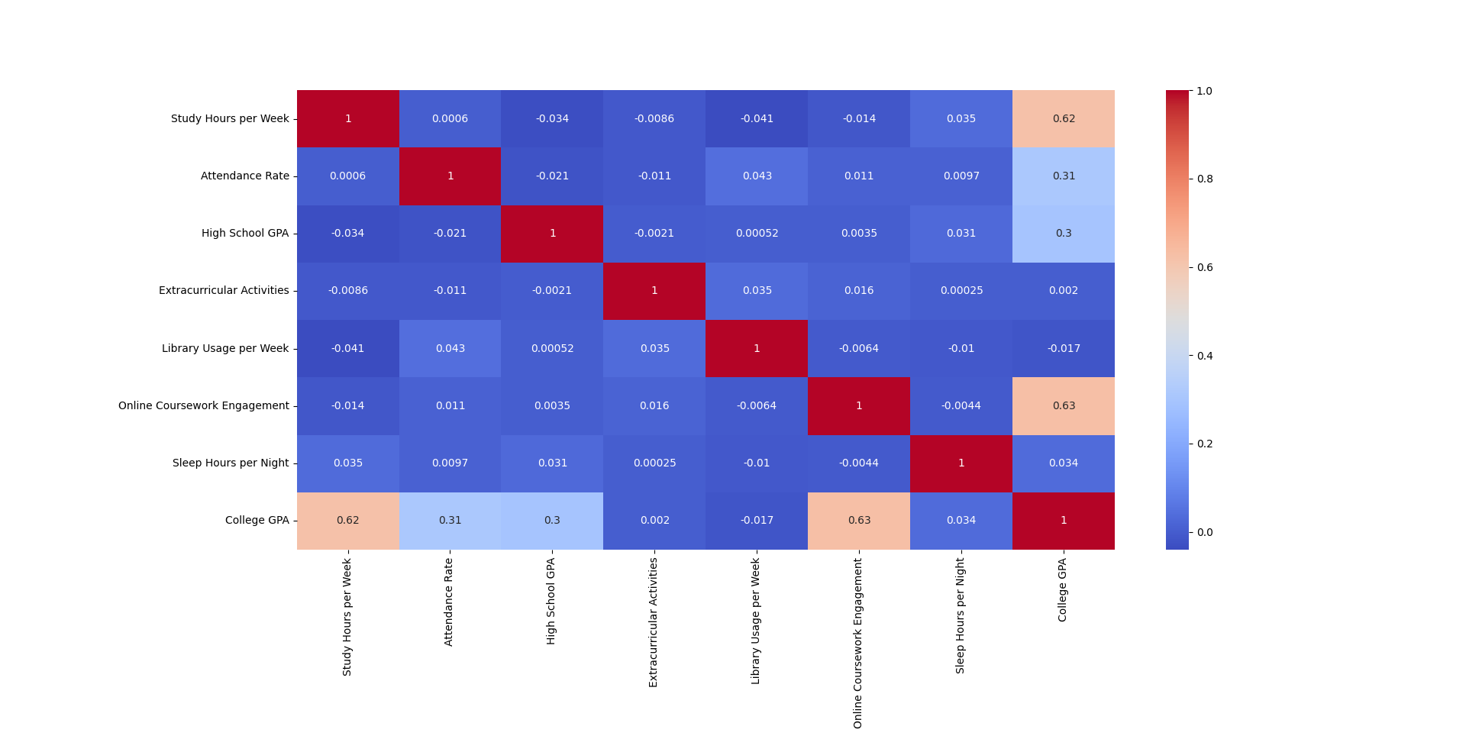
04 EXPLORATORY DATA ANALYSIS
Correlation Heatmap
KEY FINDINGS
Study Hours
Higher study hours→ higher GPA
Attendance Rate
Higher attendance → higher GPA
Online Coursework Engagement
Higher online coursework engagement → higher GPA
High School GPA
Higher attendance → higher GPA
Other factors
Other factors like sleep, extracurricular, library usage doesn’t affect the GPA too much

Slide 6
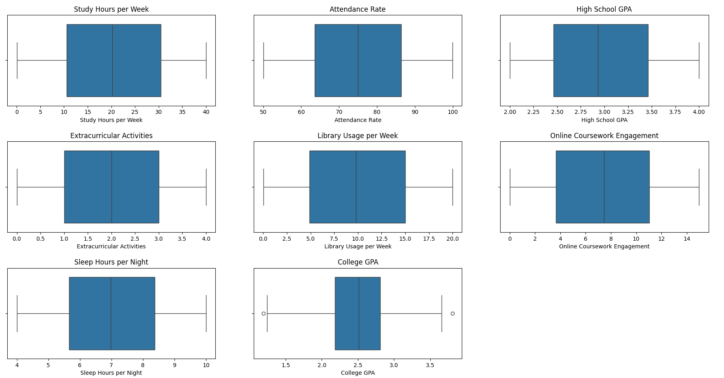
04 EXPLORATORY DATA ANALYSIS
Box Plot Analysis — Outlier Detection
Most features show balanced distribution with minimal outliers
Study habits and attendance vary across students
Sleep patterns remain relatively consistent
College GPA shows slight variation with few mild outliers
Box plots helped understand spread and data distribution
Outliers in College GPA were not removed as it is the target variable, preserving model accuracy and real-world prediction capability
INSIGHTS

Slide 7
05 MODEL SELECTION & EVALUATION
Linear Regression + 5-Fold Cross Validation
y = β₀ + β₁x₁ + β₂x₂ + ... + βₙxₙ
Why Linear Regression?
y = Predicted GPA x = Features β = Model Coefficients
Target (GPA) is continuous, easy to interpret, and ideal for regression tasks.
5-FOLD CROSS VALIDATION PROCESS
Fold 1
→
Fold 2
→
Fold 3
→
Fold 4
→
Fold 5
Each fold uses 4 parts for training and 1 part for testing, repeated 5 times for reliable evaluation.
R² Score
Mean Absolute Error
RMSE
Tells how well your features (study hours, attendance, etc.) explain GPA. Example: R² = 0.80 means your model explains 80% of GPA variation using your input features.
Shows on average how many GPA points your predictions are off (e.g., 0.3 means you’re off by 0.3 GPA units on average).
Like MAE but penalizes big mistakes more. If RMSE is higher than MAE, it means your model sometimes makes large prediction errors.

Slide 8
06 MODEL RESULTS
Exceptional Predictive Accuracy
📈
📏
⚡
Mean R² Score
Mean MAE
Mean RMSE
0.9849
0.0192
0.0548
98.49% variance explained
Average error of just ~0.02 GPA
Very low penalty on large errors
Model Interpretation
The model achieved R² = 0.9849, meaning it explains 98.49% of the variation in College GPA. With a Mean Absolute Error of just 0.019 GPA points, the model predicts student GPA with remarkable accuracy. These results demonstrate that academic and lifestyle factors are strong indicators of college performance.

Slide 9
07 PREDICTION SYSTEM
How Students Use the Model
STUDENT INPUTS →
MODEL OUTPUT
▸ Study Hours per Week
🎓
▸ Attendance Rate (%)
▸ Major (Business/Science/Arts/Engineering)
→
▸ High School GPA
Predicted
College GPA
▸ Extracurricular Activities (count)
▸ Part-Time Job (Yes/No)
Example: 3.72 / 4.0
▸ Library Usage per Week
▸ Online Coursework Hours
▸ Sleep Hours per Night

Slide 10
08 CONCLUSION & FUTURE WORK
Outcomes & Next Steps
CONCLUSION
Successfully built a GPA predictor using Linear Regression
Achieved 98.49% R² score — very high accuracy
Study habits, attendance & high school GPA are the strongest predictors
Data preprocessing & EDA proved essential for model quality
5-Fold Cross Validation ensured reliable, unbiased evaluation

Slide 11
Thank You
TOOLS & LIBRARIES USED
🐼
🔢
📉
🎨
🤖
pandas
NumPy
matplotlib
seaborn
scikit-learn
BCS-4D | Muhammad Ali Raza · Muhammad Sarim Hussain · Aakif Abrar Awan

