Slide 1




Big Data Analysis Project -Phase 1.
Ali Inamdar.
Scalable Database – CS 673.

Slide 2
Contents:
Extracting the Data.
Table Creation and Data Loading.
Data Analysis Tasks:
Top 3 airports with ’highest delay time’.
Top 3 airlines with ‘highest delay time’.
Largest type of delay.
4. Conclusion.

Slide 3
Data Source
Data Expo 2003 : Airline on time data.
The data represents flight arrival and departure times for all commercial flights within the USA for all years.
Download link: Data Expo 2003:Airline on time data.

Slide 4
Steps for working with data in HADOOP.
Step1: Extracting the data from the site and download the csv file from the website.
Step 2: Creating a Hive table and load all the file data into it. Prefix the table with your name.
Step 3: Displaying the first 100 rows of each table we created.
Step 4: Data Analysis tasks.

Slide 5
Step 1: Extracting the data from the site and download the csv file from the website.
hdfs dfs -mkdir -p /user/hive/warehouse -creating “warehouse” directory inside “hive” directory
hdfs dfs -chmod g+w /user/hive/warehouse - granting write permission to the group
2003.csv File:
wget https://dataverse.harvard.edu/api/access/datafile/:persistentId?persistentId=doi:10.7910/DVN/HG7NV7/KM2QOA
mv :persistentId?persistentId=doi:10.7910%2FDVN%2FHG7NV7%2FKM2QOA 2003.csv.bz2
bzip2 -d 2003.csv.bz2 - unzip
hdfs dfs -put 2003.csv /user/hive/warehouse - Copying the new file back to HDFS

Slide 6
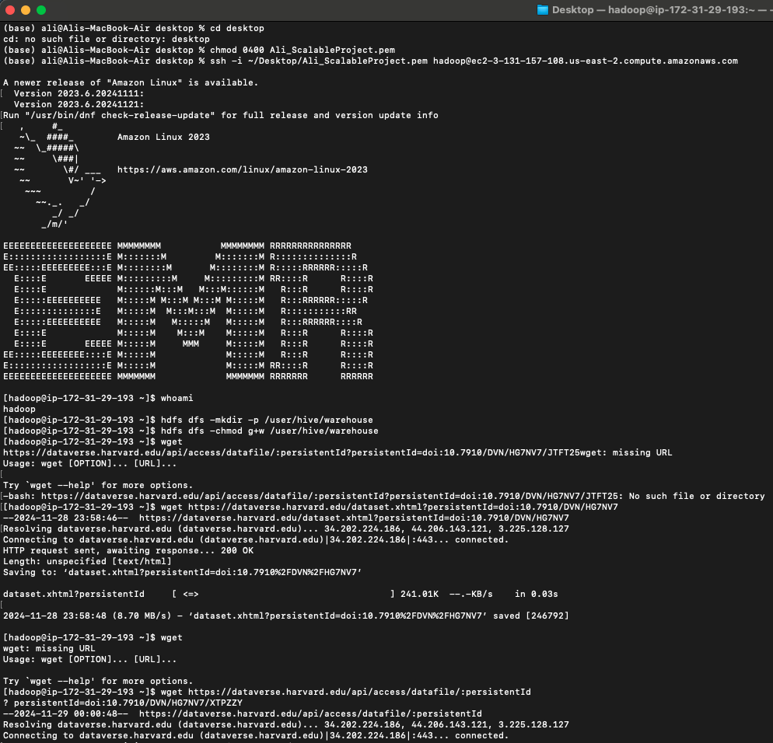
Launching Hadoop

Slide 7
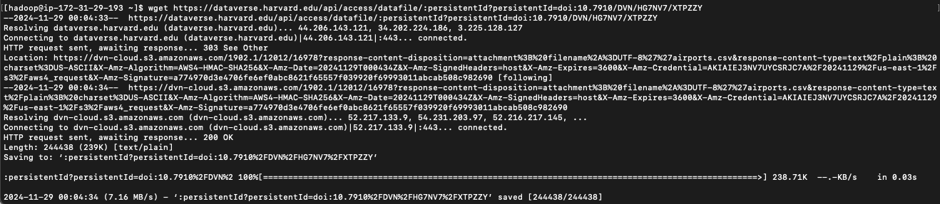
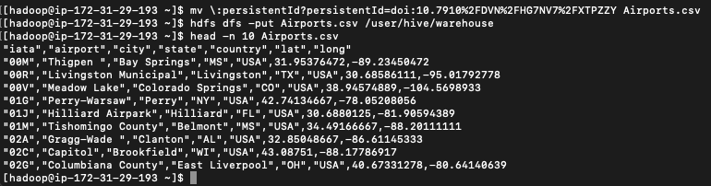
Connecting to the website:
Airport CSV:

Slide 8
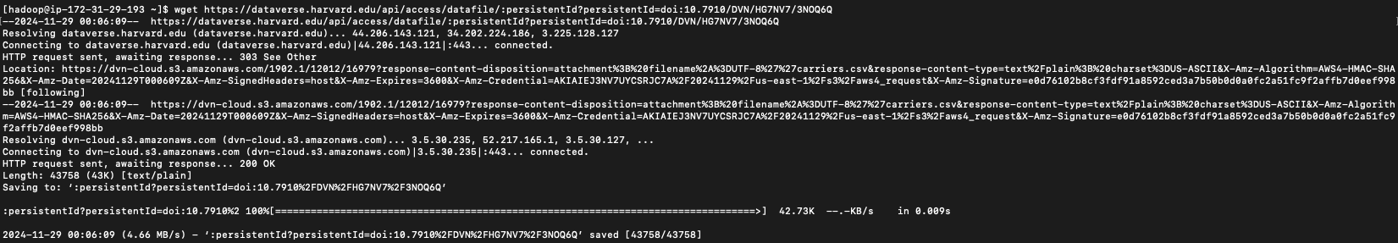
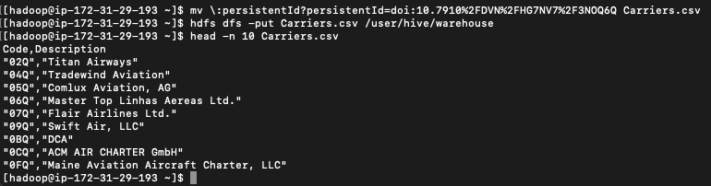
2. Carriers CSV

Slide 9
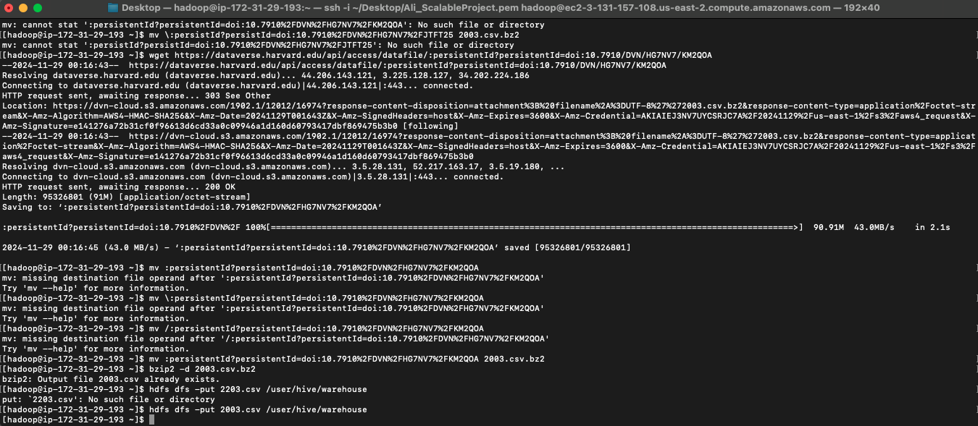
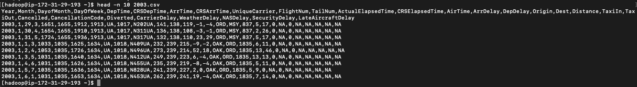
3. 2003 CSV

Slide 10
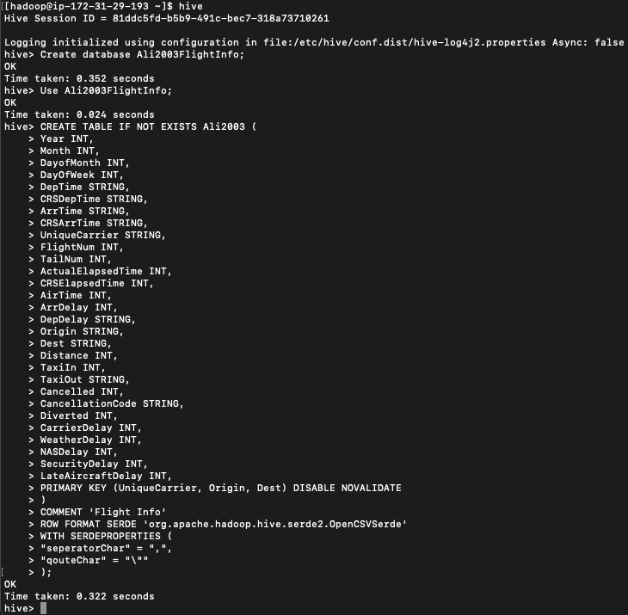
2003 CSV
Step 2: Connect to Hive to Create Databases and Tables needed.
Hive
Creating a new database AliFlightInfo.
Use AliFlightInfo; -Using the new database
Creating the necessary tables & loading the data inpath

Slide 11

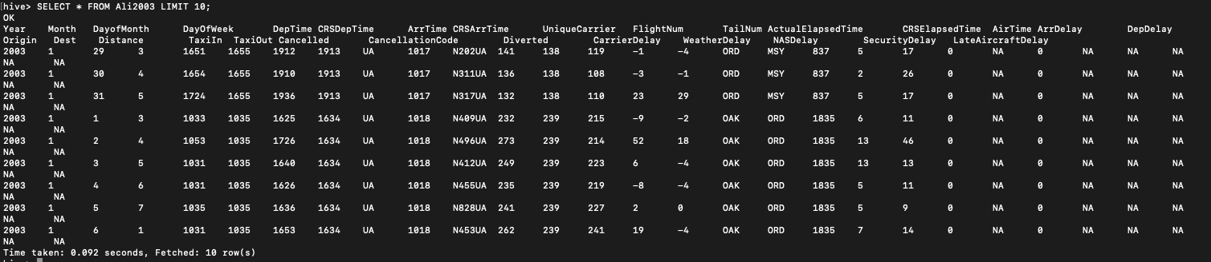
2003 CSV

Slide 12
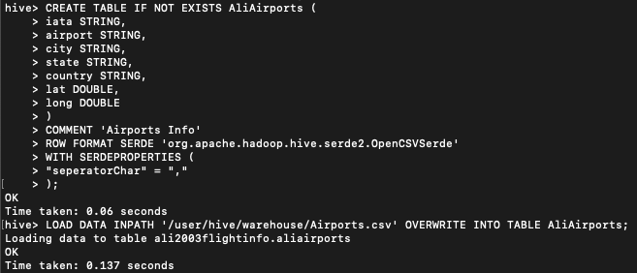
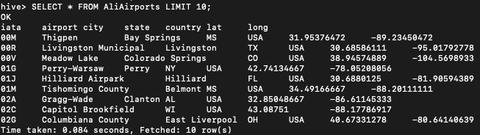
Airport CSV

Slide 13
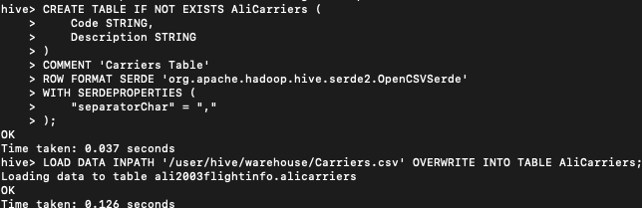
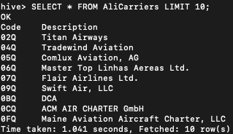
Carriers CSV

Slide 14
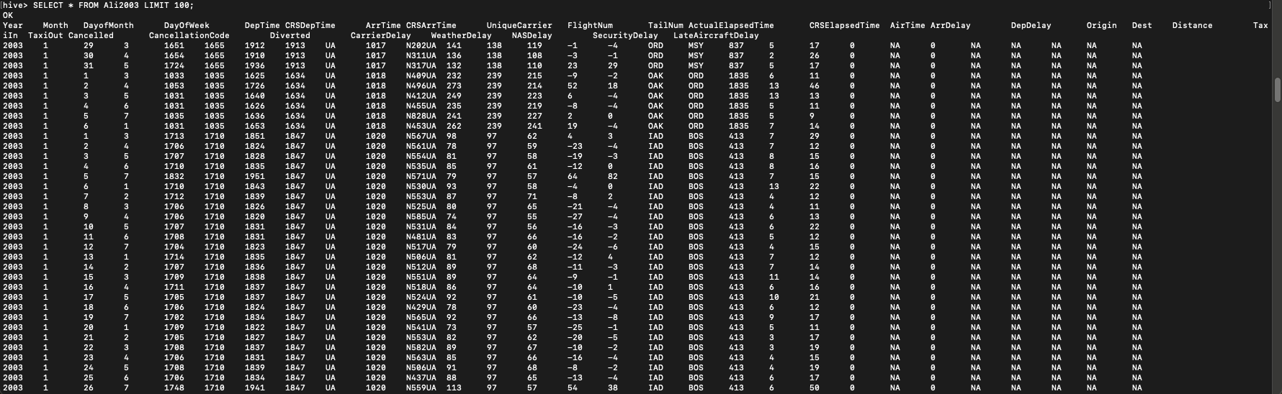
Step 3: Displaying 100 rows of each table created.
2003 CSV

Slide 15
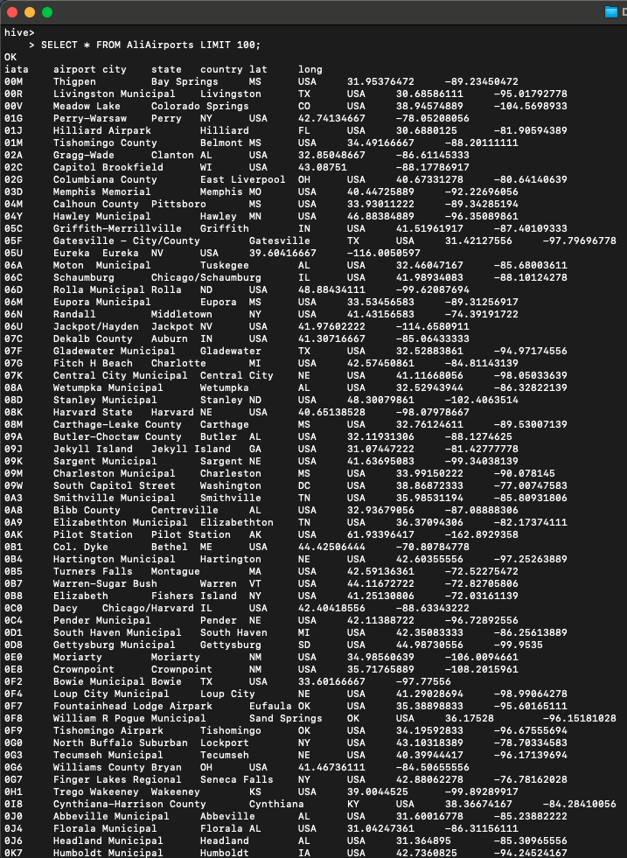
Airports CSV

Slide 16
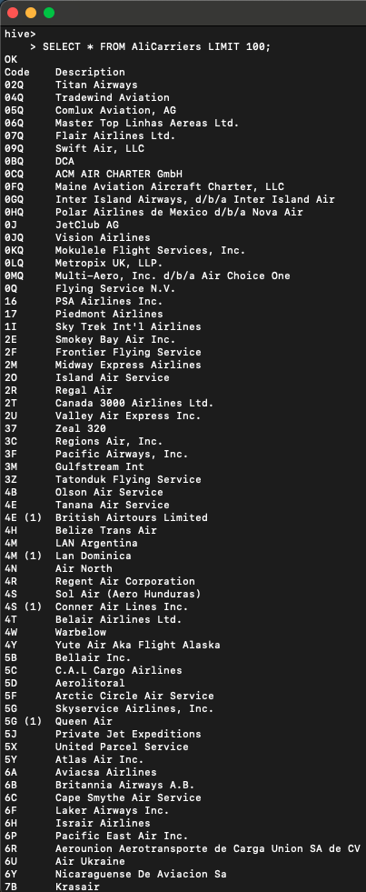
Carriers CSV

Slide 17
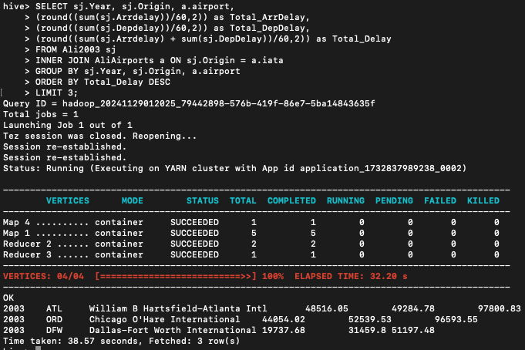
Step 4: Data Analysis.
Determine the three airports with the highest delay time (in hours)
Year 2003
Origin

Slide 18
Results: Origin
Year | Airports | Arrival Time Delay (In Hours) | Departure Time Delay (In Hours) | Total Delay (In Hours)
2003 | William B Hartsfield – Atlanta Intl (ATL) | 48,516.05 | 49,284.78 | 97,800.83
2003 | Chicago O’Hare International (ORD) | 44,054.02 | 52,539.53 | 96,593.55
2003 | Dallas-Fort Worth International (DFW) | 19,737.68 | 31,459.80 | 51,197.48

Slide 19
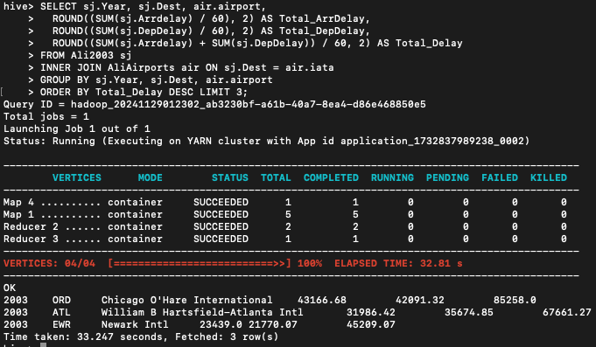
Determine the three airports with the highest delay time (in hours)
Year 2003
Destination

Slide 20
Results: Destination
Year | Airports | Arrival Time Delay (In Hours) | Departure Time Delay (In Hours) | Total Delay (In Hours)
2003 | Chicago O’Hare International (ORD) | 43,166.68 | 42,091.32 | 85,258.00
2003 | William B Hartsfield – Atlanta Intl (ATL) | 31,986.42 | 35,674.85 | 67,661.27
2003 | Newark International (EWR) | 23,439.00 | 21,770.07 | 45,209.07

Slide 21
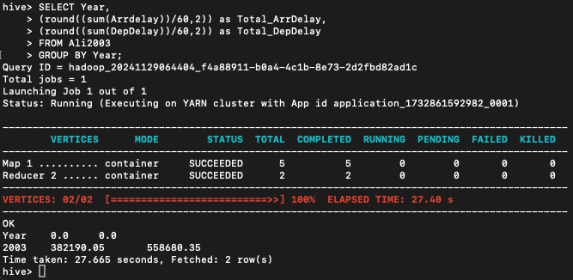
Determine overall Arrival and Departure Delay (in hours)
Determining which value is Largest (Arrival/Departure).
Year 2003

Slide 22
Results: Determination of Largest value (Arrival/Departure)
Year | Arrival Time Delay (In Hours) | Departure Time Delay (In Hours) | Total Delay (In Hours)
2003 | 382,190.05 | 558,680.35 | 940,870.40
Analysis: Departure has the ‘Highest Time Delay’ in the year 2003.

Slide 23
Visualization:

Slide 26
Here we can see that Total Departure Delay takes up 60% of total delay time.

Slide 27
Conclusion:
In 2003, the top 3 airports with the highest delays by origin were Atlanta's Hartsfield-Jackson Intl (ATL) with 97,800.83 hours, followed by Chicago O'Hare Intl (ORD) with 95,593.55 hours, and Dallas-Fort Worth Intl (DFW) with 51,197.48 hours.
Conversely, by destination, ORD led with 85,258.00 hours, ATL followed with 67,661.27 hours, and Newark Intl (EWR) with 45,209.07 hours.
Overall, departures contributed significantly to delays, totaling 558,680.35 hours. Accounting up to a 60% of the total delay.

Slide 28
Thank you!
Ali Inamdar.
Scalable Database – CS 673

