Slide 1
Kaggle Competition:
Allstate Claims Severity
Team KGW ： Wen Li ． Lei Zhang ． Chuan Hong ． Lydia Kan

Slide 2
Content
Workflow
EDA
Initial Features Selection
Feature Engineering
Supervised Learning
Results and Finding
Future Works

Slide 3
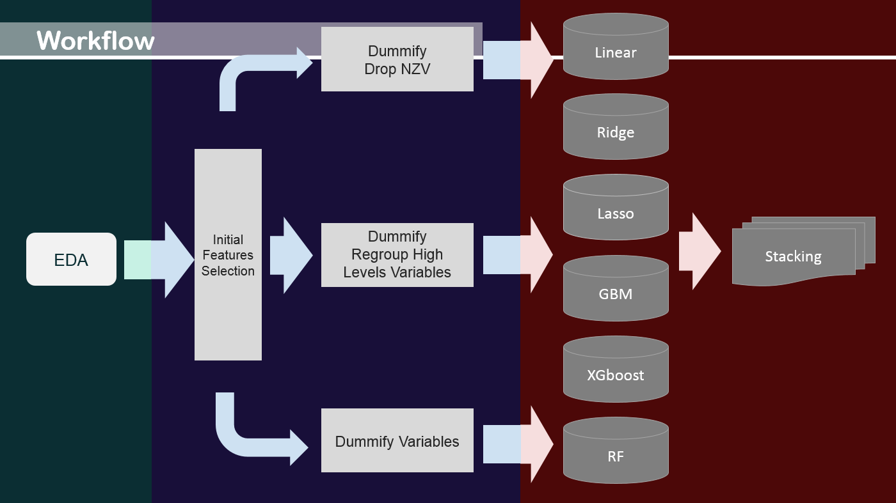

Slide 4
Numeric Graphic: Dataset
Categorical Variables
cat1 – cat116
Continuous Variables
14 Variables
cont1 – cont14
Levels 2 - 326
116 Variables

Slide 5
Numeric Graphic: The Categorical Variables
Variable | Train | Test | Variable | Train | Test
cat89 | I | F | cat105 | R S
cat90 | G |  | cat106 |  | Q
cat92 | F | G E | cat109 | BM CJ BV BY BT B BF BP J AG AK | AD
cat96 |  | H | cat110 | BK H BN DV EI BD BI AN AF CB EH | BH CA EN
cat99 |  | U | cat111 | D | L
cat101 | N U |  | cat113 | BE T AC | AA R
cat102 | H J |  | cat114 | X
cat103 |  | M | cat116 | BI V BL X FS P GQ AY MF JD AH EV CC AB W AM IK AT JO AS JN BF DY IB EQ JT AP MB C IO DQ HO MT FO JI FN HU IX | AQ EM FY AI N ET KO BJ IW DB LP MX BR BH JS ER A BN BE IS LS HS EX

Slide 6
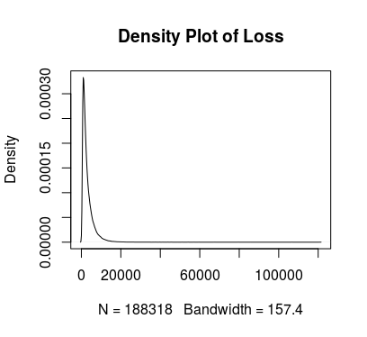
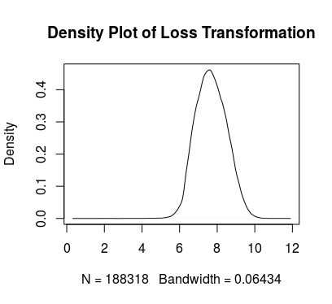
Graphic EDA: Output Variable

Slide 7
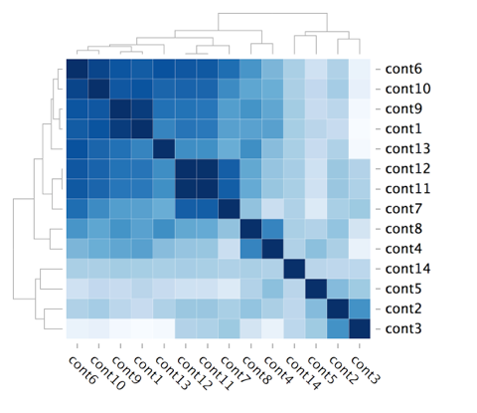
Graphic EDA: Input Variable
Correlations of all continuous variables

Slide 8
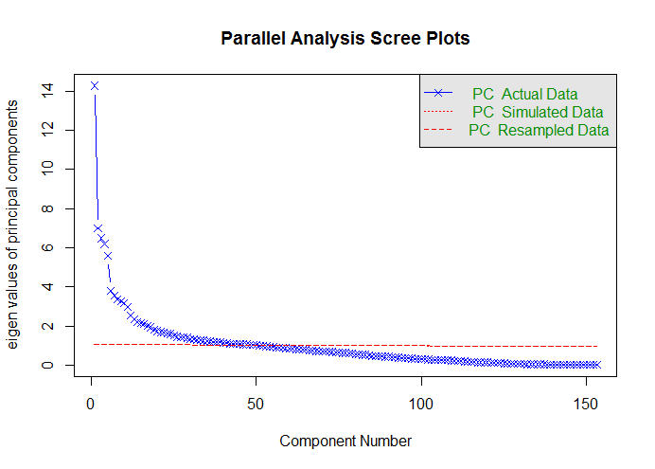
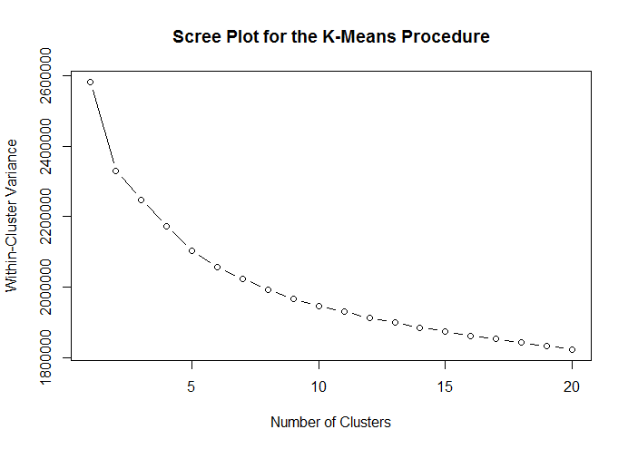
Initial Features Selection: Unsupervised
Goal: Check if the models are able to simplify the dimensions
Result: There is no significant classification

Slide 9
Features Engineering
Dummify Categorical Variables
( Keep All Features)
Pro:
Keep all information
Con:
Take too much time / Not suitable for MLR / Overfitting
Dummify Categorical Variables
>> Drop Near Zero Variance
Pro:
Time saving/Required by some models
(e.g. MLR)
Con:
High error and may lose some information
Select the Variables Have > = 15L
>> Group the Levels (variables) by Count and Avg of Loss
>> Dummify Categorical Variables
Pro:
Do Not throw away useful features
Con:
Multiple ways to group variables

Slide 10
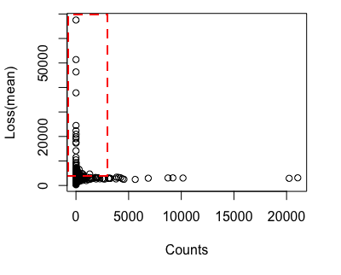
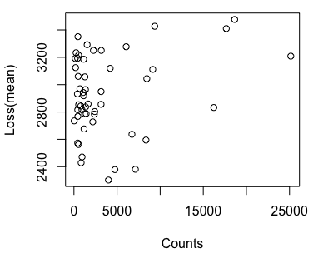
Features Engineering
cat116
326 levels → 10 new groups
cat112
51 levels → 11 new groups

Slide 11
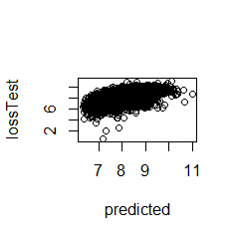
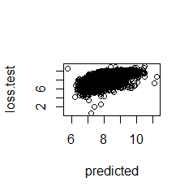
Supervised Models
Multiple Linear Regression
Features Engineering: Drop NZV
RMSE: 0.57659
Multiple Linear Regression
Features Engineering: Drop Correlated V. + New Group
RMSE: 0.56557

Slide 12
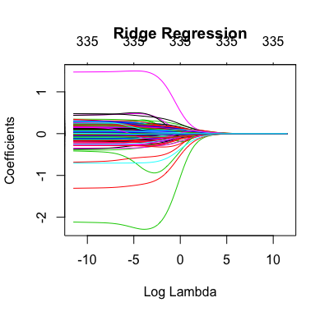
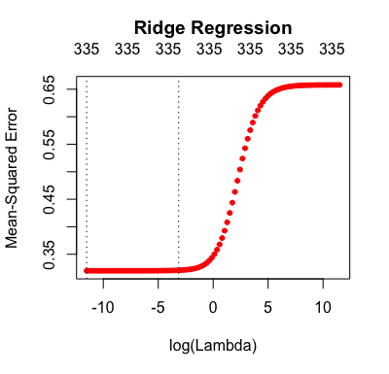
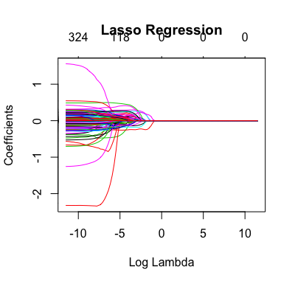
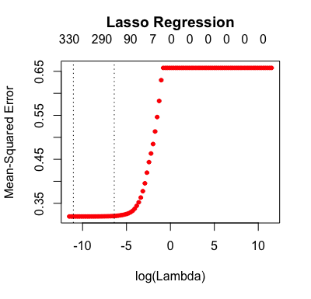
Supervised Models
Ridge Regression
Features Engineering: New Group
Parameter: Lambda 1e-05
RMSE: 0.56414
Lasso Regression
Features Engineering: New Group
Parameter: Lambda 1.592283e-05
RMSE: 0.56415

Slide 13
Supervised Models
Random Forest
Features Engineering: NZV
Parameter: Number of trees = 500 , No. of Variables tried at each split = 51
RMSE: 2014.217

Slide 14
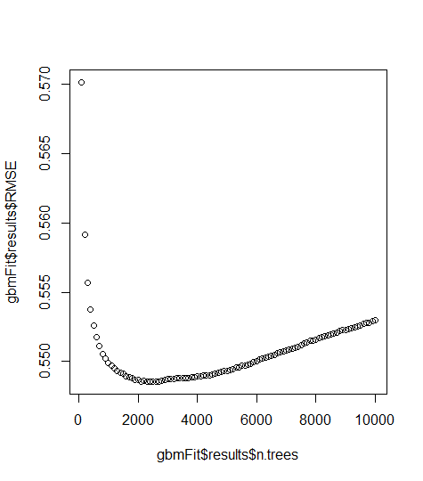
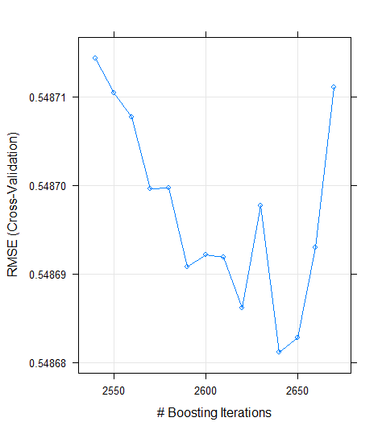
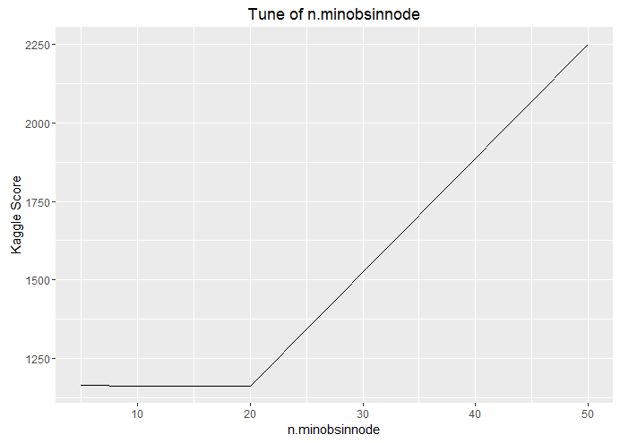
Supervised Models
Gradient Boost
Features Engineering: NZV
Parameter: ntree=2640
n.minobsev = 20
interation.depth = 5
shinkage = 0.1
RMSE: 0.51
Increase Kaggle score by tuning parameters
ntree
2600: 1163.89861
2640: 1162.56392
n.minobsev
50: 2251.57822
5: 1165.24778
10: 1162.56392
20: 1162.22589

Slide 15
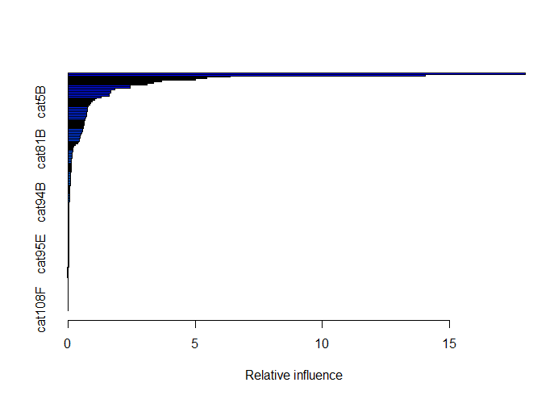
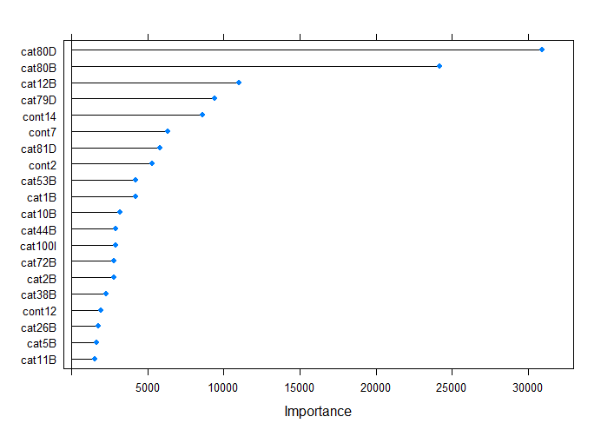
Supervised Models
Importance of Variables
cat99R, cat99T, cat108F : 0.000000000000
83 out of 153 variables influence more than 0.05

Slide 16
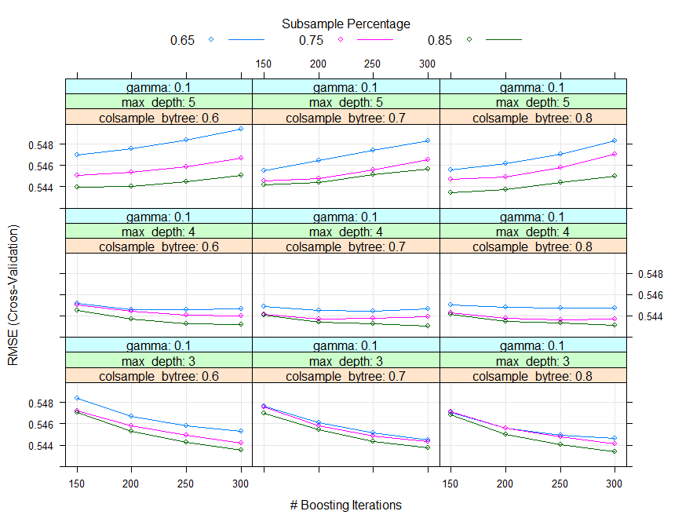
Supervised Models
XGBoost - xgbTree
Features Engineering: New Group
Parameter:
nrounds = c(150, 200, 250, 300)
max_depth = c(3, 4, 5)
eta = 0.3
gamma = c(0.1, 0.2)
colsample_bytree = c(0.6, 0.7, 0.8)
min_child_weight = 1
subsample = c(0.65, 0.75, 0.85)
RMSE: 0.5451

Slide 17
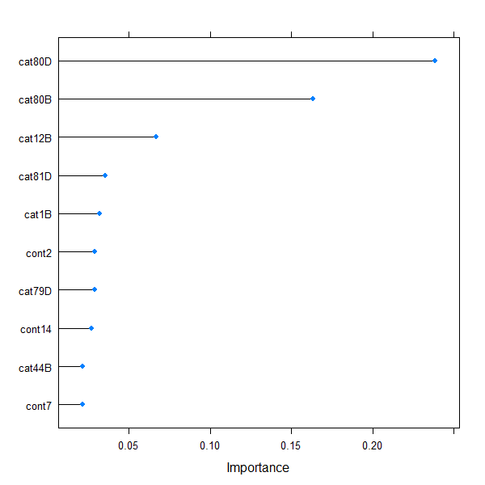
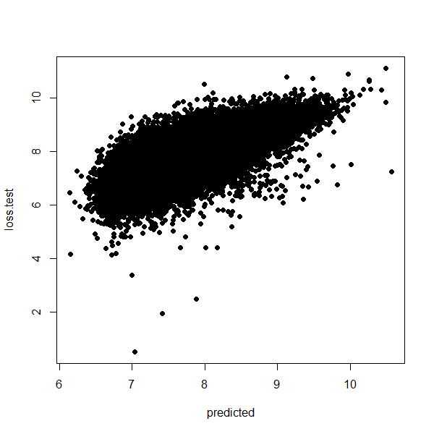
Supervised Models
Relative importance of variables (top10)
Scatter plot of loss.test vs. predicted loss

Slide 18
Results and Finding
Model | Features Engineering | Parameters | RMSE | Kaggle Score
MLR | Drop NZV |  | 0.57659
MLR | Drop High Cor + New Group |  | 0.56557
Ridge | New Group | Lambda: 1e-05 | 0.56414
Lasso | New Group | Lmabda: 1.592283e-05 | 0.56415
RandomForest | Drop NZV | Ntree: 500 mtry = 51 | 2014.217
GBM | Drop NZV | Ntree: 2640 n.Minobsev: 20 | 0.51 | 1162.22589
XGB (xgbTree) | New Group | nrounds = 300 max_depth = 4 eta = 0.3 gamma = 0.2 colsample_bytree =0.6 min_child_weight = 1 subsample = 0.85 | 0.5451

Slide 19
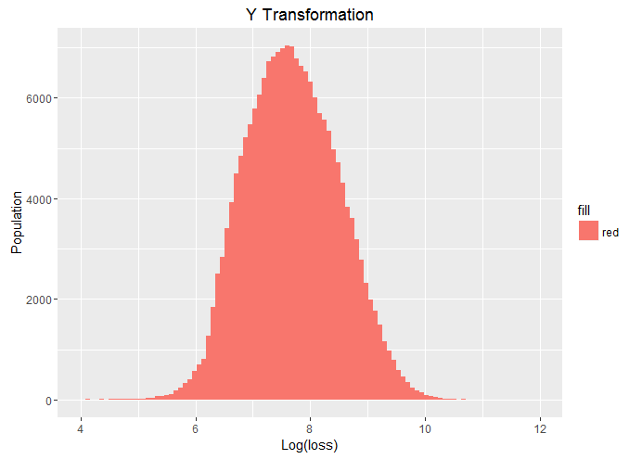
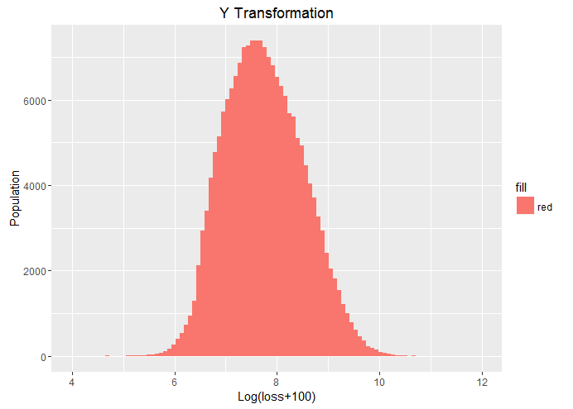
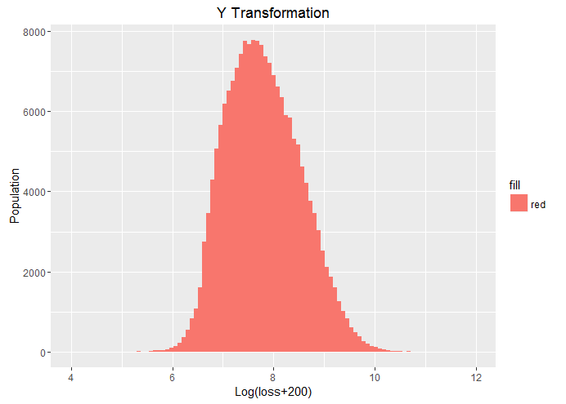
Future Works
Gradient Boosting with “zv”
“nzv” cut off the variables with 5% less variance
The kaggle score of our best boosting model is 5.6% higher than rank 1
With all variables, tune the parameter again
2. Transform the y value-----reduce the variance?
3. Stacking different models to get higher accuracy

