Slide 1
911 Call Patterns In Seattle
by Cristina Andronescu

Slide 2
Introduction
Main questions underpinning the project:
What can we learn about the behavior of 911 callers in Seattle?
What are some implications for optimizing the way in which emergency services provide assistance to these users?

Slide 3
Goal and roadmap
Understand Seattle 911 caller behavior and provide recommendations for optimizing emergency responses
Data
Initial insights
Timing
Location
Type of call
Call timing by for most frequent types of call
Location of most frequent types of call during peak hours

Slide 4
Data
Two data sets:
911 call data from Seattle Police Department
1, 324, 526 observations
spans approximately 3 years from 2010 through 2012
Geospatial data set for Seattle neighborhoods

Slide 5
Initial Insights

Slide 6
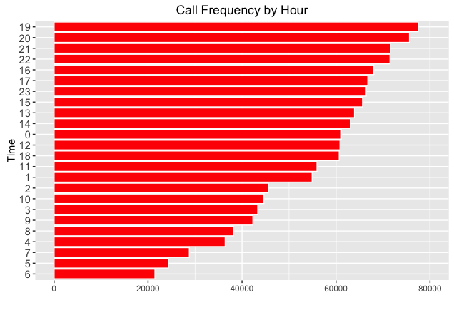
When do some of the most frequent type of call occur?

Slide 7
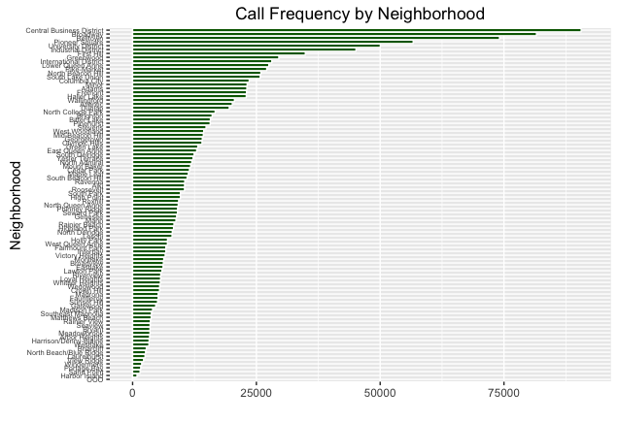
Where do people make the most calls from?

Slide 8
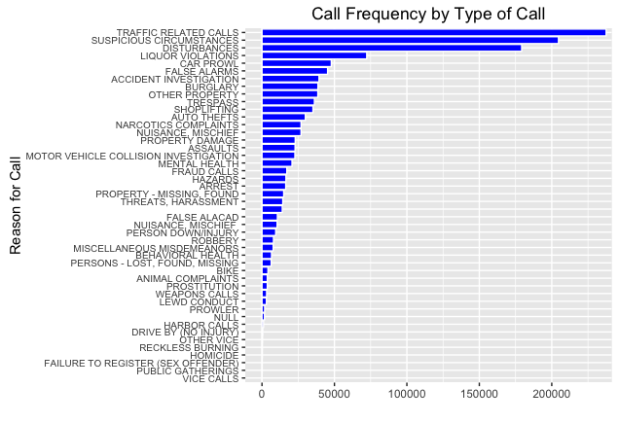
What are the most frequent types of call made?

Slide 9
When do some of the most frequent types of call occur?

Slide 10
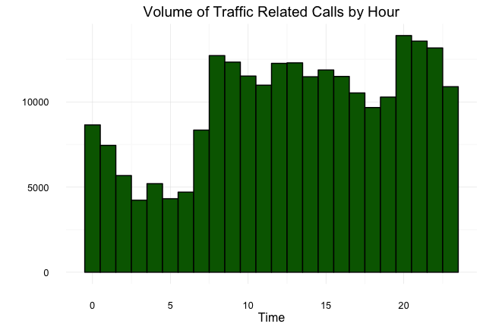

Slide 11
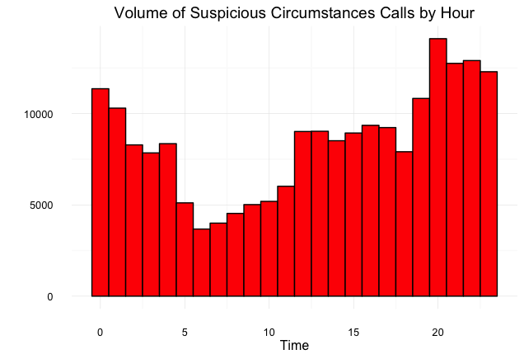

Slide 12
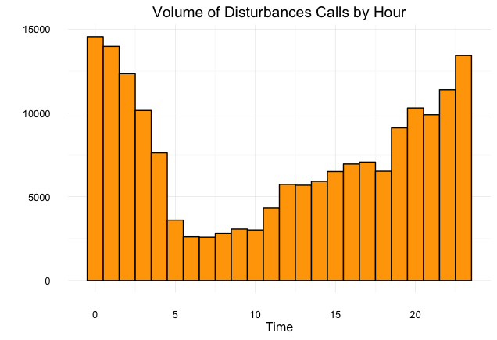

Slide 13
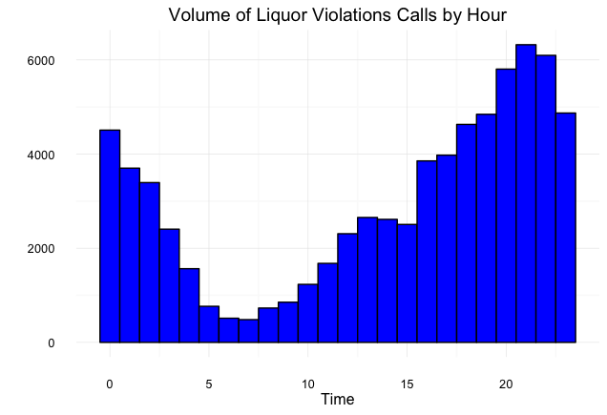

Slide 14
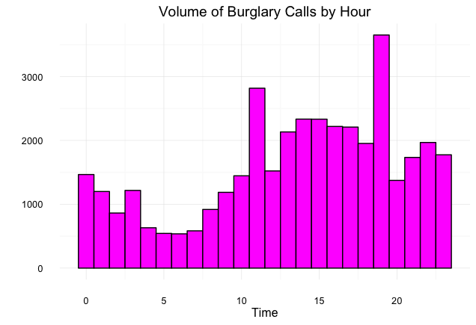

Slide 15
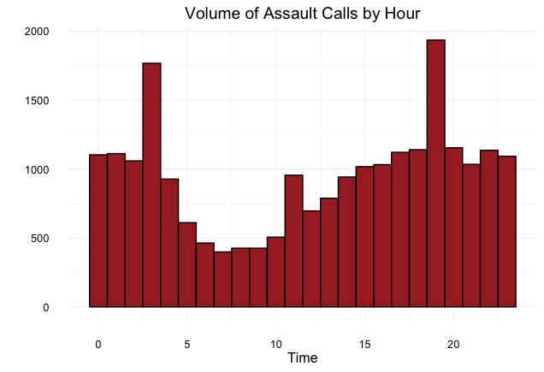

Slide 16
Where do most frequent types of call occur during peak hours?

Slide 17
Traffic Related Calls
Northern neighborhoods of Ballard, Fremont and University District become hotspots for traffic related calls during evening peak hours along Belltown Downton and Broadway.

Slide 18
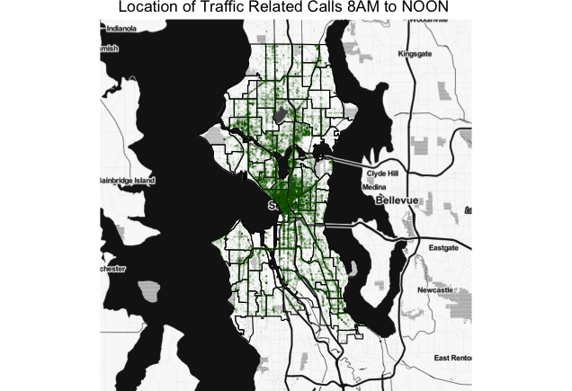

Slide 19
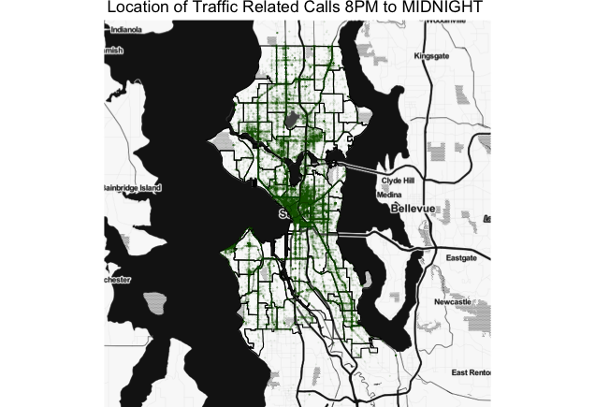

Slide 20
Suspicious Circumstances
Disturbance calls evenly spread, with multiple small hotspots beyond the Belltown-Downtown-Broadway area

Slide 21
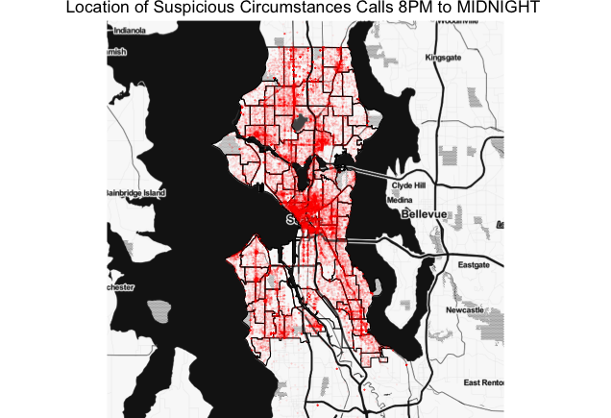

Slide 22
Disturbances calls
University District become a large hotspot for disturbances calls between midnight and 4 AM and the volume of calls increases as relative to the previous peak interval (8PM to midnight)

Slide 23
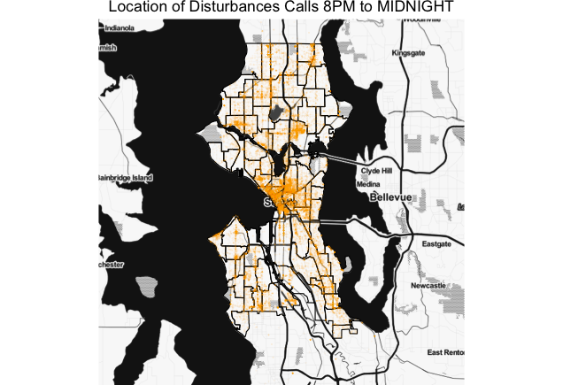

Slide 24
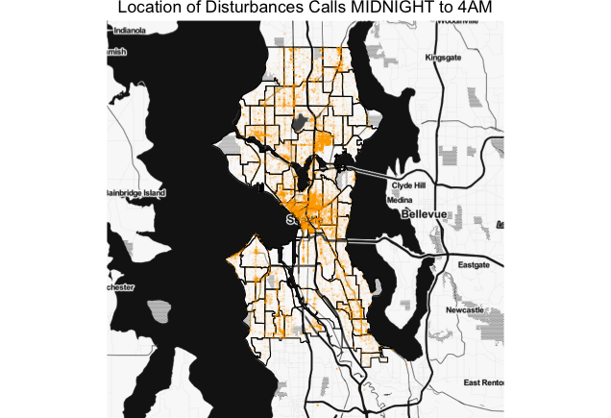

Slide 25
Liquor Violation Calls
Among the most common types, liquor violation calls are the most geographically concentrated, occuring mostly in Downtown and the Southernmost area of Broadway

Slide 26
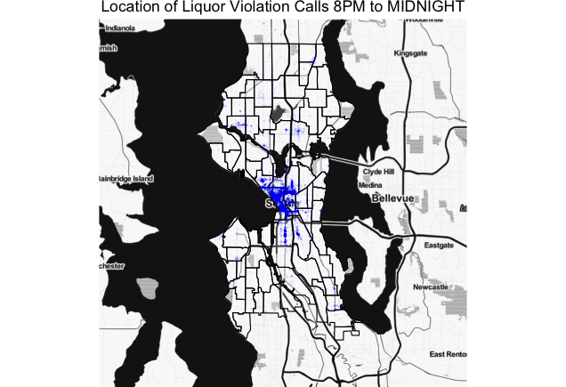

Slide 27
Burglary Calls
Burglary calls are also widespread, although the Downtoan Southern Briadway area and the Northern side of the University District remain primary hotspots

Slide 28
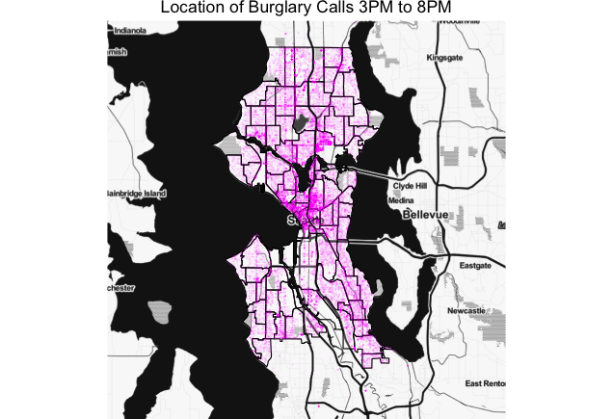

Slide 29
Assault Calls
Between midnight and 4 AM the southernmost area of Broadway becomes a third small hotspot for assault calls besides the two other in the Downtown area.

Slide 30
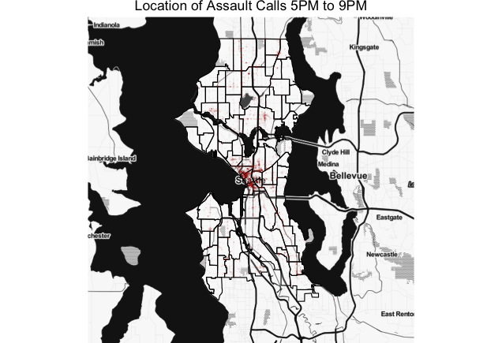

Slide 31
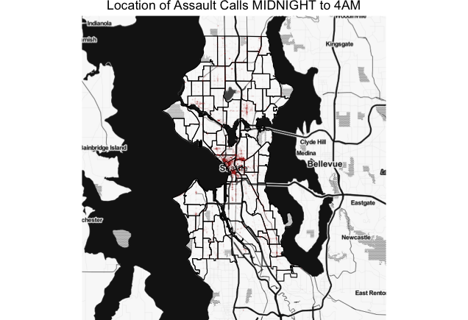

Slide 32
Conclusions
Based on the available data, the analysis has suggested some locations and times where particular types of incidents occur more regularly
Emergency services may want to prioritize these these to optimize readiness to respond or prevent these incidents.

Slide 33
Future Work
Add analysis by day
Add analysis by neighborhood
Create interactive user interface such as a Shiny app for user selected parameters

