Slide 1
Shiny Project: What Do Words Really Mean?
By Alex Rohr

Slide 2
Word definitions have been fluid over time
Nice: This word used to mean “silly, foolish, simple.” Far from the compliment it is today!
Silly: Meanwhile, silly went in the opposite direction: in its earliest uses, it referred to things worthy or blessed; from there it came to refer to the weak and vulnerable, and more recently to those who are foolish.
Awful: Awful things used to be “worthy of awe” for a variety of reasons, which is how we get expressions like “the awful majesty of God.”

Slide 3
Intro to Data
Videogame review data dating back to 2012

Slide 4
Quantifying Adjective Strength
Dataset scrapes videogame reviews since 2012 for most commonly used adjective.
Each of the reviews also has a numeric grade associated with it (1-10).
The data set has 11 adjectives, which do you think is best and which do you think is worst:
Disaster; Mediocre
Unbearable; Okay
Painful; Good
Awful; Great
Bad; Amazing
Masterpiece

Slide 5
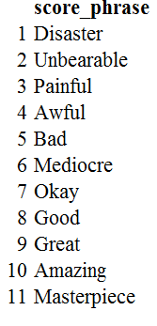
Ranking

Slide 6
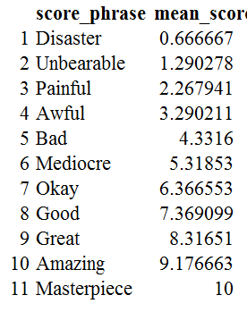
Ranking with means

Slide 7
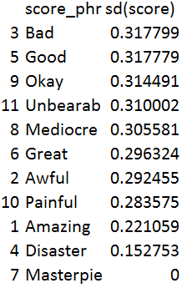
Are certain word meanings less reliable than others?
There appears to be a non-linear relationship between the means and standard deviations

Slide 8
Shiny App

Slide 9
Further research
Have the trends changed over time?
Are these rankings outliers in any way linguistically?
What words have changed the most in meaning over time?
Best way of moving forward is with other reviews, so the results can be quantified (restaurant reviews, movie reviews, etc)
May be more accurate than a dictionarymws

