Slide 1

Speed Dating Experiment
- How to win a dating partner?
Presenter:
David Dai

Slide 2
Outline
Introduction
Data background
Features of the dataset
Research Question
Data Analysis
Exploratory data analysis
Conclusion
Summary & Limitations

Slide 3
Dataset Background
Data was gathered from participants in experimental speed dating events from 2002 – 2004. The subjects were drawn from students in graduate and professional schools at Columbia University. At the end of their speed dating events, participants were asked if they would like to see their date again.
They were also asked to rate their date on six attributes:
Attractiveness
Sincerity
Intelligence
Fun
Ambition
Shared Interest
The dataset includes questionnaire data gathered from participants at different points in the process. These fields include: demographics, dating habits, self-perception across key attributes, beliefs on what other find valuable in a mate, and lifestyle information.

Slide 4
Dataset Background
Source:
The data compiled by Columbia Business School and can be accessed on Kaggle.com.
Dataset
The dataset has 195 variables, corresponding to 8378 speed dating pairs from 551 participants in a total of 21 dating events.
Aim
The aim for the analysis is use exploratory data analysis strategies to extract information from our dataset:
What are the most/least desirable attributes in a male/female partner?
Will being physically attractive help you get more dates?

Slide 5
Dataset Structure
Survey | Survey 1. | Survey 2. | Survey 3.
Question 1. | 6 var. | 6 var. | 6 var.
Question 2. | 6 var. | 6 var. | 6 var.
Question 3. | 5 var. | 5 var. | 5 var.
Question 4. | 6 var. | 6 var. | 6 var.
Question 5. | 5 var. | 5 var. | 5 var.
Question 6. | N/A | 6 var. | 6 var.
Var. Without Repetition
Unique Personal Info. | 62 var.
Var. On Scorecard
Scorecard (filled by partners) | 10 var.
Var. Of Sports
Sport activities | 17 var.
NOTE: 11 variables were removed because of duplicate survey questions.

Slide 6
Data Analysis

Slide 7
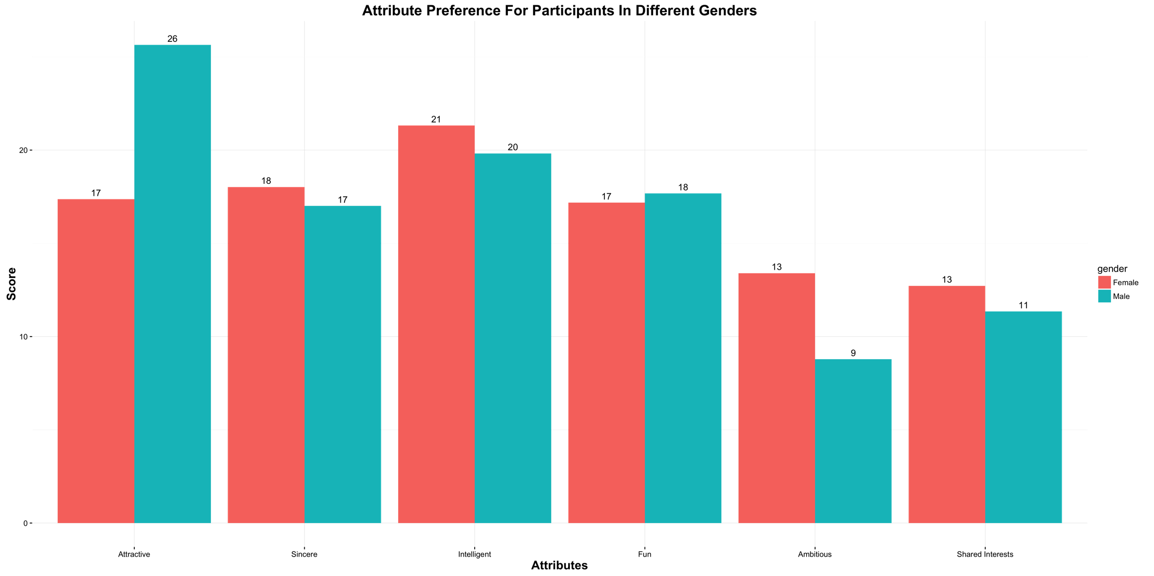
Data Analysis
What are the most/least desirable attributes in a male/female partner?
For Male → Partner Being Physical Attractive
For Female → Partner Being Ambitious
Notes:
The score of each attribute will add up to 100 in total, the score of each single attribute can reflect the percentage of how these attributes were weighted among the participants.
Male participants appear to place significance on physical attractiveness, while female participants placed more on ambition attribute.

Slide 8
Data Analysis
Take a look at the result of surveys for more information
NOTE:
3 different surveys were made to collect information from participants at different points in the process.
Survey 1.: Filled out before the speed dating event.
* containing original score on the preference of the 6 attributes.
Survey 2.: Filled out the day after participating in the event
Survey 3.: Filled out 3-4 weeks after they had been sent their matches.
All attribute-related variables were normalized so that the number for these variables can reflect weight (percentage) among all attributes measured in the same question.

Slide 9
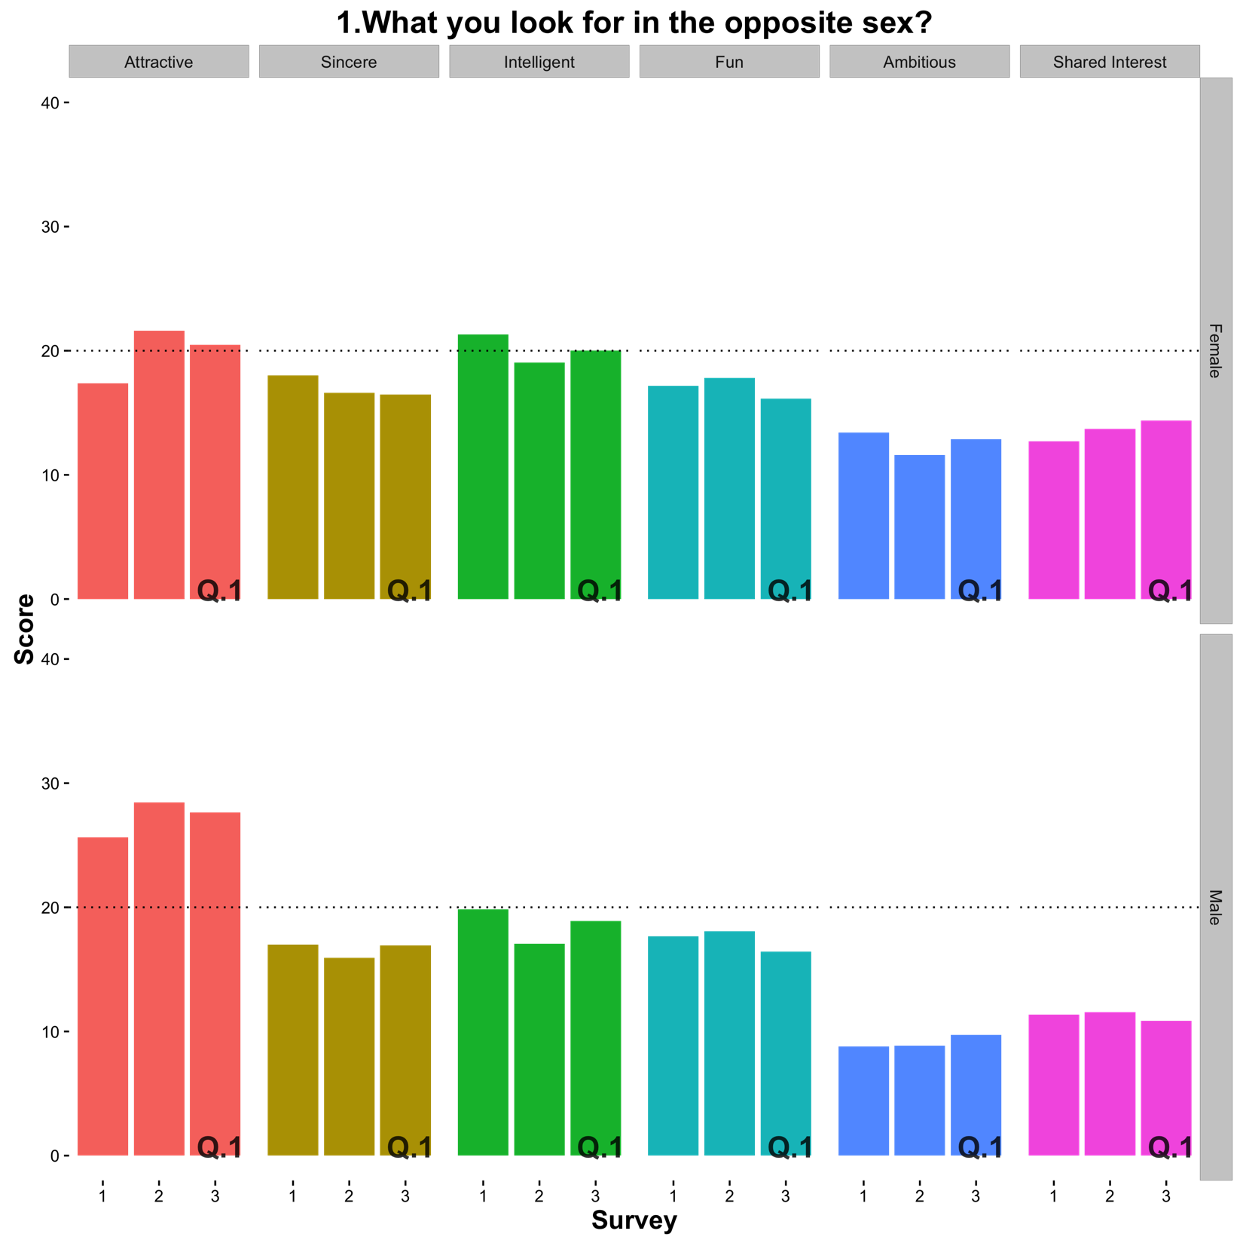
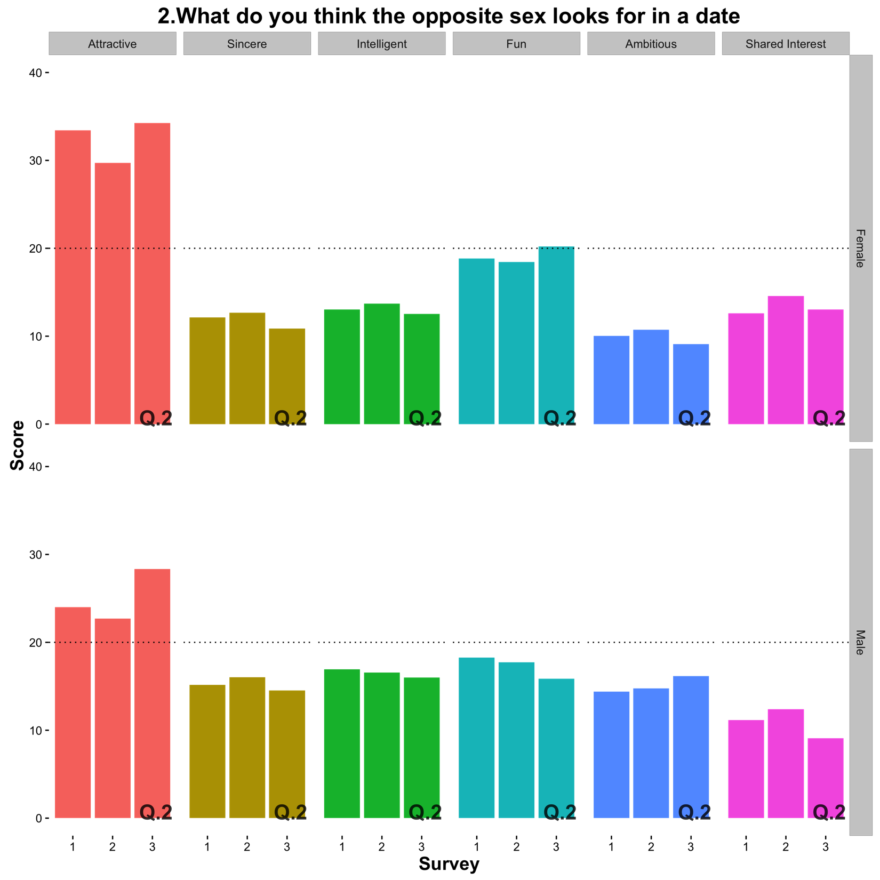
Observations
Q1. What you look for in the opposite sex?
Males → Phy. Attractiveness
Females → Balanced
Q2. What do you think the opposite sex looks for in a date?
Males → Phy. Attractiveness
Females → Phy. Attractiveness

Slide 10
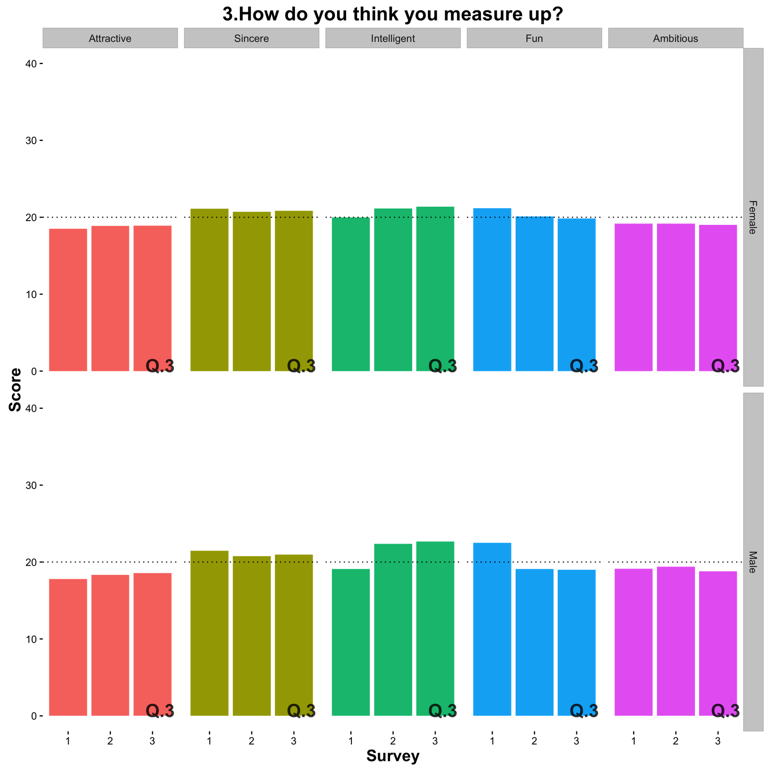
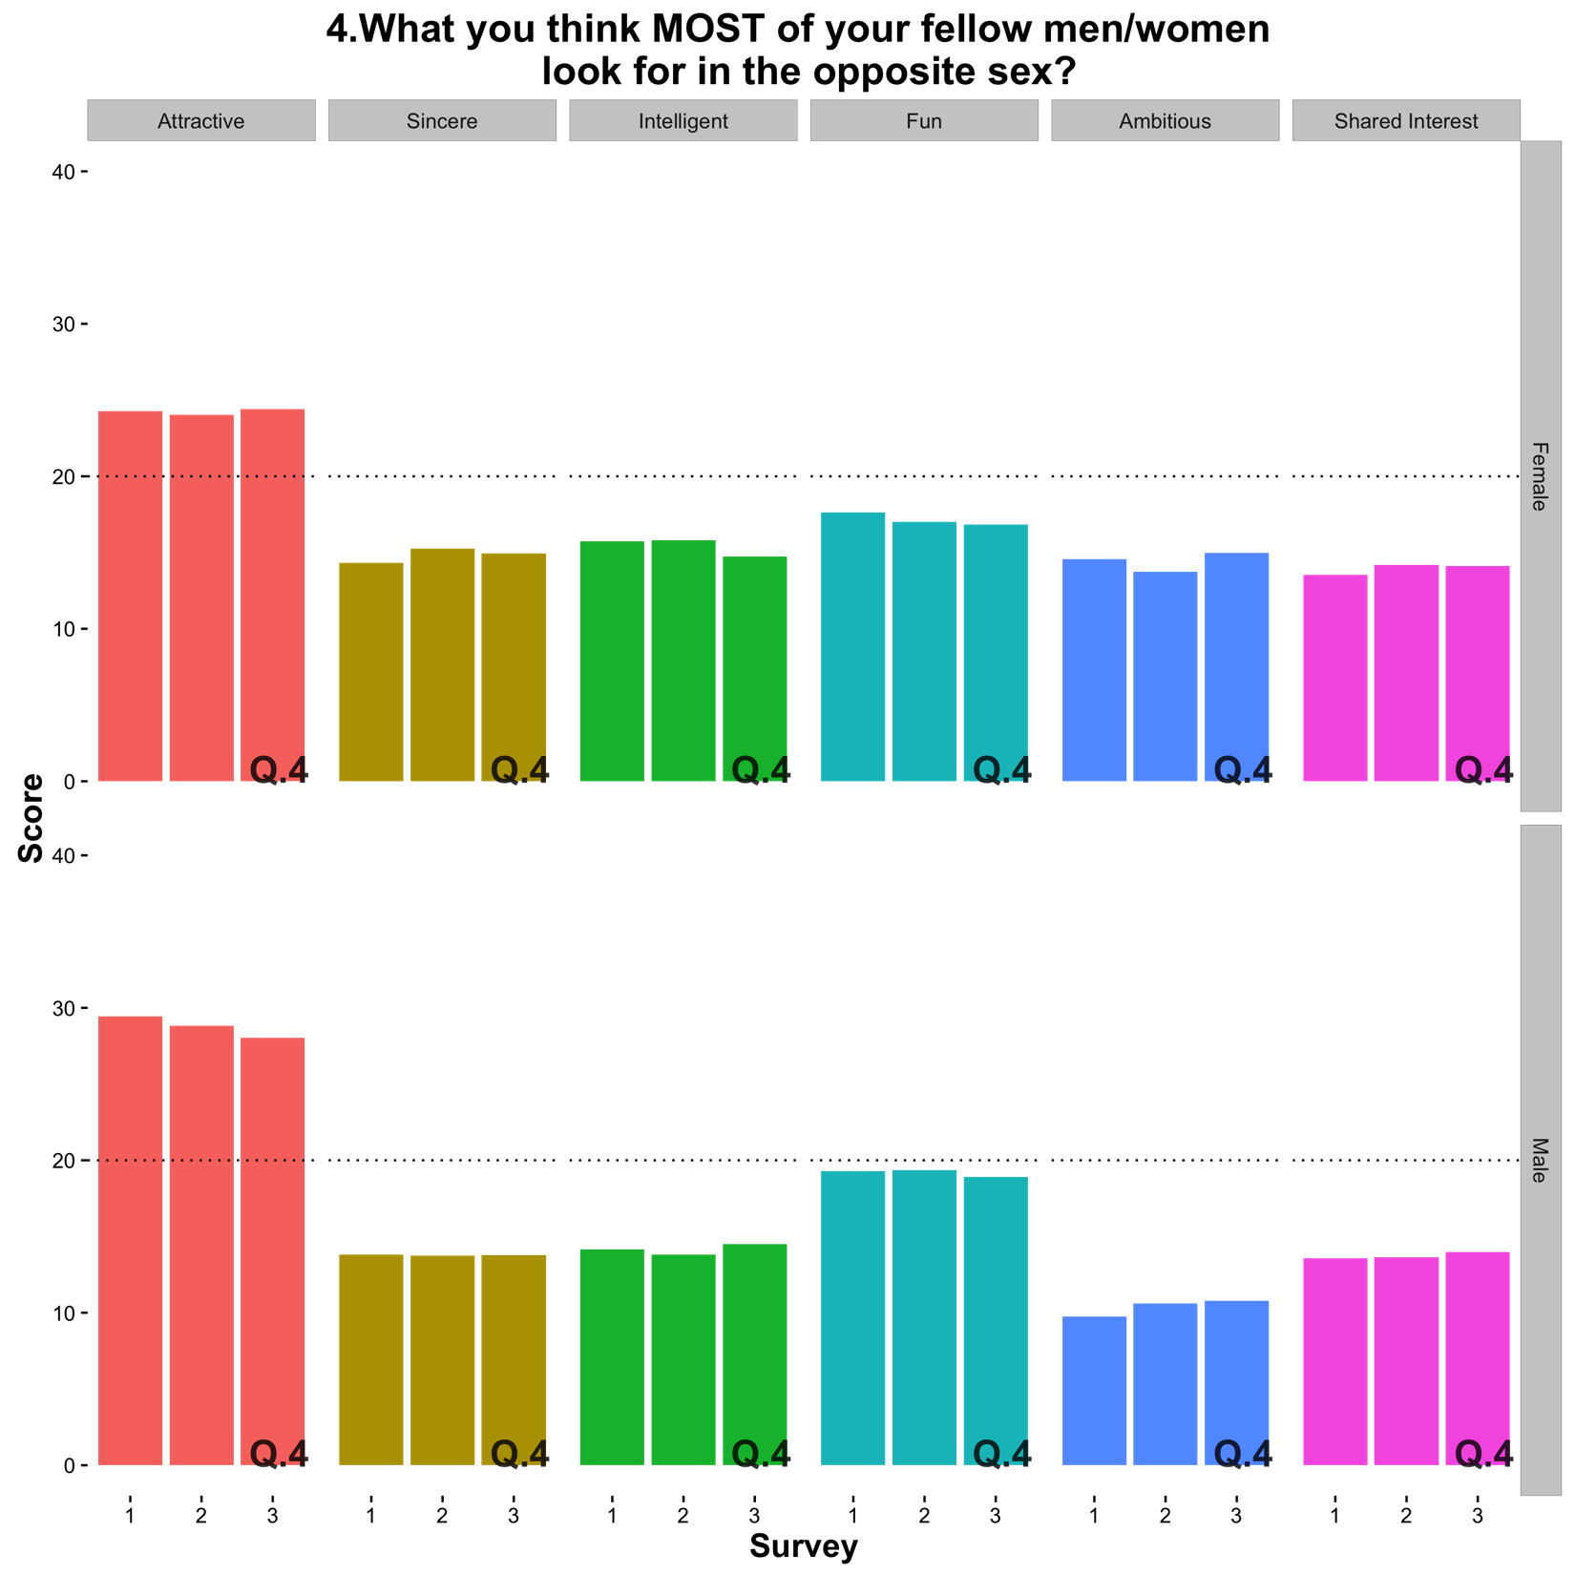
Observations
Q3. How do you think you measure up?
Males → About even
Females → About even
Q4. Distribute the points that best reflects the actual importance of these attributes in your decisions?

Slide 11
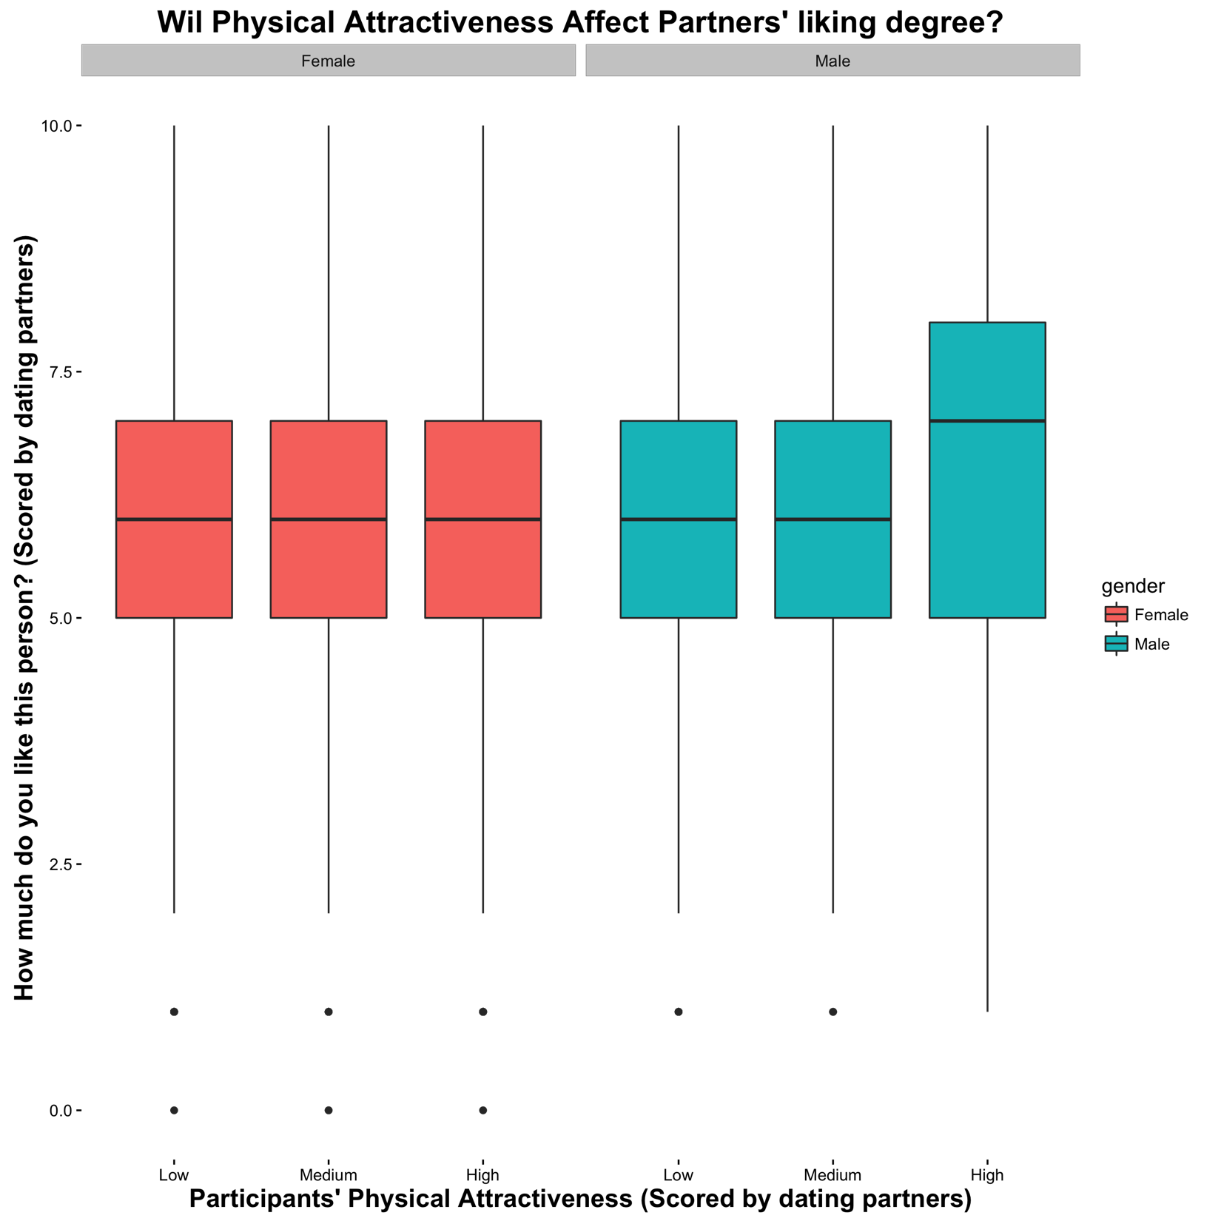
Data Analysis
Will being physically attractive help you get more dates?
Observations
Males
Those rated high in physical attractiveness have a higher mean score in liking degree from females than other groups.
Females
There is no distinct differences among different attractiveness group.

Slide 12
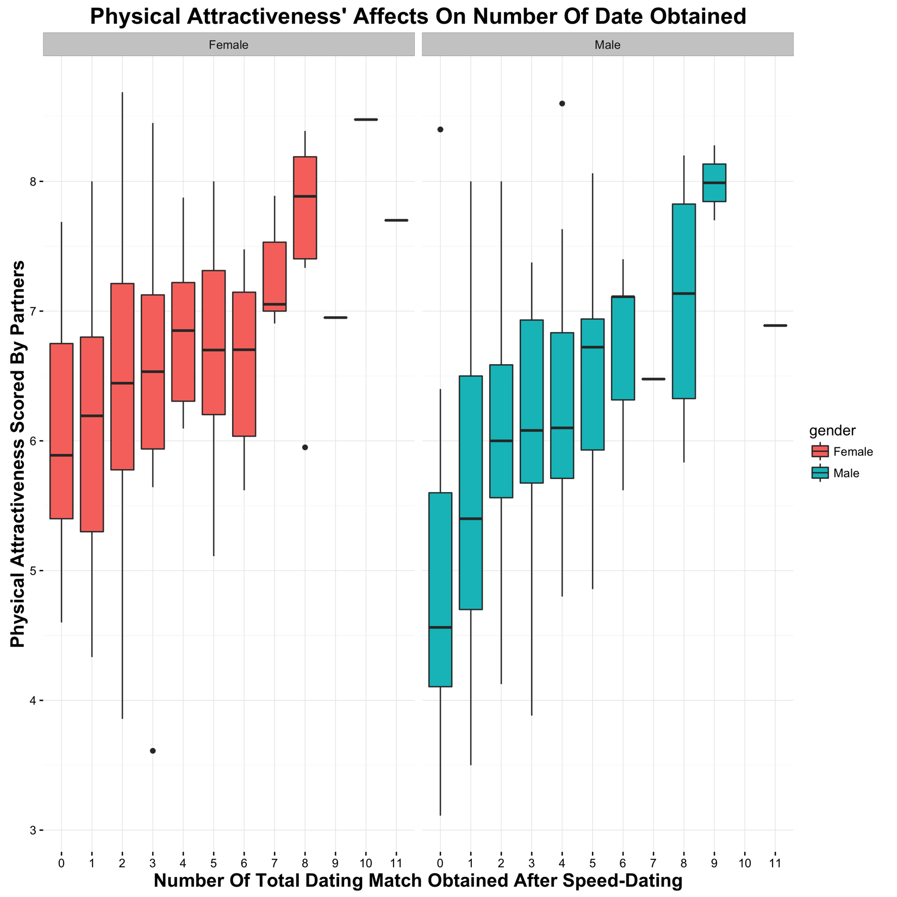
Data Analysis
Will being physically attractive help you get more dates?
Observations
Males
The higher mean physical attractiveness scored by the partner, the more dates they would get.
Females
(same as above)
BUT
Females seem to be more sensitive towards physical attractiveness than males do
Notes:
W

Slide 13
Summary
Physical attractiveness is probably the most considered and valued attribute among these six attributes: attractiveness, sincerity, intelligence, fun, ambition, and shared interests.
Even though males valued physical attractiveness more than that of females , females seem to have higher sensitivity on physical attractiveness than do males.
i.e.: The attitude of females towards males might change greatly based on males’ physical attractiveness.
Limitations
The data was collected from a small group of people, which might lose generality.
The understandings of those 6 attributes varied by different individual, which might introduce inaccuracy and these scores could not reflect the true preference among people.
More surveys can be conducted to collect the chronological change in people’s preference on different attributes.
Too much subjective manipulations were implemented by the presenter, which might lead to loss of information from key features.

Slide 14
Thank you very much!

