Slide 1
Help Yelp Help You

Slide 2
So you’re thinking about trying out a new restaurant...
What’s it’s rating?
Who’s giving it these ratings?
What’s important to these people?
What do I have in common with them?
What if they like different things than I do?

Slide 3
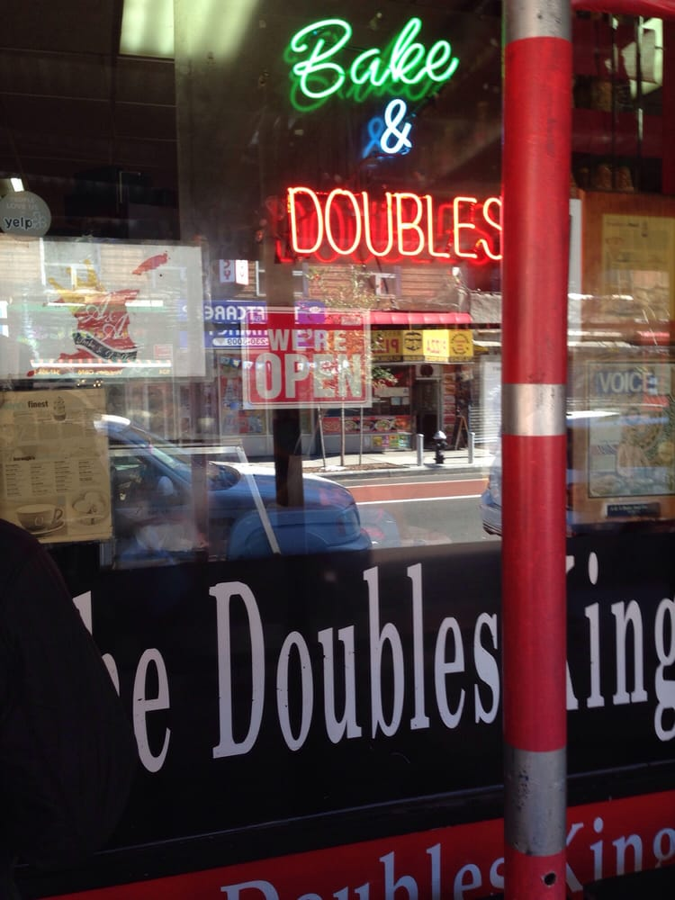
A&A Bake and Doubles Shop
Scraped 100 “Most relevant” Reviewers
Then scraped all of those reviewers reviews of other restaurants. Yielding 4673 unique reviews
Words in common between ratings?
Common restaurants that I had also reviewed and compared our results

Slide 4
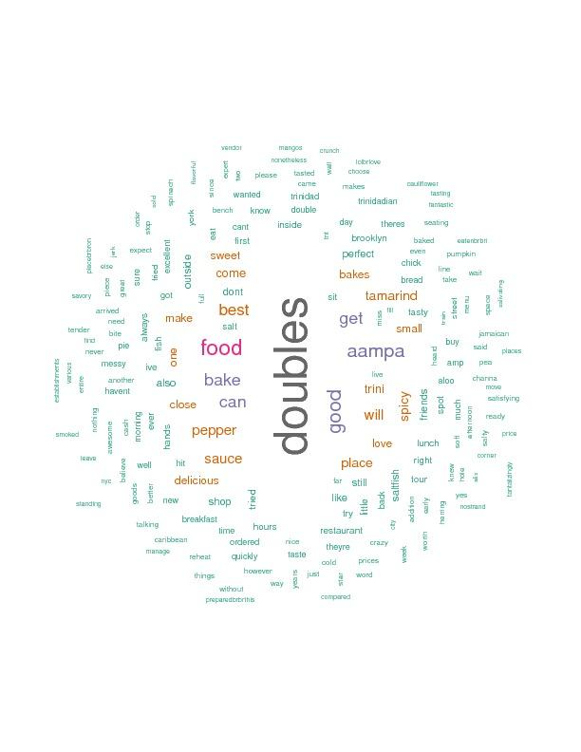
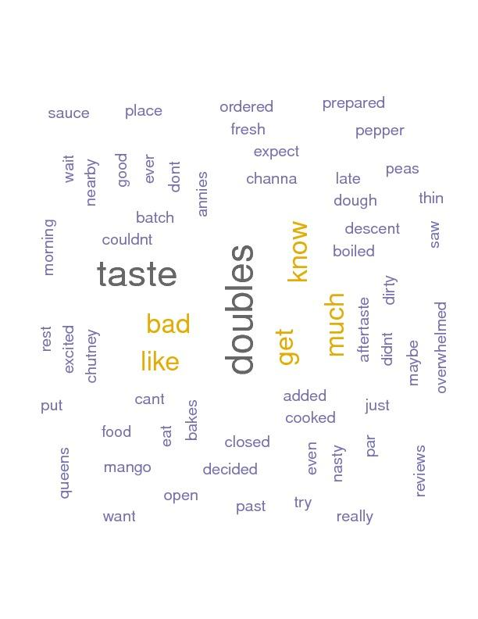
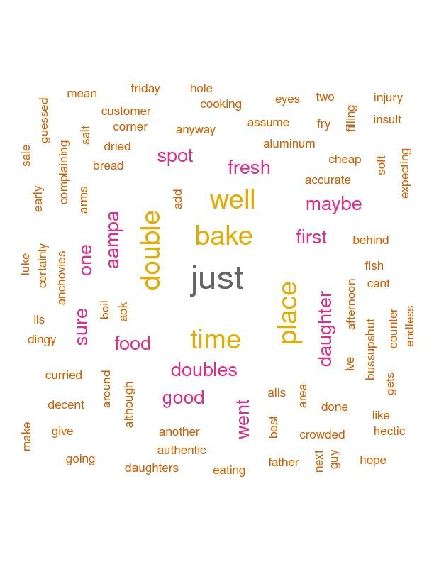
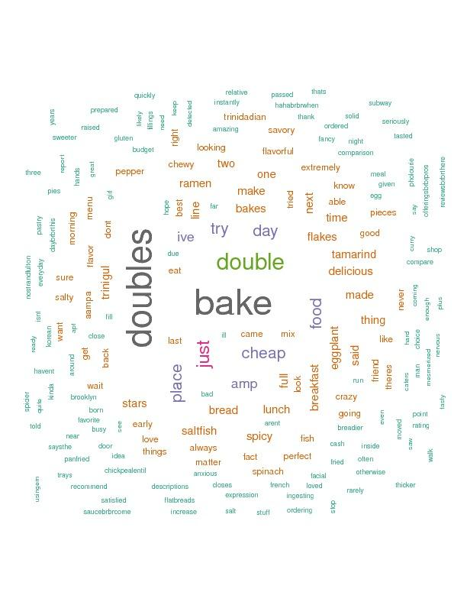
What People said based on Rating

Slide 5
Common Reviews
From the 4673 reviews scraped, I had 24 reviews in common with 18 different reviewers.
The Idea is that each other reviewer is a model, so what are my residuals?
For each review in common:
(𝛴(mystars - theirstars)^2)/number of reviews
This yielded an RSS for each user ranging from 0 to 4

Slide 6
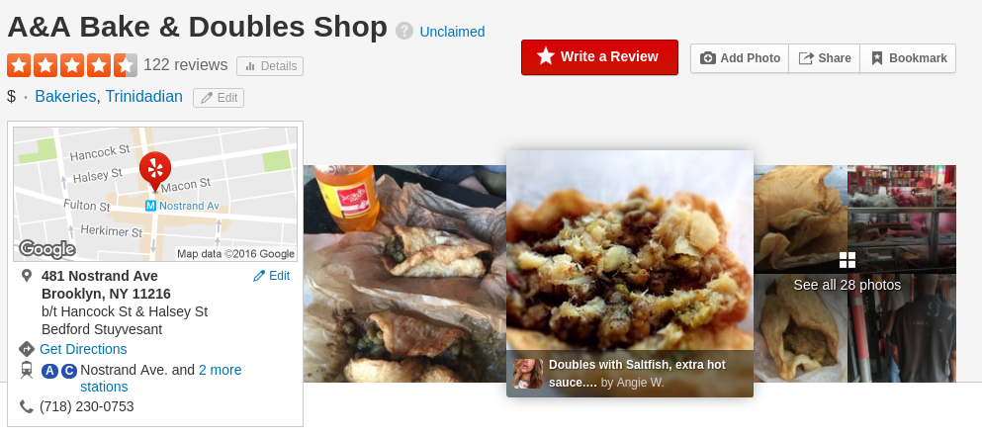
Adjusted Yelp Score
I then filtered my reviews by (RSS < 1) and then averaged them returning 4.0
0.5 stars less that the mean of all reviews.

Slide 7
What’s Next?
This was supposed to be a Shiny app
I thought I knew Shiny. I do not.
Create function that finds like-minded users first, and then suggests restaurants based on their ratings.
Learn more statistics.
Create more Yelp reviews for more test data.

